Slide 1
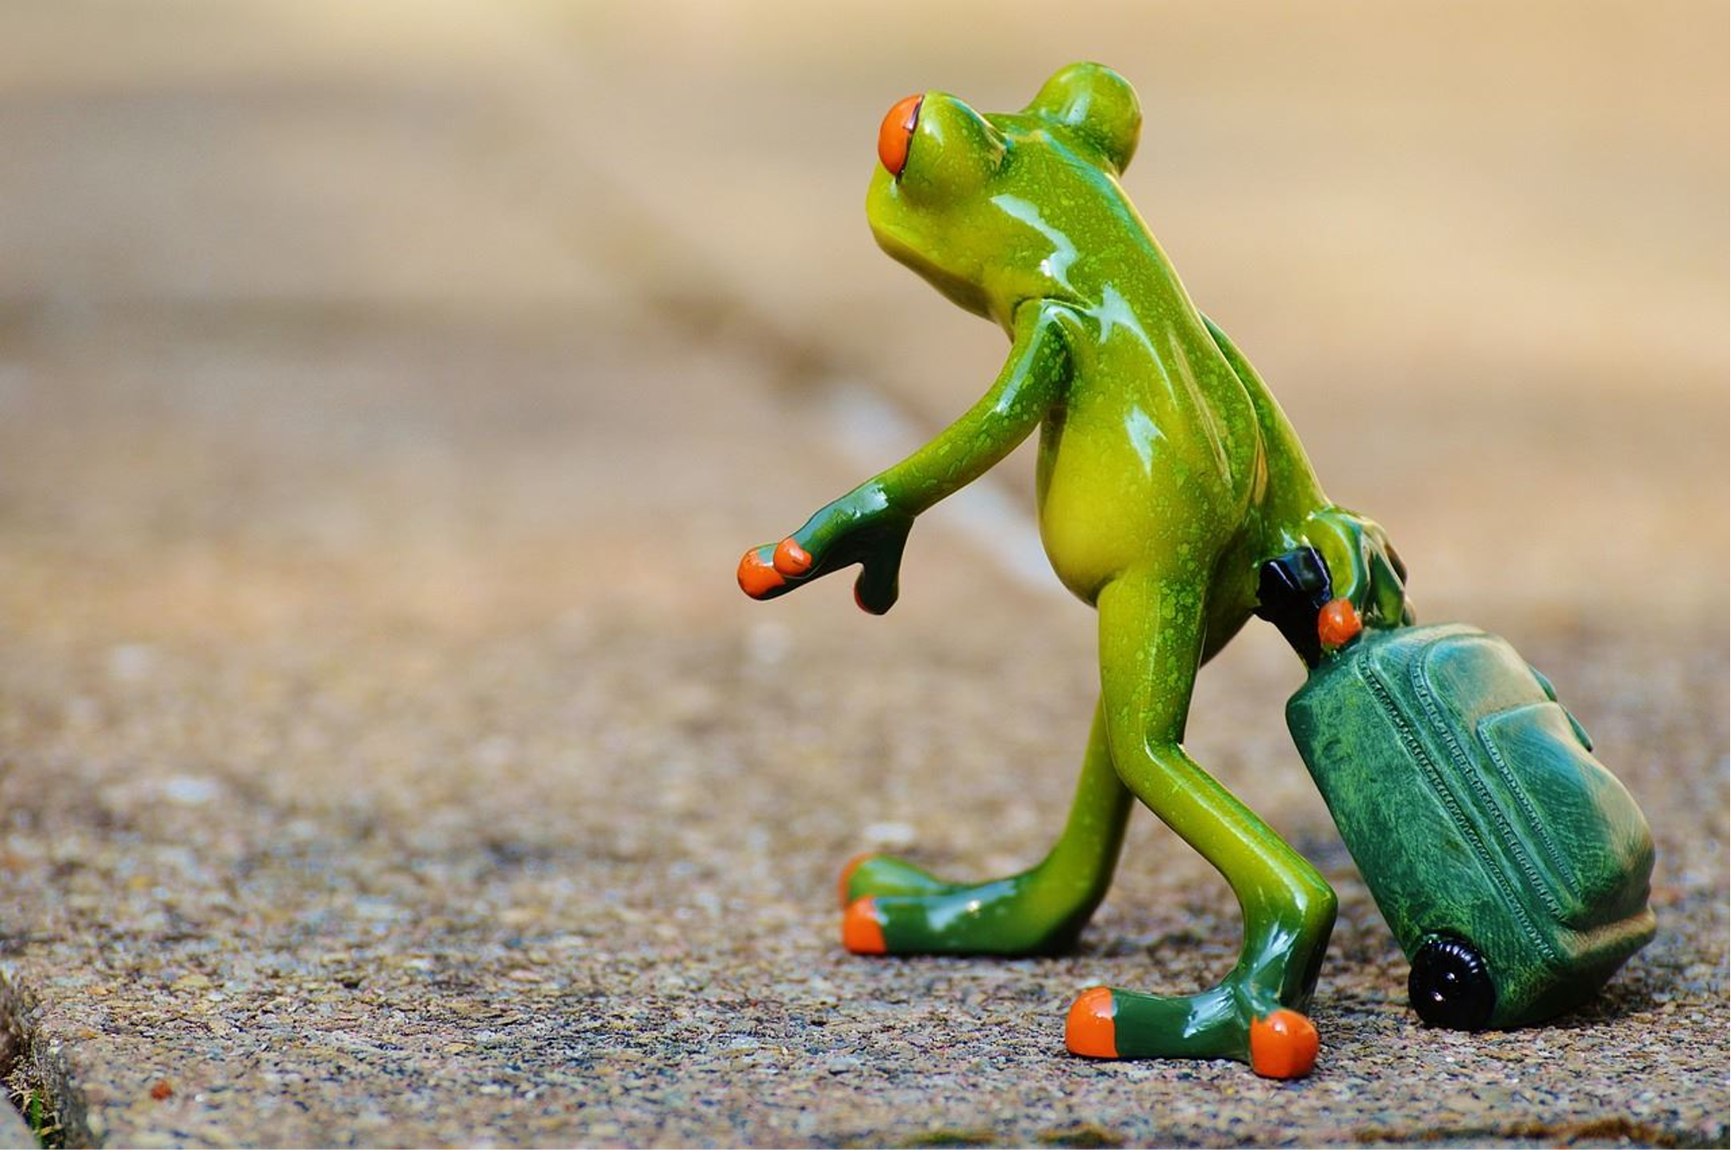
Unit 3 Reading
Alex around the world

Slide 2
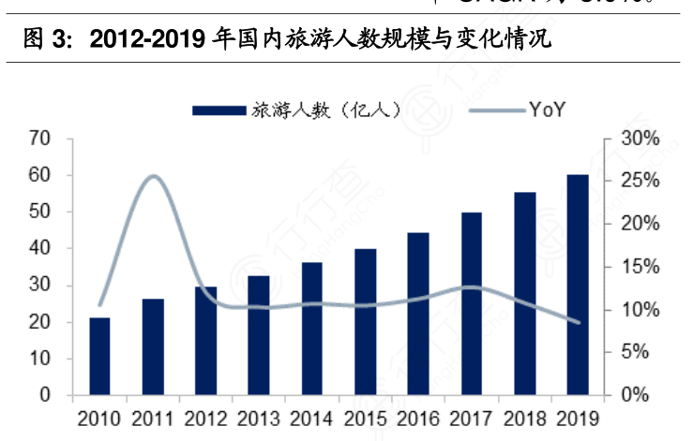
Lead in
The number of people who went travelling was increasing.
More and more people tended to go travelling.

Slide 3

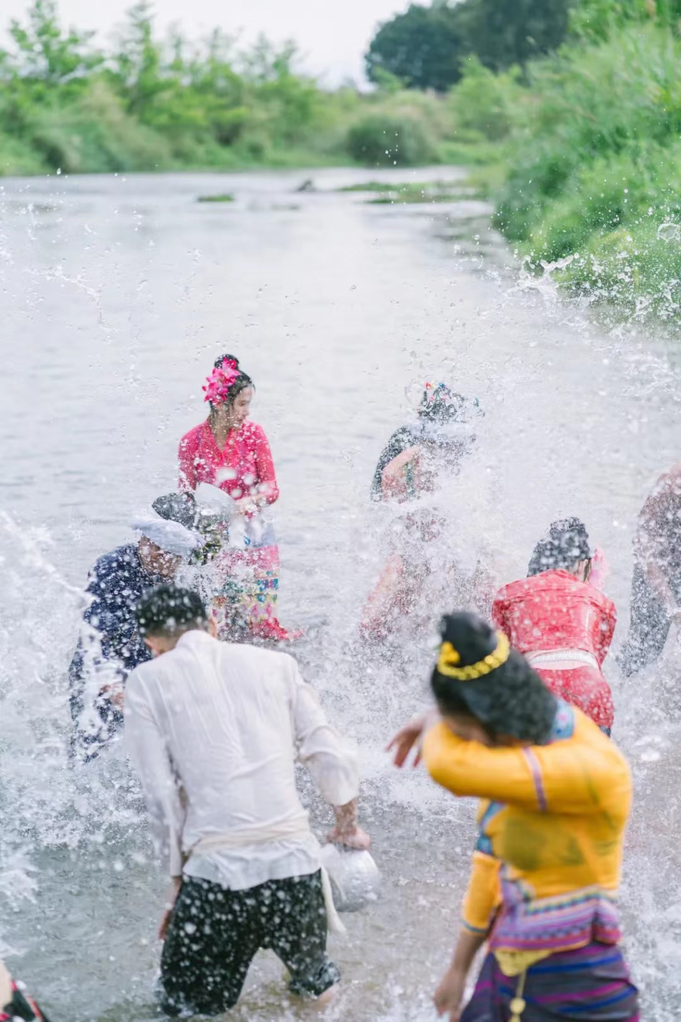
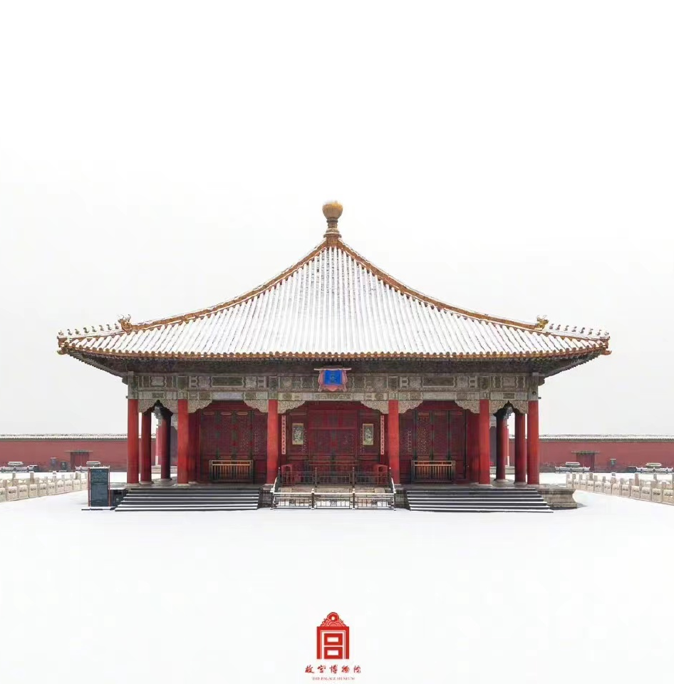
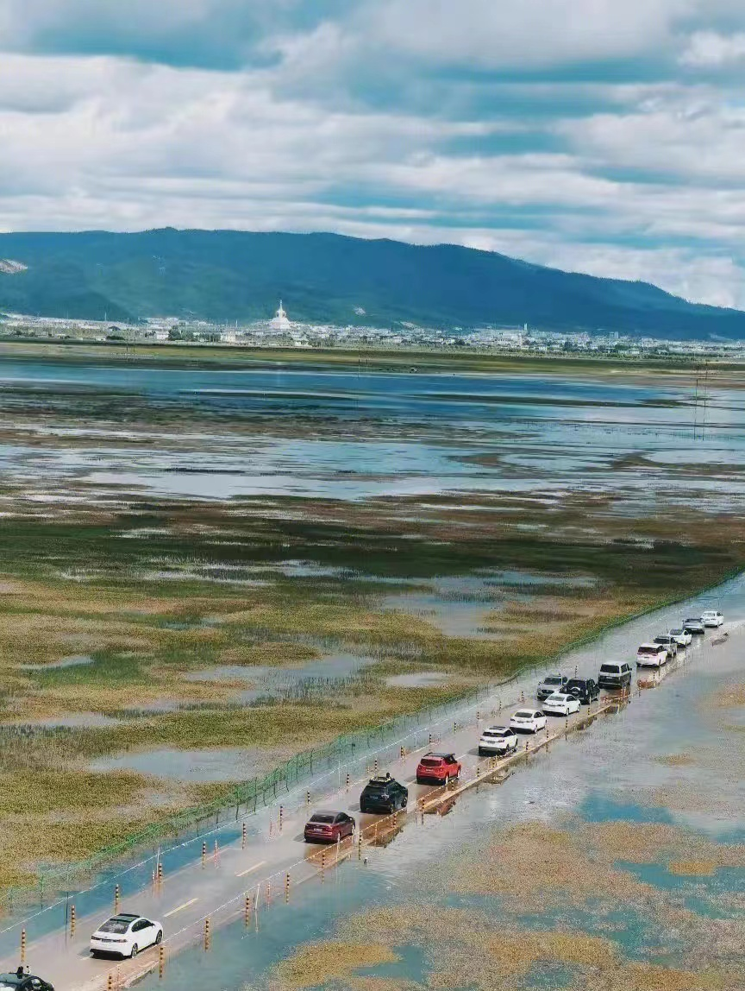
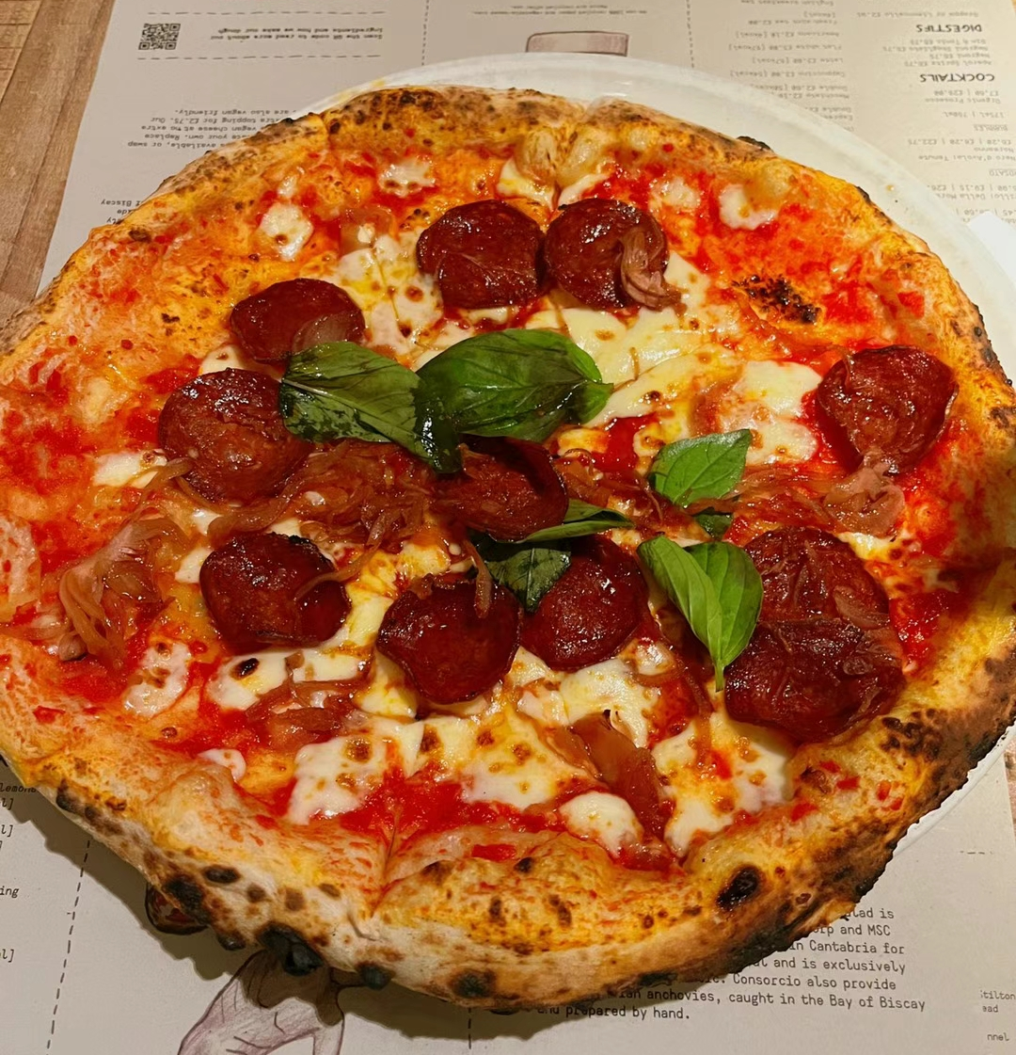
Lead in
different cultures and customs
Do you like travel? Why?
magnificent architecture
beautiful scenery
tasty food

Slide 4
Pre-reading
Travelling is a way to learn about other cultures.
The travel journal (P30-31) below was written by Alex Zhang, a travel writer. He shares his experiences of some wonderful festivals around the world.
Now let us follow his footsteps!

Slide 5


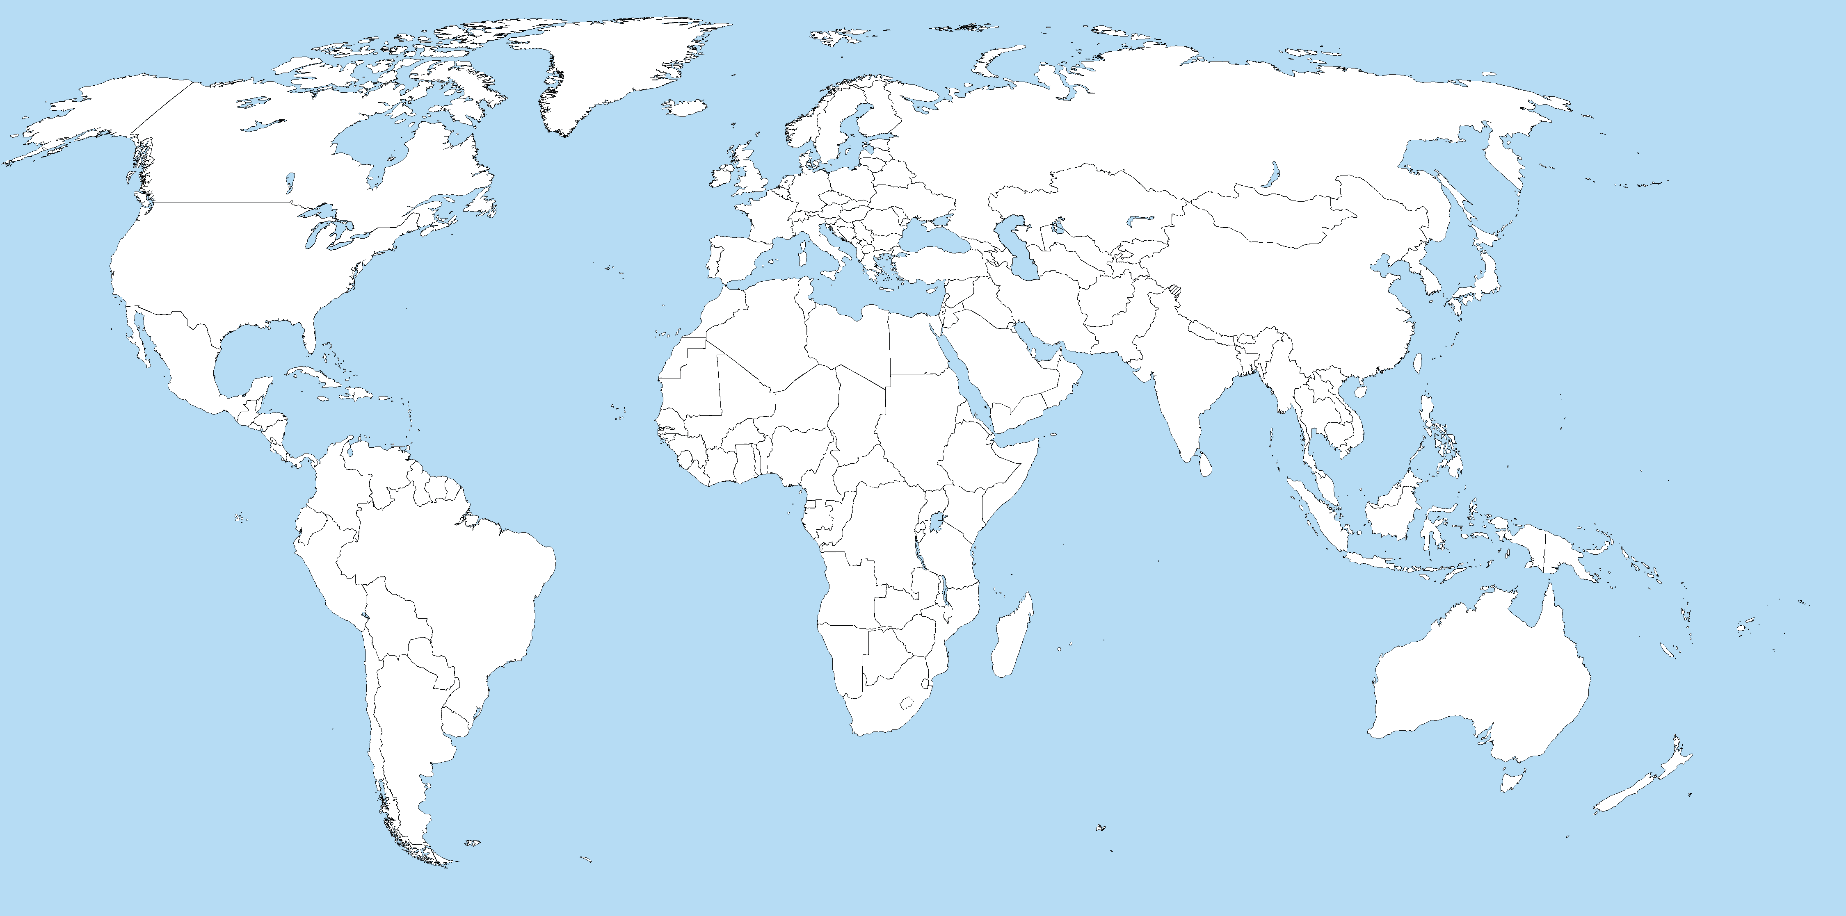

Reading: Alex around the world
India

Slide 6

Scanning
Listen to the travel journal about the Indian wedding (P30) carefully and find some detailed information:
10 January
1. date: ____________________________________________
2. place: ___________________________________________
3. guests: __________________________________________
4. bride:____________________________________________
5. bridegroom:_______________________________________
6. what the promises about:____________________________
____________________________
This is a travel journal, so what other important information is missing?
In a brightly decorated hotel room
Hundreds of guests, in formal and colorful clothes
Wearing an eye-catching red silk sari
On a beautiful white horse
How they were going to support each other and live together happily

Slide 7
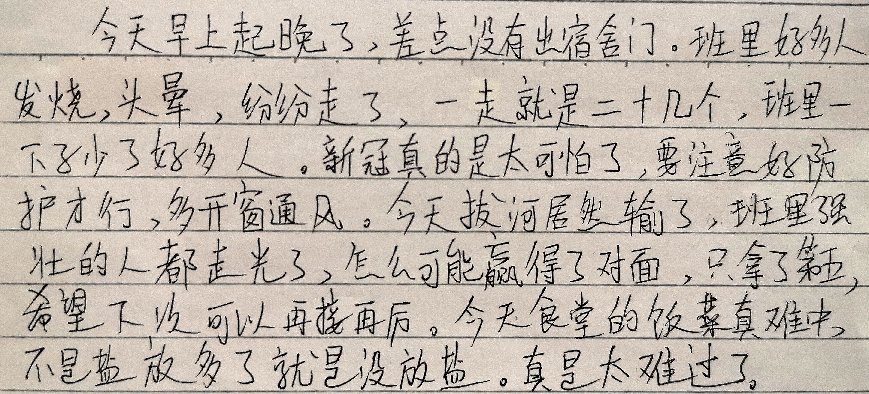

Slide 8
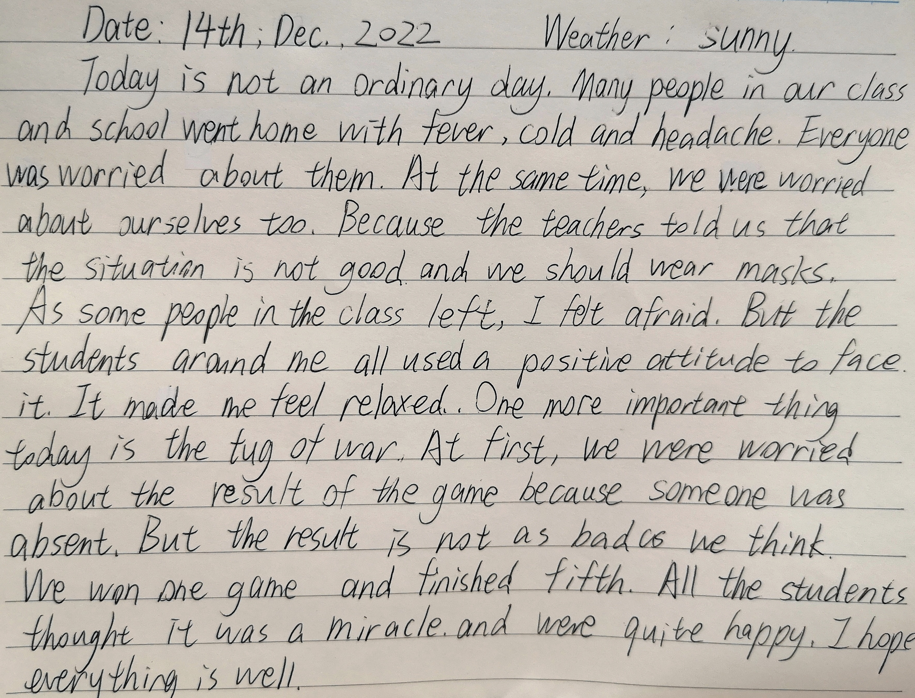

Slide 9
Further reading and thinking
1. What did Alex think of the Indian wedding? Use details in the travel journal to support your opinion.
precious
Line 1: I knew it would be the opportunity of a lifetime.
impressive
Line 7: ...but a few made a deep impression on me.
romantic
Line 16: It was very romantic!

Slide 10
Further reading and thinking
2. What kind of feeling is involved in the last sentence?
Why did Alex say he had two left feet and both of them hurt?
idiom:
to be very awkward in your movements, especially when you are dancing or playing a sport.
He was not good at dancing but he did a lot of dancing

Slide 11
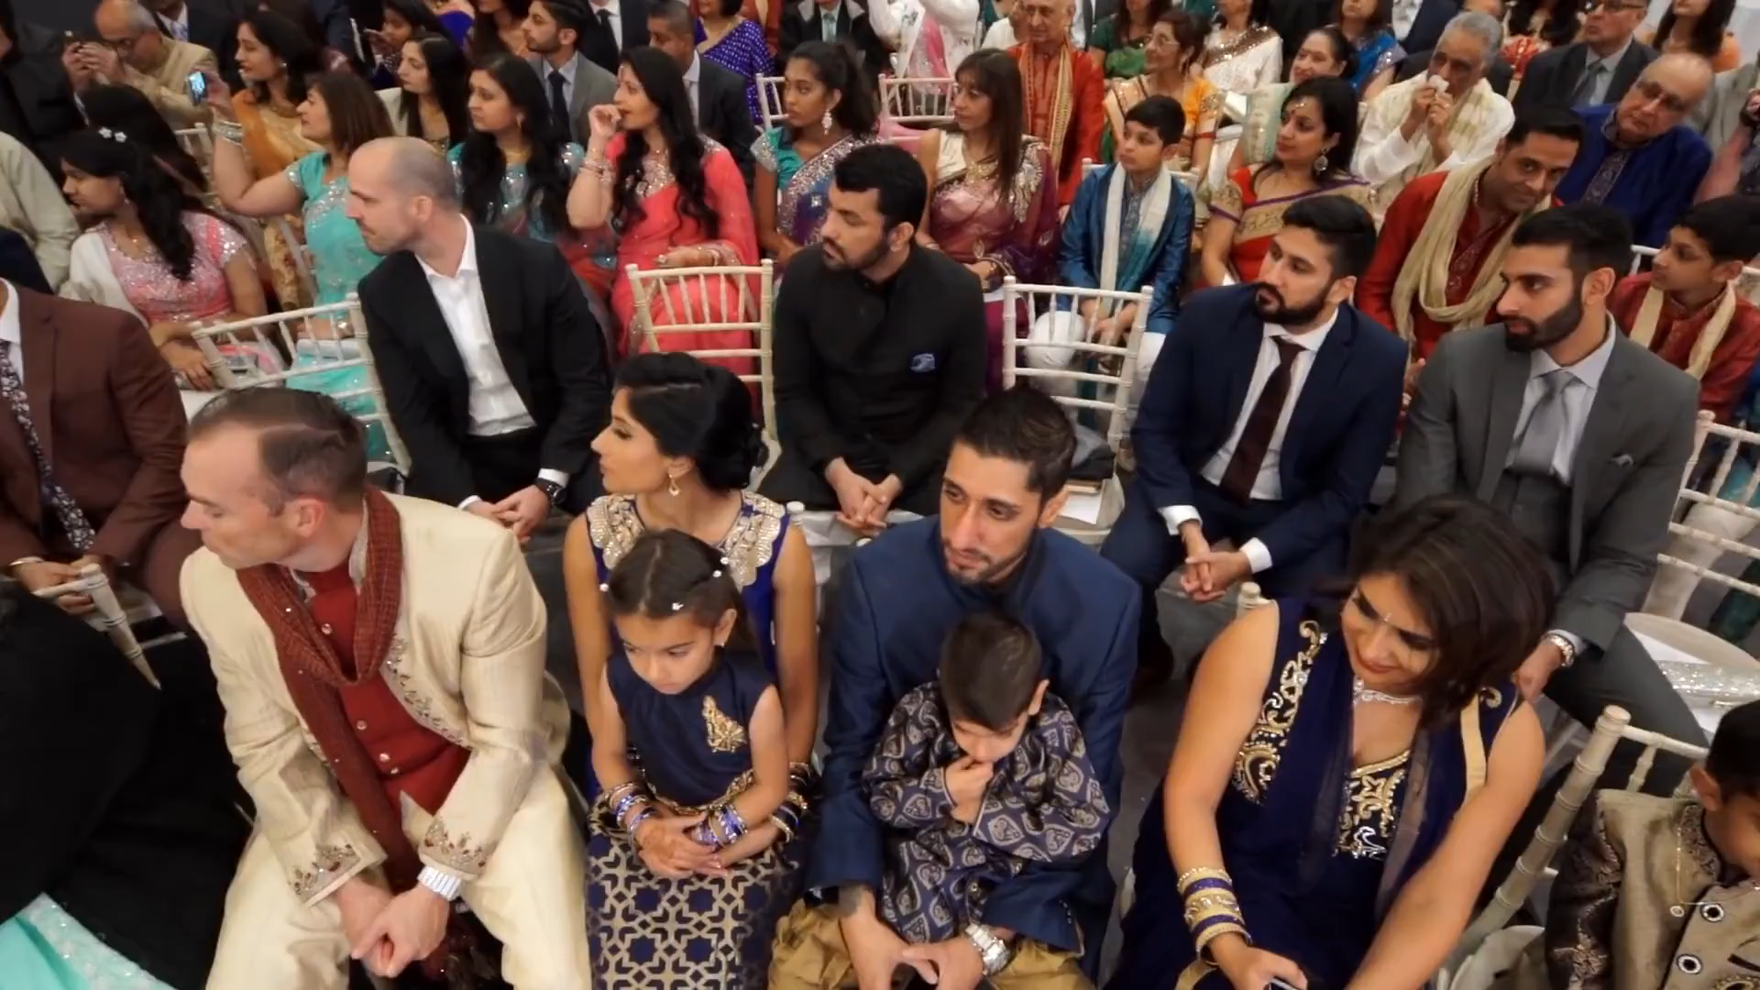

Slide 12
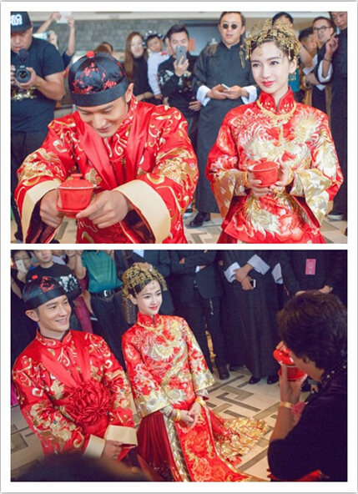
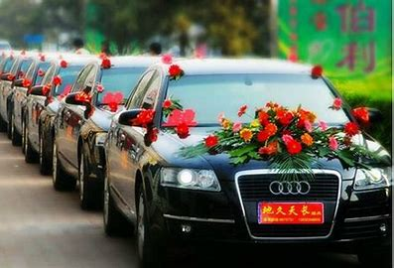
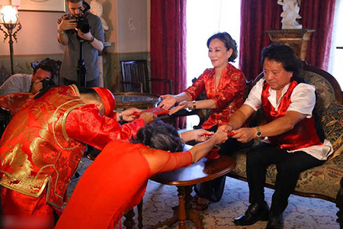
What are the differences between Chinese weddings and Indian weddings?
Discussion

Slide 13
Alex around the world
Brazil

Slide 14
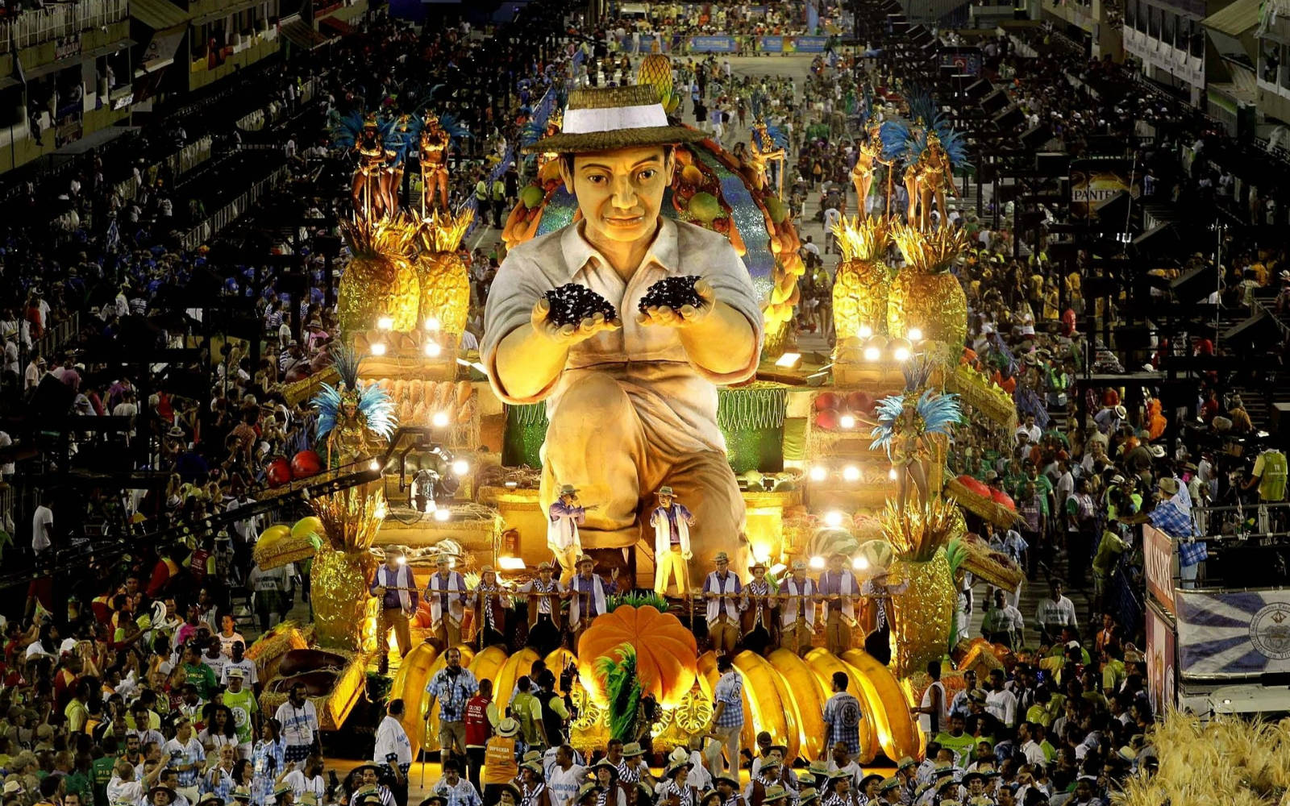
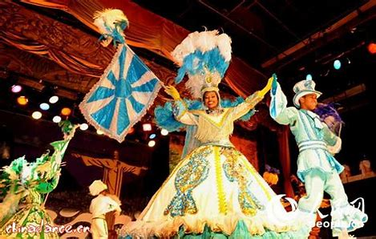
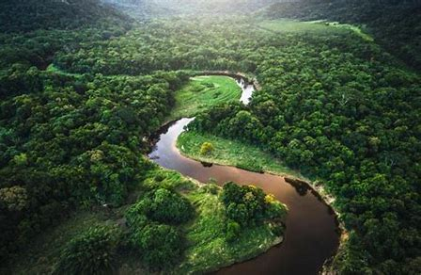
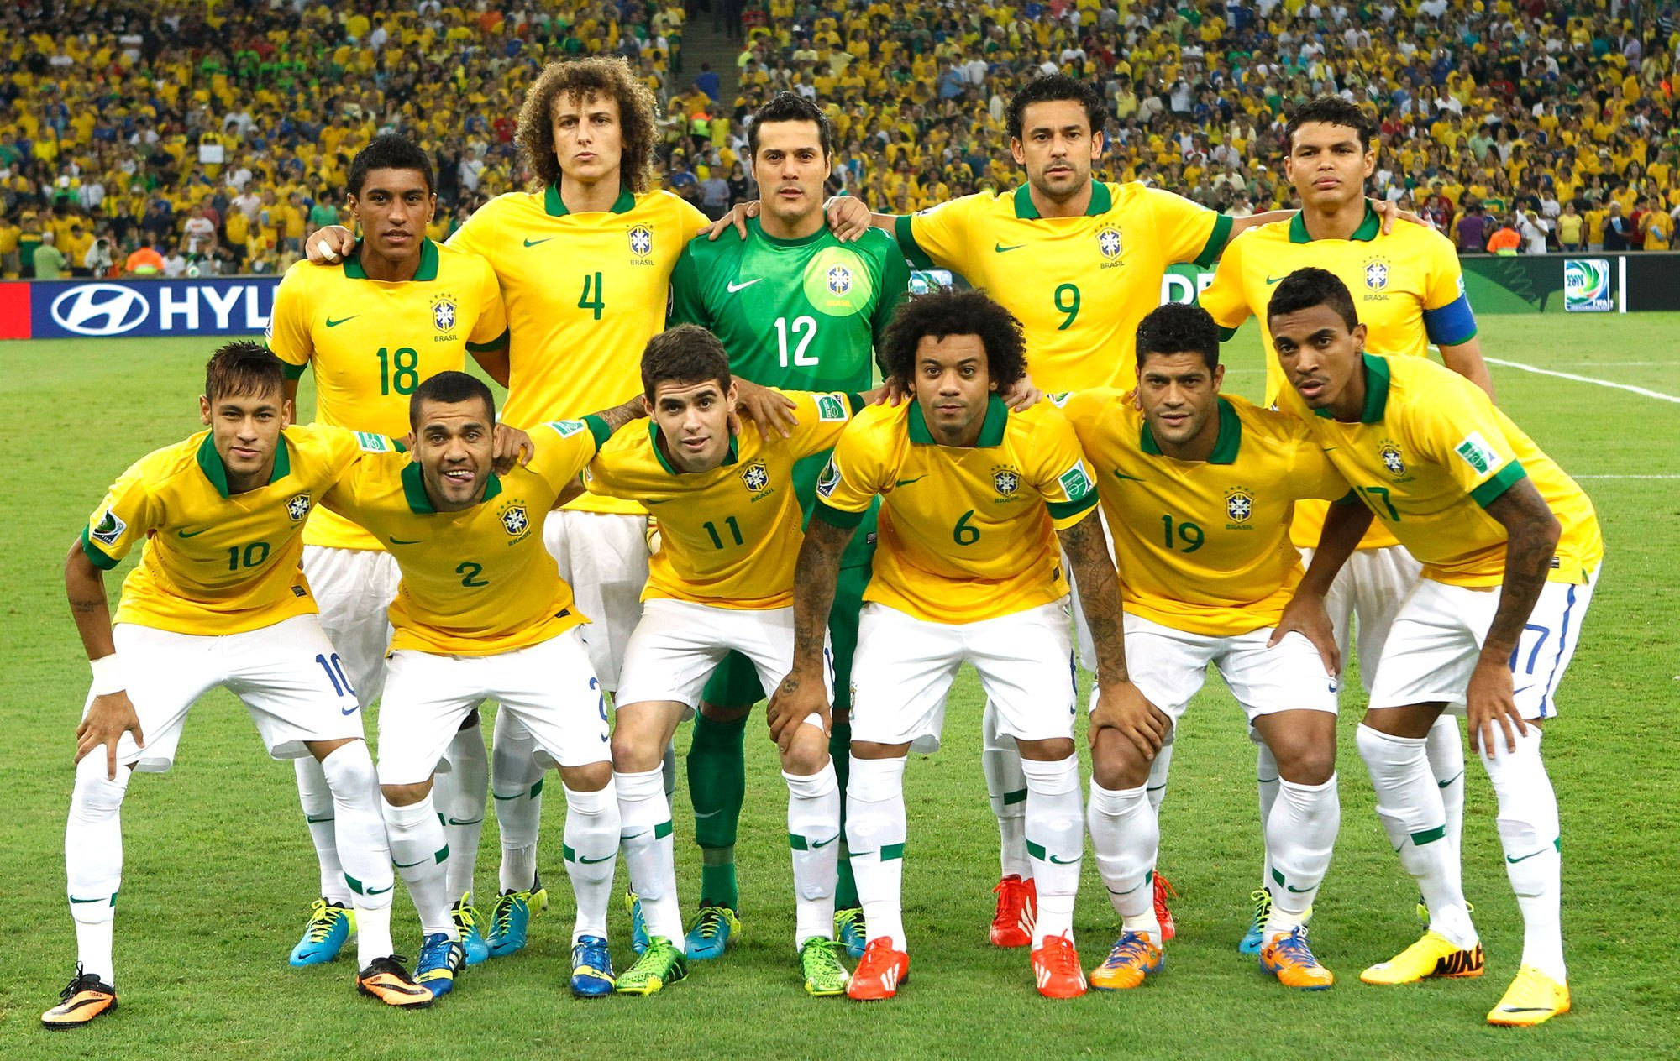
Lead in
What can you think of when we mention Brazil?

Slide 15
Skimming
listen to the travel journal about the Rio Carnival (P31) quickly and put the events in the correct order.
The Rio Carnival
a. The group started marching down the street.
b. Alex saw dancers and musicians standing in the street.
c. Alex took his place in the crowd.
d. The group jumped into action.
e. The crowd passed many street stands.
c
b
d
a
e

Slide 16
Skimming
Part 1 (Para.1)
Part 2 (Paras.2-3)
Part 3 (Para.4)
Before the street party
During the street party
After the street party

Slide 17
Scanning
During the street party
1. What did Alex see and smell when he passed the street stands?
He saw iceboxes of soft drinks and beer, and smelt the roasted
meat in the air.
2. How many senses are used here in para.3? Give examples.
Hearing, sight and smell

Slide 18
Scanning
After the street party
1.“ Even as I lay in bed that evening, the bright colours and lively music were still swimming all around me.” What kind of feeling does the author want to show in this sentence?
The experience was ____________________________.
impressive/amazing/unforgettable

Slide 19
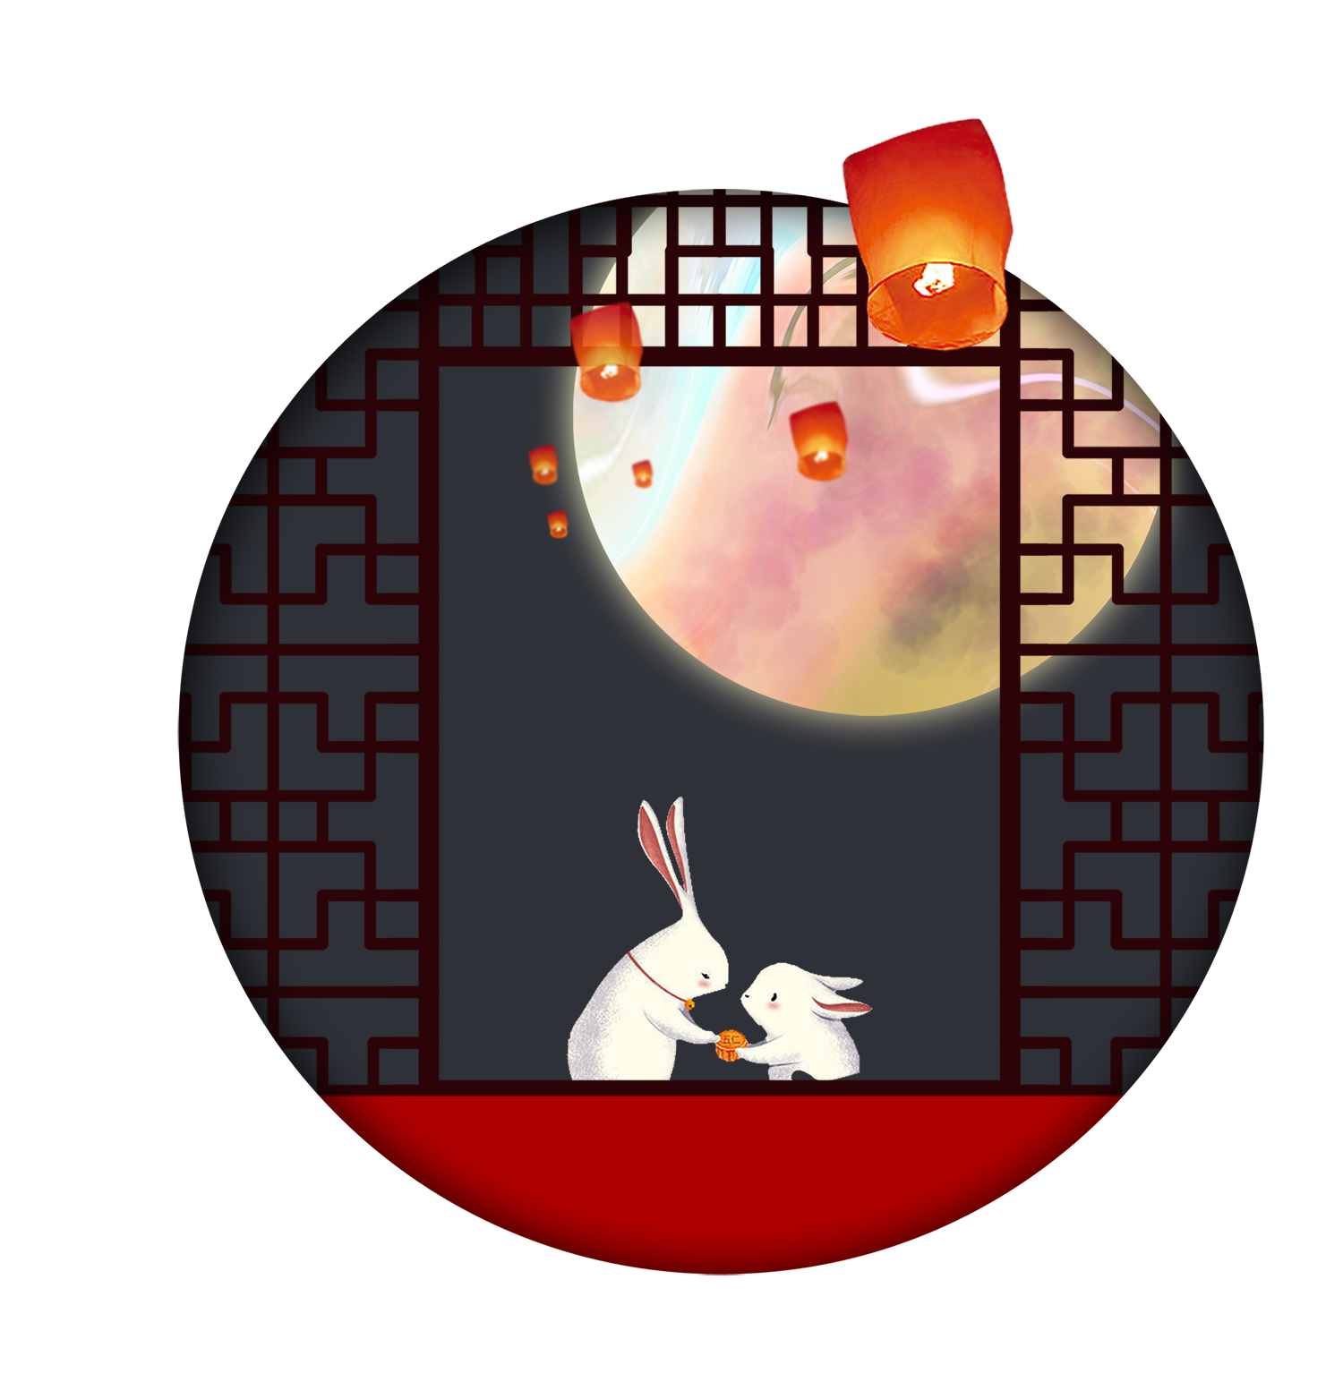
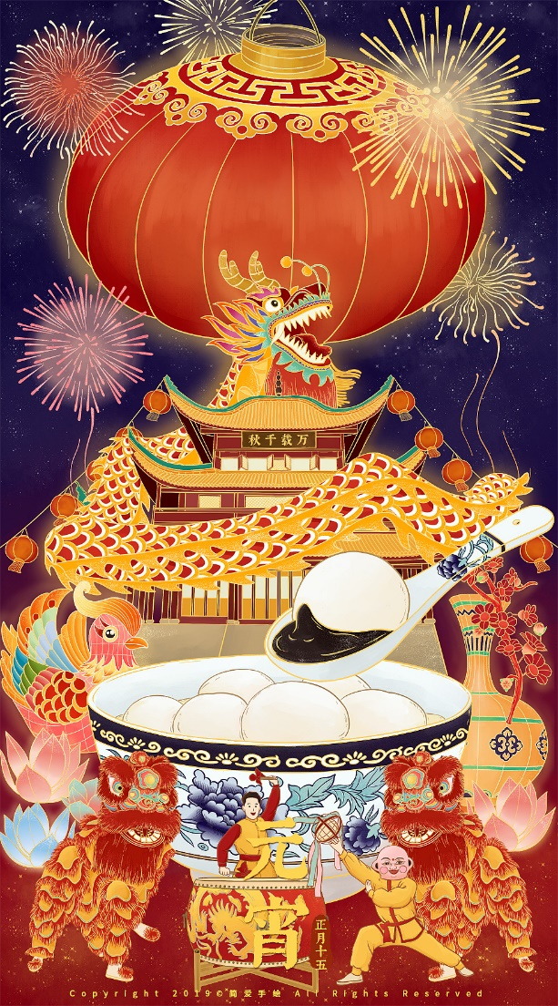
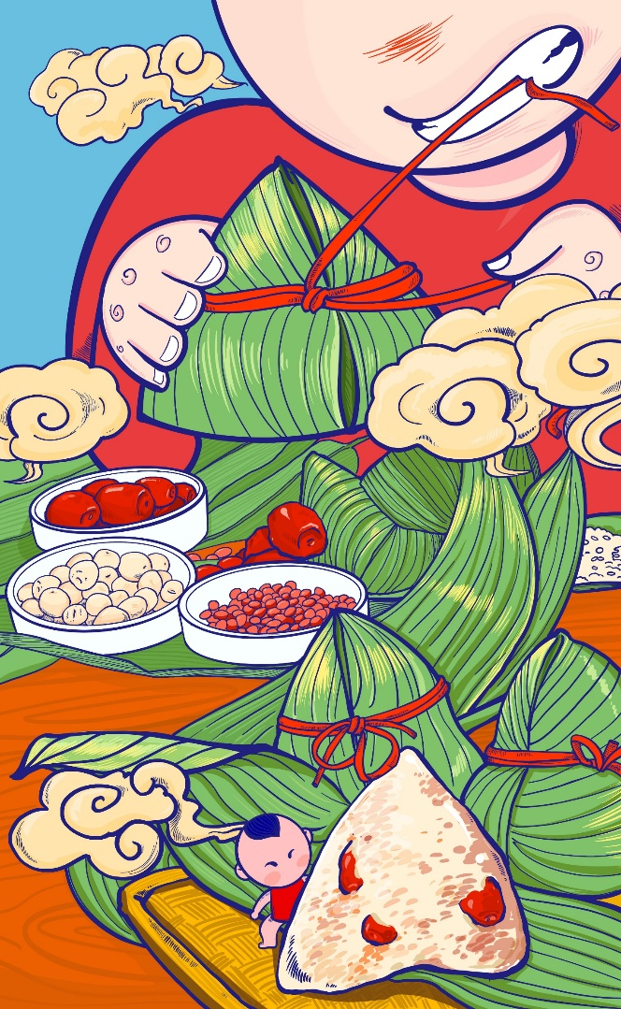

Do we have a similar carnival in China?
No, but we do have many traditional festivals.
cultural heritage

Slide 20
What should be your attitude towards different customs or cultures?
Critical reading
Try to understand and show respect for the customs and cultures that are different from yours.
When in Rome, do as Romans do.

Slide 21
Writing
Assuming you were Alex, your friend Tom in Rio wants to know how Chinese celebrate the spring festival, write a letter to him to introduce it.
Festival | The spring festival
Date | fall on /take place on
Meaning
Activity
Food

Slide 22
Dear Tom,
Delighted to know that you’re interested in the spring festival, I’d like introduce it to you.
Firstly, with a long history, the spring festival falls on the _______ day of the lunar month. Moreover,__________________________________
_____________________________________________________________. Last but not least, ________________________________________________
________________________________________________________________.
If there is anything else you want to know, please write to me soon.
Yours, Alex

Slide 23
Homework
Put the finishing touches to your writing in terms of grammar, coherence and accuracy.

