Slide 1









4A Unit3
How many?
Period 2: Fun time
Tang Zhuangqiao Primary School
Zhou Zhiyan
PPT模板下载：www.1ppt.com/moban/

Slide 2

Task 1: Enjoy the song

Slide 3

Task 2: Read and find
Tips: 4人一组仔细观察13-19， 你们发现了什么？
one | eleven
two | twelve
three | thirteen
four | fourteen
five | fifteen
six | sixteen
seven | seventeen
eight | eighteen
nine | nineteen
ten | twenty
What can you find?
(1) teen表示“十几”。
(2) 基数词后加teen变
十几,如fourteen。
(3) 其中三个要注意：
thirteen是13,
fifteen 是15,
eighteen只有一个t,
其余全部加上teen。

Slide 4
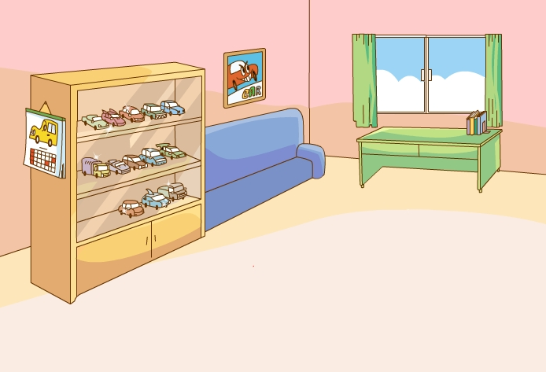
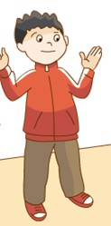
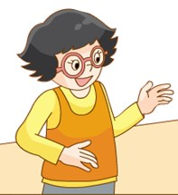
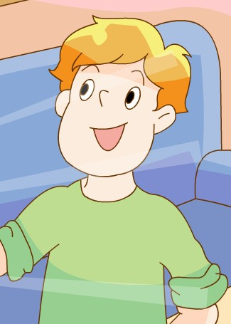
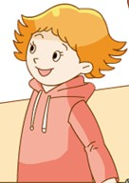
Task 3: Rivise and talk
Tips: 4人一组讨论一下
他们正在说些什么呢？
What are they talking about?

Slide 5
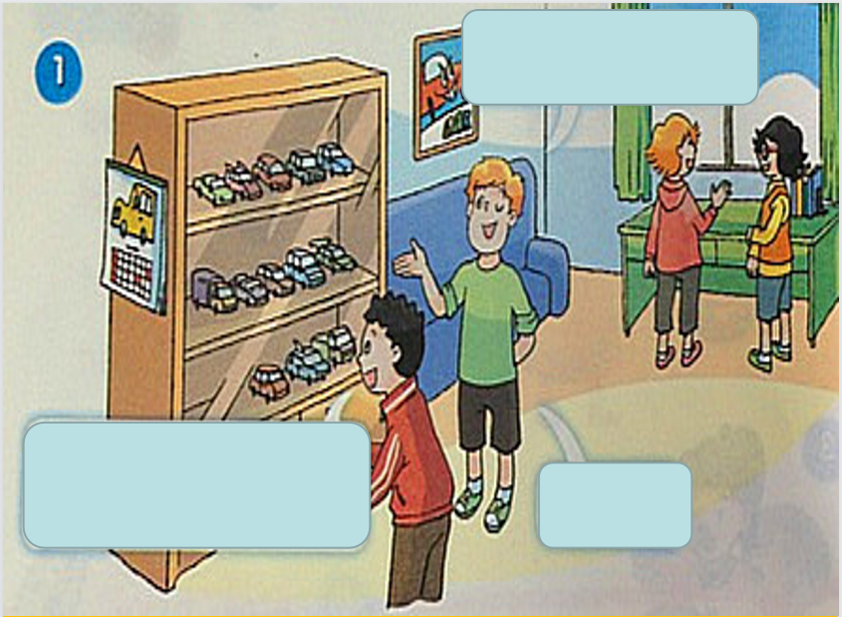
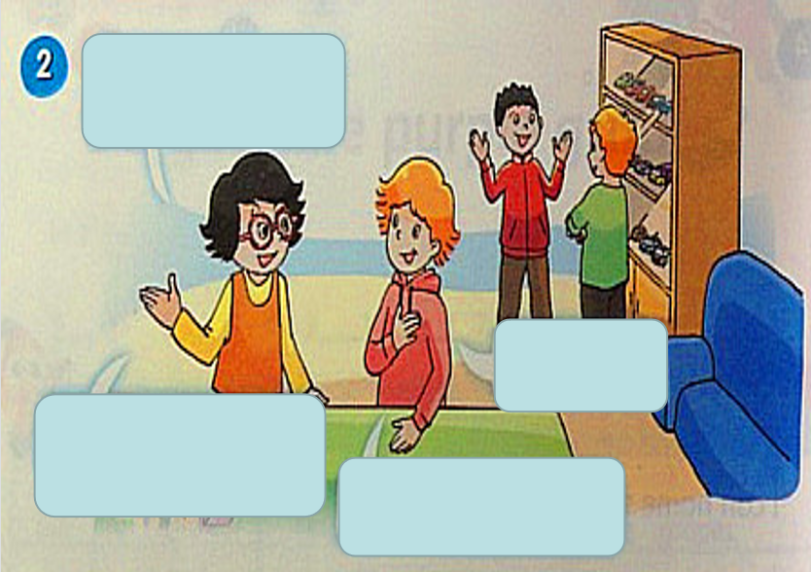
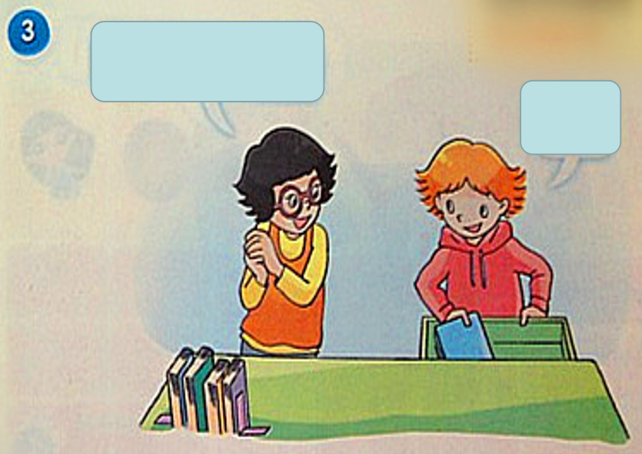
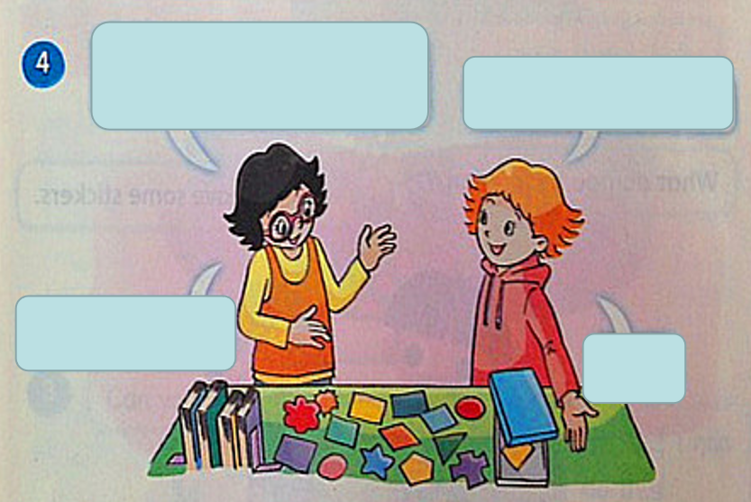

Slide 6


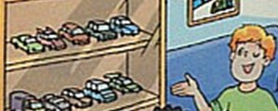

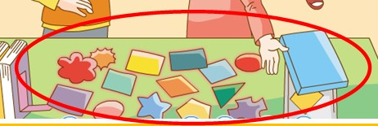
Task 4: Mike’s report
Tips: 2人一组互相说一说，
然后一人展示。
Who | What | How many
toy cars
thirteen
stickers
fifteen
Hello， I’m
They’re ...
They’re my good friends.
Look at my
I have ...
Those are Helen’s ...
She has ....
They are very beautiful.

Slide 7
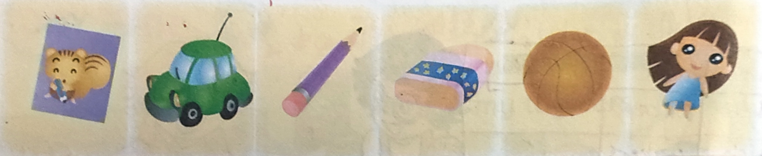
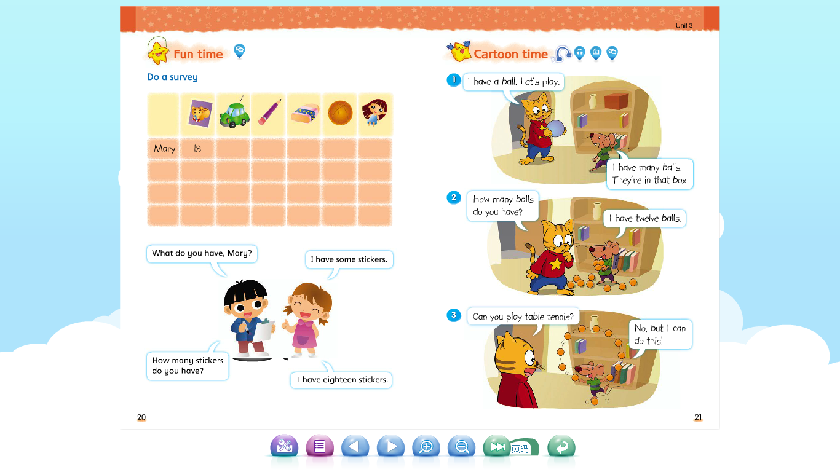

Task 5: Listen and tick
Tips；听录音，勾选出Mary和Peter拥有的物品
What Who
Mary
Peter
√
√
√
√
√
Peter
Mary

Slide 8










Task 6: Read and match
A: Hello, Mary.
B: Hello, Peter.
A: Do you like balls?
B: No, I don’t.
A: What do you like?
B: I like dolls.
A: Do you have any dolls?
B: Yes. I do.
A: How many dolls do you have?
B: I have five dolls.
A: What else do you have?
B: I have some stickers and pencils.
A: How many stickers and pencils?
B: I have seventeen stickers and eight pencils. What about you，Peter?
A: I have twelve toy cars and three balls.
B: Oh. I see. Goodbye.
A: Goodbye.

Slide 9
Task 7: Try to say
Peter
Hello, I’m Peter.
I like toy cars.
Look. I have twelve toy cars.
They are blue, yellow, red, black and orange.
I have three balls.
I can play well.
This is my friend Mary.
She likes dolls.
She has five dolls.
They’re lovely.
She has seventeen stickers.
They’re beautiful.
She has eight pencils too.
What about you?
What do you have？
And how many do you have?

Slide 10
Task 7: Try to say
Tips: 2人一组互相说一说，
然后一人展示。
Hello, I’m Peter.
I have ...
I have ...
This is my friend Mary.
She has ...
She has ...
She has ...too.
What do you have？
And how many do you have?
...
Peter

Slide 11
Task 8: Do a survey
Tips: 4人一组，一人调查记录，三人回答。通过问答了解成员拥有的物品及其数量
What Who
A: Hello...
B: Hello...
A: What do you have?
B: I have...
A: How many ...(s) do you have?
B: I have...

Slide 12
Task 9: Give a report
Tips：就刚才小组调查情况进行汇报，自己先练说，然后向大家展示。
Hello, I’m ...
In my group.
I have ...
It’s/They’re...
This is my friend ...
He/She has ...
It’s/They’re...
This is my friend ...
He/She has ...
It’s/They’re...
This is my friend ...
He/She has ...
It’s/They’re...

Slide 13
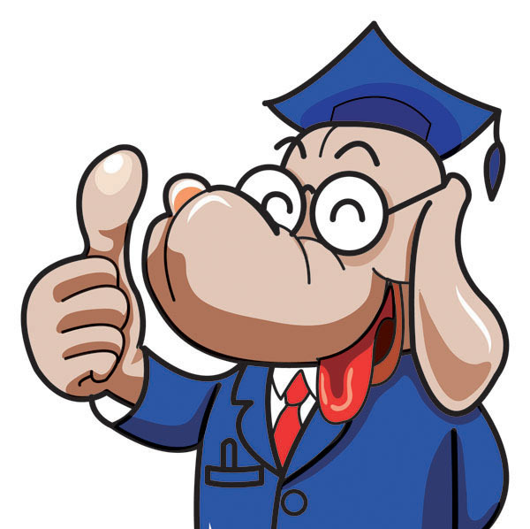
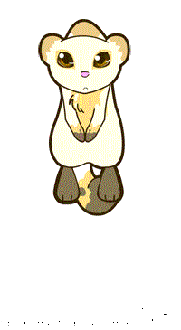


Homework:
Finish the listening and speaking tasks online.
上网完成听、说作业。
2. Act out the story with your friends.
和朋友一起表演故事。

Slide 14
THANK
YOU!
Goodbye!

