Slide 1
Enjoy a song

Slide 2
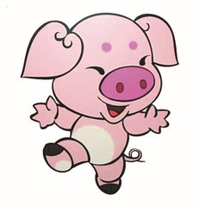
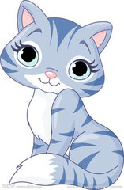
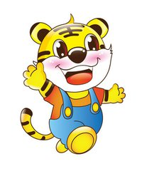
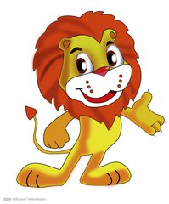
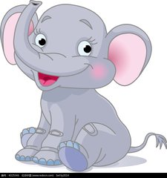
Game!
Miss Ji 最喜欢的动物，你能猜中吗？
Guessing game
Do you like ...s?

Slide 3
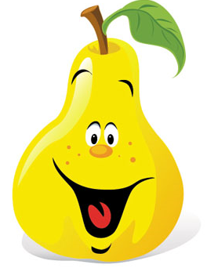
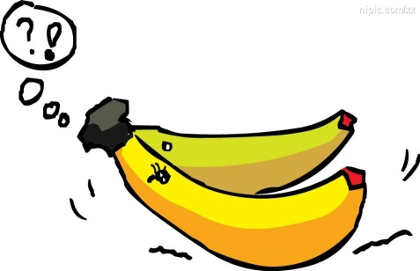
Game!
Miss Ji 最喜欢的水果，你能猜中吗？
Do you like ...s?

Slide 4
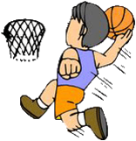
Game!
你能猜中我有什么东西吗？
Tip1:
I can play it.
(打、玩)
Do you have a ...?
Tip2:
It’s round
(圆的).
basketball
play basketball

Slide 5
Unit 4 I can play basketball (Period 1)

Slide 6
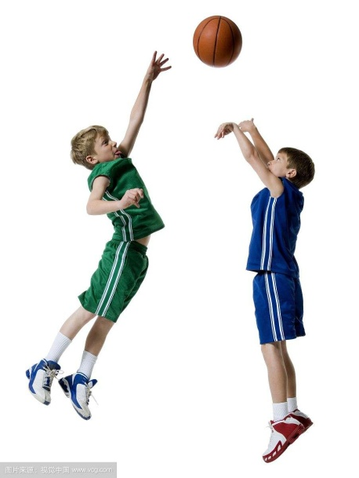
Can you play basketball?
Yes, I can.
What other sports do you know?
你还知道哪些体育运动吗？
No, I can’t.

Slide 7
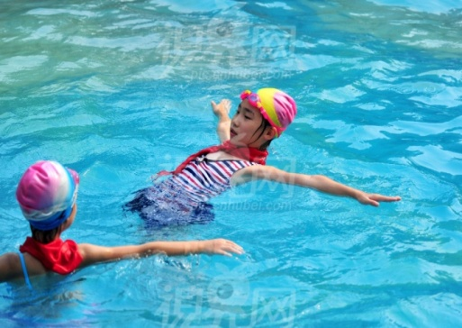
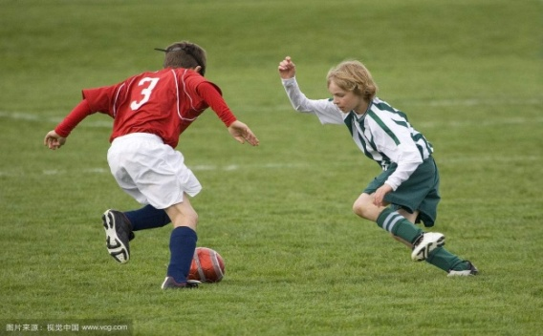
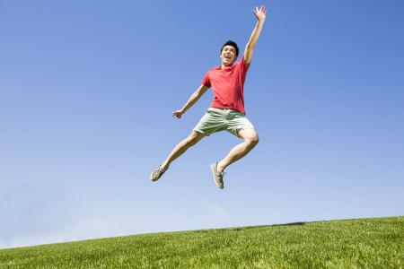
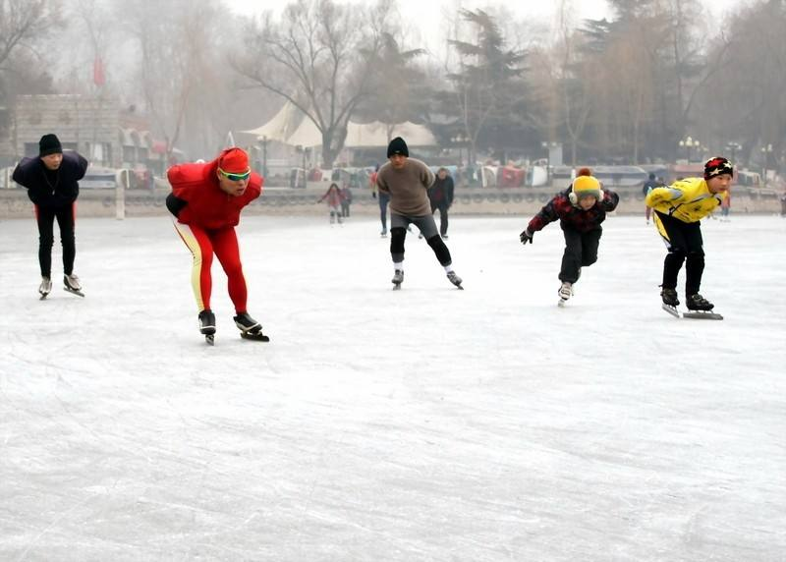
Let's read
swim
play football
jump
skate
make

Slide 8
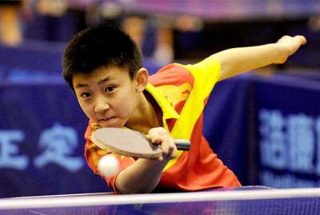
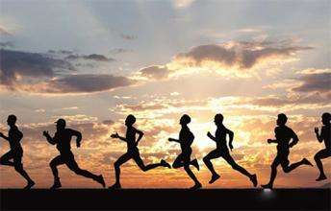
Pair work
两人一组，问问对方会不会这些运动？
Can you …?
Yes, I can. / No, I can’t.
play football
play table tennis
jump
skate
swim
run

Slide 9
Let's chant
Jump, jump, can you jump?
Yes, yes, yes, I can.
Swim, swim, can you swim?
No, no, no, I can't.
Skate, skate, can you skate?
Yes, yes, yes, I can.
..., ..., can you...?
..., ..., ..., I ...
Make a new chant
四人一小组创编一首新的儿歌

Slide 10
Look and say
仔细观察图
并回答问题

Slide 11
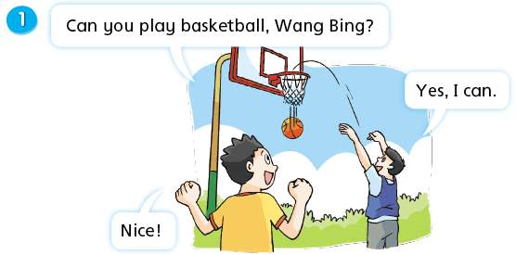
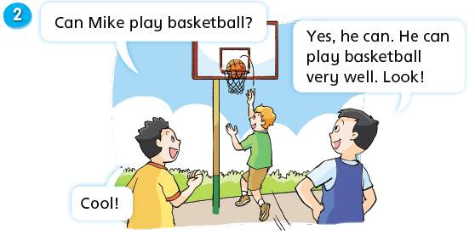
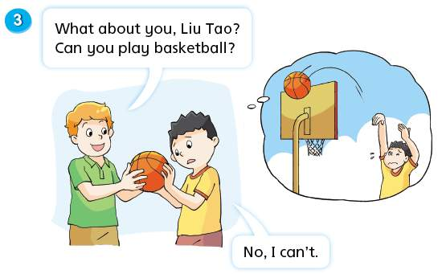
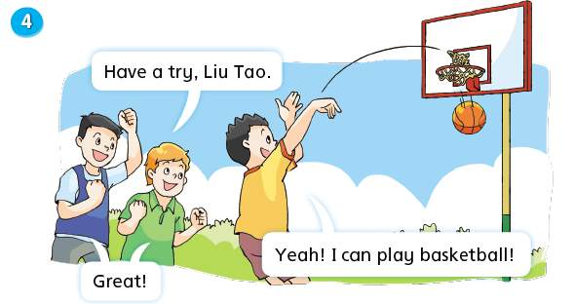
Try to ask
(自主提问)
Who are the boys?
（这些男孩是谁？）
Can ...play basketball?
What are they doing?
(他们在做什么？)
A: They’re playing football.
B: They’re playing basketball.
1.Can Wang Bing play basketball?
2.Can Mike play basketball?
3.Can Liu Tao play basketball?

Slide 12
Listen and answer
两人一组进行问答
Tip: 注意听关键词
1.人物姓名
2.是否会打篮球
1.Can Wang Bing play basketball?
Yes, he can.
2. Can Mike play basketball?
Yes, he can.

Slide 13
Watch and choose
1. Can Liu Tao play basketball at first(首先)?
Yes, he can. B. No, he can’t.
2. Can Liu Tao play basketball at last(最后)?
A. Yes, he can. B. No, he can’t.

Slide 14
watch and choose

Slide 15
Watch and choose
1. Can Liu Tao play basketball at first(首先)?
Yes, he can. B. No, he can’t.
2. Can Liu Tao play basketball at last(最后)?
A. Yes, he can. B. No, he can’t.
朋友如何鼓励LiuTao?
Have a try.
试一试
Liu Tao 是怎么做到的？
How does Liu Tao feel?刘涛的心情如何？
How does Liu Tao feel now?现在刘涛的心情如何？

Slide 16
我们要在朋友失落的时候给他鼓励！
A friend in need is a friend indeed.
在别人需要时给予帮助的人才是真正的朋友。

Slide 17
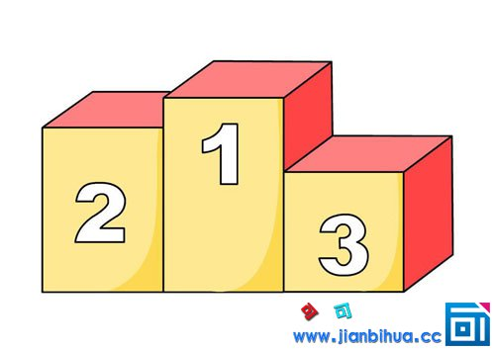
Think and order
思考一下：你觉得谁的的球技是No.1
为什么？
你能在书上找到理由吗？
very well 非常好
Mike

Slide 18
你能从故事中找出称赞、夸奖的单词吗？请用铅笔圈出来。
Cool！
Great！
Nice！
How can we read these sentences?
我们应该用什么样的语气来读这些句子呢？
What else can you say?
你还会说些什么赞美的话？

Slide 19
Listen and repeat
Tips:跟读模仿，理解故事.

Slide 23
Happy reading
三人一小组选择一种喜欢的方式读故事
Read after one
（跟一个人读）
Read in roles
（分角色读）
Read together
（齐读）
…

Slide 24
Try to act
三人小组分角色表演，记得加上动作和表情哦！

Slide 25
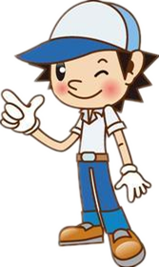
听说学校公告栏有个新通知。
Let's have a look!

Slide 26
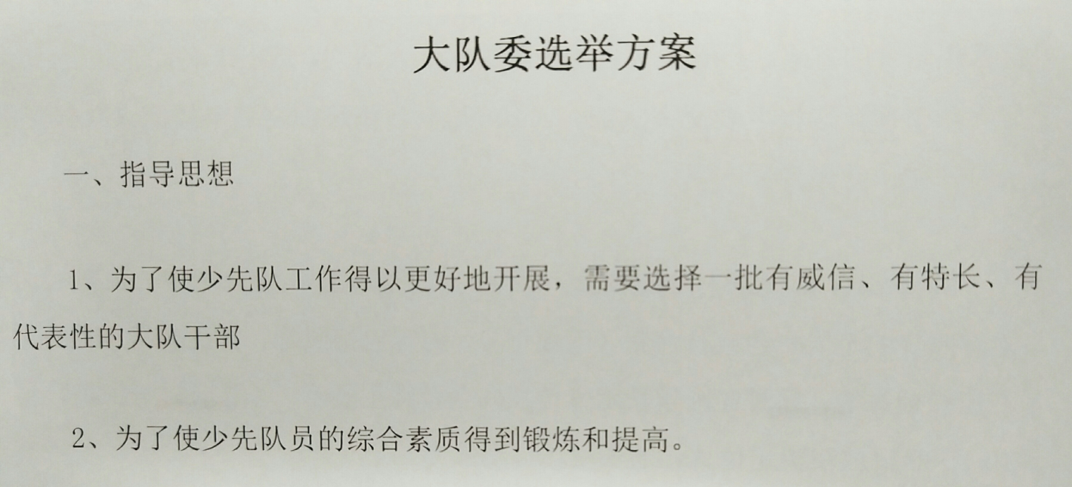
Billboard公告栏
才艺展示?
I can do many things!
我会做许多事情，我有很多技能呀！
走！一起去参加面试吧！

Slide 27
面 试
A: Hello!
B: Hello! What's your name? 你叫什么名字？
A: My name is ...
B: What can you do? 你会做什么？
A: I can ...
B: Can you ...?
A:Yes, I can./ No, I can't.
B. Cool!/Great!/Nice!/Have a try!
Let's creat!创编故事
Work in groups, and try to creat a new story about interview.
四人一组，一人是面试官，另外三人是面试者。
发音标准
语言流畅，表情生动
脱稿表演，表情生动，动作自然

Slide 28
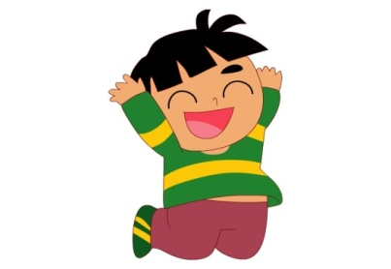
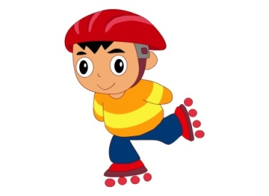
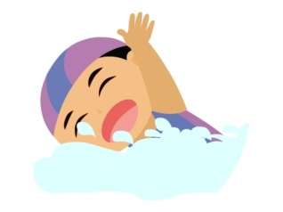
Summary Time
1,今天，我们认识了一些运动的词汇.
Do more exercises and we will be healthy.
多做运动有益健康。
2, 你想询问他人是否会做某项运动，你会怎么说？
3，你想夸赞别人，你会怎么说？
4，你的好朋友不会踢足球，你会怎么鼓励他？
5，你还体会到了什么呢？

Slide 29
Homework
Read and act the storytime.
听读模仿，融入表演。
2.Make a survey about what your classmates can do and do a report.
调查你的同学能做的事并且汇报。

Slide 30
Thanks!
Bye!

