Slide 1

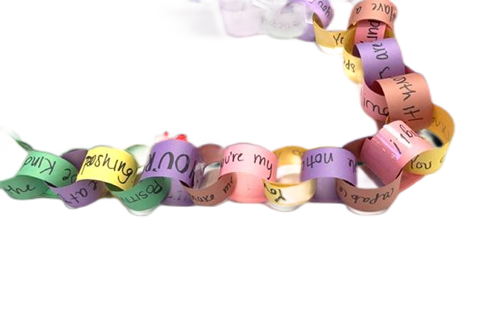
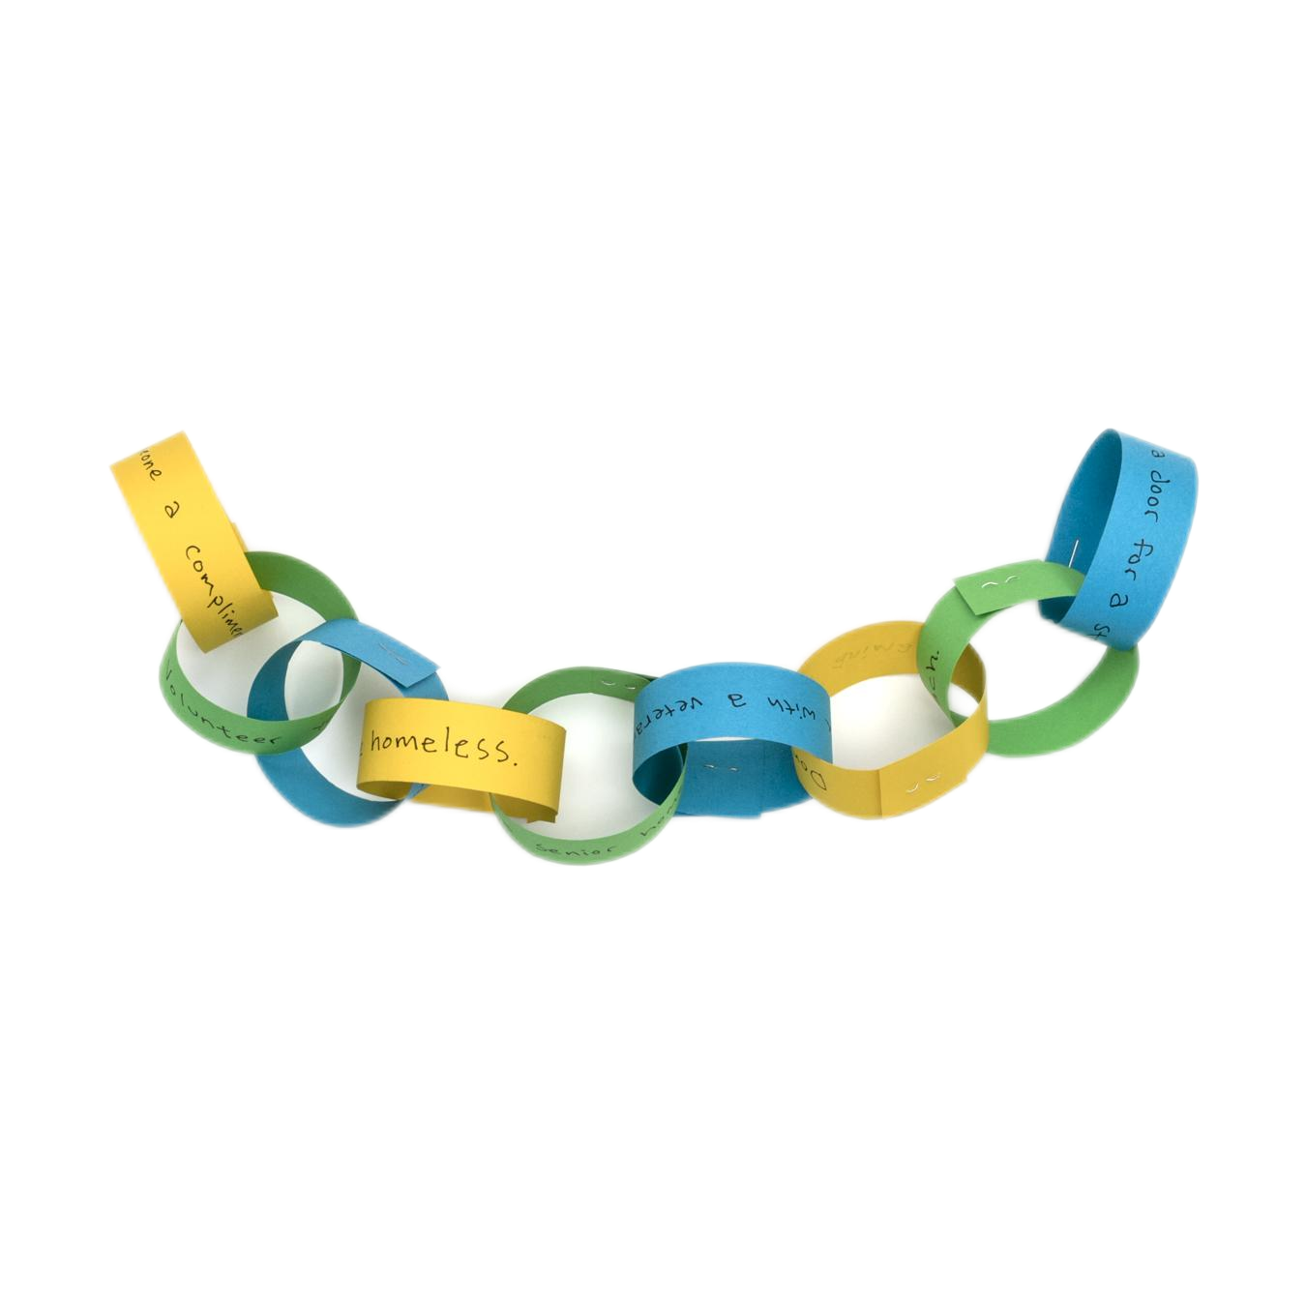
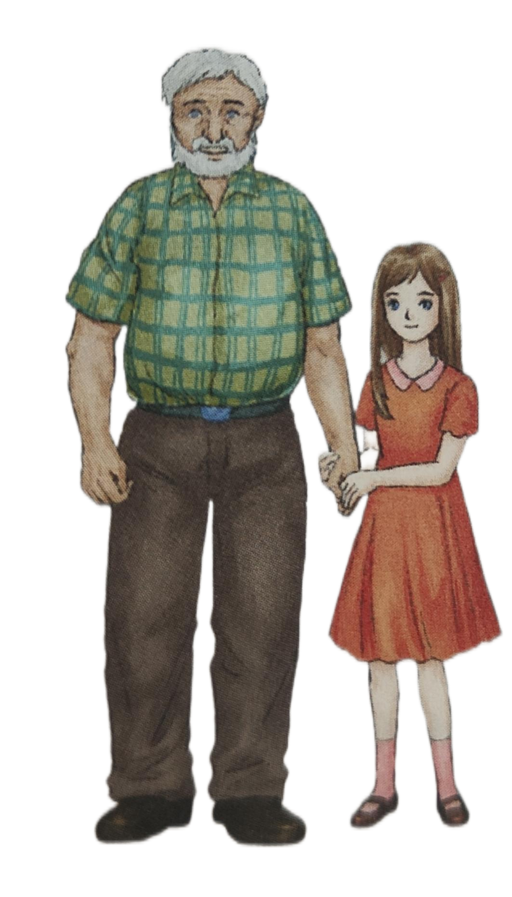


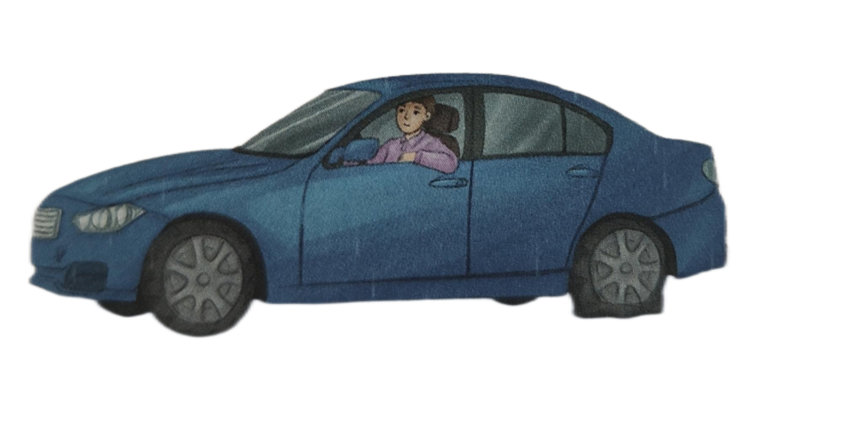
The chain
of

Slide 2

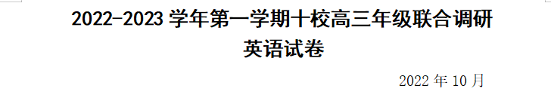
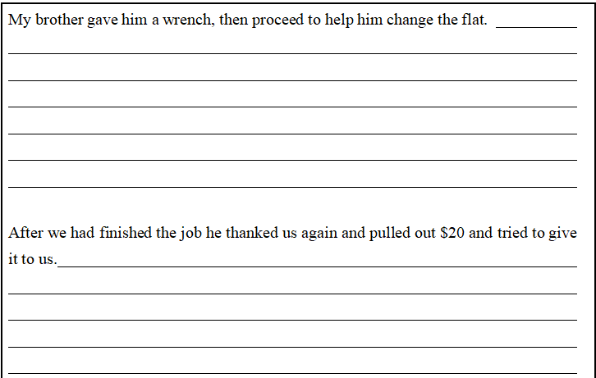
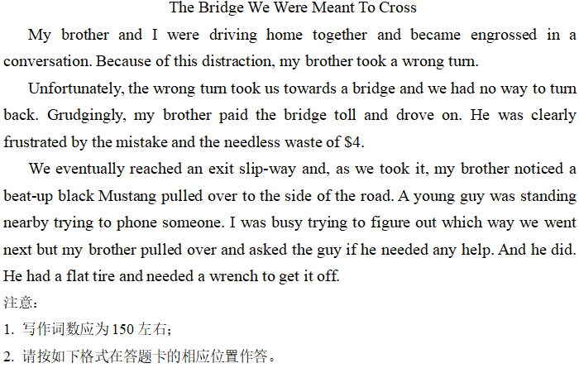
lead-in(share and talk)
Do you still remember the following continuation writing?
kindness from strangers

Slide 3


Read and find
Para.1-5
an old man
Q1
_______,____________,______
Tom
a young girl
Who
on the road near a solitary house
Q2
____________________________
Where
on a rainy night
Q3
When ________________
Tom had a flat tyre and he asked a young girl and an old man for help.
Q4
What _______________________

Slide 4
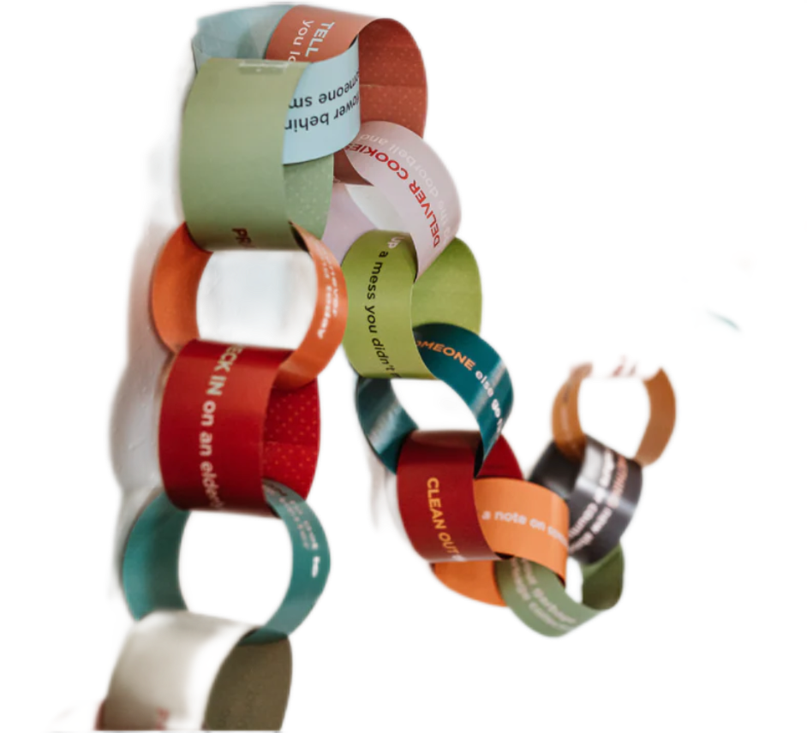
Read and analyze
Para.6-11
How did the girl and her grandfather help Tom?

Slide 5
Read and analyze
Para.6-11
simply nodded his head
1. The old man _____________________ and _____ Tom to open the door of his car.
asked
Action description
2. With the help of his young assistant, the old man ____________________.
3. The two____________________ their work.
Tip1: Use specific verbs instead of general words to describe the actions vividly.
quickly got to work
were concentrating on

Slide 6
Read and analyze
Para.6-11
What’s Tom’s reaction to the old man’s help?
Tom had money ready and handed it to the old man.
Have a try
If you were the author, how would you describe Tom’s gratitude?
Action description
Tip1: Use specific verbs instead of general words to describe the actions vividly.
e.g. With tears rolling down, Tom offered his hearty gratitude.
1. Tom向他露出一个感激的微笑---
2. Tom给了他一个大大的拥抱---
Tom cast a grateful smile to him.
Tom gave him a big hug.

Slide 7
Read and analyze
Para.6-11
What did the old man do when Tom would like to pay them?
Action description
The grandfather waved a hand in front of his face and said, “There is no need. Just be careful about getting home and continue the chain of kindness.”
Language description

Slide 8
Read and analyze
Para.6-11
The grandfather waved a hand in front of his face and said, “There is no need. Just be careful about getting home and continue the chain of kindness.” (para.11)
Language description
Soon the old man stepped to the window. “You’re all set,” he said. (para.8)
Use direct speech to show the speaker’s character and emotion
“How can I help?” the old man asked with a smile on his face. (para.6)

Slide 9
Read and analyze
Para.6-11
Direct speech:
It makes expression more vivid and fully displays the speaker’s emotion.
It is suitable for highlighting important plots.
Indirect speech:
It makes expression more brief.
It is suitable for promoting the development of plots.
Language description
Tip2: Combine direct speech and indirect speech

Slide 10
Read and compare
Para.12-14
What are Tom’s feelings and thoughts after getting help?
after getting help
before getting help
He began to see everything differently. (para.13)
He saw the ramp as a constant reminder of his own disability, and he felt it laughing at him. (para.13)
compare
He began to look forward to each new day and view it as an opportunity to help others to continue the chain of kindness.(para.14)
personification
He could feel a familiar wave of despair start to wash over him.(para.2)
inanimate subjects
(无灵主语)
psychological description
Tip3: Use rhetorical devices(修辞手法) to make the description more vivid.

Slide 11
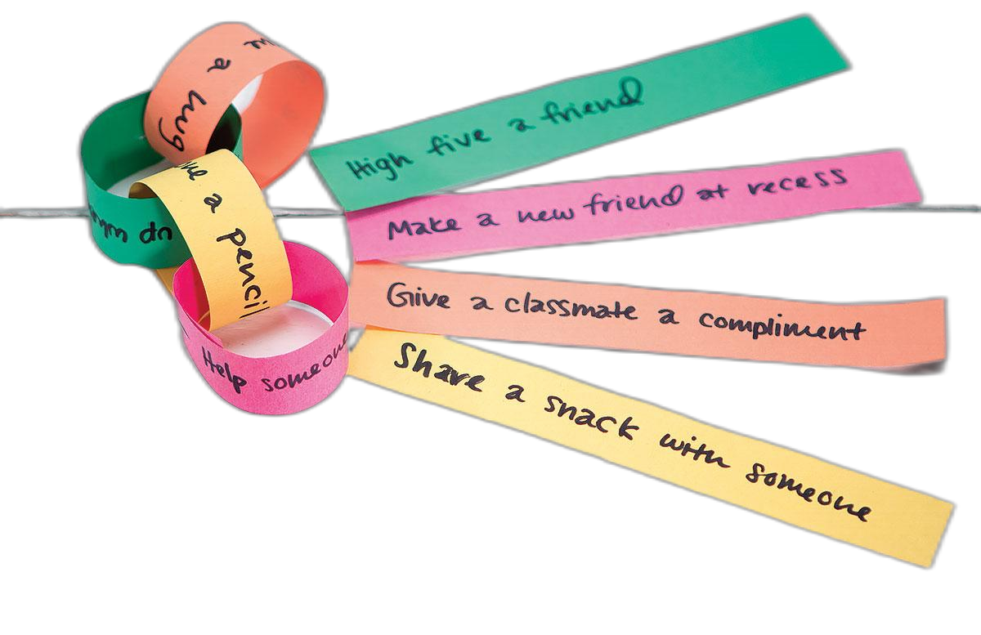
Read and compare
Para.12-14
inanimate subjects(无灵主语): The subject is lifeless thing.
He felt desperate. --- A wave of despair washed over him.
_________________________________一股暖流朝他袭来。
More sentences:
He had a good idea. --- (occur to)
She was very excited. --- (seize)
A wave of warmth washed over him.
A good idea occurred to him.
Excitement seized her.

Slide 12
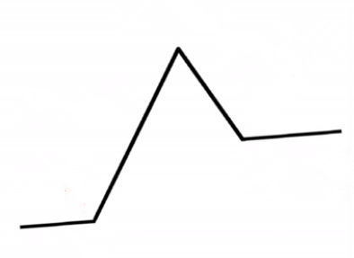
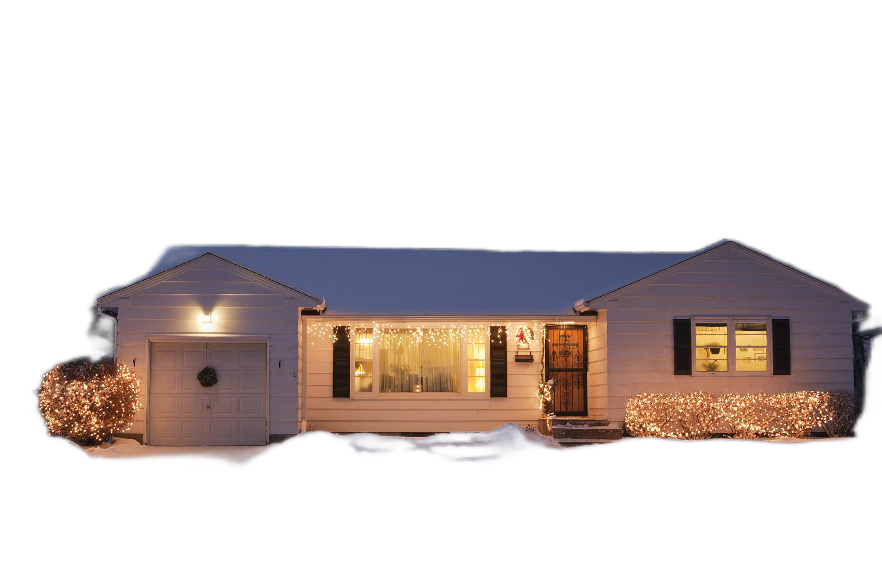
Conclude
Theme
Helping others/Kindness can make a ________ to the receiver.
difference
C
Climax(para11)
A
Main ideas
Falling action
(para12-13)
A. Tom saw the wheelchair ramp differently.
B. Tom came across a flat tyre in the heavy rain.
C. Tom was told to continue the chain of kindness.
D. Tom was determined to help others and continue the chain of kindness.
E. Tom was helped by the old man and the girl.
E
D
Rising action
(para3-10)
Resolution(para14)
B
Beginning(para1-2)

Slide 13

Writing
Try to do the continuation writing on the paper according to what you have learned in this class.
assessment
logic
description | action description
 | language description
 | psychological description
grammar

Slide 14
Possible version
I was standing by my car when a man with broken English suddenly appeared. He asked, “What’s the matter with your car?” I said I thought there was a gas leak because I smelled it. He got under the car, and two minutes later, he slid out and said it was all fixed. He asked me to start it up and see if it worked well. I did as he said. To my delight and relief，my car did indeed roar to life and had power. l jumped with excitement.
I thanked my rescuer and asked him if l could pay him for his help. He shook his head instantly, saying, “I don’t need your money.” I thanked the nice man again and gave him a big hug. My heart was full and said he was a blessing in my life. His face lit up and he gave us a beautiful smile. A wave of warmth washed over my sister and me. We were both moved to tears and extremely grateful. The kind-hearted rescuer touched us deeply. We were determined to try our best to help those who got into trouble without expecting anything in return.

Slide 15
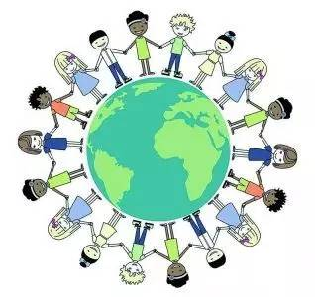
Further thinking
Try your best and do whatever you can to show your kindness in daily life. And you will find the world’s full of beauty.

Slide 16
Homework
Two：
Write down how Tom might continue the chain of kindness.
One:
Polish the continuation writing
(70 words)

Slide 17


