Slide 1
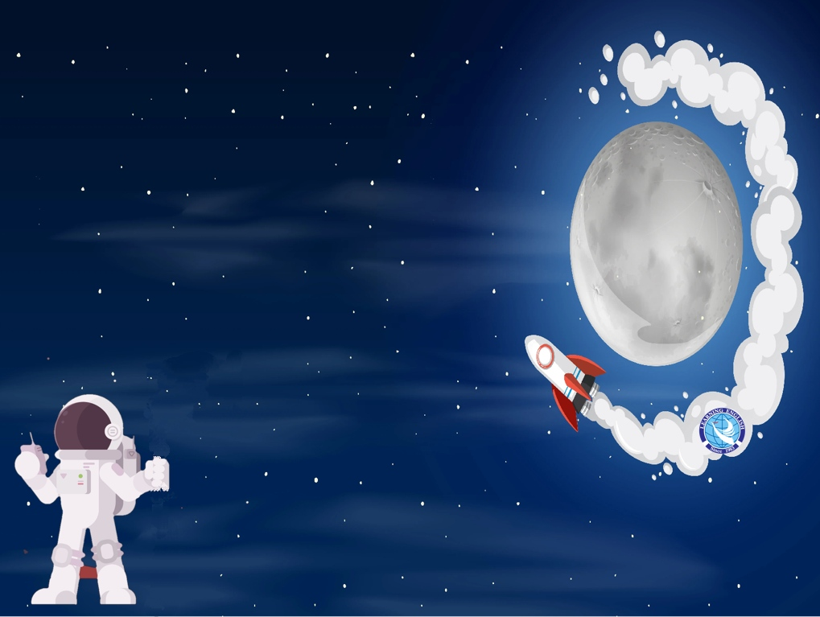
Unit 2
Out of this world
Reading
Life on a space staion

Slide 2

Before reading

Slide 3

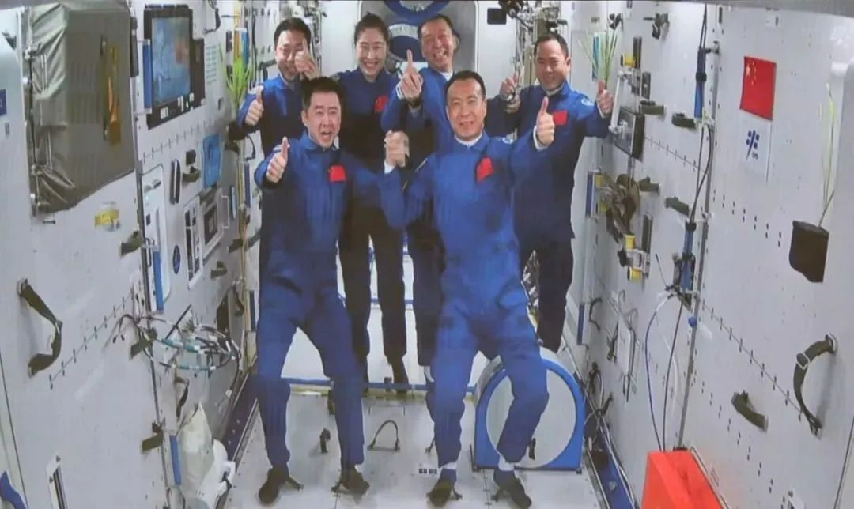
Look and say
Astronauts
On China space station
1. Who are they? Where are they?
2. What famous astronauts do you know about?

Slide 4
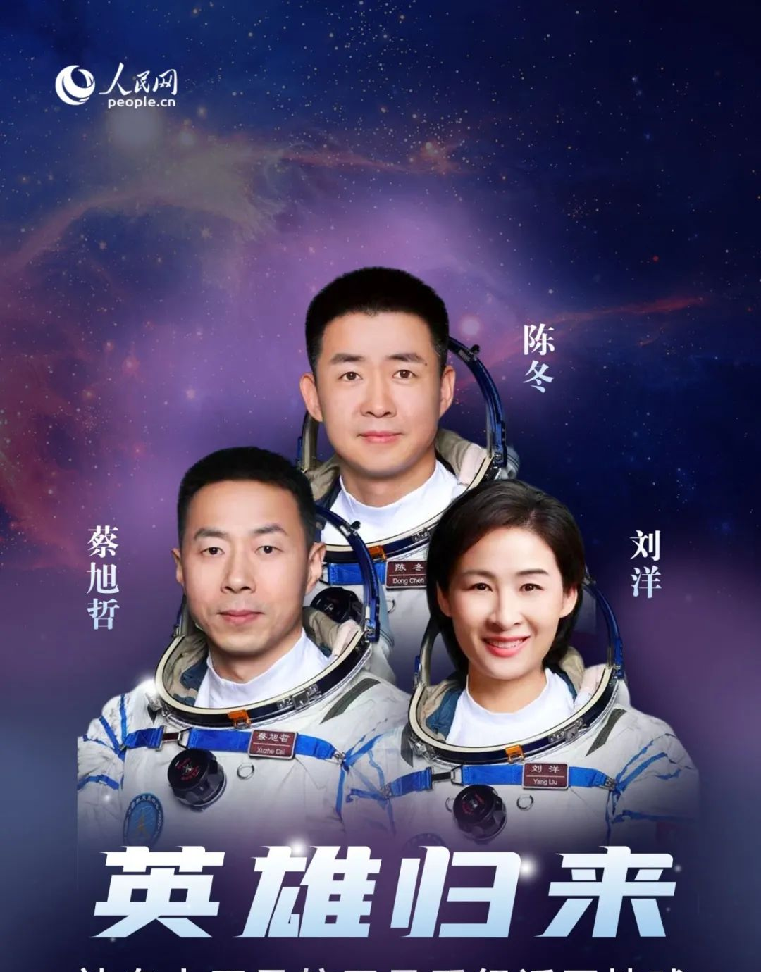
The three astronauts on the Shenzhou XIV mission returned to Earth on Sunday evening after a six-month mission that completed the in-orbit assembly of the Tiangong space station.

Slide 5


Life
on a space station
Now let’s read a lecture given by an astronaut to find out the answers.

Slide 6

While reading
Read and finish the tasks as quickly as possible.

Slide 7

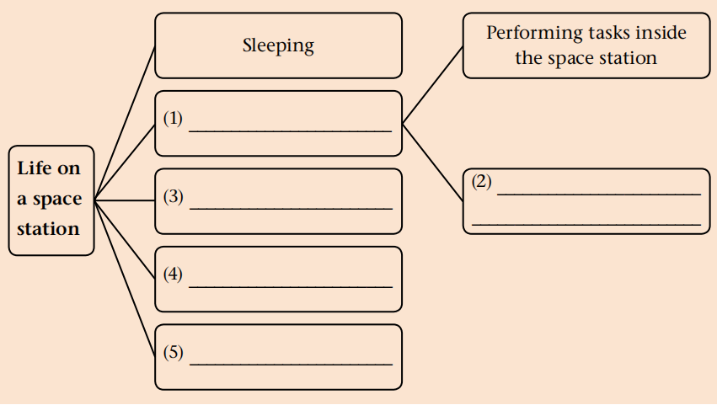
Read the lecture transcript and complete the chart below.
Task 1
Possible answers:
Working
Eating
Performing tasks
outside the space
station
Exercise
Leisure activities

Slide 8
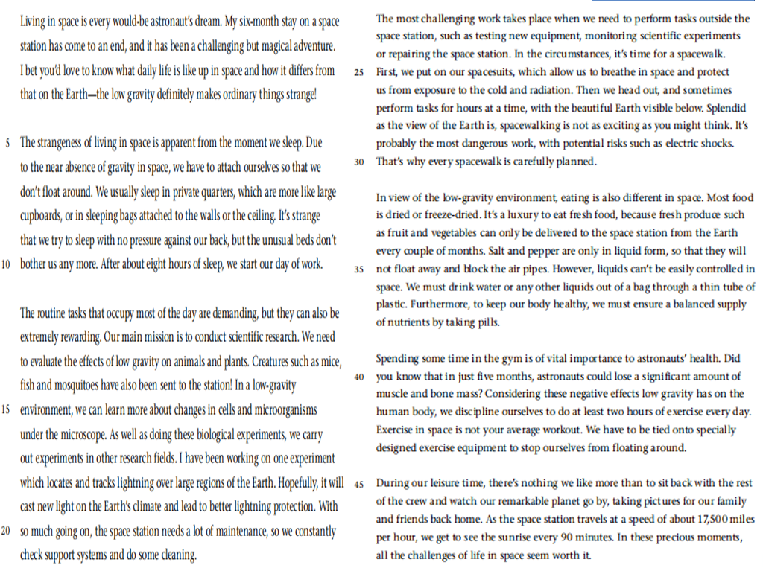

Introduction
Six aspects of life on the space station
Try to analyze the structure of the lecture.
Main body
Conclusion
Topic sentences

Slide 9
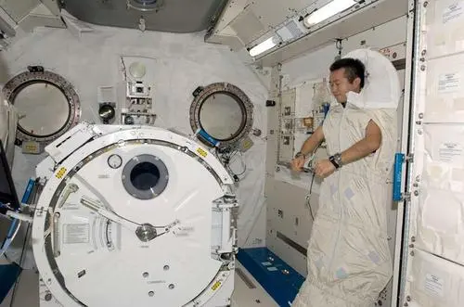
1. How do astronauts sleep in space?
They have to attach themselves, sleep inside in private quarters or in sleeping bags attached to the walls or the ceiling.

Slide 10
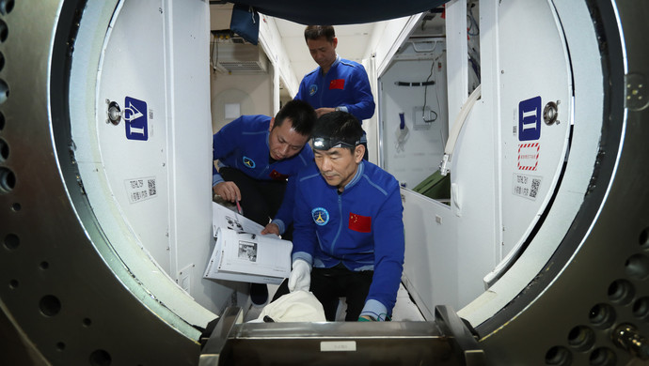
2. What routine tasks do astronauts do on the space station?
Inside
1. Conduct scientific research
2. do a lot of maintenance, so constantly check support systems and do some cleaning
Outside
Test new equipment, monitor scientific experiment, repair the space station

Slide 11
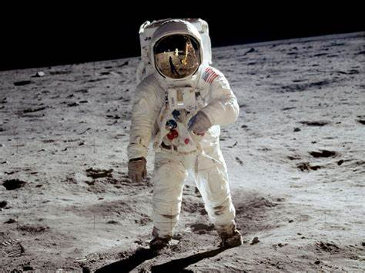
3. What do spacesuits allow astronauts to do?
Spacesuits allow them to breathe in space and protect themselves from exposure to the cold and radiation.

Slide 12
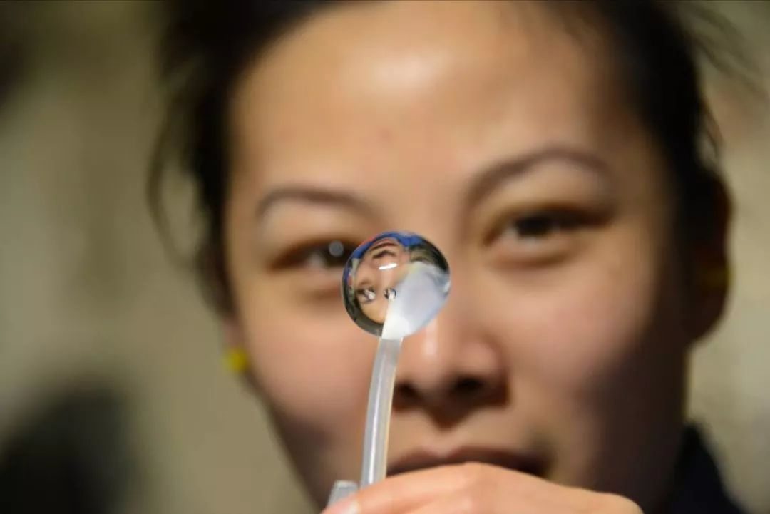
4. How do astronauts drink water or any other liquids?
They drink water or any other liquids out of a bag through a thin tube of plastic.

Slide 13
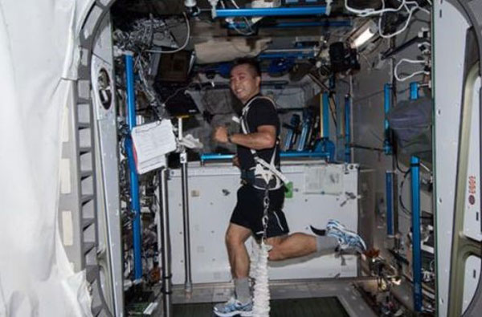
5. Why do astronauts need to spend some time in the gym?
The near absence of gravity makes them lose muscle and bone mass and going to the gym helps prevent this.

Slide 14
Discussion

Slide 15
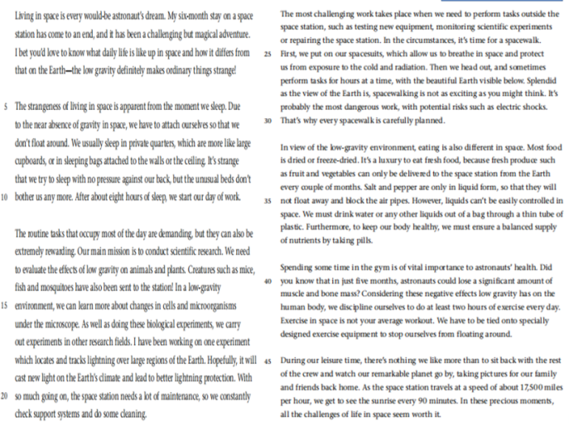
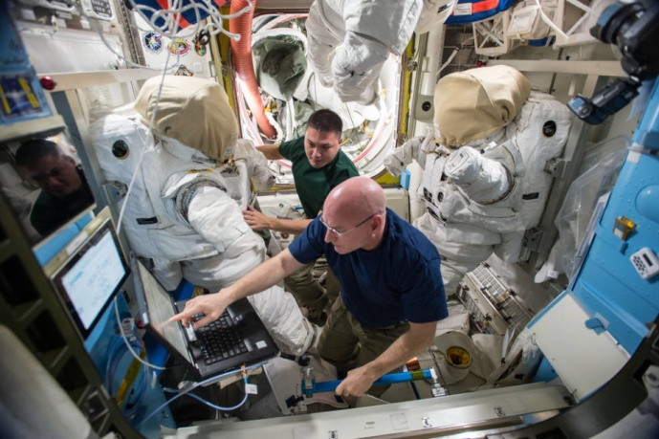

Think & Share
1. What do you think of daily life on a space station? Use details from the lecture transcript to support your opinion.

Slide 16
At the end of the lecture, what questions would you like to ask the astronaut?

Slide 17

Q
Discussion
What qualities do you think are needed to become an astronaut?

Slide 18
Possible answer:
Curiosity
Creativity
Qualities of being an astronaut
…
Intelligence
Education
Physical Condition
Mental Endurance
(忍耐力)
Adaptability

Slide 19
Conclusion

Slide 20
