Slide 1

Unit 1 Lights, camera, action!
Reading

Slide 2

Zootopia

Slide 3
Free-talk
Do you like this type of film? why？
What elements of a film can you think of?
screenplay(剧本), film stars, acting, amazing settings, music, sound effect, props, special visual effect,etc.

Slide 4

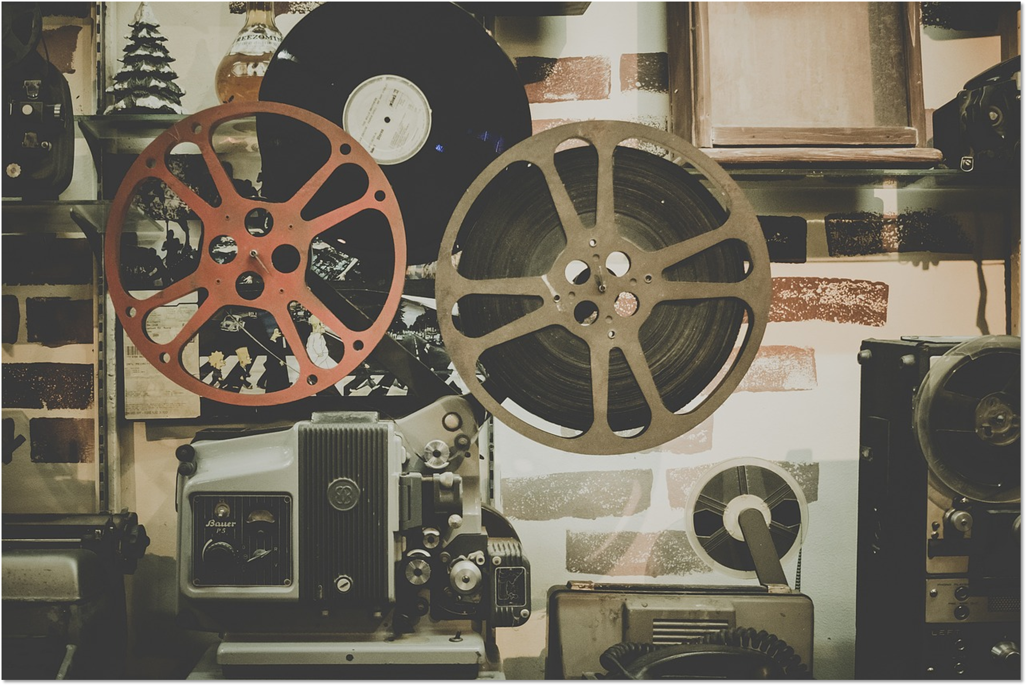

  Behind the scenes

Slide 5
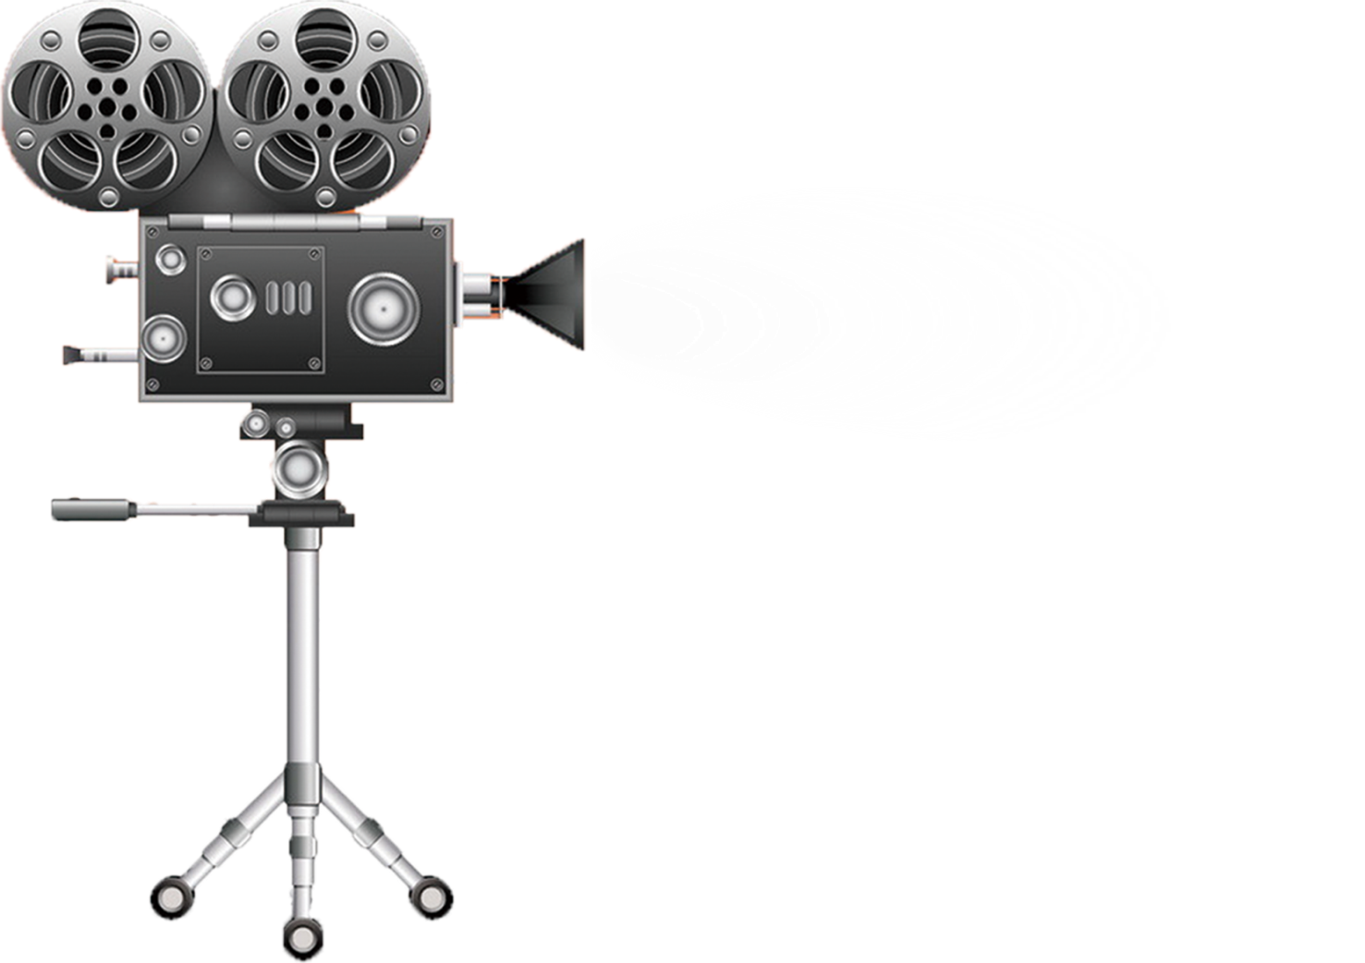
FFast readingst-reading
topic sentences
Today, I’ll give you a brief introduction to some aspects of film-making you might not be familiar with.
To begin with … sound effects
Another aspect …visual special effects
Props also contribute to a film’s success
What we see on the cinema...people behind the scenes

Slide 6

Introduction (Para. 1): Some aspects of film-making behind the scenes require a lot of hard work.
Aspect 1 (Para. 2):
Sound effects
(1) __________________
Main body:
Aspect 2 (Para. 3):
Visual special effects
(2) ___________________
Props
Aspect 3 (Para. 4):
(3) ___________________
Think of and appreciate the work done behind the scenes.
Conclusion (Para. 5): (4)

Slide 7
Structure of the lecture transcript
A
B
C
B
D
1
1
1
2
3
4
5
2
3
4
5
2
3
4
2
3
5
4
5
1

Slide 8
Careful reading
1.Why are the scenes requiring CGI(计算机生成图像） filmed in front of a green screen in the studio?
2.Among these examples in the speech, which one best reflects the devotion and efforts of the director?

Slide 9
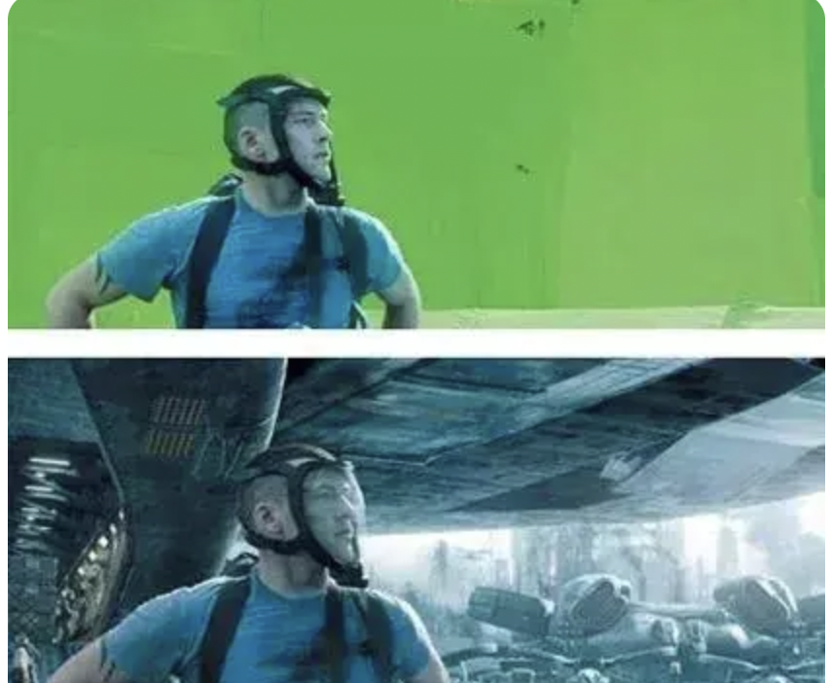
Why are the scenes requiring CGI filmed in front of a green screen in the studio?
Visual effects
As green doesn’t match any natural hair or skin color,actors can be easily separated from the background.

Slide 10
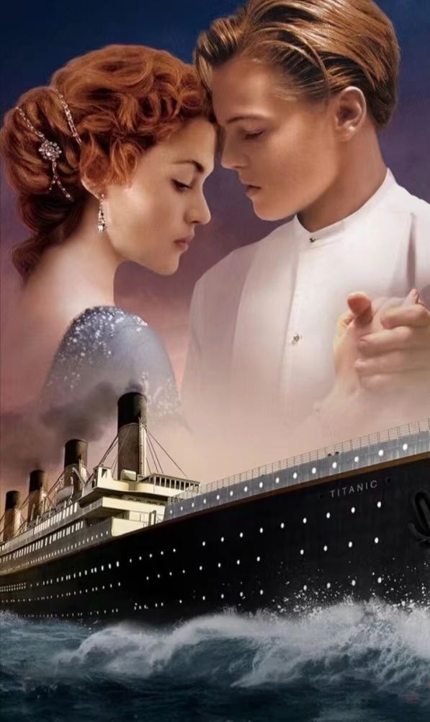
Among these examples in the speech, which one
best reflects the devotion and efforts of the director?
·spent six months looking at and revising plans
·talked to historians to know better about the ship
·went down to the bottom of the Atlantic 0cean to see what was left of the ship for himself
·lt took 500 workers 100 days to build the fine model,not to mention the thousands of props inside.

Slide 11
Discussion
1.Why are the sound effects mentioned in the speech added after the scene has been shot?
2.Why do some directors prefer using CGI in films?

Slide 12
Discussion
Why are the sound effects mentioned in the speech added after the scene has been shot?
It's inconvenient or impossible to add the sound effects when the scene is being shot, like the dinosaur sound, so the directors come up with creative ways to mix several sounds to produce the vivid sound.

Slide 13
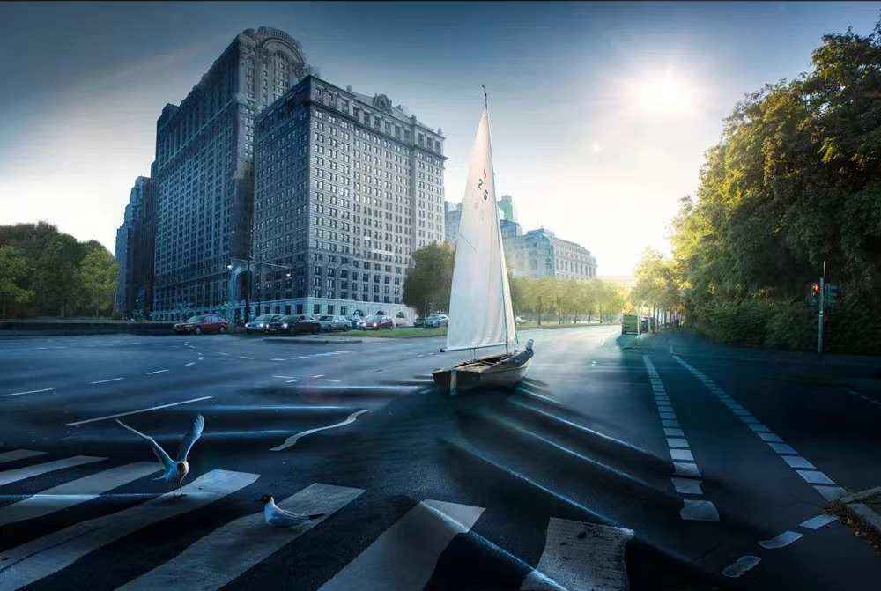

Why do some directors prefer using·vivid experience
CGI in films?
·save lot of trouble and budget
·vivid experience
·ensure actor’s or actress’s safety
·a strong sense of authenticity

Slide 14
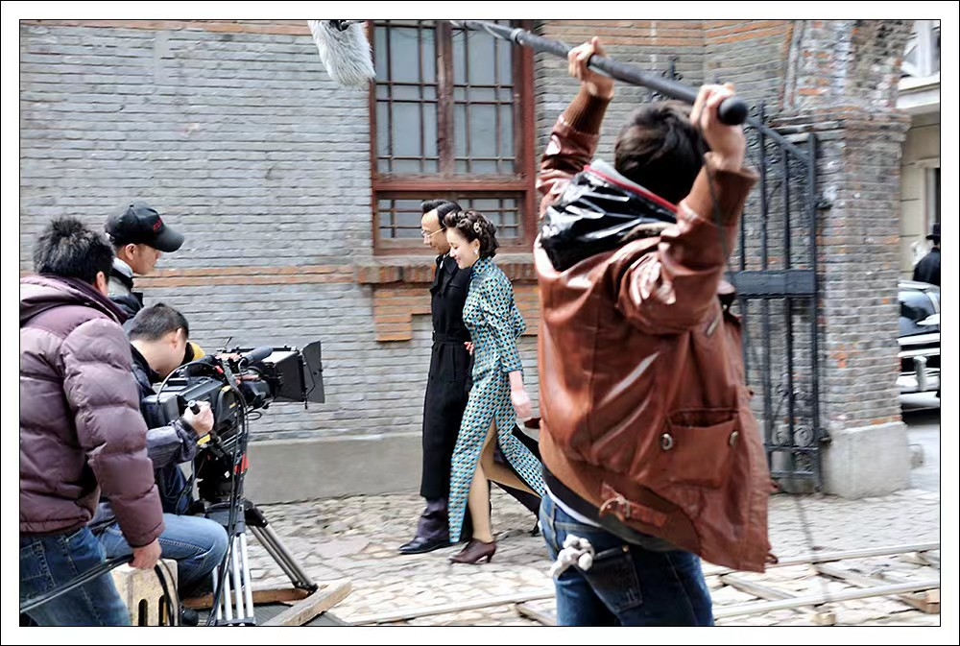

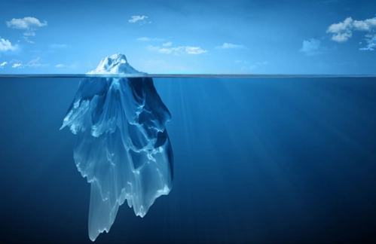
Summary
Film-making involves a lot of hard work behind the scenes. What we see is just a tip of the iceberg.
Spare a thought for all those talented/dedicated people behind the scenes next time we go to the cinema.
What conclusions can you draw from the lecture?

Slide 15
Homework
If you are the director of The Wandering Earth(流浪地球), you are awarded with The Best Feature(最佳故事片) and The best Recording(最佳录音奖) in Gold Award(金鸡奖). Please write a mini-speech to express thanks to the various talented people behind the scenes.

Slide 16



