Slide 1
A hedge between
keeps friendship green!

Slide 2
Warm-up
A game
What will you choose?
In twenty years?
vs

Slide 3
Time can change a person’s choice!
vs

Slide 4
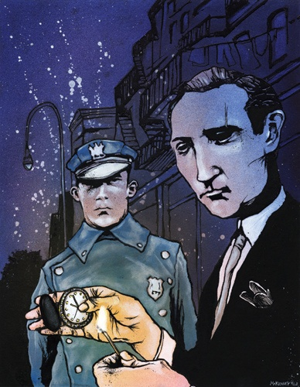
After
Twenty Years
By O. Henry
常州市第五中学 王海惠

Slide 5
Learning objectives
At the end of the class, you will be able to:
1. get the main idea of the story and understand the elements of a novel and O.Henry-style endings.
2. analyze the personalities of the characters
3. voice your opinions when friendship meets justice
4. write a possible ending to the story based on your understanding of the characters

Slide 6
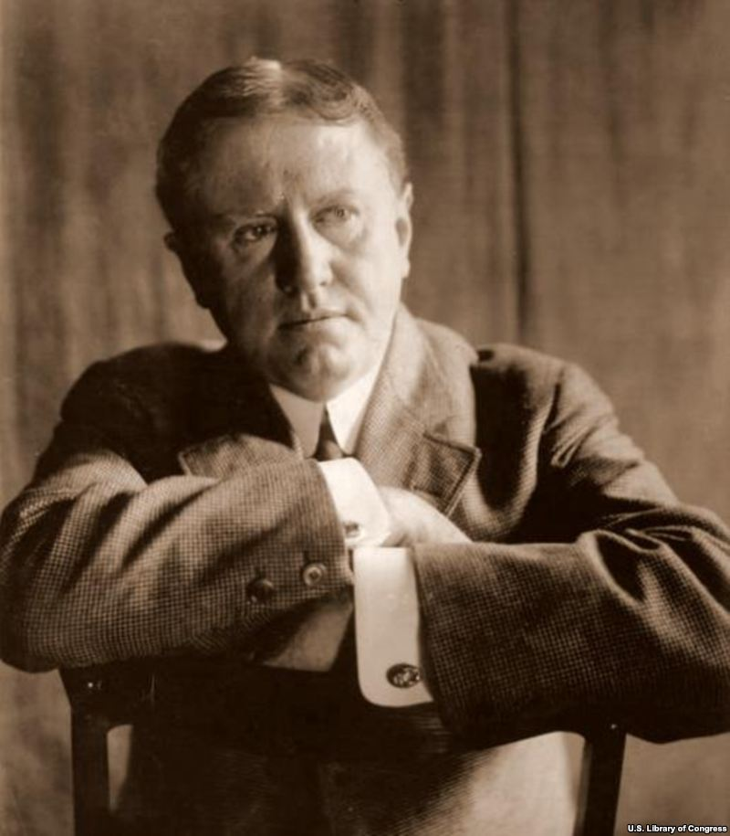
Brief introduction to the Author
William Sydney Porter (1862-1910)
American writer
worked at various jobs
served three years in prison
focused on the everyday life of ordinary people in New York
known for the surprise endings
1
4
The Gift of the Magi
O. Henry
O. Henry

Slide 7
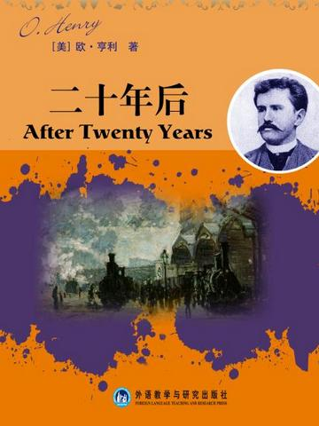
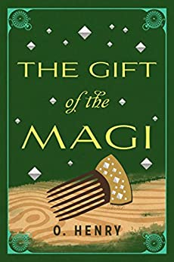
O.Henry’s works

Slide 8
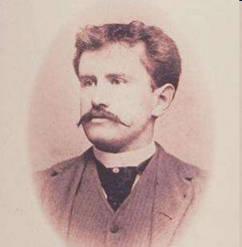
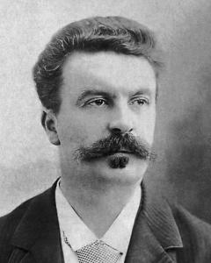
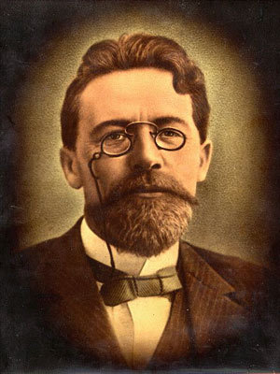
The three kings of short story in the world
Maupassant
France
(莫泊桑）
Chekhov
Russia
(契诃夫）
O. Henry

Slide 9
O. Henry-style endings:
a sudden twist
an unexpected change of the characters` inner world, experience, destiny
a surprising yet understandable result

Slide 10
Time can change a person’s choice!
After
Twenty Years
By O. Henry
O. Henry-style ending

Slide 11
After twenty years
Setting
When
Setting
Where
Character
Who
Novel
Beginning
Development
plot
Climax
Ending

Slide 12
Read and think (para.1-10)
1.Why had the man chosen to leave New York before?
2. From his appearance and narration, what kind of people do you think the man and Jimmy are?

Slide 13
Read and think (para.1-10)
1.Why had the man chosen to leave New York before?
He had chosen to travel to the West to make his fortune.
Knowledge link:
the West: In the early 1800s, America’s Westward Expansion（西部扩张） started. During the expansion, many people went to exploit the West to make money. New York is located in the north-east of the US and was already a big city by then.

Slide 14
Read and think (para.1-10)
2. From his appearance and narration, what kind of people do you think the man and Jimmy are?
the man | Jimmy
smart
had many fights
the truest
the most reliable fellow
deserving the wait
rich and successful
poor taste
ambitious
adventurous
had strong faith in his friend

Slide 15
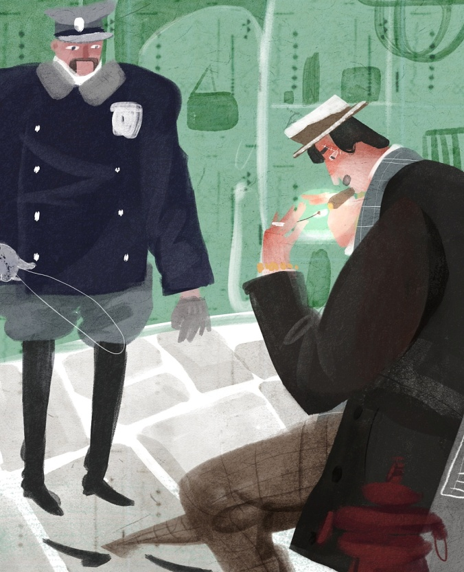
Predict
Do you think Jimmy will come to the appointment?

Slide 16
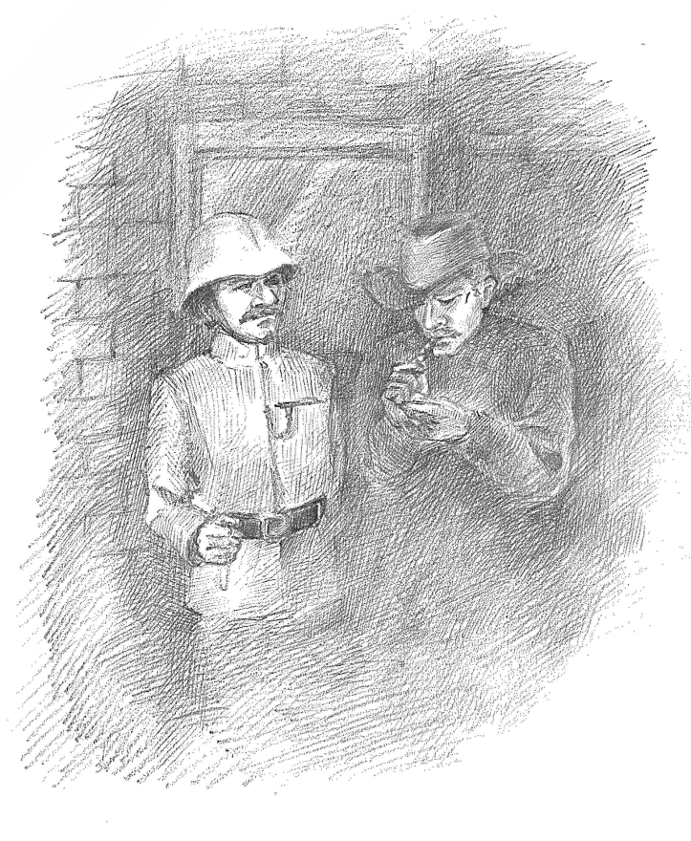
Read and think (para.11-21)
3. How many characters are there in this story?
4. Do you like this ending? Give your reasons.
surprise ending:
Bob----a criminal
Jimmy---the policeman on the beat
(在巡逻中）
the tall man---- a plain-clothes man
(便衣警察）

Slide 17
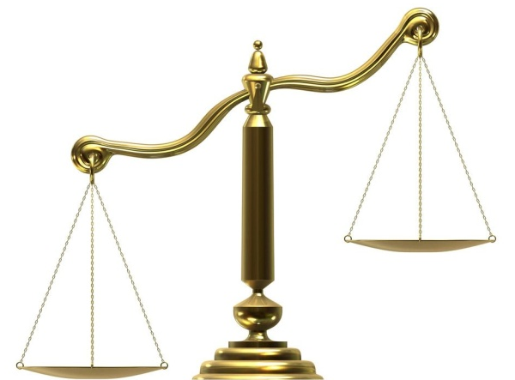
Think and share
Imagine you were Jimmy, what would you choose when you found out Bob was the wanted criminal: Justice or Friendship?
Justice
Friendship

Slide 18
Conclude and continue the story
Time can change a person’s choice!
O. Henry-style ending
appointment
1. Bob and Jimmy both chose to fulfill the _______________.
2. Bob chose to be a criminal in order to survive in making his __________________.
3. Jimmy chose to be a______________ in order to keep the social order and earn his living.
4. Jimmy chose to betray the friendship and turned _____________ in. (告发某人）
fortune
policeman
Bob
What would Bob choose to do ? Would Bob choose to understand and forgive Jimmy’s betrayal?

Slide 19
Write your own ending
Bob’s heart sank, hands trembling but immediately handcuffed(戴上手铐）. He looked around_________________________________________.
Yes, Jimmy said__________________________________.
Bob murmured. I should have been __________________.
Poor Bob_______________________________________.
Looking down again ______________________________.
Indeed, he had gained ____________________________.
Time could change everything, let alone a man’s choice.

Slide 20
My own ending
Bob’s heart sank, hands trembling but immediately handcuffed(戴上手铐）. He looked around in disbelief for his best friend, who once had been so loyal to their friendship, but in vain. Yes, Jimmy said he couldn’t arrest me himself. Bob murmured. I should have been so foolish to come so far to witness this betrayal. Poor Bob was completely immersed in anger and despair in the cold and unmerciful wind. Looking down again at the note in his hand, he caught a glimpse of his oddly set diamand scarfpin. Indeed, he had gained something precious at the cost of losing something valuable. Time could change everything, let alone a man’s choice!

Slide 21
Homework
1.Go on polishing your writing.
2. Read the original story of “ After Twenty Years” to better understand what message O.Henry conveys through this short story.

Slide 22
A true friend is known
in the day of adversity.
疾风知劲草，患难见真情！

Slide 23
Thank you!

