Slide 1
Unit 6
Food and Lifestyle
Reading 1
Lihe Experimental School

Slide 2
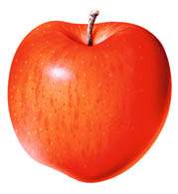
What do you like / dislike?
fruit
vegetables
fast food
potato chips
meat
snacks
main food

Slide 3
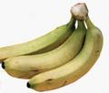
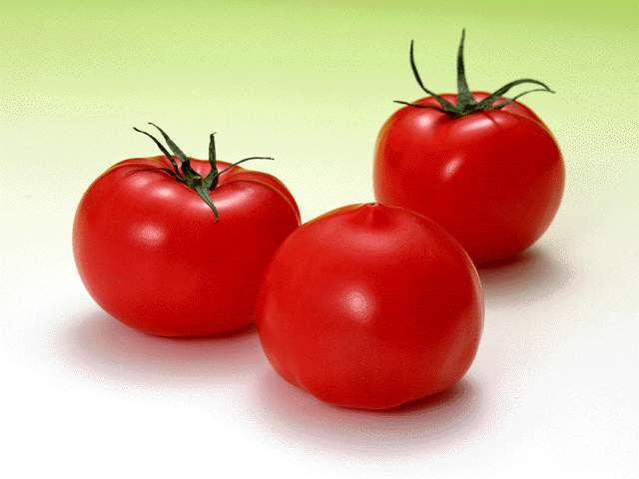
Do you like having …?
Are they/ Is it healthy?
healthy
not healthy

Slide 4
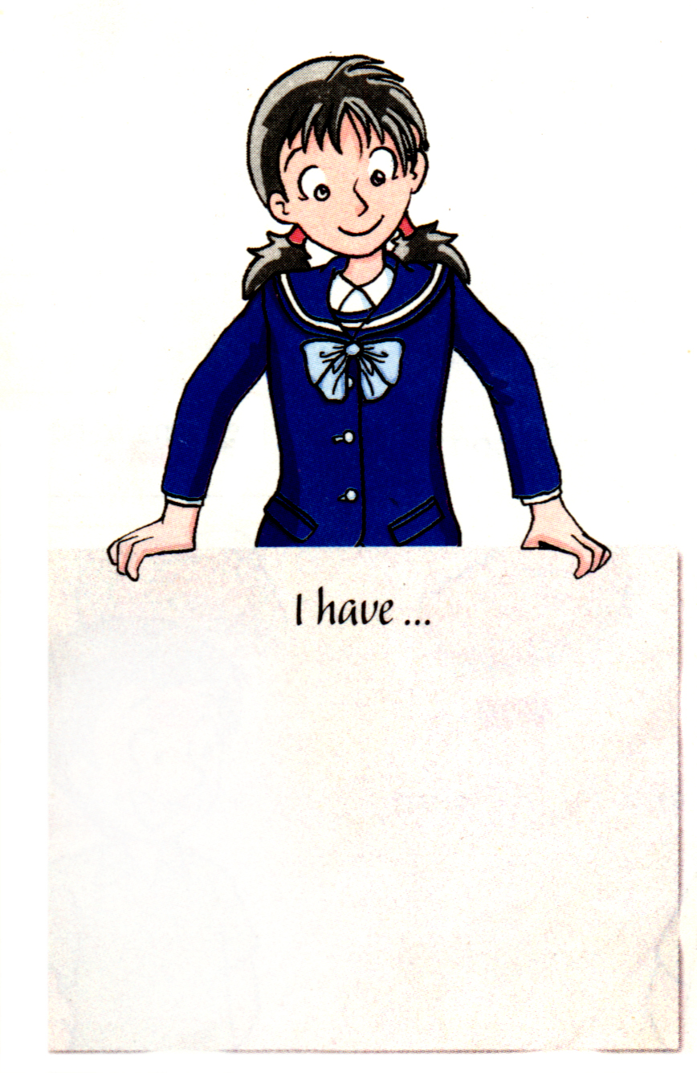
Who has a healthy diet and lifestyle, Kitty or Daniel?
/aIə/ 饮食
/aI/ 生活方式

Slide 5
Review new words
Guess the word out of the meaning and match:
not often
1 healthy ( line 3 )
do sports
2 fit ( line 3 )
3 hungry ( line 6 )
how one lives
4 seldom ( line 7)
good for one’s health
5 exercise ( line 9 )
needing food
6 lifestyle ( line 11 )
strong and healthy

Slide 6
Enjoy the video, and try to answer my questions.
What we eat and how we live
How many persons are there in the passage?
Who are they?
Who has a healthy diet and lifestyle,
Kitty or Daniel?

Slide 7
Fast reading:
Q1. How often does Kitty dance?
She dances _______________.
2. How long does Kitty dance every time?
She dances for ______________.
3. Why is healthy for so important for Kitty?
Because she needs to ______________.
4. Does Daniel have a healthy lifestyle?
5. What does Daniel plan to eat every day?
He plans to eat _________________________.
6. What does Daniel plan to do?
He plans to ________________ every week.
every day
half an hour
keep fit
No, he doesn’t.
more fruit and vegetables
go swimming

Slide 8
Careful reading:
Kitty
Hi! My name is Kitty. I love dancing. I dance for half an hour every day.
Healthy food is important for me. I need to keep fit. I always have milk and bread for breakfast. For lunch and dinner, I usually eat fish and vegetables.
Sometimes I feel hungry between meals, so I eat an apple or a pear. I seldom eat cakes or sweets. They have too much sugar and are bad for my teeth.

Slide 9
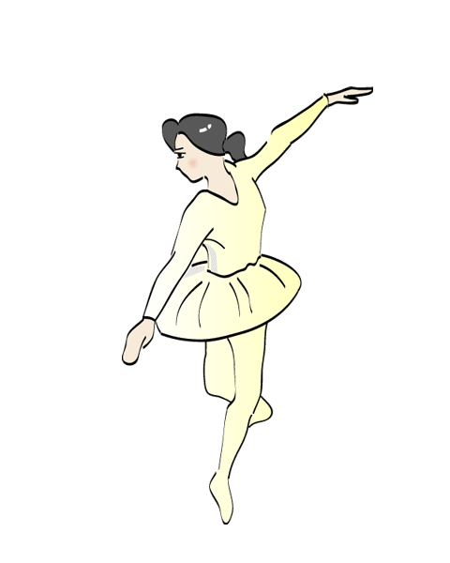
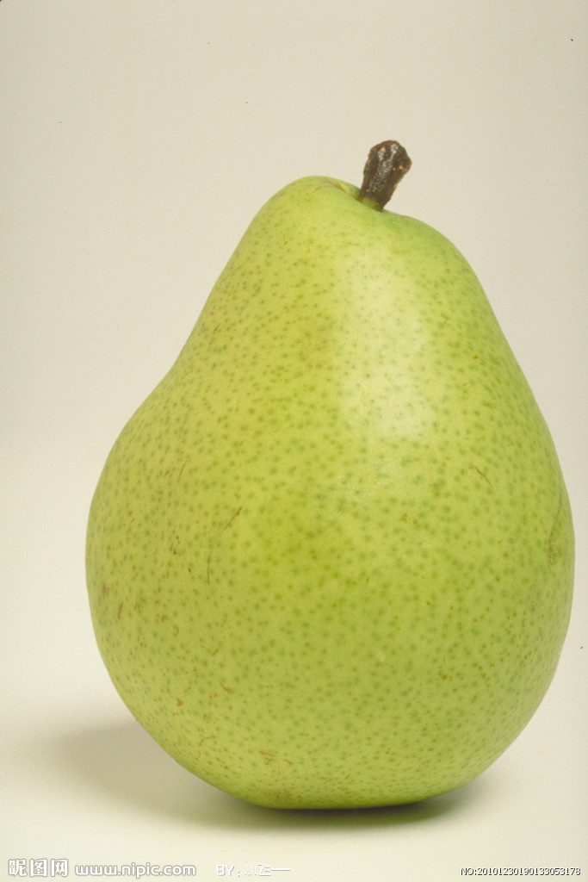
She is Kitty, she ……
Name:
Hobby:
Kitty
Need to keep fit
dancing
Need healthy food
has…
for breakfast
seldom
for lunch and dinner
between meals

Slide 10
If you are Kitty, try to complete the passage:
Hi! My name is Kitty. I love dancing. I dance for half an hour every day.
Healthy food is important for me. I need to keep fit. I always have milk and bread for breakfast. For lunch and dinner, I usually eat fish and vegetables.
Sometimes I feel hungry between meals, so I eat an apple or a pear. I seldom eat cakes or sweets. They have too much sugar and are bad for my teeth.

Slide 11
If you are Kitty, try to complete the passage:
dancer
I want to be a _______, I dance for ____________ every day. ____________ is important for me. I need to ____________.
I always have milk and bread___________.
For___________, I usually eat___________.
Sometimes I feel ______ between meals, so I eat an apple or a pear. I ________ eat cakes or _______.
They have too much_________ and are _______ for my ________.
half an hour
Healthy food
keep fit
for breakfast
lunch and dinner
fish and vegetables
hungry
seldom
sweets
sugar
bad
teeth

Slide 12
Careful reading:
Daniel
Hello! I am Daniel. I like playing computer games. I seldom exercise. I love hamburgers and cola, but they are not healthy.
I need to change my lifestyle now. I plan to eat more fruit and vegetables every day. I love beef, but I also need to eat some fish. There is a swimming pool near my home. I plan to go swimming every week.

Slide 13
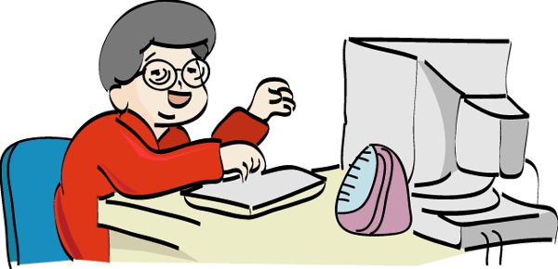
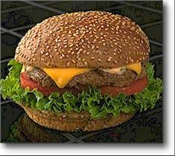
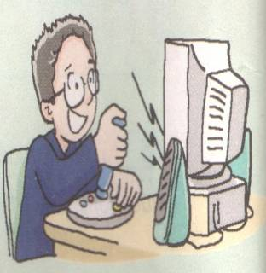
Hi, I’m Daniel
Love
Hobby
Plan to:
playing computer games
every week

Slide 14
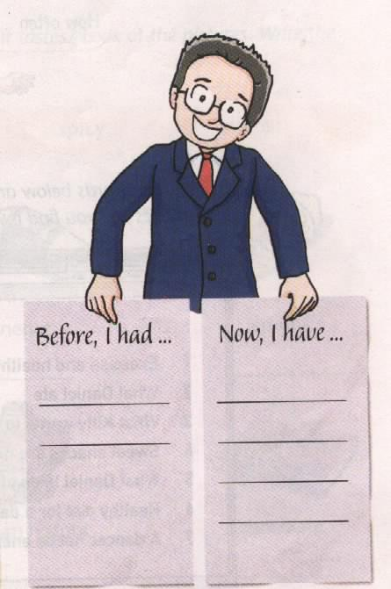
Help Kitty and Danel write about what they eat
I have ________ and ________
for breakfast every day.
I eat______ and __________for lunch and dinner. Sometimes I have an_______ or a ________ between meals. I seldom eat ______ or _______.
milk
I love ___________ and __________.
My favourite meat is _________.
I don’t eat______ and ________ every day. I don’t often eat________.
hamburgers
bread
cola
beef
fish
vegetables
fruit
vegetables
fish
apple
pear
cakes
sweets

Slide 15
Read after the tape and tell the following sentences if they are true or false.
1. Kitty loves swimming.
2. Kitty often eats healthy food.
3. There is too much sugar in cakes and sweets.
4. Daniel seldom plays computer games.
5. Daniel does not like play sports.
6. Kitty and Daniel have healthy lifestyles.
dancing
( F )
( T )
( T )
often
( F )
( T )
has a healthy lifestyle.
( F )

Slide 16
a healthy lifestyle
happy every day
a healthy diet
How do you keep healthy?

Slide 17
My suggestions建议
Healthy food
1 We should eat more fruit and vegetables.
An apple a day keeps the doctor away!
2 We should seldom eat fast food like Cola and hamburgers.
Healthy lifestyles
3We should do more exercise.
4We should not spend too much time playing computer games.
5 We should get up early and go to bed early.
Be happy every day.

Slide 18
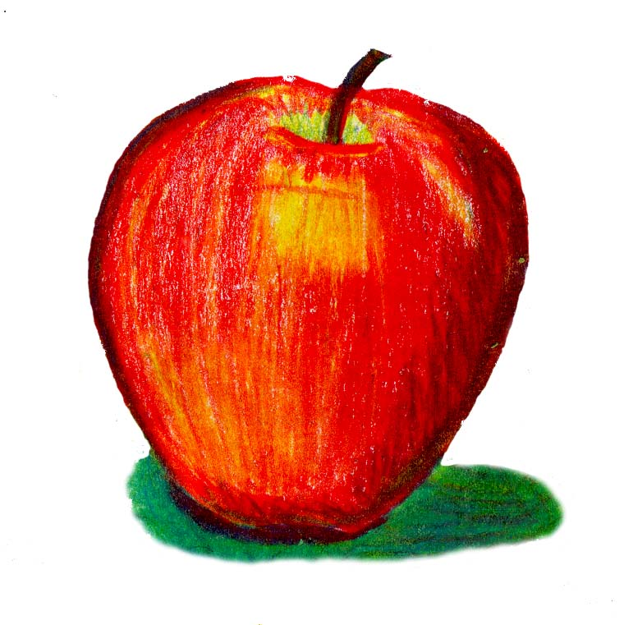
Talk about our diets and lifestyles
have … for breakfast /
lunch /dinner
often/never/
seldom
What we eat
How we live

Slide 19
Nutritionists’ advice:
营养学家的建议
*Eat more vegetables and eat less meat.
*Drink eight glasses of water every day.
*An apple a day keeps the doctor away.
*Doing more exercise every day can help
you keep healthy.

Slide 20
Homework
1.Finish the exercises book Page59
2.Read the passage after class

Slide 21
Thanks!

