Slide 1
常州市新高考
线上研修活动
2021

Slide 2
常州市新高考线上研修活动
图式理论与语篇教学
讲师团成员：查君蕾 江苏省横林高级中学

Slide 3
How to teach reading in Senior Three?
Time pressing
Schedule tight
Students exhausted
Exams always around the corner

Slide 4
The Value of Science

Slide 5
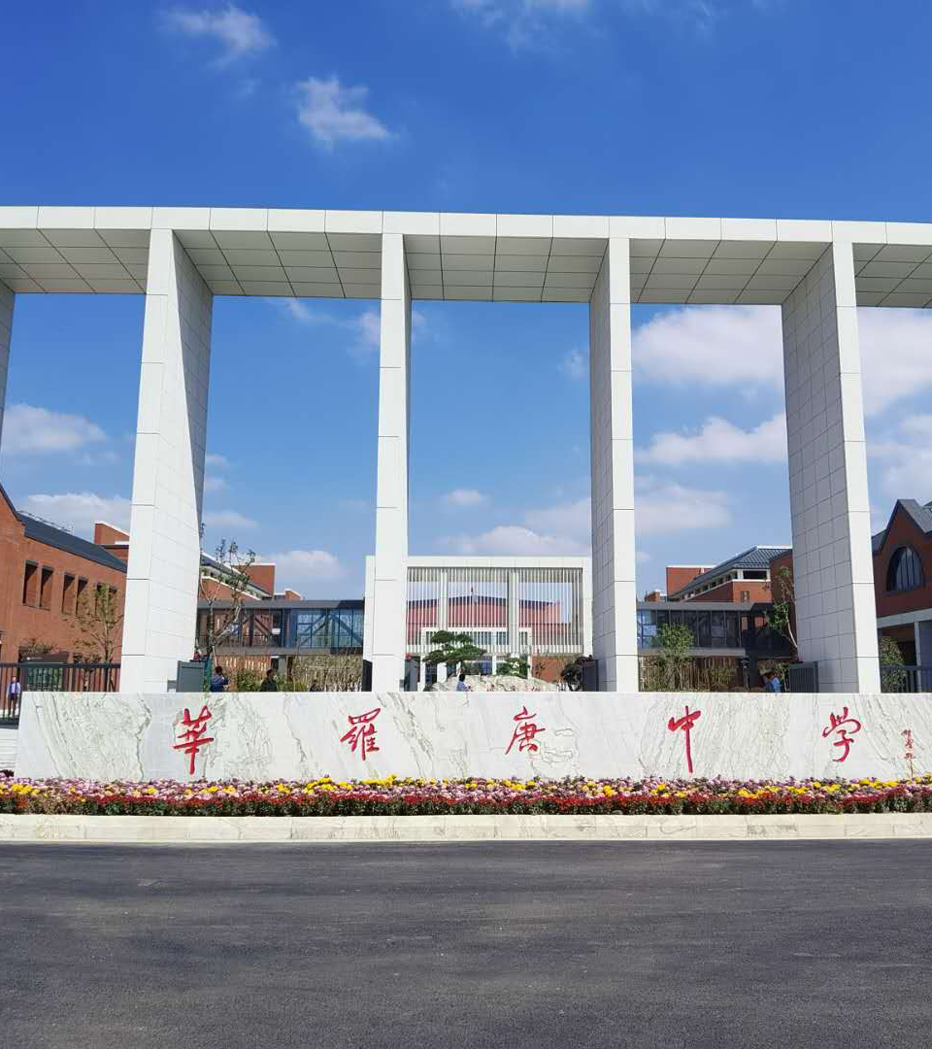
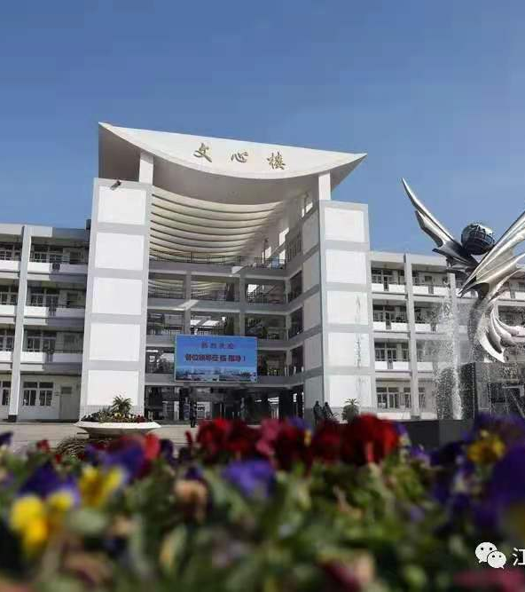
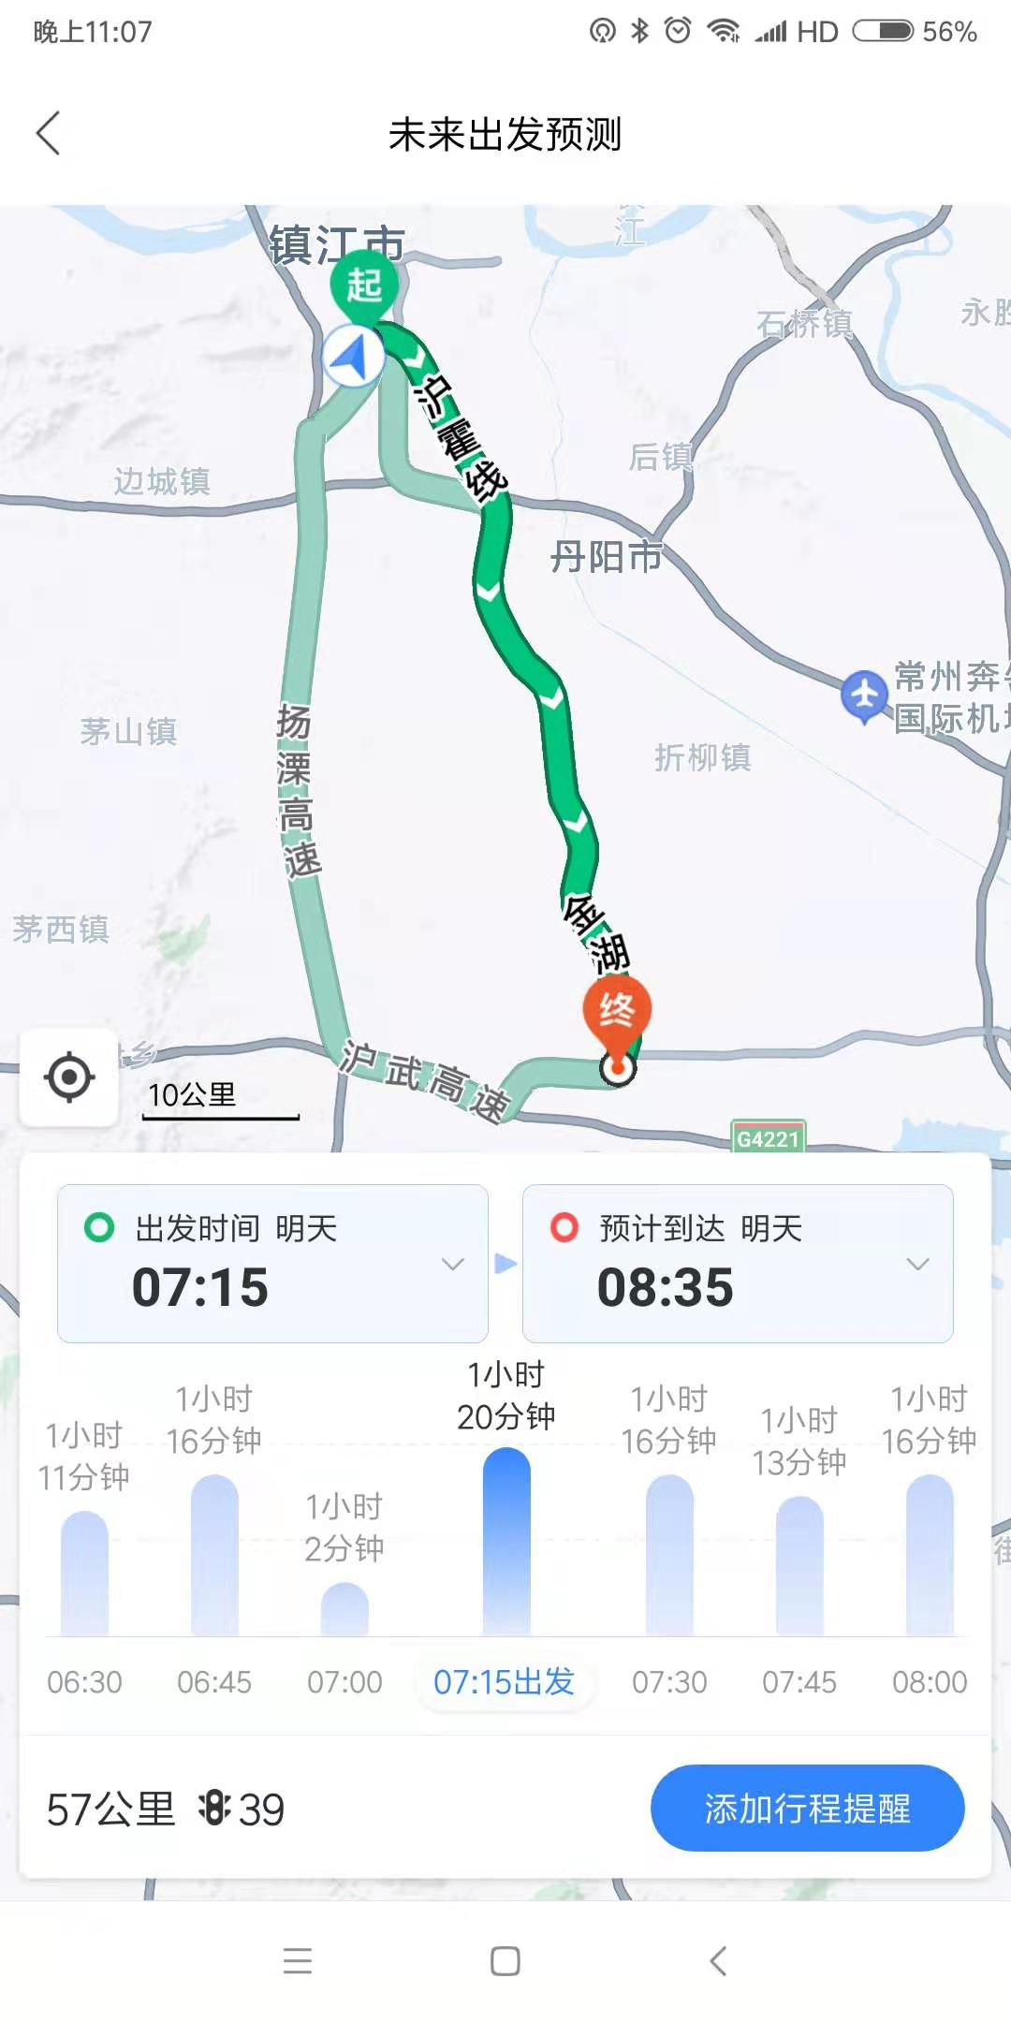
Welcome to my class!
Zhu Dan
Dagang High School
Zhenjiang

Slide 6
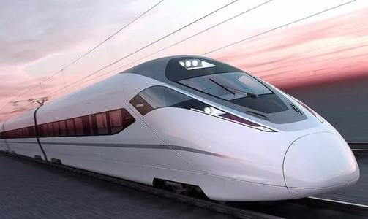
The Value of Science

Slide 7
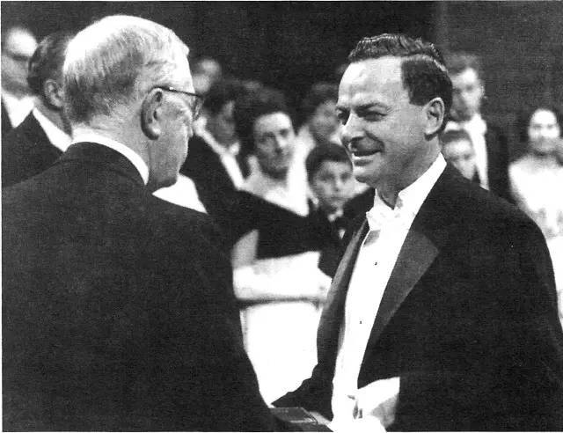
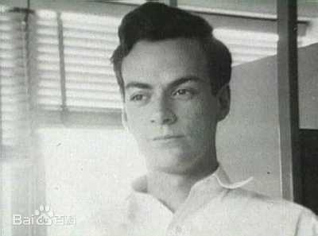
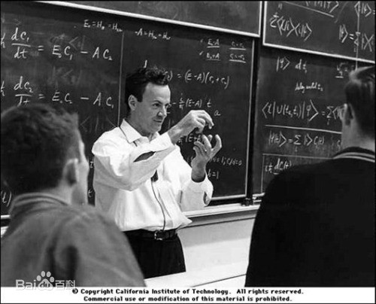
Manhattan Project
atomic bomb
Richard Feynman
an American scientist
won the Nobel Prize in Physics in 1965

Slide 8
这些图片只是为了公开课的热闹与好看吗？
Absolutely no！
高三的阅读课还需要这些吗？
Absolutely yes！

Slide 9
图式理论 美国人工智能专家鲁梅尔哈特（Rumelhart） ：
人们在理解新事物的时候，需要将新事物与已知的概念、过去的经历，即背景知识，联系起来。对新事物的理解和解释取决于头脑中已经存在的图式，输入的信息必须与这些图式相吻合。

Slide 10
布卢姆（Benjamin S. Bloom）：
只要对下列三个自变量予以适当注意，就有可能使绝大多数学生的学习都达到掌握水平。
认知准备状态
情感准备状态
教学质量

Slide 11
阅读教学相关图式
1
内容图式
2
形式图式
3
语言图式

Slide 12
“内容图式”是指读者对文章所涉及的主题内容、题材或文化背景知识的熟悉程度；
“形式图式”也被称作“修辞图式”，主要指读者对文章的组织形式、篇章结构、体裁风格等语篇修辞知识的熟悉和掌握；
“语言图式”是指读者所掌握的语言文字知识，如词汇、语法等（包括技能）。

Slide 13
导入： 激活内容图式 认知与情感准备
especially necessary for
Senior 3 students

Slide 14
M9U1 Reading
Canada

Slide 15
10 provinces in Canada
英属哥伦比亚省（B.C）; 亚尔伯它省（Alberta）
萨斯卡其旺（Saskatchewan）
曼尼托巴省（Manitoba）; 安大略省（Ontario）
魁北克省（Quebec）
布朗什维克省（New Brunswick）
新芬兰省及拉不拉多（New Foundland and Labrador）
爱德华王子岛省（Prince Edward Island）
诺瓦斯克莎省（Nova Scotia）；
and 3 districts
纽茵特（Nunavut）; 育空区（Yukon）
西北区（Northwest Territory）

Slide 16
M9U1 Project
Is Australia really a sporting nation?

Slide 17
Brainstorming
Unique cultures of the following countries:
France, Britain, India and Australia.

Slide 18
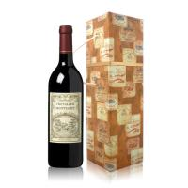
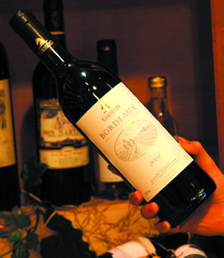
France
Grape wine

Slide 19
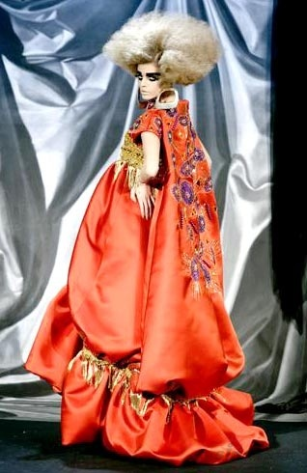
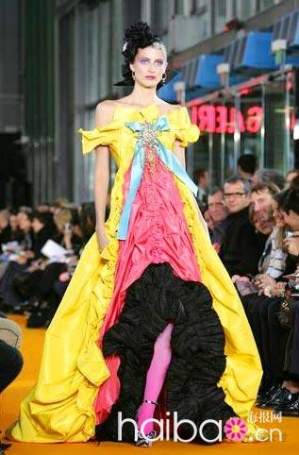
France
Fashion show

Slide 20
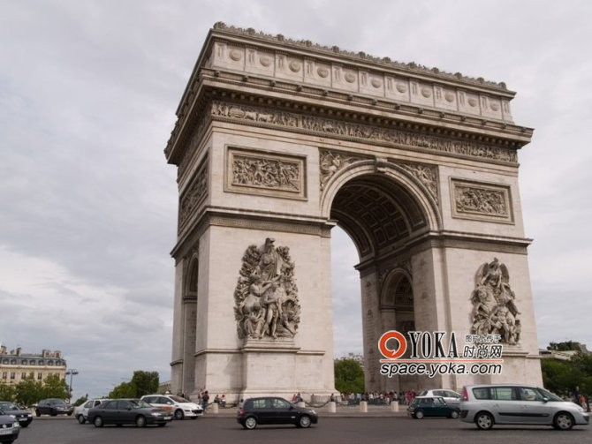
France
The Triumphal Arch

Slide 21
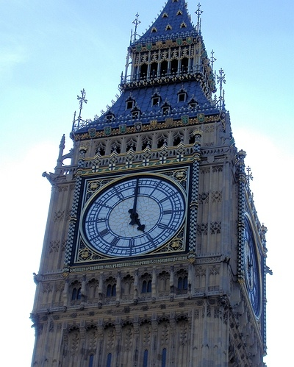
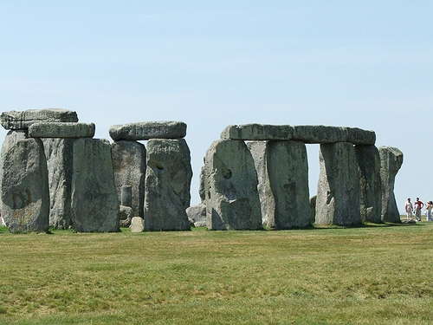
Britain
Big Ben
Stonehenge

Slide 22
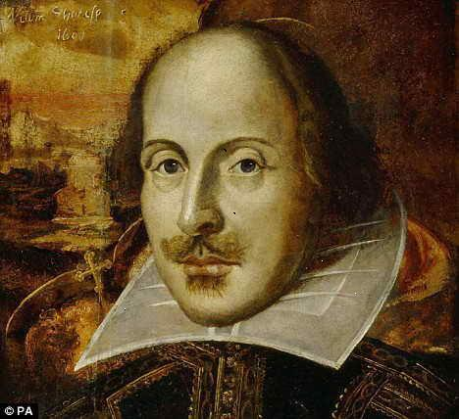
Britain
Shakespeare

Slide 23
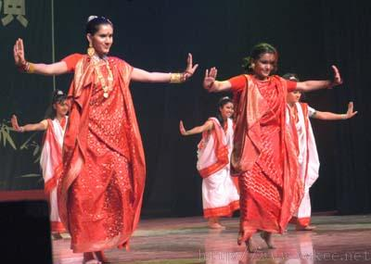
India
dancing

Slide 24
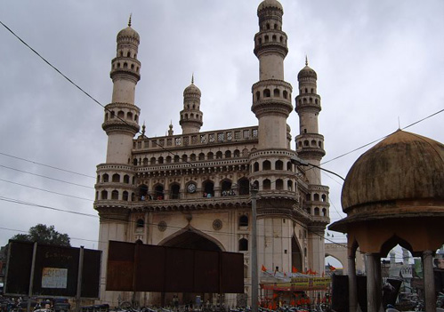
Bollywood

Slide 25
Australia
the Sydney Opera House

Slide 26
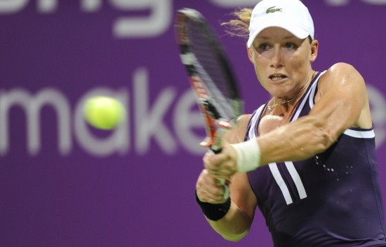
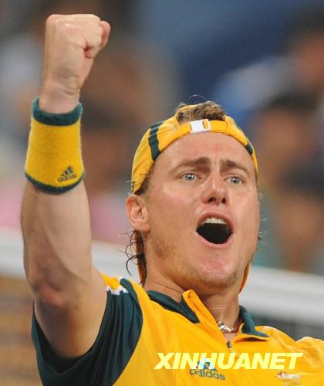
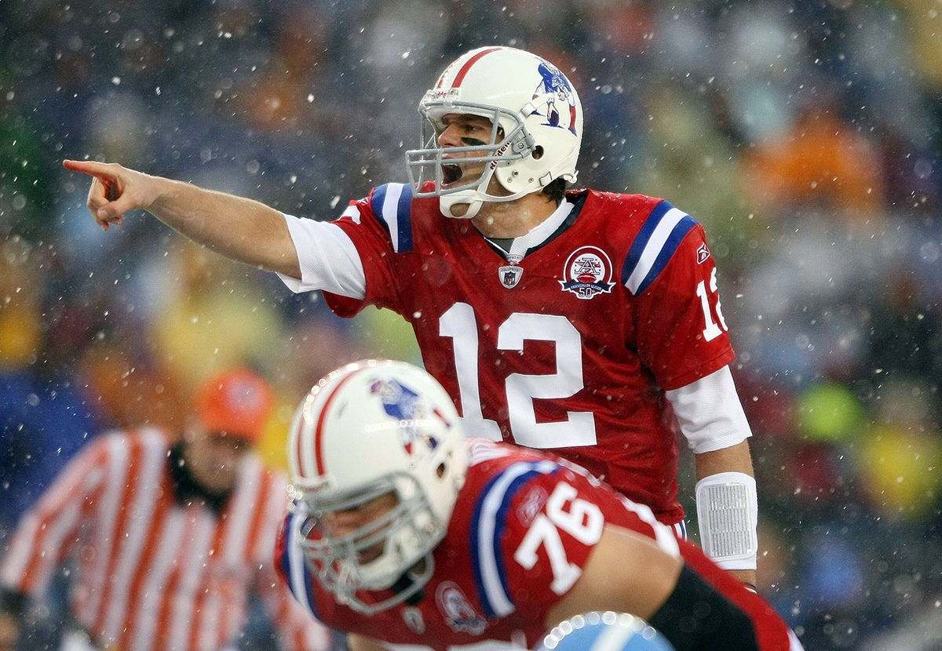
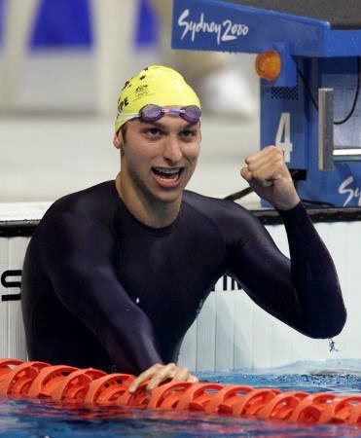
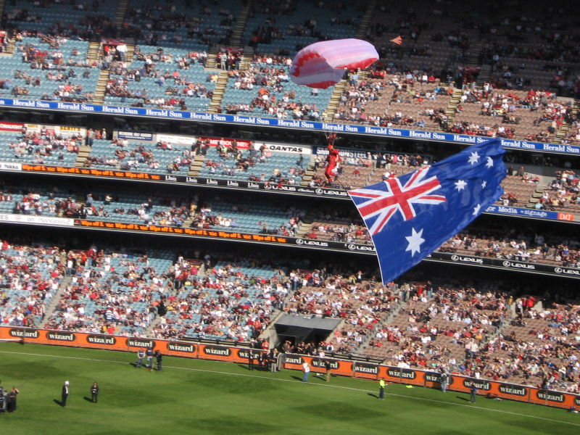
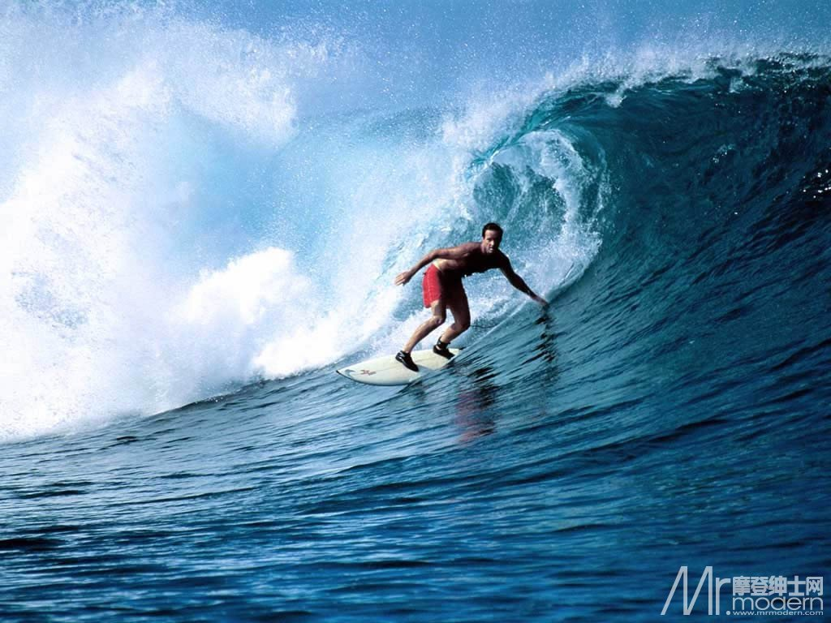
Is Australia really a sporting nation ?

Slide 27
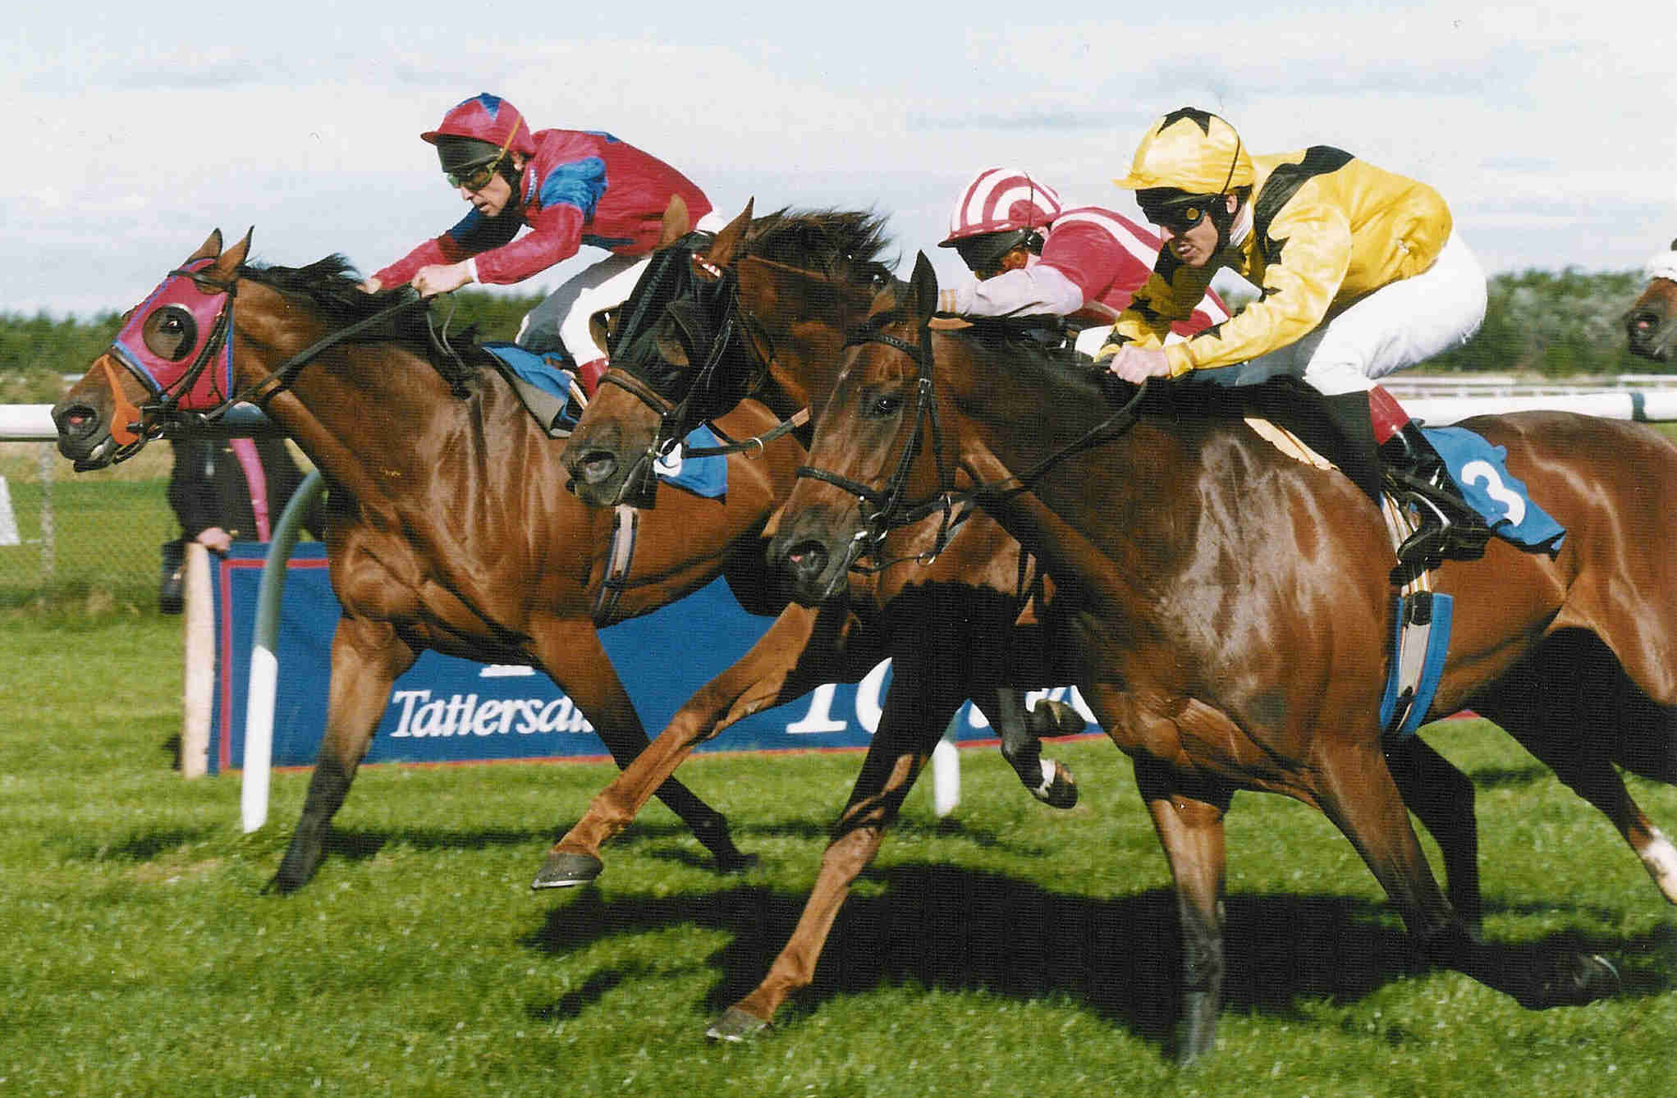
It is indeed a great sporting nation!

Slide 28
赫德森（Hudson，T.，1982）在运用图式理论研究外语教学的实验中，设计了与文章内容相关的图画，用以激活受试者头脑中与文章内容相关的图式，结果表明，引出的图式是阅读理解中的一个重要因素，对理解的作用大于外语能力。

Slide 29
提炼形式图式
“形式图式”也被称作“修辞图式”，主要指读者对 文章的组织形式、篇章结构、体裁风格 等语篇修辞知识的熟悉和掌握；

Slide 30
图式理论--两种基本的信息处理方式 bottom up/ top down
“自上而下”的方式加速信息的吸收与同化，有助于读者消除歧义；当输入的信息有不同解释的时候，帮助我们作出抉择。

Slide 31
分析文体特征

Slide 32
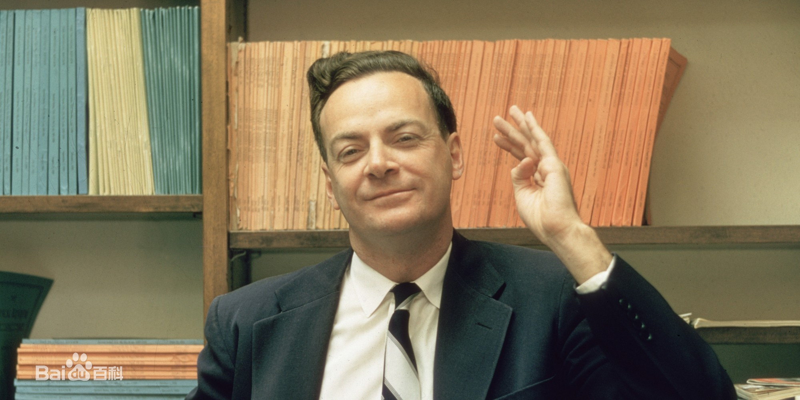
lecture transcript 讲座记录

Slide 33
Lecture transcript
A clear argument: persuasive and motivating
Strict logic: easy to get across to the audience

Slide 34
发现文体特征

Slide 35
Part 1: Paras.1-2 Introduction
– speaker’s experience
Why did Feynman choose “the value of science” as the topic of his lecture?
Because though he was once confused, he is quite clear about the value of science and determined to share it with the public.

Slide 36
the first sentences of the rest paragraphs
→ the main body the lecture
The first way in which science is of value…
The Value of Science
Strict
logic
Another value of science is the …
I would now like to turn to a third value …

Slide 37
writer’s experience
introduction:
a clear argument
a question
an argument
lecture transcript
main body:
strict logic
conclusion

Slide 38
不同文体、不同题材、不同形式

Slide 39
M9U1 Reading
Canada

Slide 40
Brainstorming
What subjects do we often talk about?
population
culture
Size and location
symbol
country
Beautiful scenery
history
major cities
food

Slide 41
Fast Reading
Main idea
Para 1
Size and location
Para 2
Beautiful scenery
Para 3
population
Para 4-7
Major cities
Para 8
Niagara Falls
history
Para 9
Para 10
National symbol
Para 11
conclusion

Slide 42
M9U1 Project
Is Australia really a sporting nation?

Slide 43
Is Australia really a sporting nation?
Para. 1: Nothing ambiguous! Australians’ love for sports is absolute and seems compulsory. Why?
Para. 2: However, most of them don’t do sports themselves. They just ______ sports games.
Para. 3: Still, it is a great sporting nation.
_______：____ climate
________：(Para.4-7): swimming and surfing,
tennis, team sports, cricket
________：(Para.8): … …
Para. 9: Indeed a great sporting nation!→ _________
watch
mild
Reasons
Examples
Statistics
Conclusion

Slide 44
M9U2 Reading The Acropolis

Slide 45
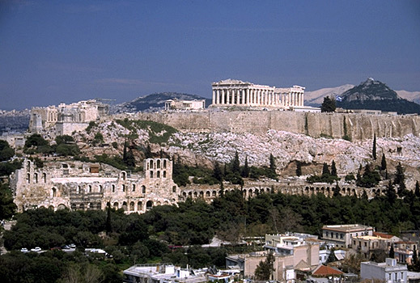
structure:
Greek civilization
Para
1
the Acropolis
Para
2
Damage
3-4
Para
Repair
Para
5-7

Slide 46
Structure of an exposition说明文 about historic sites
Greek civilization
↓
Athens
↓
Acropolis
↓
damage
↓
repair

Slide 47
a mind map of details of the Acropolis
gold-covered statue of Athena
six female statues
smallest
Erechtheum
Athena Nike
the Acropolis
Parthenon
largest
Gold statue of Athena

Slide 48
earth-quake
Mind map
Turks, warehouse, store gunpowder
by nature
2 wars
Italy, explosion
the damage
by man
clumsy repairs
travelers
theft
traffic
an Englishman
cut off, sold, turned over to, shown
smog and acid rain
friction between Greece and Britain

Slide 49
文体特征的快速掌握
→阅读策略的形成
→阅读信心、速度、效果的提升
especially important for
Senior 3 students

Slide 50
扩展语言图式

Slide 51
强大而丰富的语言图式
→ 扎实的英语基础
→阅读能力
→写作水平

Slide 52
观察 - -归纳 —比较 – 领悟 – 扩展已有语言图式
With more knowledge comes a deeper, more wonderful mystery, inspiring one to look deeper still.
1. With the new year came more challenges, inspiring him to work still harder.
突出新年，衔接更紧
2. Around the corner came the next bus, attracting all the waiting passengers immediately.
3. Down the hill came a tiger, frightening all the people nearby.
描写更生动，画面感更强
介词短语+谓语+主语，现在分词短语(结果)

Slide 53
崔允漷：
现在很多课堂看似热闹，但轰轰烈烈的公开课后，还要老老实实把教学内容按传统方式重新教学一遍

Slide 54
崔允漷：
把学习还给学生，把讲授降到最低限度。
语言图式：
理解、观察、总结、比较、领悟
especially useful for
writing

Slide 55
构建全新图式，升华主题意义
→

Slide 56
《课标（2017年版）》：学生对主题意义的探究应是学生学习语言的最重要内容，直接影响学生语篇理解的程度、思维发展的水平和语言学习的成效（教育部，2017）。

Slide 57
《课标（2017年版）》
主题：为语言学习提供范围或语境。
主题意义：个人与文本、个人与他人、个人与自我的积极互动中建构形成的意义。
译林版新教材《前言》：在拓展阅读板块中，学生将通过观点表达等活动，进一步探究主题意义，获得关于该主题的新认识

Slide 58
What’s the value of science to contemporary China?

Slide 59
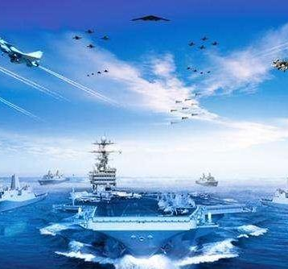
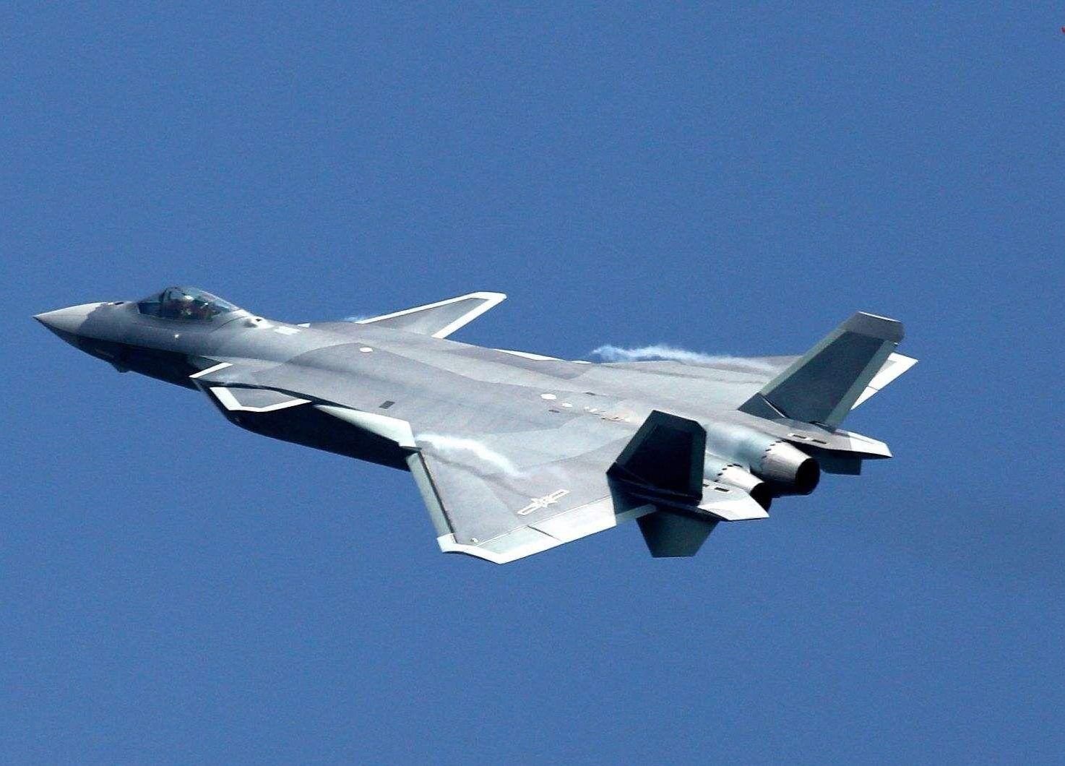
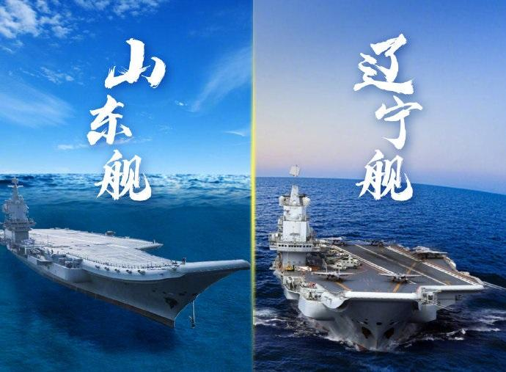
a guarantee for
safe development
Notes:
safely

Slide 60
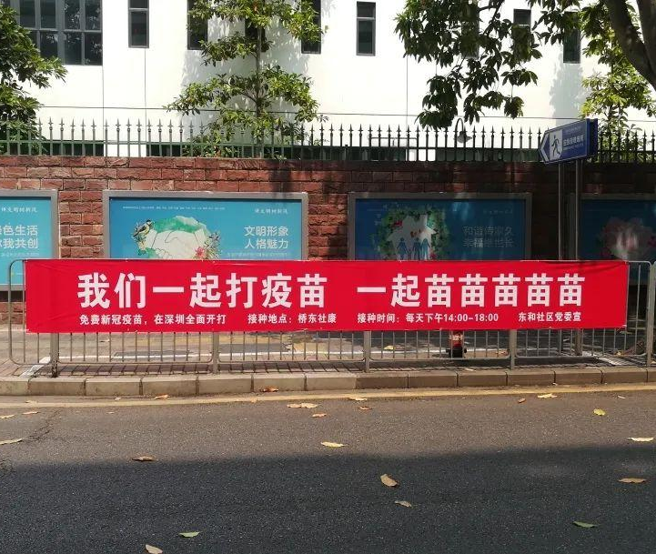
a guarantee for
healthy development
Notes:
healthily

Slide 61
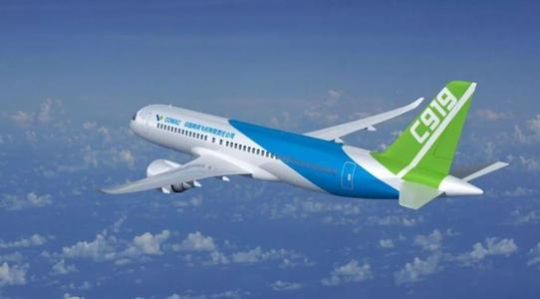
a guarantee for
independent development
Notes:
independently

Slide 62
a guarantee for
sustainable development
Notes:
sustainable

Slide 63
跳出文本
→ 现实世界与时代洪流
→自豪感与使命感升腾
→ 思考科学的价值与自身的关系
→联系学生生活实际
→更好的教学效果

Slide 64
If possible, always relate the material to
your students, and their surroundings.
especially meaningful for
Senior 3 students

Slide 65
新的内容与语言图式融入已有图式
→ 全新图式

Slide 66
应用新建图式 聚焦表达输出

Slide 67
高考写作
应用文 15’+ 读后续写 25’
经常、当堂、限时、片段的训练

Slide 68
Writing 1:
What do you think of after reading the passage?
Requirements:
at least 5 sentences
as many vocabulary and sentence patterns from this lesson as possible
good handwriting

Slide 69
简单：简单到让所有学生都有能力参加
根本：接近学生实际学习与生活的语境
开放：尽可能少地限制学生的活动
有话可写，有话想写，有话能写，人人参与

Slide 70
Writing 2:
Re-describe a scene in the continuous writing you did before, using the sentence patterns.
Requirements:
1. good handwriting

Slide 71
仿写是行之有效的写作方式，它能帮助学生迅速入门（张冠文，2021）。

Slide 72
From between the tissue fell a bank note, giving me quite a surprise.
2. Down the bus went the young man, bare-footed, leaving the other passengers speechless, but thinking a lot.
Below the video were many sincere comments from viewers, instantly changing my mood and moving me to tears.
八省联考
2021常州期末
2021 浙江春季
Notes:
de

Slide 73
作文是可以提高的！

Slide 74
Writing 3:
Describe a scene in your life, using the sentence patterns learned just now.
Requirements:
at least 5 sentences
good handwriting

Slide 75
联系生活，学生更乐意写；
迁移、创新能力！

Slide 76
阅读教学相关图式
1
内容图式
2
形式图式
3
语言图式
4
表达性输出

Slide 77
以上或许很多是老师们已经做或者正在做的，但图式理论为我们提供了理论依据，让我们更有信心接着这样去做。运用图式理论进行语篇教学没有固定的途径和模式，需老师们仔细揣摩，灵活把握。

Slide 78
阅读新授课
阅读讲评课

Slide 79
Believe in yourself!
Stick to your style!
You will make it!

Slide 80
常州市新高考线上研修活动
谢谢观看

