Slide 1
常州市新高考
线上研修活动
2021

Slide 2
常州市新高考线上研修活动
高中英语读后续写评分标准分析
及指导策略分享
讲师团成员：贺惠芬 常州市北郊高级中学

Slide 3
基于2021高考的高中英语读后续写真题的评分标准分析
A MOTHER’S DAY SURPRISE The twins were filled with excitement as they thought of the surprise they were planning for Mother’s Day. How pleased and proud Mother would be when they brought her breakfast in bed. They planned to make French toast and chicken porridge. They had watched their mother in the kitchen. There was nothing to it. Jenna and Jeff knew exactly what to do. The big day came at last. The alarm rang at 6 a.m. The pair went down the stairs quietly to the kitchen. They decided to boil the porridge first. They put some rice into a pot of water and left it to boil while they made the French toast. Jeff broke two eggs into a plate and added in some milk. Jenny found the bread and put two slices into the egg mixture. Next, Jeff turned on the second stove burner to heat up the frying pan. Everything was going smoothly until Jeff started frying the bread. The pan was too hot and the bread turned black within seconds. Jenna threw the burnt piece into the sink and put in the other slice of bread. This time, she turned down the fire so it cooked nicely. Then Jeff noticed steam shooting out of the pot and the lid starting to shake. The next minute, the porridge boiled over and put out the fire. Jenna panicked. Thankfully, Jeff stayed calm and turned off the gas quickly. But the stove was a mess now. Jenna told Jeff to clean it up so they could continue to cook the rest of the porridge. But Jeff’s hand touched the hot burner and he gave a cry of pain. Jenna made him put his hand in cold water. Then she caught the smell of burning. Oh dear! The piece of bread in the pan had turned black as well.
As the twins looked around them in disappointment, their father appeared. _________
The twins carried the breakfast upstairs and woke their mother up. _________

Slide 4
读后续写题型极简解读：
读
写
读是写的基础，要写好续写，首先要读懂、读透，然后要会归纳、会演绎、会用正确优美的语言生动得讲故事。

Slide 5
读
What to pick from the given story?
故事的基本要素
who where when what why how

Slide 6
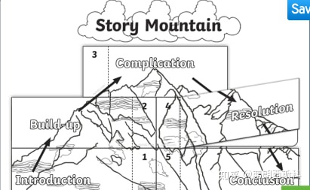
信息梳理
常用演示手法

Slide 7
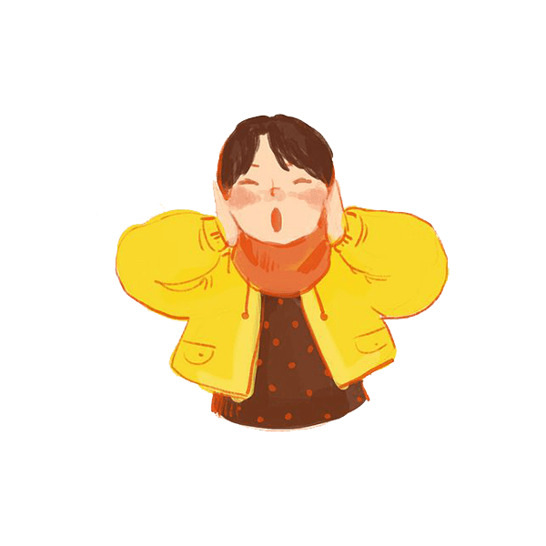
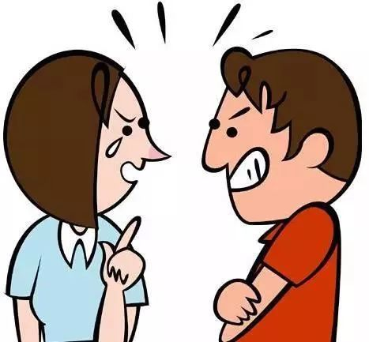
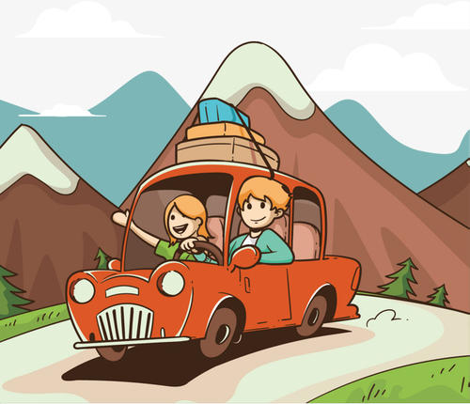
Step 2
But no more helicopters came and it was getting dark again.
P1
Mapping
P2
It was daybreak when Jane woke up.
可以引起更多兴趣的图示法
Tom
（图文无关））
Jane

Slide 8
最简单的关键词列表法或箭头推进演示
情节的发展过程
Information 1
Jeff and Jenny
planned to make breakfast for Mom on Mother’s Day （P1)
It went smoothly in the beginning (P2)
But it turned out a mess (p3)
抛出一个问题
让写作者去解决一个问题，通常也会伴随着情绪的变化
注意情绪的变化或发展
Information 2
How pleased and proud Mother would be when they brought her breakfast in bed.
这篇文章里面开篇提到的情绪有特别意义，给读者或者写作者一个暗示或者提示：为什么妈妈会感到开心且自豪？
孩子的成长，懂事儿。growth, grow up这个对于文章最后进行恰当合理的升华非常重要。

Slide 9
Information 3
As the twins looked around them in disappointment, their father appeared. ________________ The twins carried the breakfast upstairs and woke their mother up. __________________________
有问题的时候，爸爸出现了。
故事发生在楼上，妈妈还没起床，但是被他们叫醒了
读
→
写
What to include in your story?
P1：爸爸帮助解决了问题 （了解情况--提供帮助--解决问题）
P2：妈妈的反应--孩子们的反应--（享受早饭）--感悟

Slide 10
How to write?
作文评价的三个维度：内容、语言和结构（篇章结构、逻辑、续写完成度、内容、语法和词汇)
五档 （21-25）
--创造了丰富的内容和情节，续写完整，逻辑合理，与原文融洽度高
--应用了多样且恰当的词汇和语法，可能有个别错误，但是完全不影响理解
--有效得使用句间衔接和上下文过渡
四档（16-20）
--创造了比较丰富的内容和情节，续写比较完整，与原文融洽度较高，逻辑合理
--应用了较为多样且恰当的词汇和语法，有少量错误但是不影响理解。
--比较有效得使用句间衔接和上下文过渡
三档 （11-15）
--续写基本完整，逻辑较为合理，与原文有些许脱节
--使用简单的词汇和句型，有少量错误，但是基本不影响理解
--使用简单的句间衔接和上下文过渡
二档 （6-10）严重脱节，简单的词汇和句型，有很多错误，几乎没有使用上下文过渡和衔接
一档（1-5）使用了简单的词汇和句型，错误非常多，严重影响理解，与原文情节基本无关或逻辑严重不合理，或有部分抄袭

Slide 11
内容
凡是符合这个大框架的就算是逻辑合理，至于细节可以各自适当发挥
1、逻辑合理
P1：爸爸帮助解决了问题 （了解情况--提供帮助--解决问题）
P2：妈妈的反应--孩子们的反应--（一起享受早饭）--感悟
孩子主动告知计划
爸爸主动询问情况
孩子啥都没说爸爸看了厨房的样子和他们的表情知道今天是母亲节猜到了孩子的计划
父亲了解情况
父亲提供帮助
父亲打下手，孩子重新做饭
父亲帮助孩子做早饭，孩子打下手
父亲觉得早饭做成啥样没关系，关键有这份心，鼓励孩子直接端上去给妈妈

Slide 12
内容
影响高分的问题
2. 与原文融洽度高
这不是电影剪辑镜头可以来来回切换
除非有明确的表示回忆这样的词作提示
2020高三期中全市联考
What made it more difficult was that I knew this was not the first time I had let such a moment pass.
充分关照到原文的背景设置
本文写作常见类型
与原文细节不冲突
1） Mother’s Day----- Birthday （小问题）
2) P1 第一句写了爸爸跑进厨房 （中问题）
3） P2第一句写了Jeff and Jenny把早餐藏起来，喊，妈妈，快起床！（中问题）
4） P2第一句写了妈妈来到楼下，发现了摆在桌子上的早餐 （大部分都是因为没读懂upstairs）（大问题）
5）第一段只写了爸爸，或者只写了twins (大问题)
6）把做粥和面包变成了做煎饼或者外面去买吃的回来（不算问题）

Slide 13
内容
冲淡主题/主要情节
情节要简单，描述要生动
一段解决一个问题
3. 丰富的内容和情节≠ 绕、
≠废话
≠ 曲折
≠复杂
Show rather than tell.
Don’t tell me! Show me!
人物的互动、对话、独白、表情、动作、环境、心情等等的描写
eg. felt surprised
clapped her hands over her mouth
不要干巴巴的陈述

Slide 14
Father helped them and the breakfast was done soon.
With father giving a helpful hand, the twins eventually made the breakfast ready, an inviting smell floating in the morning air.
Father’s inspiring smile lifted the twins’ spirits up. Jeff wasted no time in toasting another piece of bread while Jenny carefully cooked the rest of the porridge after cleaning up the mess.
细节
Mum felt so happy that she couldn’t hold back her tears.
Never had Mum imagined that her children would give her
such a surprise gift on Mother’s Day. Tasting the porridge, she
could no longer contain her emotions.

Slide 15
eg. 有画面感的描述 （extracted from HARRY POTTER)
It was nearly midnight, and he was lying on his front in bed, the blankets drawn right over his head like a tent, a torch in one hand and a large leather-bound book ( A History of Magic, by Bathilda Bagshot) propped open against the pillow.

Slide 16
内容
4. 恰当的结尾
1) 普通结尾 享用早餐
2）爸爸拍了一张照片记录这个美好瞬间
3）更好结尾有升华或感悟，但必须要符合文本内容，必须能从故事中得到的启示或感悟
鸡汤不能偏离主题
* The greatest love in the world is maternal love.
* It’s mother’s love that makes the world go round.
* It is love that helps us overcome the obstacles in life.
* It is love that makes the family bond tighter.
* It is this experience that makes the children learn to appreciate parents’ devotion.
结尾的感悟要具体一点，不要太泛
结尾扯的太远，比如爸爸拍照上传到网上引发很多反响属于与原文融洽度不高

Slide 17
续写完整
有效的句间衔接和上下文过渡
内容比例的分配合理
结构
有效的句间衔接不一定要通过however, but, so这样的明确表示逻辑的过渡词，恰当得运用状从、非谓语结构等都可以实现。
The twins felt depressed. Their ather burst into laughter.
Seeing the obvious depression in the twins’ eyes, their father burst into laughter uncontroallably before he offered a hand.
有效的句间衔接就是要拒绝简单的词汇、句子的拼凑和堆砌
P1尾句跟P2所给首句的有效过渡和衔接
The breakfast was done/ finished. (一般，凑合）
When the breakfast was finally done, father signed to them to send it upstairs. （不错）
The breakfast was done. The twins, looking more than satisfied, couldn’t wait to present the gift to their Mum. （非常好）
Eventually the breakfast was ready and now, it was the moment! （哎哟不错哦）
大问题
第一段花费很多笔墨去描写爸爸怎么帮助他们包扎甚至去医院，他们在跟爸爸说明情况的时候怎么样的难过，紧张，懊恼，最后做饭的过程写不下了，就一句话搞定。第二段有些人写了很多环境描写，阳光，风，窗外的小鸟，写母亲跟孩子的反应相对少。
内容比例的分配合理就是指要么两段字数相差太多，或者主次不够明确，主要内容太少，无关情节太多，导致故事节奏拖沓。

Slide 18
语言
词汇、句型表达的多样性、恰当性和正确性
五档 （21-25）
--创造了丰富的内容和情节，续写完整，逻辑合理，与原文融洽度高
--应用了多样且恰当的词汇和语法，可能有个别错误，但是完全不影响理解
--有效得使用句间衔接和上下文过渡
四档（16-20）
--创造了比较丰富的内容和情节，续写比较完整，与原文融洽度较高，逻辑合理
--应用了较为多样且恰当的词汇和语法，有少量错误但是不影响理解。
--比较有效得使用句间衔接和上下文过渡
三档 （11-15）
--续写基本完整，逻辑基本合理，与原文情节有些许脱节
--使用简单的词汇和句型，有少量错误，但是基本不影响理解
--使用简单的句间衔接和上下文过渡
二档 （6-10）严重脱节，简单的词汇和句型，有较多错误，几乎没有使用上下文过渡和衔接
一档（1-5）使用了简单的词汇和句型，错误非常多，严重影响理解，与原文情节基本无关或逻辑严重不合理，或有部分抄袭

Slide 19
词汇和句型比较丰富才有可能往四档以上打
套句可以使用，鼓励学以致用，但是要用的恰当
不在乎大家都用这个表达，但是要注意用的时机、场合、人物身份等
pluck up one’s courage
用了恰当的高级的词汇和句型就一定能得高分吗？
孩子鼓足勇气重新做饭
爸爸鼓足勇气帮助他们做饭
爸爸的脸是pink red
当爸爸知道了孩子们的计划后couldn’t utter a single word
同一个意思的不同表达重复堆砌，反复写，导致节奏拖沓，啰嗦

Slide 20
语言的正确性至关重要！
典型案例：
一个学生故事内容非常好，用的语句和词汇乍看也非常高级，不是那种特别背的，有用好句的意识，但是：几乎每一句都有错，而且很多都是动词错误。
还有一个学生故事内容也不错，用了一些句型，句型和词汇不是很复杂，但是几乎没有错
评分是怎样的呢？

Slide 21
错误的类型！
少量的拼写错误或偶然的语序错误
搭配或动词错误
大量堆砌的词组或单词（没有连接）
非谓语表达的运用错误最典型最可怕最多！

Slide 22
影响得分的其它因素：
1. 字数低于120酌情扣分，不设上限
2. 书写差的酌情扣分，以是否影响理解为依据
3. 写成全对话形式看内容表达完成度再酌情扣分，原则上不降档，跟高分肯定无缘
4. 人称问题分情况：如果是he, she搞错了算小问题，几乎可以忽略，但是如果在文章中出现了we这样的，那就属于跟原文不融洽，从第三者/旁观者视角变成当事人视角是不可以的

Slide 23
读后续写指导策略
The nurses, complaining about working Christmas, turned to sympathy for the homeless family. It was only a split second later that we came up with a brilliant idea of a special Christmas party.
1. 归纳大意
2. 首句衔接
3. 沉浸 注意
4. 范文导引
5. 词块积累
6. 语言纠正
7. 一稿多写
让学生沉浸阅读两个文本，即原文和续写段落，让学生通过反复阅读自己去注意到这个题型的特点和要求，注意到参考范文里的词句表达，然后自己去总结该怎么完成这样一个写作任务，而不是以讲代悟，限制了学生的主动学习。
I was stuck for five or six minutes though it felt much longer. My heart pounded thunderously against the mounting tension in the air.

Slide 24
常州市新高考线上研修活动
谢谢观看

