Slide 1
常州市新高考
线上研修活动
2021

Slide 2
常州市新高考线上研修活动
动静结合，提升学生读后续写语言表达技能
讲师团成员：刘欢 江苏省华罗庚中学

Slide 3
What caught my attention?
一评：14
二评：19
仲裁：23
什么样的文章值得高分？
高级（词汇、语法结构）表达

Slide 4
1. 高级表达=高分？
2. 什么样的表达算高级？
3.如何创造高级的表达？

Slide 5
1. 高级表达=高分？
明确读后续写的评分标准
评分: 先根据整体情况对文章进行定档，然后依据该档的相应要求来确定或调节档次，最后打分。打分主要从续写内容、词汇语法、篇章结构三方面考虑。
1.创造情节的质量、续写的完整性及与原文情境的融洽度。
2.词汇、语法的准确性、恰当性及多样性。
3.上下文的衔接和全文的连贯性。

Slide 7
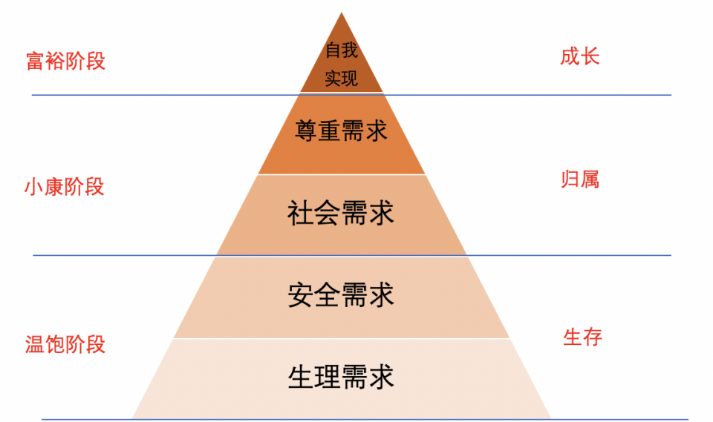
Language
高级
Plot
Theme
低级

Slide 8
2016年10月高考读后续写
阅读下面短文，根据所给情节进行续写，使之构成一个完整的故事。
One weekend in July, Jane and her husband, Tom, had driven three hours to camp overnight by a lake in the forest. Unfortunately, on the way an unpleasant subject came up and they started to quarrel. By the time they reached the lake, Jane was so angry that she said to Tom, “I’m going to find a better spot for us to camp” and walked away.
With no path to follow, Jane just walked on for quite a long time. After she had climbed to a high place, she turned around, hoping to see the lake. To her surprise, she saw nothing but forest and, far beyond, a snowcapped mountain top. She suddenly realized that she was lost.
“Tom!” she cried. “Help!”
No reply. If only she had not left her mobile phone in that bag with Tom. Jane kept moving, but the farther she walked, the more confused she became. As night was beginning to fall, Jane was so tired that she had to stop for the night. Lying awake in the dark, Jane wanted very much to be with Tom and her family. She wanted to hold him and tell him how much she loved him.
Jane rose at the break of day, hungry and thirsty. She could hear water trickling (滴落) somewhere at a distance. Quickly she followed the sound to a stream. To her great joy, she also saw some berry bushes. She drank and ate a few berries. Never in her life had she tasted anything better. Feeling stronger now, Jane began to walk along the stream and hope it would lead her to the lake.
As she picked her way carefully along the stream, Jane heard a helicopter. Is that for me? Unfortunately, the trees made it impossible for people to see her from above. A few minutes later, another helicopter flew overhead. Jane took off her yellow blouse, thinking that she should go to an open area and flag them if they came back again.
But no more helicopters came and it was dark. _________________________________
It was daybreak when Jane woke up. _________________________________________
Theme: Despite their quarrel, love still exists. 吵闹但不离不弃
Plot: 结局直升机救援，又累又饿又委屈的妻子晕倒在陌生的救援人员怀里，丈夫失踪？
Plot: 远远地看到直升机飞过，妻子大喊一声，飞机上的丈夫听到喊叫声，飞下来相拥而泣？

Slide 9
提升语言表达的前提
把握故事主旨，设计合理情节
Language
Plot
Theme

Slide 10
2. 什么样的表达算高级？
误区：
复杂的句型和词汇等于高级表达
简单的词汇和句型写不出漂亮的故事

Slide 11
复杂的句型和词汇等于高级表达？
评分档次 | 描 述
（22-25分） 优秀档 | ①创造了新颖、丰富、合理的内容，富有逻辑性，续写完整，与原文情境融洽度高。 ②使用了多样且恰当的词汇和语法结构，表达流畅，语言错误很少，且完全不影响理解。 ③自然有效地使用了段落间、语句间衔接手段，全文结构清晰，前后呼应，意义连贯。
______________

Slide 12
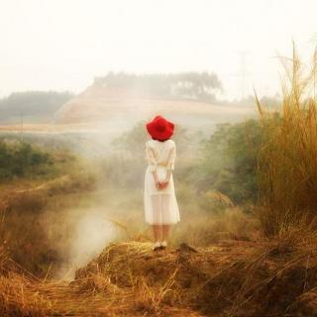
简单的词汇和句型写不出漂亮的故事？
But you didn't

Slide 13
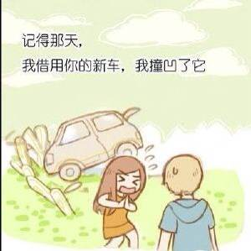
Remember the day I borrowed your brand new car and dented it?
I thought you'd kill me, but you didn't.

Slide 14
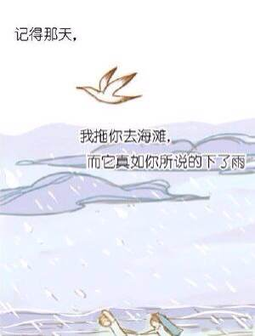
And remember the time I dragged you to the beach, and you said it would rain, and it did?
I thought you'd say, "I told you so." But you didn't.

Slide 15
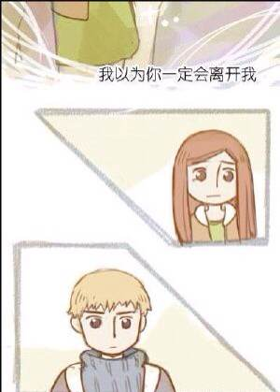
Do you remember the time I flirted with all the guys to make you jealous, and you were?
I thought you'd leave, but you didn't.

Slide 16
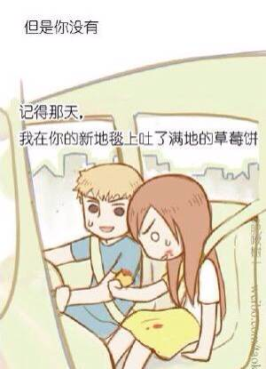
Do you remember the time I spilled strawberry pie all over your car rug?
I thought you'd hit me, but you didn't.

Slide 17
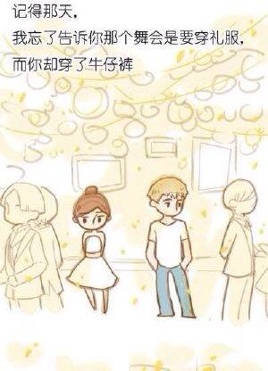
And remember the time I forgot to tell you the dance was formal and you showed up in jeans?
I thought you'd drop me, but you didn't.

Slide 18
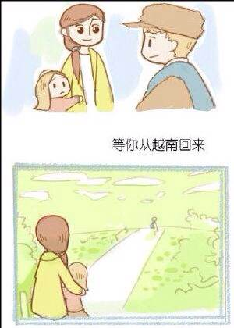
Yes, there were lots of things you didn't do.
But you put up with me, and loved me, and protected me.
There were lots of things I wanted to make up to you when you returned from Vietnam.
But you didn't.

Slide 19
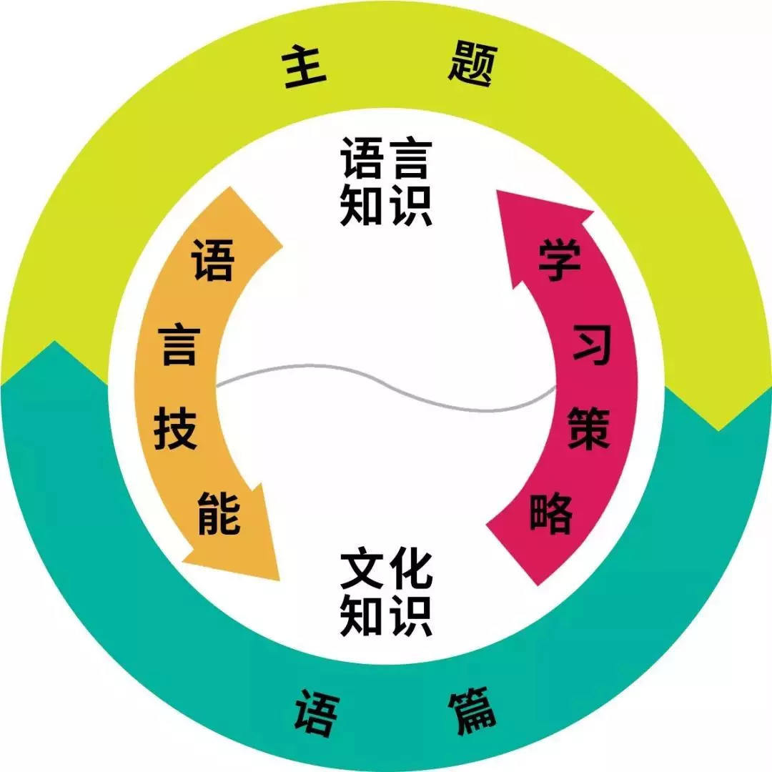
3.如何创造高级的表达？
构建语料库
人与自我
背诵、积累
人与社会
应用
人与自然
以主题为引领，以语篇为依托

Slide 20
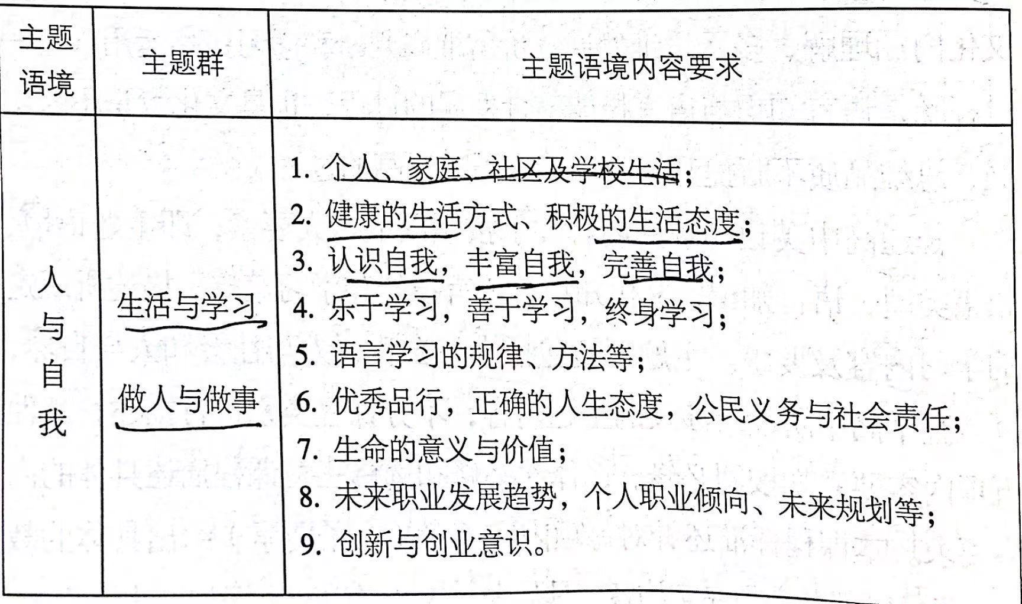

Slide 21
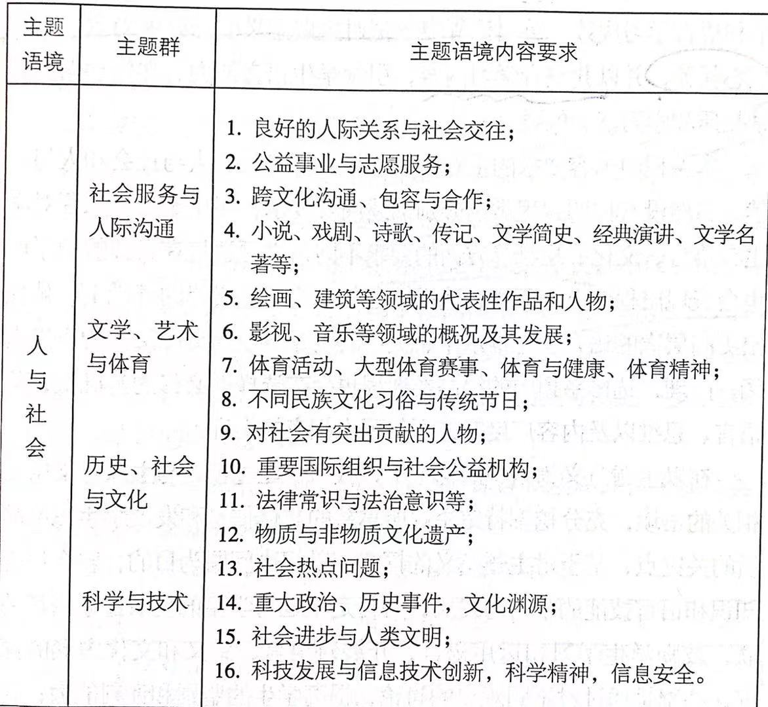

Slide 22
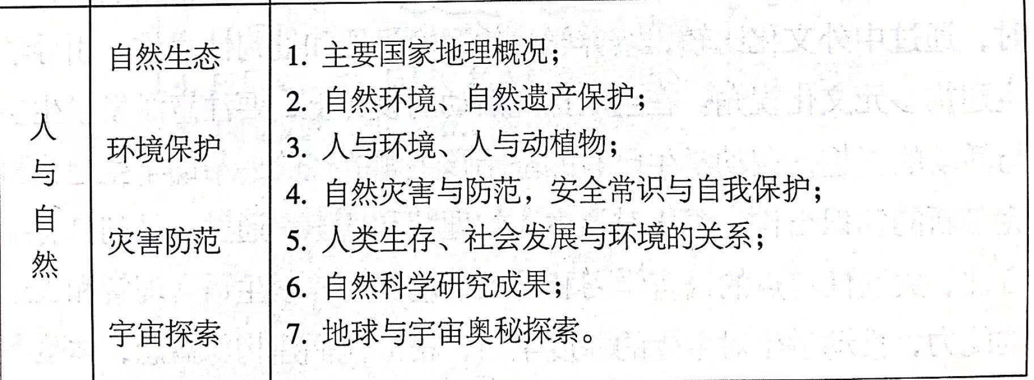

Slide 23
课堂实例
动静结合，以活用动词使续写故事更生动的片段写作教学设计为例
《课程标准》在高中英语选修课程部分对书面表达要求学生在词汇知识方面要深度学习词语，在表达各种信息时提高词语使用的准确性和丰富性，在特定的语境中，有效运用同义词、近义词、反义词，正确理解和确切表达比较复杂的主题意义和观点。在语言技能方面要求学生能通过书面方式再现想象的经历和事件，借助词语和句式形象地传递自己的思想和情感，使用特殊词汇和语法进行创造性的表达。
场景化、片段化

Slide 24
教学目标
1.分析对比文本，了解动静结合的描写可以使得续写故事更富画面感，更加生动；
2.运用丰富、准确的动词生动描述各种场景；
3.运用动静结合的生动描写，使得故事更加引人入胜。

Slide 25
教学步骤
Scene---A vain businessman helped an old woman:
A vain businessman felt offended by those talking without acting and reached into his wallet. He took out a 50-dollar check, walked straight to the lady, and said, “Madam, please take the money and buy yourself a pair of warm winter boots.”
A vain businessman felt offended by those talking without acting and reached into his wallet. He headed for the old woman proudly, handed her a small amount of money and waited for the "Thank you" he wanted to hear. After the old woman said so, he turned around with a smile playing around his mouth and stepped back quickly to prevent the woman from making his fancy suit dirty.
摘自期初考试学生考场作文实例

Slide 26
板书设计
Continuation writing------An appealing story
What?------vivid descriptions
Why?------picture the scene
How?------?

Slide 27
如何写出生动故事？-------动态描写入手
Scene---A vain businessman helped an old woman:
A vain businessman felt offended by those talking without acting and reached into his wallet. He headed for the old woman proudly, handed her a small amount of money and waited for the "Thank you" he wanted to hear. After the old woman said so, he turned around with a smile playing around his mouth and stepped back quickly to prevent the woman from making his fancy suit dirty.

Slide 28
都是帮助，场景不同，如何下手？

Slide 29
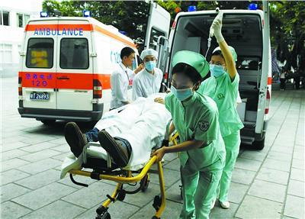
Scene1---A medical intern(实习医生) helped a boy:
Fill in the blanks with verbs
Suddenly, a boy fell off the back of the bus. He hit the road face down and rolled over. He lay still in the middle of the road as the bus sped away. None of the cars behind stopped. Thinking that he could die in a matter of minutes, I stopped my car and carefully _________ the boy. With the help of some passers-by, I ________ the unconscious boy into the car and _______ back to the hospital. After his family was contacted, and he was ________ into emergency surgery, I drove home, exhausted but happy.
examined
lifted
raced
wheeled
Attention: Specific and accurate verbs that sound natural are preferred!

Slide 30
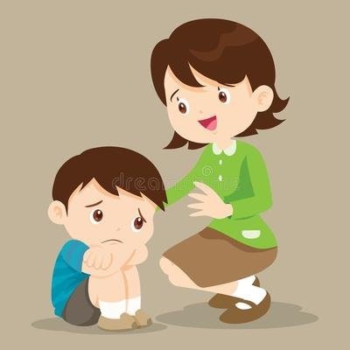
Scene2 : Mrs. Lim comforted a boy
Use specific, and accurate verbs to express “say”:
“I know how you feel,” Mrs Lim gently , as if she could read Jonah's mind. Jonah was surprised as he had not expected a total stranger to sense his loneliness. Mrs. Lim ________, “I can see it in your face. You look lonely.” Jonah ______, not knowing what to do next. “Just say hello to someone today,” she __________, “I promise they'll respond. Once you've made the first move, it just gets easier.”
whispered
added
sighed
encouraged

Slide 31
Scene3: Henry rescued his classmate Robert
Write 2-3 sentences with specific and accurate verbs to show how Henry saved Robert.
Robert was fast sinking. It seemed as if Robert would be drowned. Just at the moment, Henry, who won the gold medal for swimming last month, happened to be passing by. ___________________________________________
_____________________________________
______________________________________

Slide 32
Check
Did he/she avoid any grammatical mistakes?
Did he/she use various and specific verbs to describe the scene?
Are the verbs accurate and natural?
Are there better verbs to replace them?

Slide 33
Hearing the scream, Henry ran to the riverside, took off his clothes and jumped into the water without hesitation. He reached Robert just as he was sinking the last time. With great effort and with much danger to himself, he brought Robert to the shore.
Hearing the scream, Henry rushed to the riverside, threw off his clothes and plunged into the water without hesitation. He reached Robert just as he was sinking the last time. With great effort and with much danger to himself, he dragged Robert to the shore.

Slide 34
如何写出生动故事？-------动态描写入手
accurate
specific
natural
actions
verbs

Slide 35
如何写出生动故事？-------动静结合
Scene---A vain businessman helped an old woman:
A vain businessman felt offended by those talking without acting and reached into his wallet. He headed for the old woman proudly, handed her a small amount of money and waited for the "Thank you" he wanted to hear. After the old woman said so, he turned around with a smile playing around his mouth and stepped back quickly to prevent the woman from making his fancy suit dirty.

Slide 36
Types of static descriptions
The young woman in the picture has a face that resembles my own in many ways. Her face is a bit more oval than mine, but the softly waving brown hair around it is identical.
A sense of guilt and shame swallowed Jenny. Her mind was in a mess. Would Gwen forgive her? Would she ever talk to her again?
It was dreadfully cold; it was snowing fast, and was almost dark, as evening came on--- the last evening of the year. In the cold and the darkness, there went along the street a poor little girl, bareheaded and with naked feet.
appearance description
psychological description
environmental description

Slide 37
如何写出生动故事？-------动静结合

Slide 38
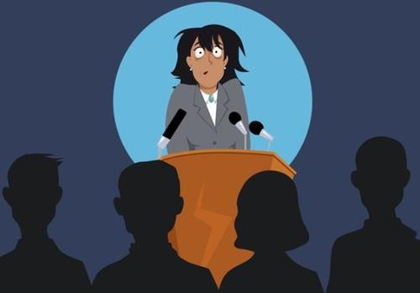
Scene4: You are in the preparation room. You are about to give a public speech in front of a large crowd. Write 2-3 sentences to show your nervousness.
Ten minutes later, I would be standing and talking in front of the whole class. ________
________________________________________

Slide 39
Check
Did he/she avoid any grammatical mistakes?
Did he/she use various and specific verbs that are natural and accurate?
Did he/she combine dynamic descriptions with static descriptions?

Slide 40
Ten minutes later, I would be standing and talking in the front of the whole class. Looking through the window at the trembling trees in the strong wind, the bitter and painful memory of my first English speech came back to me once again. I was consumed with anxiety and tension. My legs were trembling and my face was burning. I felt like giving up.

Slide 41
Bonus
A wave of warmth overtook the woman.
A wild gaiety (快乐) took hold of her.
A feeling of panic seized her．
Anxiety tore her into pieces．
His heart is overflowing with joy．
I could feel anger boiling up inside me．
Smile spread across his face.
He stood up, hugged his parents, and smiled, trying not to let his emotions get the better of him.
Sitting at the comer of arena, Androcles was overcome by a strong sense of fear and despair, with his heart beating wildly.
少而精
追求基于自身基础和水平的优质表达

Slide 42
Scene :A couple, Jane and Tom, had a quarrel. Jane got lost in the forest.
1. Describe Jane's feelings (fear/regret) with 2-3 sentences.
But no more helicopter came and it was getting dark again. ____________________________________
_________________________________________.
2. Describe what Jane did to get saved with 2-3 sentences.
Fortunately, a helicopter flew overhead just at that moment.___________________________________
___________________________________________

Slide 43
读后续写
Language
Plot
Theme
以主题为引领，以语篇为依托

Slide 45
常州市新高考线上研修活动
谢谢观看

