Slide 1
常州市新高考
线上研修活动
2021

Slide 2
常州市新高考线上研修活动
读后续写
关注续写前的有效阅读
讲师团成员：汤志琴 常州市金坛第一中学

Slide 3
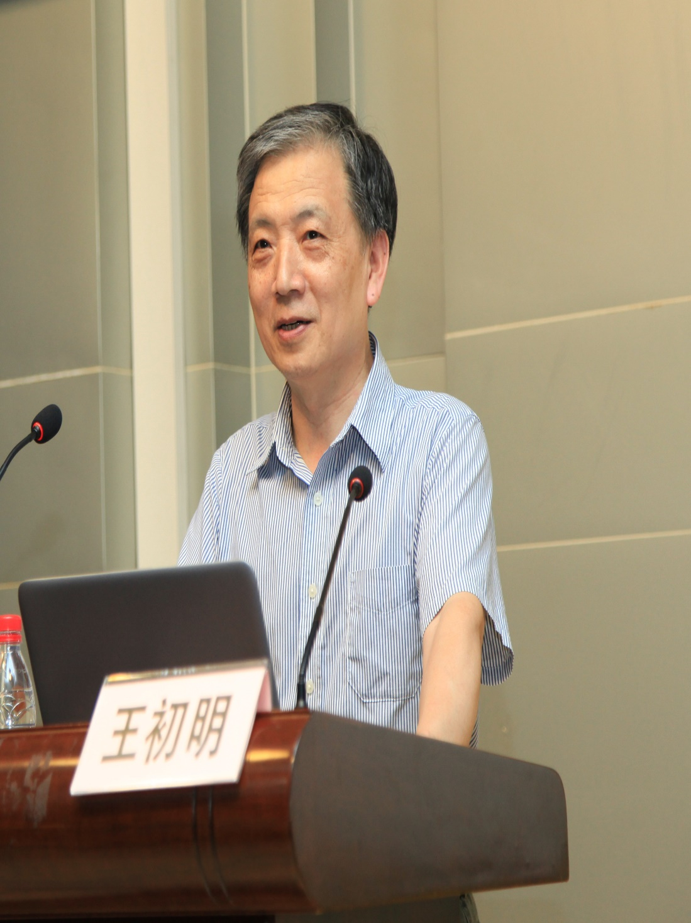
《读后续写何以有效促学》
《以“续”促“学”》
《高考英语“读后续写”题的促学功能》
《从“以写促学”到“以续促学”》
《如何提高读后续写中的互动强度》

Slide 4
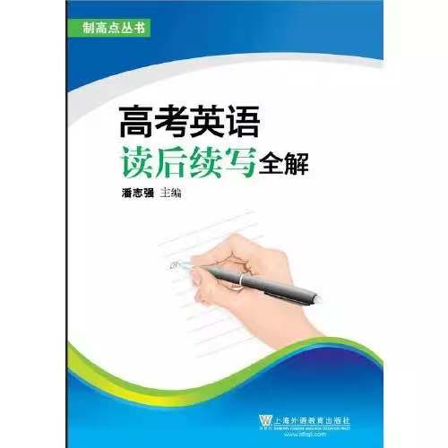
带着枷锁跳舞
明线 暗线

Slide 5
读下面材料，根据其内容和所给段落开头语续写两端，使之构成一篇完整的短文。
1. Mike licked the last of the mint chocolate chip ice cream. It was almost time to leave. He jumped into the car with his parents and headed off to the Olympic-sized pool for the big swim meet.
2. When his race came up, Mike was confident. He was strong and swift. Mike climbed out the pool, smiling. He had just won first place, making him the fastest boy in his age group.
3. "Congratulations, son," his father said. His mom gave him a hug, even though he was soaking wet.
4. A week later, it was time for another swim meet. Like before, Mike decided to enjoy his favorite ice cream flavor. Mike remembered that the last time he had won a race, he also ate mint chocolate chip ice cream first. Maybe he'd win again.
5. He’s taken first place again in his race. Mike was feeling pretty good. As it turned out, Mike decided to have some mint chocolate chip Ice cream before every one of the next few swim meets. He began to think of it as his lucky charm. After several months of placing in the top positions of every race he swam, Mike was feeling unbeatable. And he wouldn’t admit it, but all that ice cream was adding a few pounds to his athletic swimmer's build.

Slide 6
6. It didn’t take long after that for Mike to start coming in second place-and then third-and then last place in his races. The lucky mint chocolate chip ice cream had lost its magic.
7. On the day of his next swim meet, his mother sat down at the table with him. “Mike, we all love ice cream, but it's not healthy for your body to eat so much of it. Maybe it's time to stop the sweet treats for a while, especially before you go swimming.
8. Mike unwillingly agreed. He went to the swim meet, and didn’t perform well. His father offered to go running with him a few days a week to help him feel better and strengthen his muscles. The extra weight soon disappeared, and Mike found himself breathing easier at swim practices.
9. It was the last meet of the season, and Mike wasn’t sure what to expect.
10. He felt healthy again, but he didn’t know if he still had any speed in the pool.
11. Paragraph 1 :
As he drove into the water, he kicked his legs and stretched his arms as far as he could.
12. Paragraph 2 :
His jaw dropped as he realized he had beaten his own best time ,and everyone else too.

Slide 7
目 录
1
有效阅读之内容
2
有效阅读之方法
有效阅读之建议
3

Slide 8
有效阅读之内容
1. 读写作顺序
2. 读记叙文要素
3.定位关键词，读懂段首句

Slide 9
有效阅读之内容
读写作顺序
读记叙文六要素
定位关键词， 读懂段首句
先发生的先说，后 发生的后说，“先来后到”原则
顺叙
插叙
倒叙
补叙

Slide 10
有效阅读之内容
读写作顺序
读记叙文六要素
定位关键词， 读懂段首句
Para 4. A week later, it was time for another swim meet.
Time
Order
Para 5. After several months of placing in the top positions of
every race he swam, Mike was feeling unbeatable.
Para 6. It didn’t take long after that for Mike to start coming in
second place-and then third-and then last place in his races.
Para 7. On the day of his next swim meet, his mother sat down at
the table with him.

Slide 11
有效阅读之内容
读写作顺序
读记叙文六要素
定位关键词， 读懂段首句
地点
经过
时间
人物
结果/主题
Swimming pool
行为变化
&
情绪变化
Mike
His parents
起因

Slide 12
有效阅读之内容
读写作顺序
读记叙文六要素
定位关键词， 读懂段首句
lick（第1段）；won（第2段）；enjoy（第4段）；
swam（第5段）；agree, perform（第8段）
行为变化
&
情绪变化
ice cream & performance
confident(第2段）； unbeatable(第5段)；pretty good(第5段)； unwillingly (第8段)
Is the ice cream a lucky charm?
What leads to Mike’s success in swimming?

Slide 13
有效阅读之内容
读写作顺序
读记叙文六要素
定位关键词， 读懂段首句
ice cream
parents
pool
won
perform
healthy
magic
race
As he dove into the water, he kicked his legs and stretched his arms as far as he could.
比赛过程（动作描写）
心理活动
Mike’s jaw dropped as he realized he had beaten his own best time and everyone else’s too.
唯一性 方向性
关键词 (关键内容，
情感、逻辑等）
续写第一段
续写第二段

Slide 14
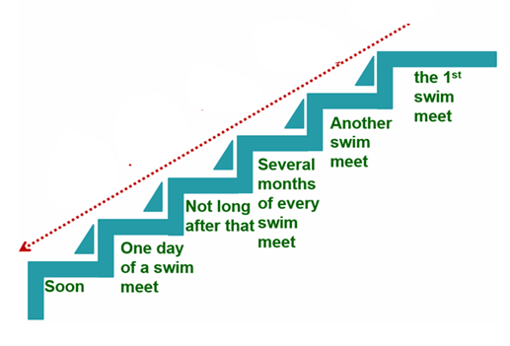
有效阅读之方法
绘制思维导图
制作表格
……

Slide 15
有效阅读之方法
绘制思维导图
制作表格
……
when | what | how
the first swim meet | first place | confident
another swim meet | first place | feel pretty good
several months of every swim meet | top positions | feel unbeatable
not long after that | second/third/ last place
one day of a swim meet | not perform well | unwillingly
the last meet | ? | ?

Slide 16
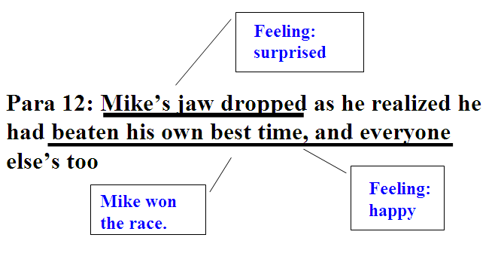
有效阅读之方法
绘制思维导图
制作表格
……

Slide 17
有效阅读之方法
绘制思维导图
制作表格
……
when | what | how
the first swim meet | first place | confident
another swim meet | first place | feel pretty good
several months of every swim meet | top positions | feel unbeatable
not long after that | second/third/ last place
one day of a swim meet | not perform well | unwillingly
the last meet | first place (the process) | confused worried surprised happy

Slide 18
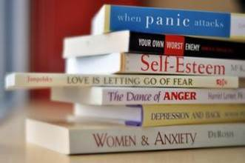
有效阅读之建议
有效阅读之建议
深耕阅读文本，关注微技能渗透。
创设多维互动，提升协同效应
关注读写过程，凸显学生主体

Slide 19
有效阅读之建议
深耕阅读文本，关注微技能渗透。
1.归纳文本大意，推断作者叙述意图的能力；
2.分析故事发展的情境模式，并合理推测新情节的能力；
3.捕捉原文伏笔，适当添加细节的能力；
4.根据关键词语构建句群的能力；
5.判断原文特点，并能沿用其特点的能力。

Slide 20
有效阅读之建议
创设多维互动，提升协同效应
语言
情境模式

Slide 21
有效阅读之建议
关注读写过程，凸显学生主体
参与
体验
合作
教学留白

Slide 22
如何确定关键词？
如何巧借原文中的词句？

Slide 23
常州市新高考线上研修活动
谢谢观看

