Slide 1
第一PPT模板网-WWW.1PPT.COM

Slide 2
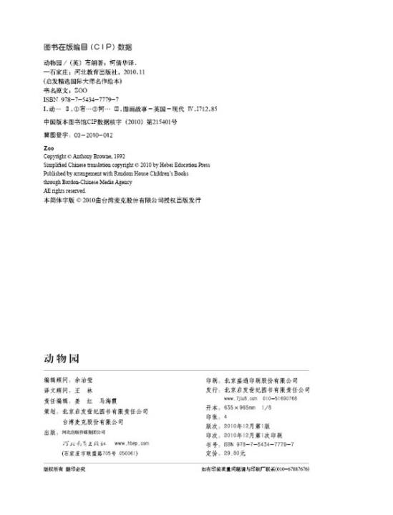

Slide 4
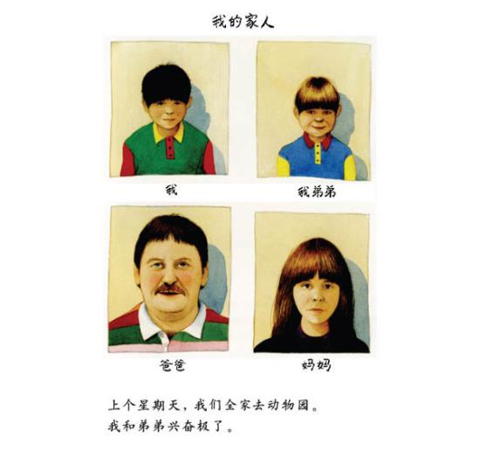

Slide 5
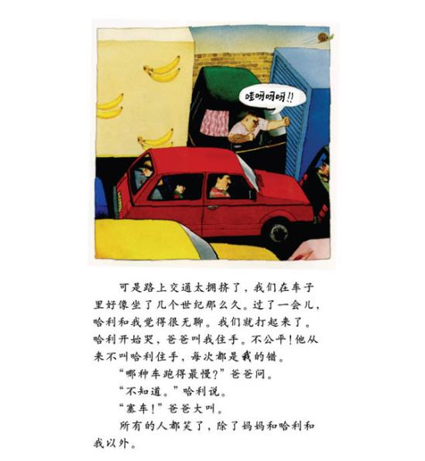
PPT模板：www.1ppt.com/moban/ PPT素材：www.1ppt.com/sucai/
PPT背景：www.1ppt.com/beijing/ PPT图表：www.1ppt.com/tubiao/
PPT下载：www.1ppt.com/xiazai/ PPT教程： www.1ppt.com/powerpoint/
资料下载：www.1ppt.com/ziliao/ 范文下载：www.1ppt.com/fanwen/
试卷下载：www.1ppt.com/shiti/ 教案下载：www.1ppt.com/jiaoan/
PPT论坛：www.1ppt.cn PPT课件：www.1ppt.com/kejian/
语文课件：www.1ppt.com/kejian/yuwen/ 数学课件：www.1ppt.com/kejian/shuxue/
英语课件：www.1ppt.com/kejian/yingyu/ 美术课件：www.1ppt.com/kejian/meishu/
科学课件：www.1ppt.com/kejian/kexue/ 物理课件：www.1ppt.com/kejian/wuli/
化学课件：www.1ppt.com/kejian/huaxue/ 生物课件：www.1ppt.com/kejian/shengwu/
地理课件：www.1ppt.com/kejian/dili/ 历史课件：www.1ppt.com/kejian/lishi/
Notes:
PPT模板：www.1ppt.com/moban/ PPT素材：www.1ppt.com/sucai/
PPT背景：www.1ppt.com/beijing/ PPT图表：www.1ppt.com/tubiao/
PPT下载：www.1ppt.com/xiazai/ PPT教程： www.1ppt.com/powerpoint/
资料下载：www.1ppt.com/ziliao/ 范文下载：www.1ppt.com/fanwen/
试卷下载：www.1ppt.com/shiti/ 教案下载：www.1ppt.com/jiaoan/
PPT论坛：www.1ppt.cn PPT课件：www.1ppt.com/kejian/
语文课件：www.1ppt.com/kejian/yuwen/ 数学课件：www.1ppt.com/kejian/shuxue/
英语课件：www.1ppt.com/kejian/yingyu/ 美术课件：www.1ppt.com/kejian/meishu/
科学课件：www.1ppt.com/kejian/kexue/ 物理课件：www.1ppt.com/kejian/wuli/
化学课件：www.1ppt.com/kejian/huaxue/ 生物课件：www.1ppt.com/kejian/shengwu/
地理课件：www.1ppt.com/kejian/dili/ 历史课件：www.1ppt.com/kejian/lishi/

Slide 6
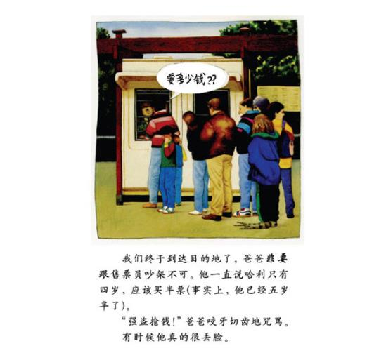

Slide 8
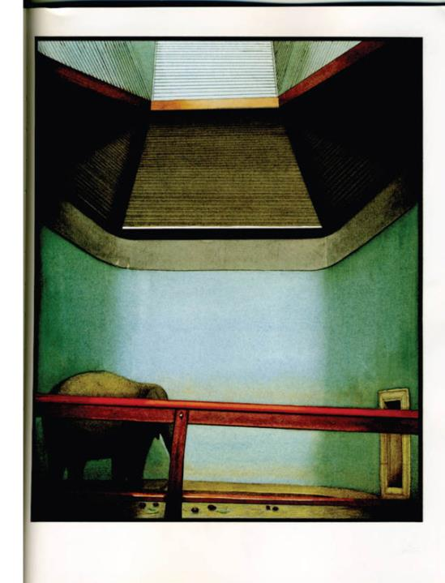

Slide 9
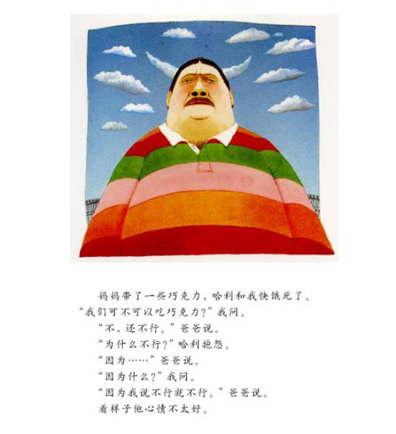

Slide 10
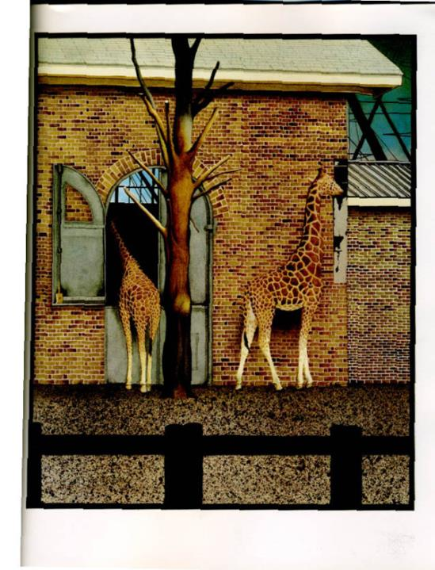

Slide 11
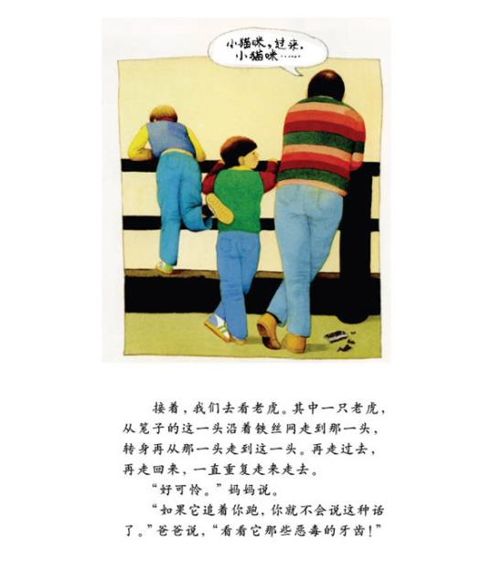

Slide 12
PPT模板：www.1ppt.com/moban/ PPT素材：www.1ppt.com/sucai/
PPT背景：www.1ppt.com/beijing/ PPT图表：www.1ppt.com/tubiao/
PPT下载：www.1ppt.com/xiazai/ PPT教程： www.1ppt.com/powerpoint/
资料下载：www.1ppt.com/ziliao/ 范文下载：www.1ppt.com/fanwen/
试卷下载：www.1ppt.com/shiti/ 教案下载：www.1ppt.com/jiaoan/
PPT论坛：www.1ppt.cn PPT课件：www.1ppt.com/kejian/
语文课件：www.1ppt.com/kejian/yuwen/ 数学课件：www.1ppt.com/kejian/shuxue/
英语课件：www.1ppt.com/kejian/yingyu/ 美术课件：www.1ppt.com/kejian/meishu/
科学课件：www.1ppt.com/kejian/kexue/ 物理课件：www.1ppt.com/kejian/wuli/
化学课件：www.1ppt.com/kejian/huaxue/ 生物课件：www.1ppt.com/kejian/shengwu/
地理课件：www.1ppt.com/kejian/dili/ 历史课件：www.1ppt.com/kejian/lishi/

Slide 13
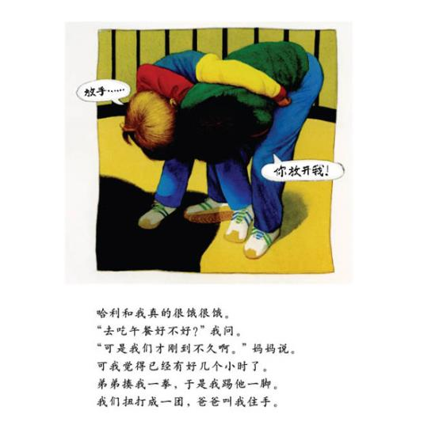

Slide 14
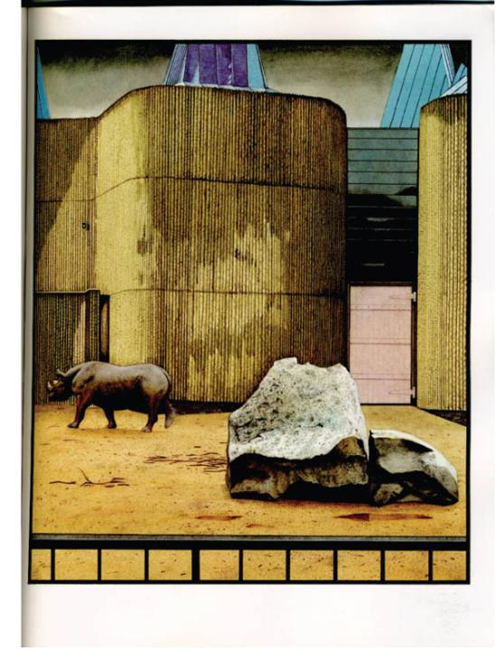

Slide 15
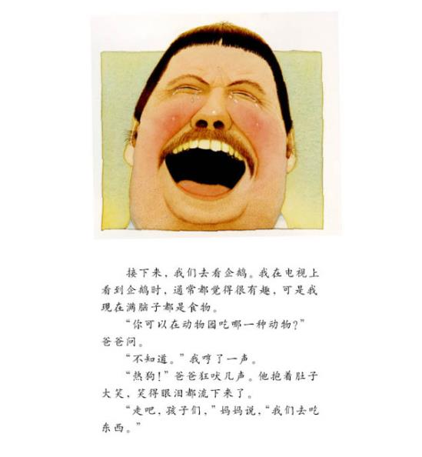

Slide 16
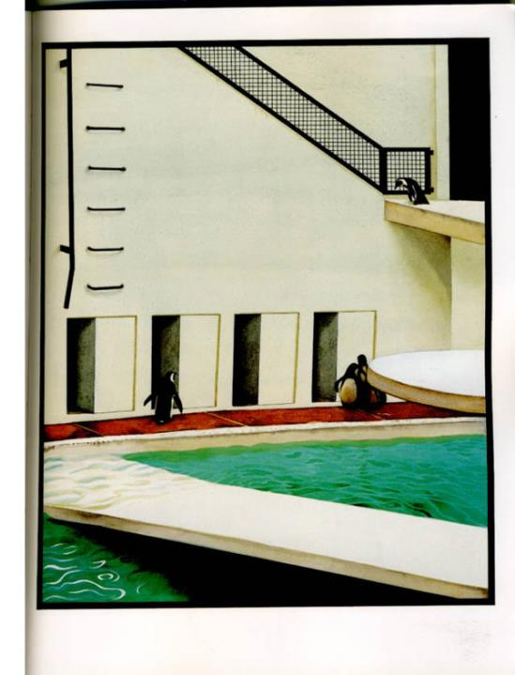

Slide 17
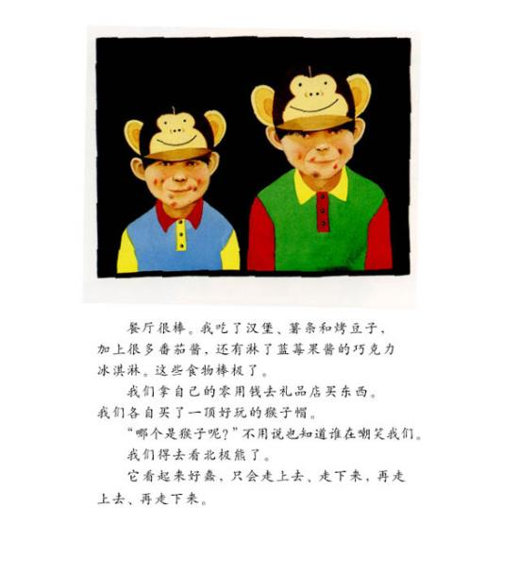

Slide 18
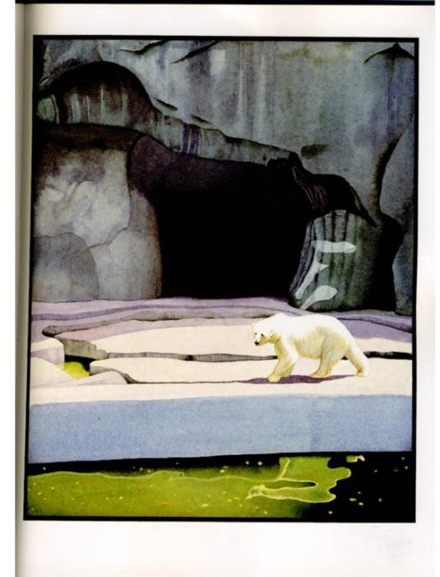

Slide 19
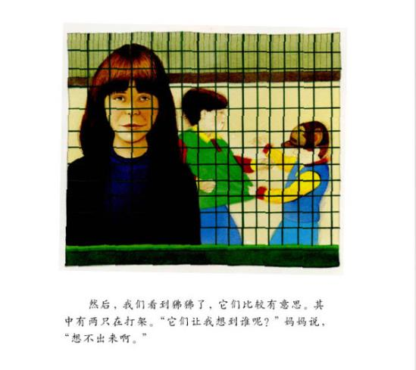

Slide 20
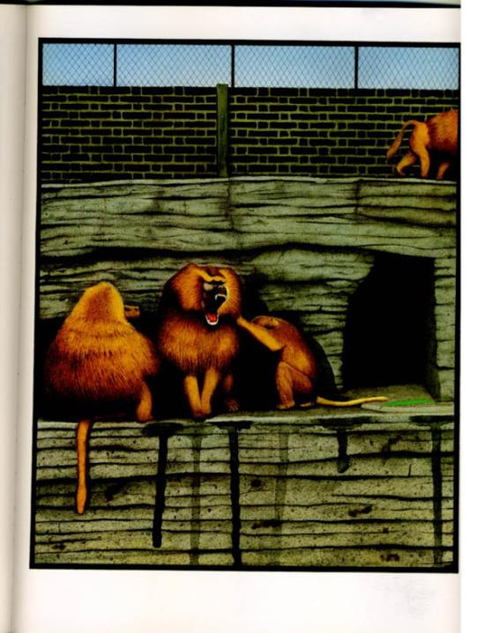

Slide 21
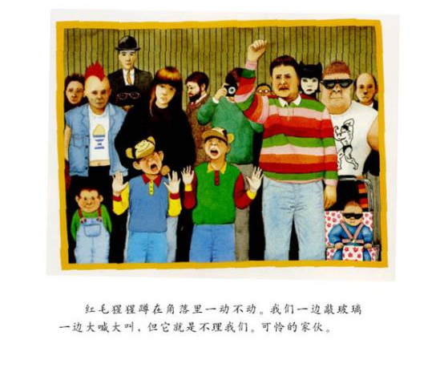

Slide 22
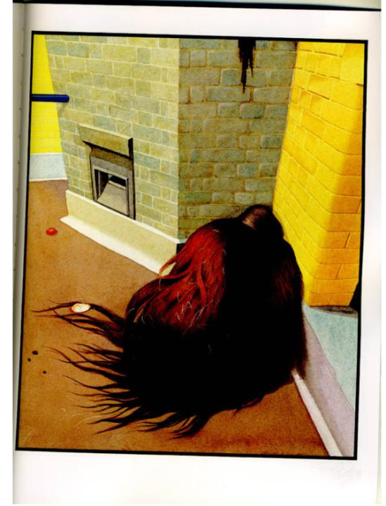

Slide 23
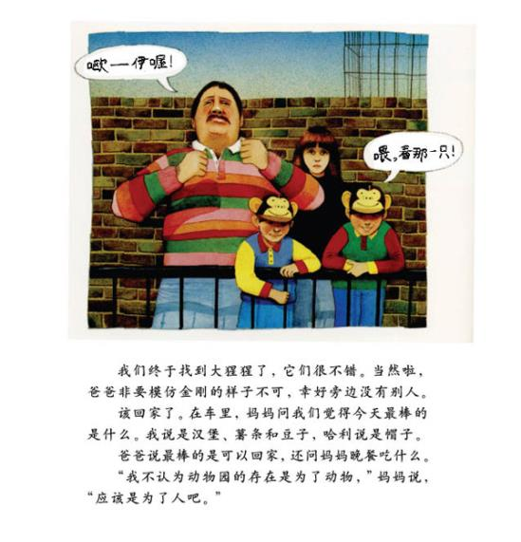

Slide 24
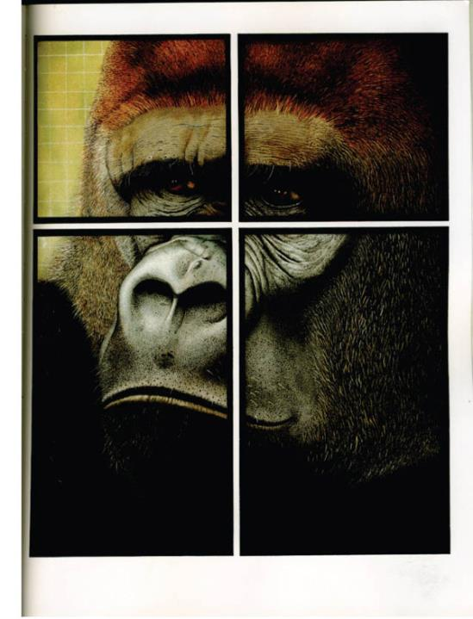

Slide 25
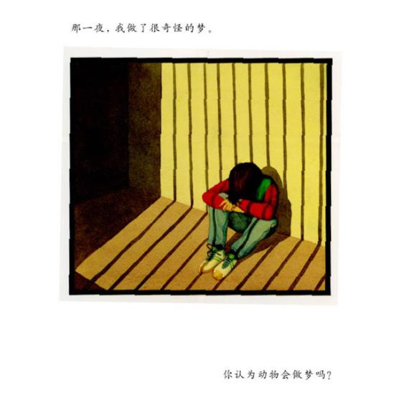

Slide 26
