Slide 1
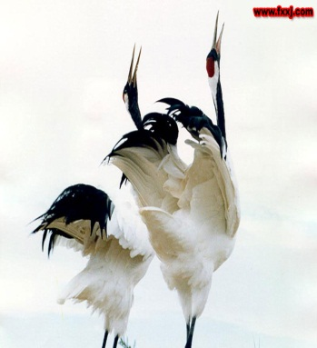
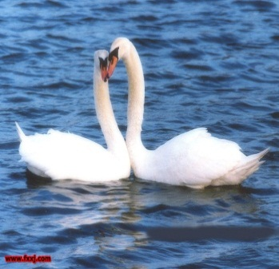
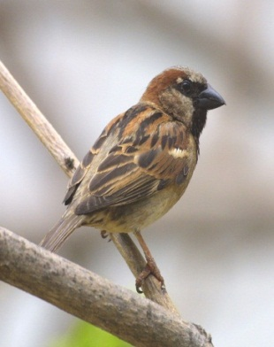
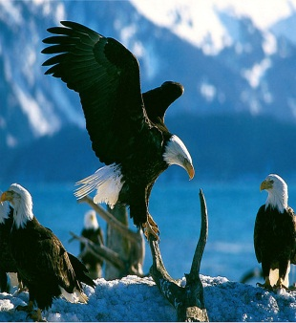
Let’s sing a chant
Cranes, cranes, they have long legs
Swans ,swans, they have white feathers
Sparrows, sparrows, they have small wings
Eagles, eagles, they have broad wings
/krein/
/swDn/
/ˈfeðər/
/’spærəu/
/’i:gl/
/brɔːd/
/wɪŋ/

Slide 2
8AU6 Welcome to the unit Birdwatching
Teacher: Fan yingxin

Slide 3
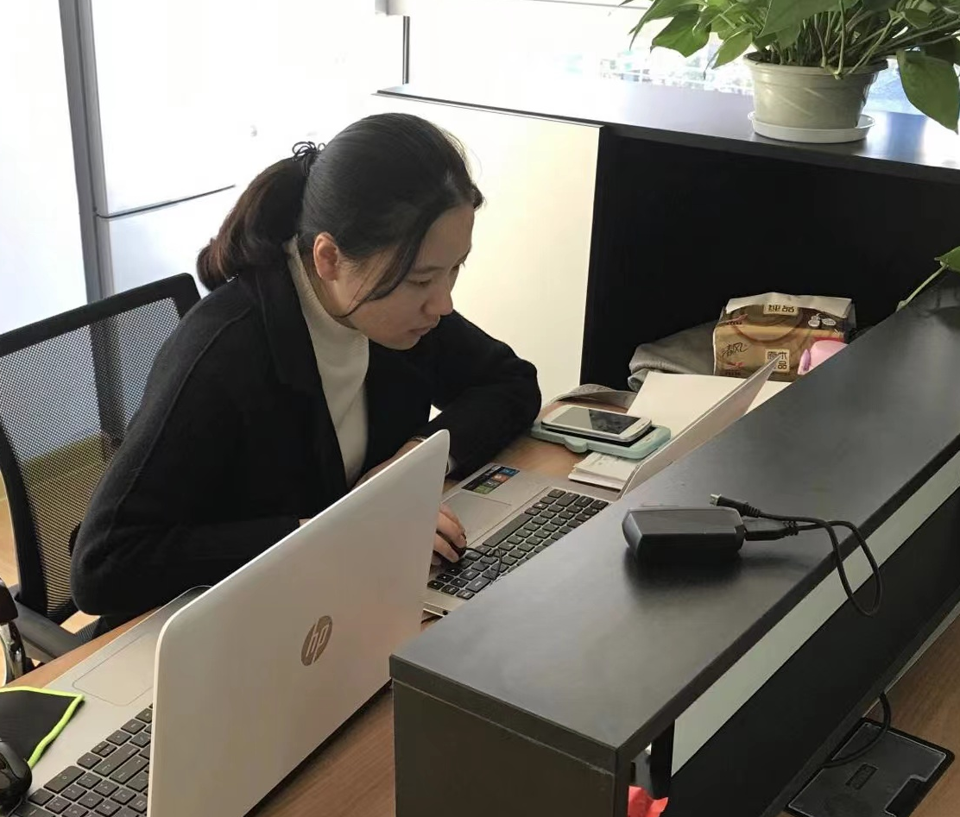
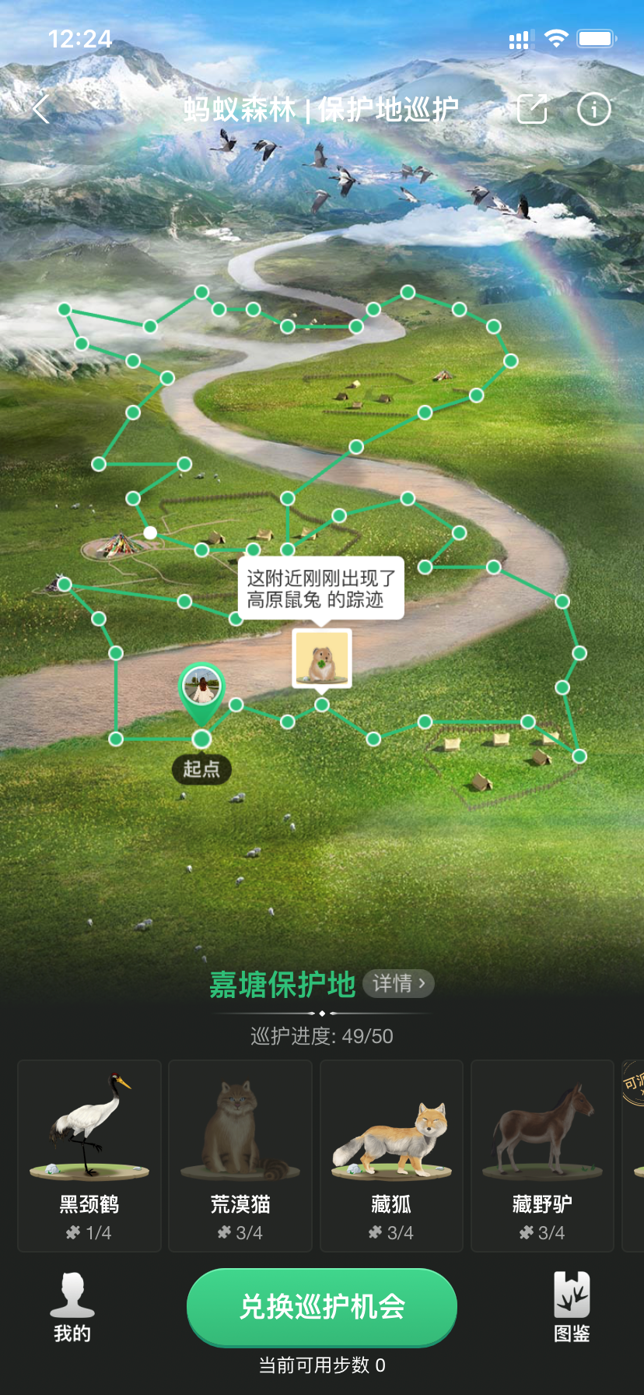
Dear Class 11,
Do you like to be a birdwatcher?
Alipay has a new activity in Mayi Forest called Proecting the Reserves.
I can protect the tigers, lions and some rare animals in JiaXing reserve. Now, I ‘d like to invite you to join the Birdwatching Club to protect the Zhalong nature reserve. There we can see many different kinds of birds like swans, cranes,eagles,sparrows.....
Yours sincerely
Miss Jiang

Slide 4
Task1: Join together
Task2: Know more about the birds
Task3: Guess and challenge(挑战)
Task4: Be a nice birdwatcher

Slide 5
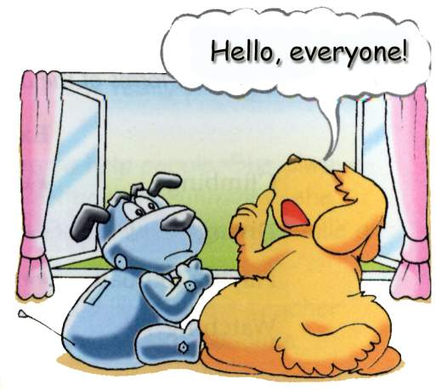
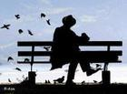
Task1: Join Birdwatching together
birdwatcher

Slide 6
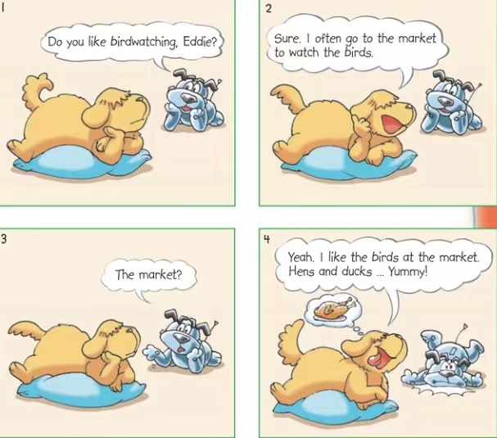
Predict(预测)
What are they talking about?

Slide 7
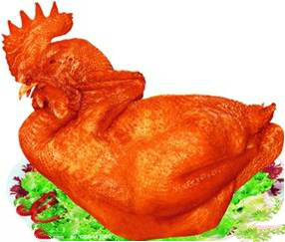
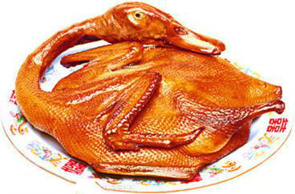
Watch and answer:
1. Where does Eddie often go to watch birds?
2.What does Eddie like?
3.Does Eddie really like watching the birds?
The market.
He likes hens and ducks.
No.He likes eating them.

Slide 8
Read in pairs(同伴)
and fill in the blanks:
Hobo asks Eddie if he likes ____________. Eddie says that he often goes to the _______ to _______ the birds because the _______ and ______ are ___________. In fact, Eddie doesn’t like birds. He just likes ________ birds and animals.
birdwatching
market
watch
hens
ducks
yummy
eating

Slide 9
Task2: Know more about the birds
Enjoy the video

Slide 10
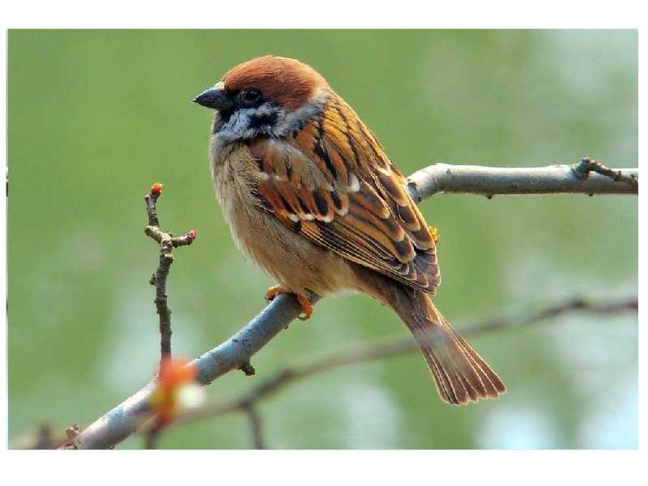
Know the looks of birds
sparrow
/’spærəu/
What color are sparrow's feathers?
black and red feathers
b. brown and grey feathers
c. white and blue feathers
Sparrows are small and have brown and grey feathers.
It's a ____, because ......

Slide 11
eagle
/’i:gl/
It's an ____, because ......
hooked beak
[hʊkt] [biːk]
adj.钩形的 n.鸟喙
broad wings
brown feathers

Slide 12
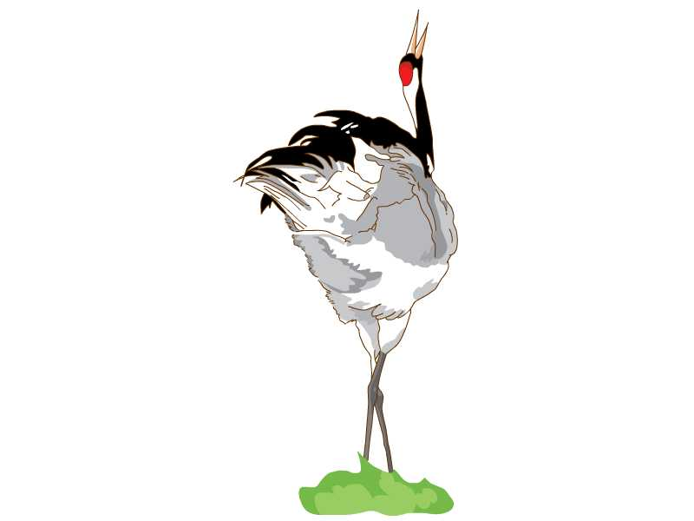
crane
It's a ____, because ......
/krein/
long thin neck
tall
long legs

Slide 13
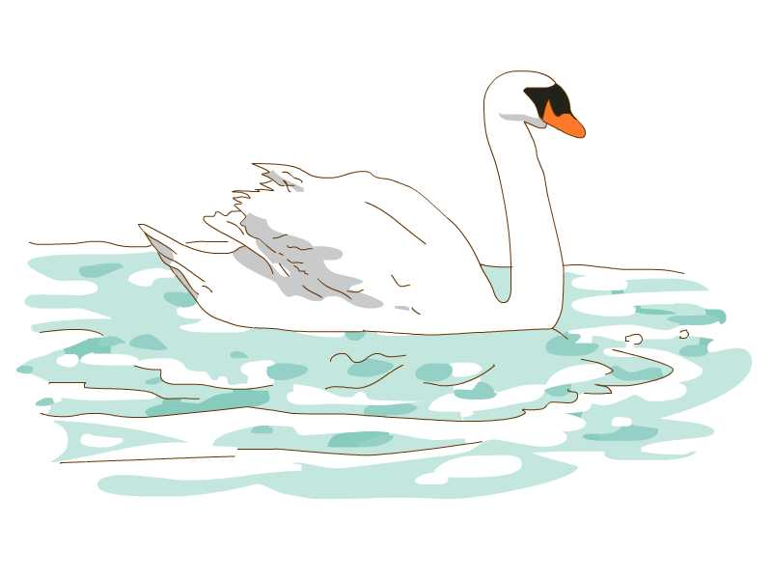
swan
/swDn/
long thin neck
white feathers
It's a ____, because ......

Slide 14
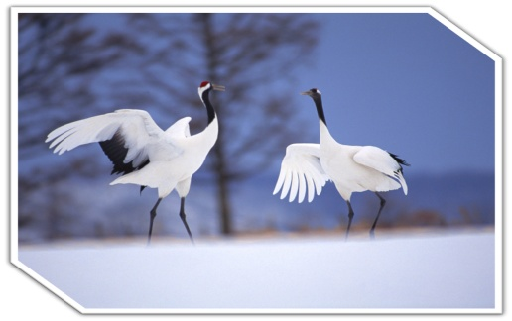
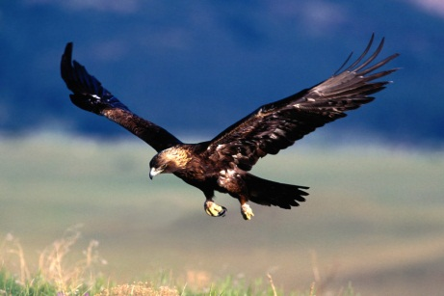
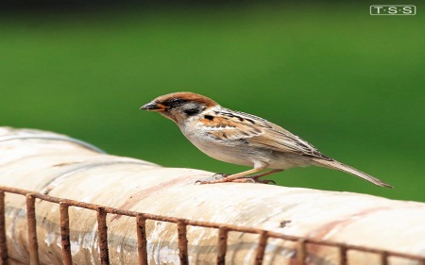
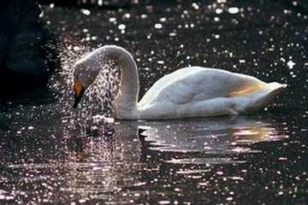
Match the birds corrtectly(Group work小组核对)
1. crane
A. broad wings and brown feathers
2. eagle
B. white feathers, long thin neck
3. sparrow
C. small, brown and grey feathers
4. swan
D. tall, long legs and long thin neck

Slide 15
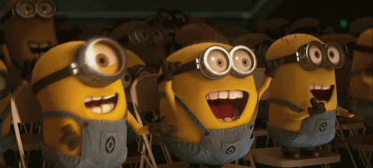
Task3: Guess and challenge(挑战)
You describe I guess
(1人描述1人猜)

Slide 16
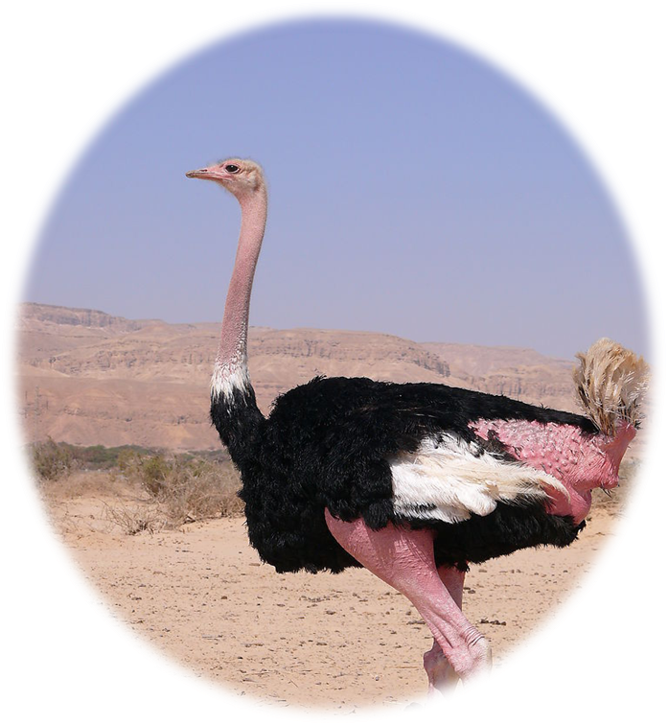
The biggest bird in the world
ostrich(鸵鸟)[ˈDstrɪtʃ]
about 2 metres tall
150 kilograms in weight
cannot fly

Slide 17
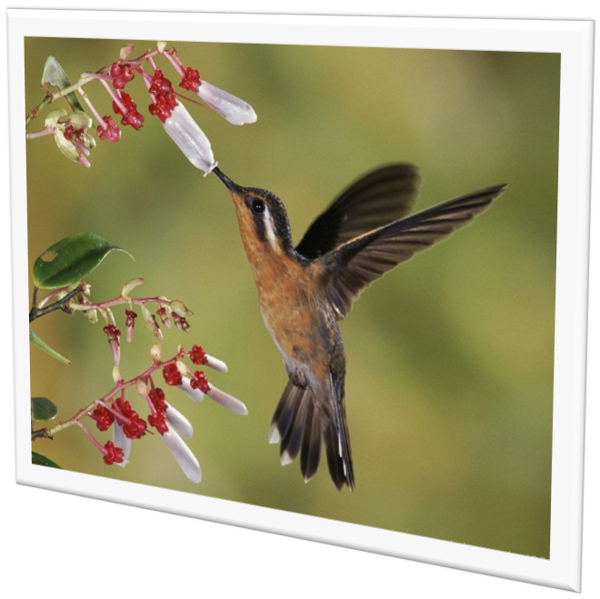
The smallest bird in the world
hummingbird(蜂鸟)
[ˈhʌmɪŋbɜːd]
2 grams
2 cm long

Slide 18
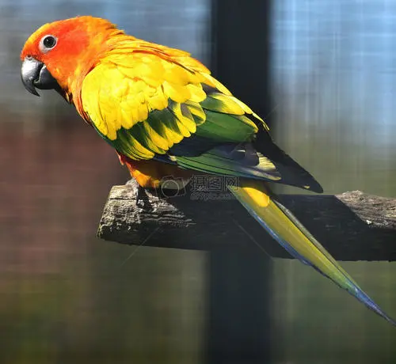
Parrot(鹦鹉)[ˈpærət]
colorful feathers
long tail(尾巴)
speak like people
smart and clever

Slide 19
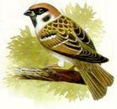
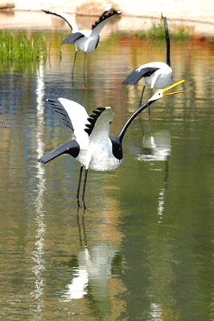
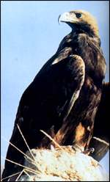
Talk and remember in groups(小组分工记忆)
Birds | Looks/features(特征)
 | small, brown and grey feathers...
 | long thin neck, white feathers...
 | tall, long legs, long thin neck...
 | broad wings, brown feathers, hookek beak...
 | tall,can not fly,the biggest bird in the world...
 | 2 cm long,very mall...
 | colorful feathers, long tail, clever...

Slide 20
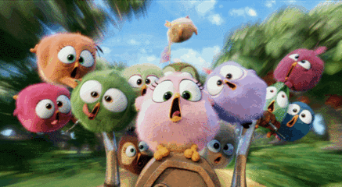
Make up a new chant(Group work 齐唱)
choose 3 your favourite birds
Cranes, cranes,they..
Swans ,swans,they ...
Sparrows, sparrows,they...
Eagles, eagles,they...
Parrots,parrots,they...
Ostriches,ostriches,they...
Cuckoos,cuckoos,they
... ...

Slide 21
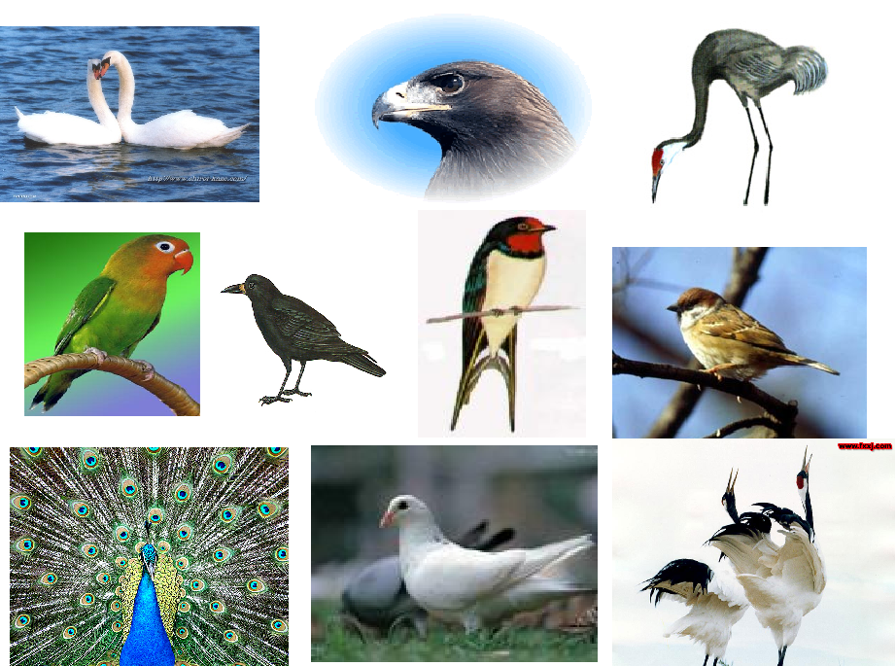
Task3: My favourite bird

Slide 22
Listen and answer
1.What is Simon’s favourite bird?
2.What do they look like?
3.How many types of cranes are there in the world?
Cranes
They are tall.
They have long legs ad a long thin neck.
Fifteen. They are rare birds.
[reə(r)] adj.稀有的

Slide 23
Make up a dialugue(Pair work同伴)
A: Which is your favourite bird?
B: I like … best.
A：Why?
B: Because they…. How about you?
A: I like ...best. They...

Slide 24
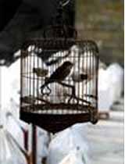
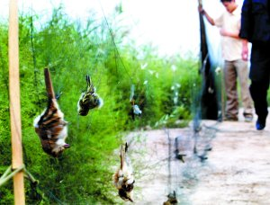
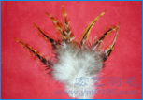
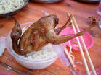
Task4: Be a nice birdwatcher
Why?
Birds are in danger!

Slide 25
Search and discuss(group work) 小组讨论，一人呈现
Birds are our friends.However,they are facing danger now_________ some people kill some big birds for their fur. Some of them may become dishes ___ the table. What’s worse, people may cut down more trees, so the birds will have no place______ (live).
What can we do for them?
First, don’t ______ (catch) or kill them. Second, don’t buy anything made of _______ (feather). When we go_______ (birdwatch), we should stop hunters from ______ (hunt) them. It’s important to protect the lovely birds_______ (make) the world better!
because
on
to live
catch
feathers
birdwatching
hunting
to make

Slide 26
Brainstorming(头脑风暴)
Give more advice(建议)
1. Build more nature reserves.
2. Don’t eat their meat.
3.Ask our government(政府) to make laws to protect them.
......
......

Slide 27
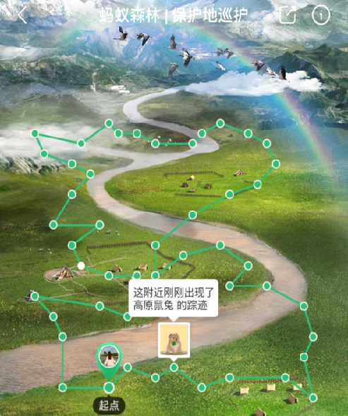
Loving birds is loving nature.
Loving nature is loving the earth.
Loving the earth is loving ourselves!
There is still a long way to protect them!

Slide 28
Homework
1.Finish the exercise on the book.
2.Find out more information about the birds on the Internet.

Slide 29
Thanks for listening~

