Slide 1

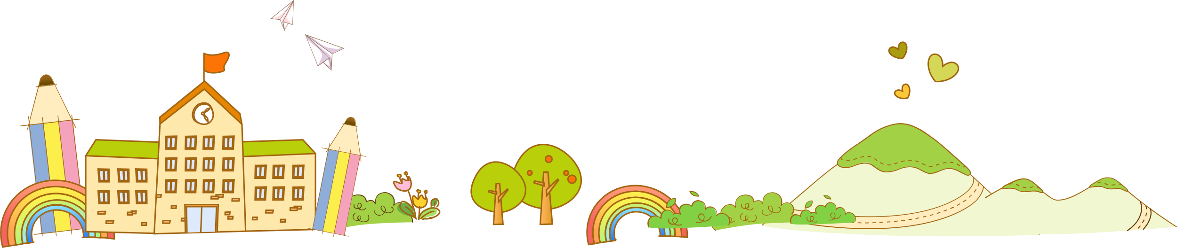
Unit 4 Are you happy?
Task

Slide 2


Let’s enjoy our school life.

Slide 3
Lead-in： Free talk
Are you happy/unhappy at school? Why?
I am happy/unhappy because my school life is _____.
(great/colorful/interesting/meaningful/wonderful
busy/boring…) .
My classmates/teachers are friendly to me...

Slide 4
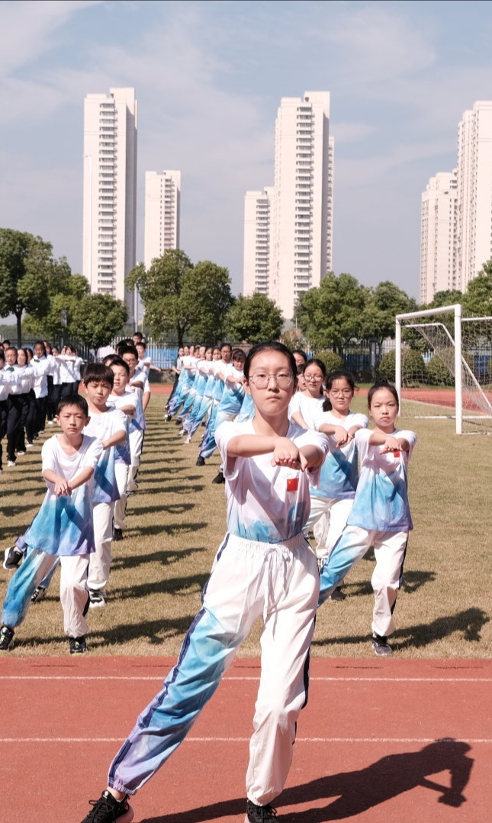

Your colorful school life
Activity
Feeling
Reasons
Because it is good for you, and it helps you get ready for the day.
Some of you like doing morning exercises.
morning exercises

Slide 5
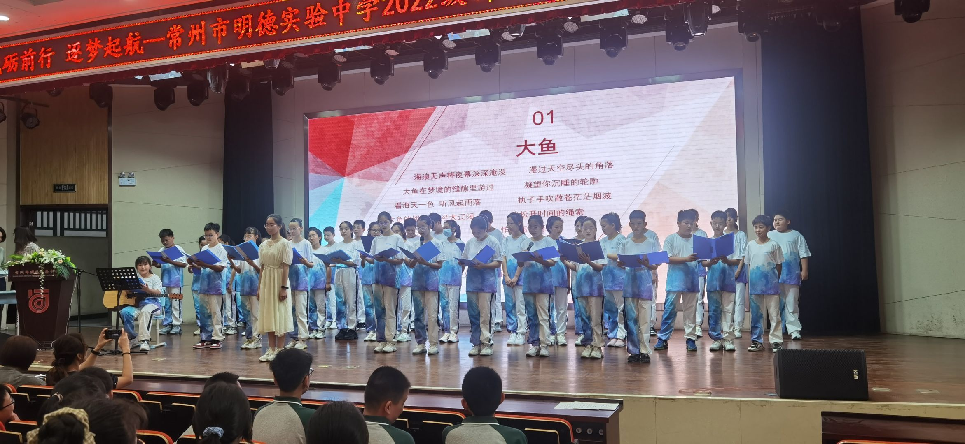
School life about you
Activity
Feeling
Reason
Because there is
too much fun in
doing after-school activities.
Some of you love doing after-school activities.
after-school activities

Slide 6
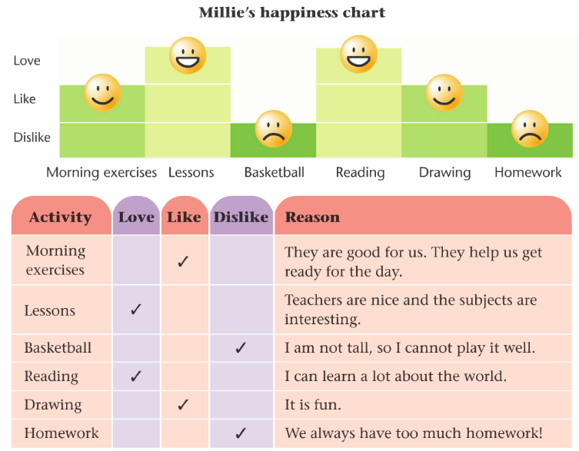
P52: School life about Millie
1. What is the chart?
It’s Millie’s happiness chart.
2. Pair work: Talk about M’s likes and dislikes.
A:What does Millie love/like/dislike…?
B: She loves/likes/dislikes…
A:Why does she love / like / dislike …?
B:Because …

Slide 7
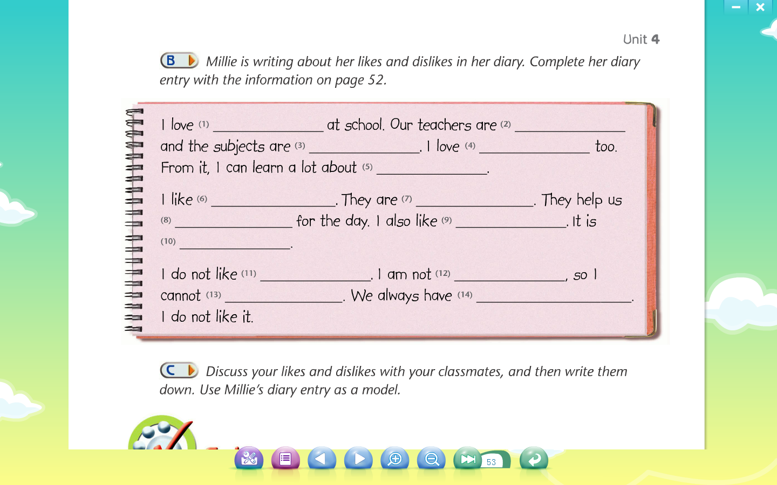
Help Milliie finish the diary
lessons
nice
interesting
reading
the world
morning exercises
good for us
get ready
drawing
fun
basketball
tall
play it well
too much homework

Slide 8
How to make the article more beautiful?
Tip 1
Tip 2
Tip 3
...

Slide 9
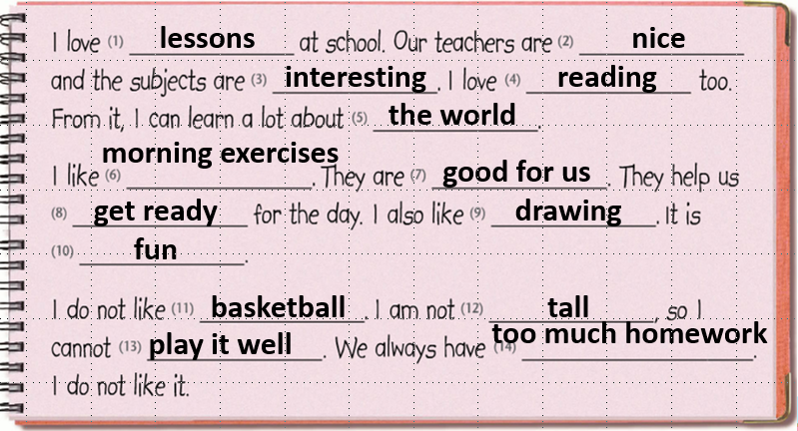
Tip 1: Clear structure（结构）
Read and match
loves & reasons
dislikes & reasons
likes & reasons

Slide 10
How to write the contents（内容）?
Tip 2: Rich contents（内容丰富）
How many activities are there?

Slide 11
Tip 3: Transitions (过渡词）
Choose the transitions to make the article more logical有逻辑性.
firstly moreover此外 however然而 as a result因此
Firstly
______ ,I love lessons at school. Our teachers are nice and the subjects are interesting. I love reading too. From it, I can learn a lot about the world.
______ , I like morning exercises. They are good for us. They help us get ready for the day. I also like reading. It is fun.
_________ ,I do not like basketball. I am not tall. so I cannot play it well . We always have too much homework.__________ , I do not like it.
Moreover
However
As a result

Slide 12
How to make the sentences more beautiful?
Firstly, I love lessons at school. Our teachers are nice and the subjects are interesting. I love reading too. From it, I can learn a lot about the world.
Moreover, I like morning exercises. They are good for us. They help us get ready for the day. I also like reading. It is fun.
However, I do not like basketball. I am not tall. so I cannot play it well . We always have too much homework.As a result, I do not like it.
Way 1
Way 2
Way 3

Slide 13
Way 1 Replacing Words
第一招 替换词语（移花接木）
I love lessons at school
I am fond of lessons at school.
I love reading too.
I am passionate about reading as well.

Slide 14
Way 2 Combining simple sentences
第二招 合并简单句（并蒂莲开）
I love lessons at school. Our teachers are nice and the subjects are interesting.
I love lessons at school because our teachers are nice and the subjects are interesting.
They are not only good for us, but also can help us get ready for the day.
They are good for us. They help us get ready for the day.

Slide 15
Way 3 Expanding the simple sentence
第三招 扩展简单句（锦上添花)
From it, I can learn a lot about the world.
If I read more books, I can learn a lot about the world.

Slide 16

I can make the article even better.
The beginning and ending are also important!
Beginning:
eg. Now I am a student at Changzhou Mingde Experimental Middle School which is as beautiful as a garden.
……
Ending：
eg.My school life is so rich and colorful that I am really happy to study in such a beautiful school!

Slide 17

Writing time
We have known how to write well. Let’s write to tell Millie about our likes and dislikes at our school or our ideal school.

Slide 18
You can choose one topic to write
My likes and dislikes at school.
My ideal school.
Dear Millie,
I am writing to tell you about my ideal school…
First of all, I am fond of lessons at my ideal school because...
I hope my ideal school can come true...
Best wishes,
xxx
Dear Millie,
Now I am a student at Changzhou Mingde Experimental Middle School and I ...
...
My school life is rich and colorful...
Best wishes,
xxx

Slide 19
Group work
1.Read your group members’ article in groups of six;
2.Give a point by handwriting（书写）, structure（结构）, content（内容）, and language（语言）;
3. Show us the best one.
Handwriting | Clean handwriting（字迹工整） （2分）
Structure | A clear structure （结构清晰） （2分）
Content | Use many activities and reasons to support （3分）
Language | Add to the variation of sentences (句型多样性) Use correct transitions过渡词 Use the formal (正式的) language （3分）
Point:

Slide 20
Show time

Slide 21
What have we learned today?
School life is the most beautiful and purest. Please cherish the moment and push forward. The future is promising!
请珍惜当下，奋力前行,未来可期!

Slide 22
Homework
▶ You must：
Polish(修饰) your article with your partner.
▶ If you can :
Make a poster (海报) to share your article.

Slide 23
Thank you !

