Slide 1
Unit 2 Colours
Integrated skills

Slide 2
Revision
white
blue
yellow
orange
green
red

Slide 3
When you …. , what colour will you wear? Why?
feel nervous
bring peace to …
give you energy
feel tired
cheer you up
feel sad
feel less confident
bring you success

Slide 4
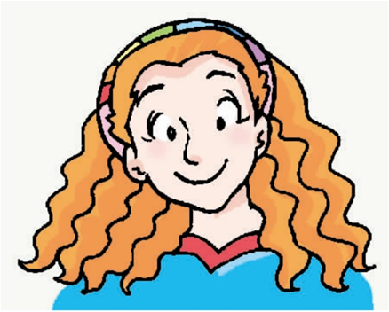
Colour Therapy(疗法)
A way to use colours to change people’s moods and improve their lives.
Mrs. Rainbow is good at colour therapy.
open up a colour therapy centre
help people change their moods
a colour therapist（治疗师）

Slide 5
Read the advertisement for colour therapy by Mrs Rainbow and then answer the following questions.
1. What channel will the programme The Teens Show be on?
It will be on STTV.
2. Where is Mrs Rainbow’s colour therapy centre?
Her therapy centre is on 21/F,810 South-east Road.
3. How much do we have to pay for the colour therapy?
One hundred yuan for half an hour.
4. What can we do if the therapy doesn’t work?
We can get our money back.

Slide 6
A2
Millie is watching The Teens Show. Listen to the interview with Mrs. Rainbow carefully and help Millie complete her notes.

Slide 7
Mrs Rainbow Colour Therapy Centre
Her therapy centre is on ______________________.
It costs ________ for 30 minutes.
If it doesn’t work, you can ________________.
She has practised colour therapy since she left ______.
Colour therapy comes from ancient India.
If you do not feel confident enough, use the colour ______ more. If you cannot sleep well, paint your bedroom_____.
If you feel stressed, eat more_____vegetables.
If you feel tired, ____ food can help cheer you up. But do not eat too much of it , or you may get ______ easily.
21/F, 810 South-east Road
100 yuan
get your money back
college
yellow
blue
green
red
angry

Slide 8
How much do you know about Mrs Rainbow?
She suggests that …
if you don’t feel confident, you should …
if you can’t sleep well, you should… .
if you feel stressed, you should...
when you feel tired, you should….

Slide 9
Suzy wants to learn something about Mrs Rainbow. Listen to Suzy’s questions and help Millie answer them. Circle the correct letters.
A3
1.
a. She works at a Museum.
b. She uses colours to change people’s moods.
c. She works for a fashion magazine.
2.
a. She colours their clothes.
b. She suggests different clothes to different people.
c. She suggests different colours to different people.
3.
a. You will sleep better if you paint your bedroom blue.
b. You should think of the sun.
c. You should wear orange.
So what does Mrs. Rainbow do, Millie?
Really? How does she do that?
What should I do to get a good night’s sleep?

Slide 10
4.
a. He should wear green.
b. He should use the colour yellow more.
c. He should think of a warm sunny place.
5.
a. She tells people what colours of food to eat.
b. She makes your clothes change colours.
c. She makes food for people.
6.
a. She will give you free clothes.
b. You will get your money back.
c. She will give you free books.
Daniel is not confident this week. What should he do?
What other kinds of colour therapy does Mrs. Rainbow do?
What if the therapy doesn’t work?

Slide 11
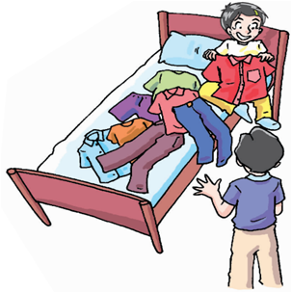
Speak up
Andy is talking with Millie about what to wear for a party and he has difficulty making a decision.

Slide 12
Listen to the conversation and answer questions
1. Which colour does Andy prefer, red or orange?
He would rather wear orange.
2. Which trousers does Andy like?
He prefers jeans.
3. Why does Millie think Andy should wear jeans?
Because she thinks jeans are comfortable and they match Andy’s shirt.

Slide 13
How to express preferences（偏好）?
1. I like/don’t like …
I like... better than...
2. would rather do sth.
would rather do A than do B
3. prefer to do sth.
prefer A to B
prefer doing A to doing B

Slide 14
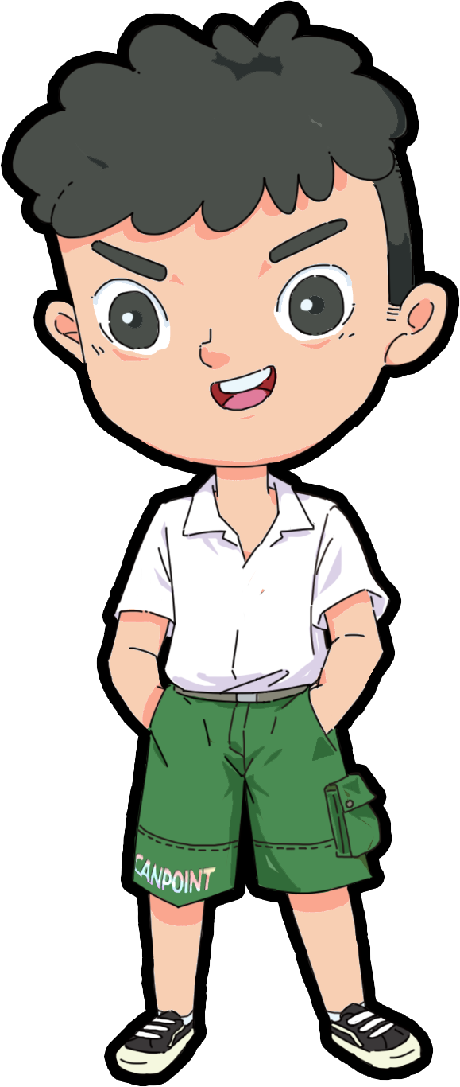
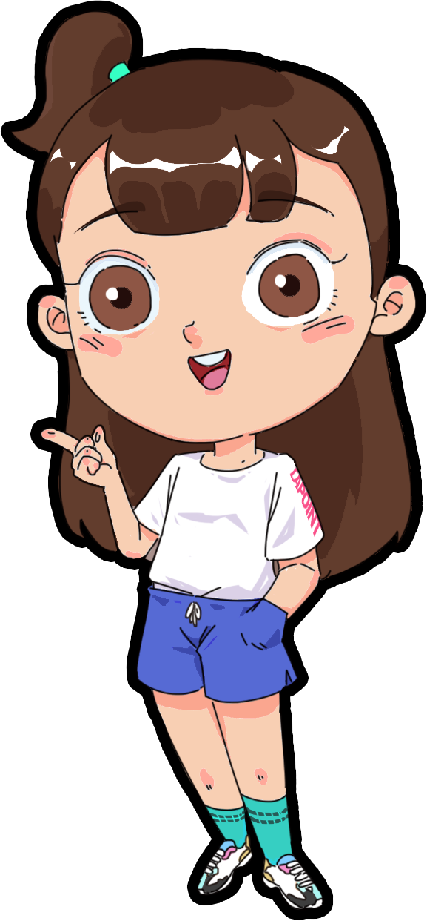
Group work
Pair work
Suppose（假设） you will go to your friend’s birthday party. Work in pairs and discuss what you will wear and why.

Slide 15
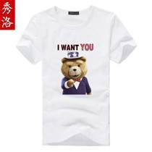
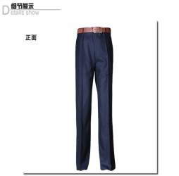
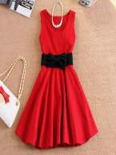
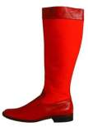
Work in pairs and make a similar dialogue.
A: I am going to a friend’s birthday party, ....Come and see if ......
B: Which ... do you prefer, ......?
A: I would rather wear.../ I like ...better than...
B: You look ...in ... Which ...do you like?
A: I prefer ......
B: Why not try ...on?
A: ...doens’t suit me./ It fits me well.
B: I think ....(doesn’t) match your...
A: Thanks for your advice.

Slide 16
Homework
1. Retell something about Mrs. Rainbow’s colour therapy
2. Recite the dialogue on Page 30
3. Finish the exercises on 创优

