Slide 1



Unit 5 Amazing things
Reading

Slide 2
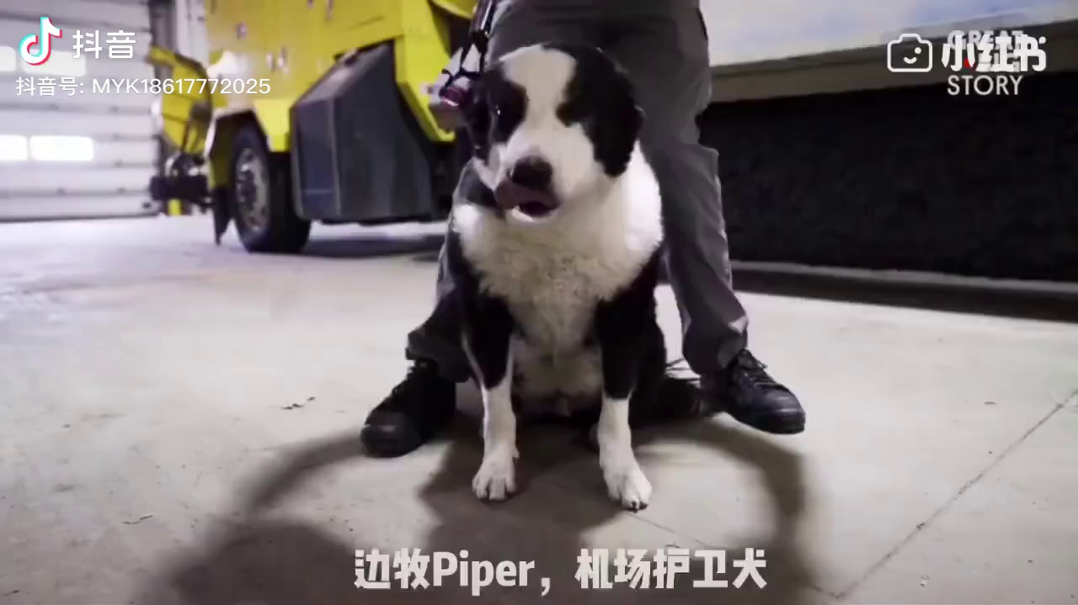
A dog named Piper
His job is to expel the birds from the airport to ensure the planes take off safely.

Slide 3
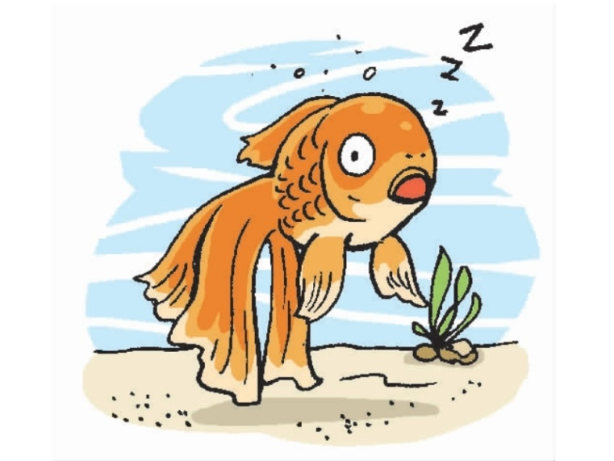
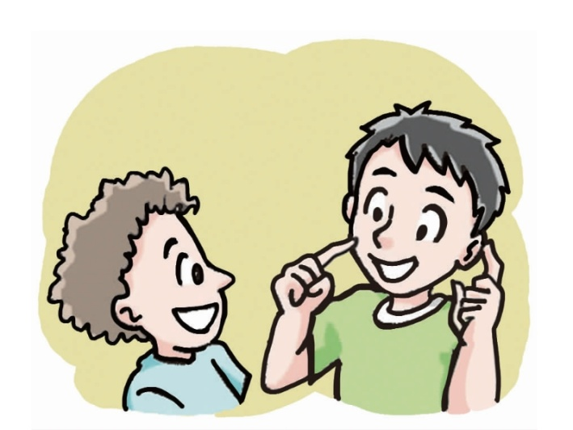
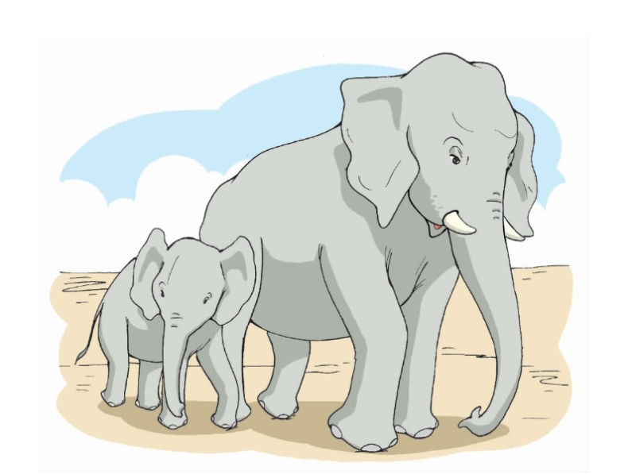
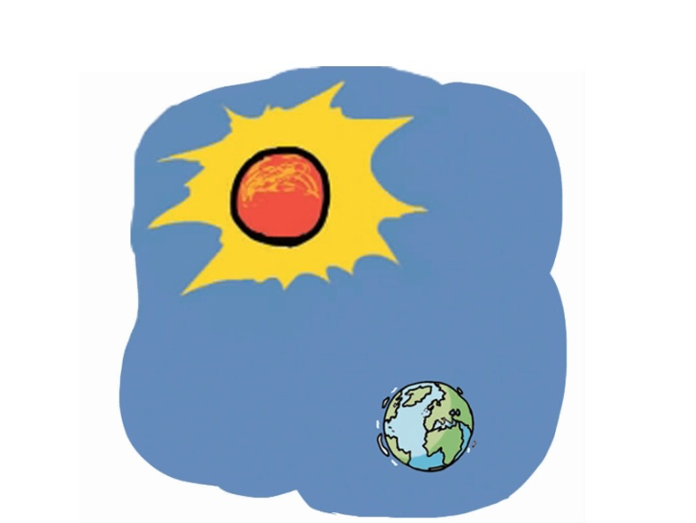
---Isn‘t that amazing?Do you know any fun facts around the world ?
---B:Yes. …

Slide 4
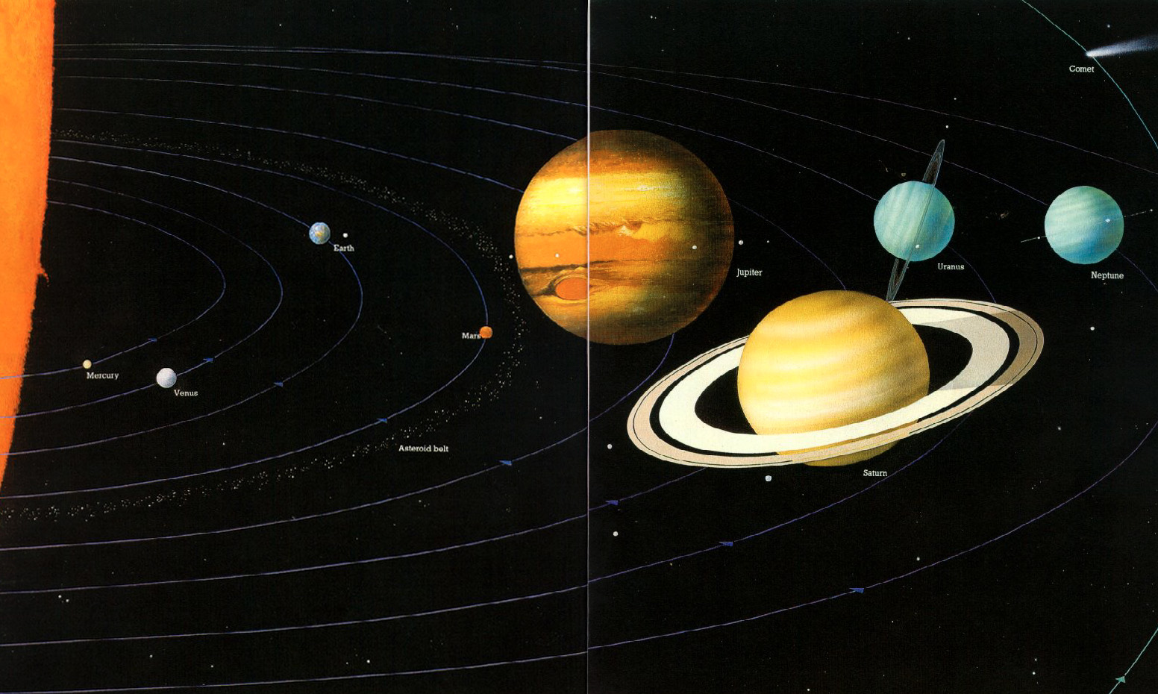
The sun is about 1,300,000 times larger than the Earth.

Slide 5
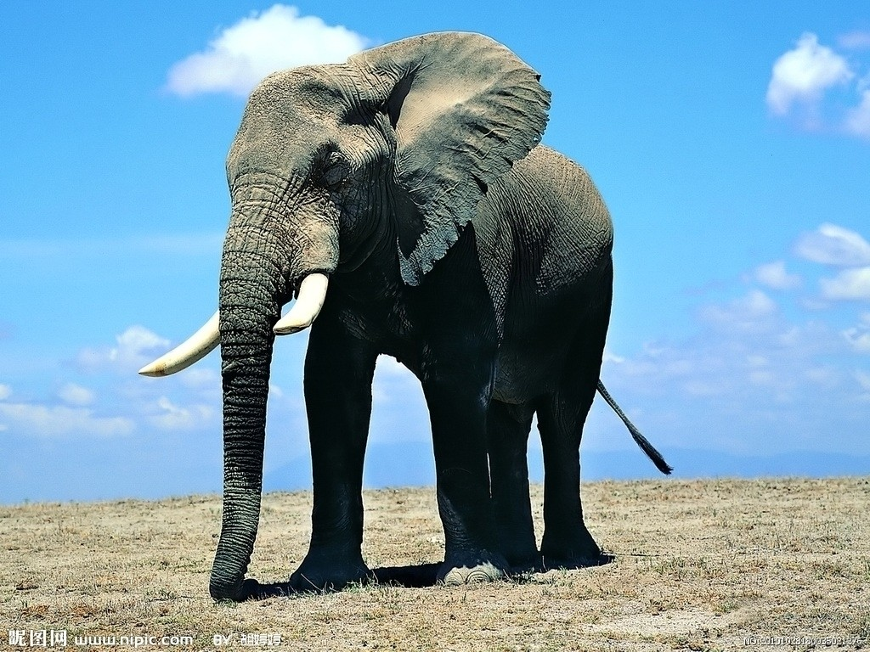
There are no bones in the back of elephants’ feet--- only fat.

Slide 6
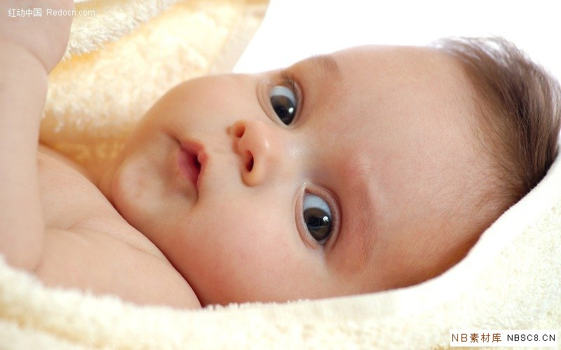
Our eyes are the same size from birth, but our nose and ears never stop growing.

Slide 7
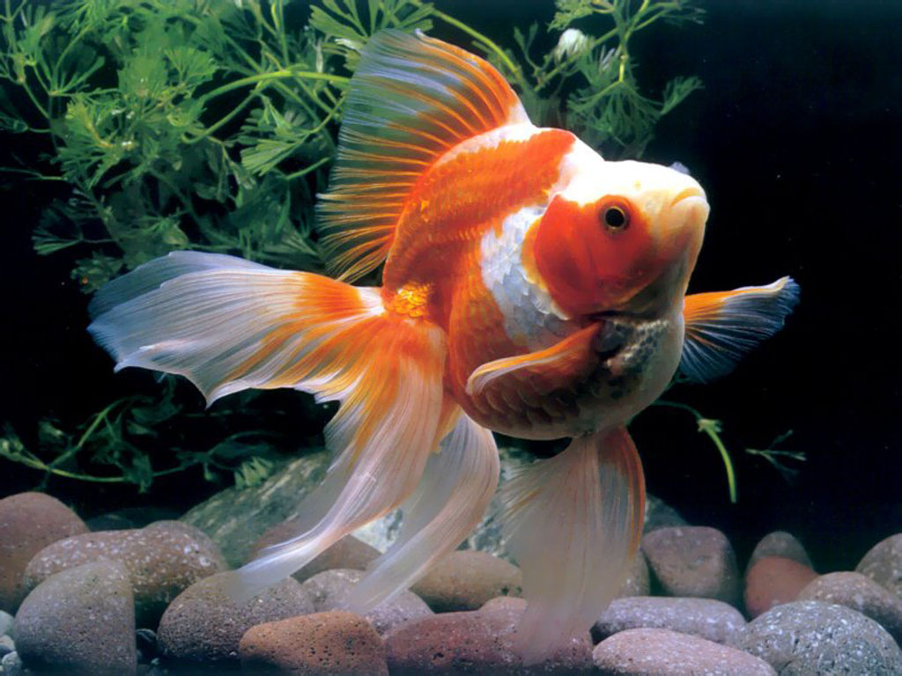
Fish sleep with their eyes open.

Slide 8
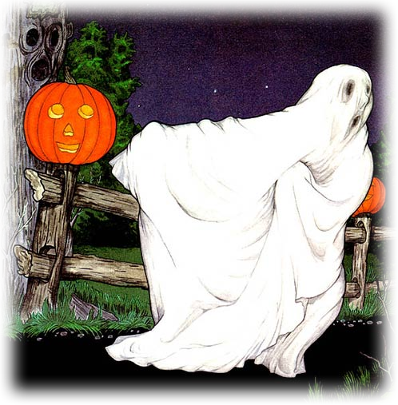


Warming up
Lead-in
Are there any ghosts in the world?
Are you afraid of ghosts?

Slide 9

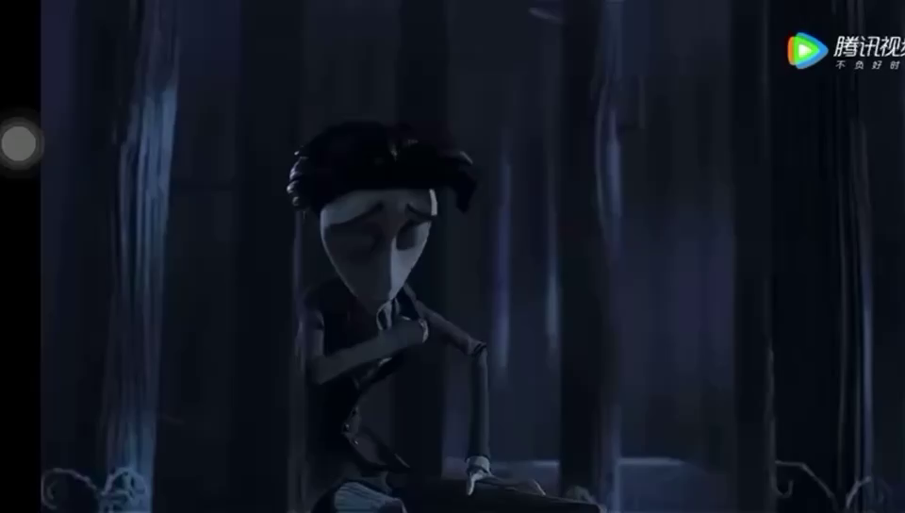
What is the young man afraid(害怕) of ?
Lead-in

Slide 10

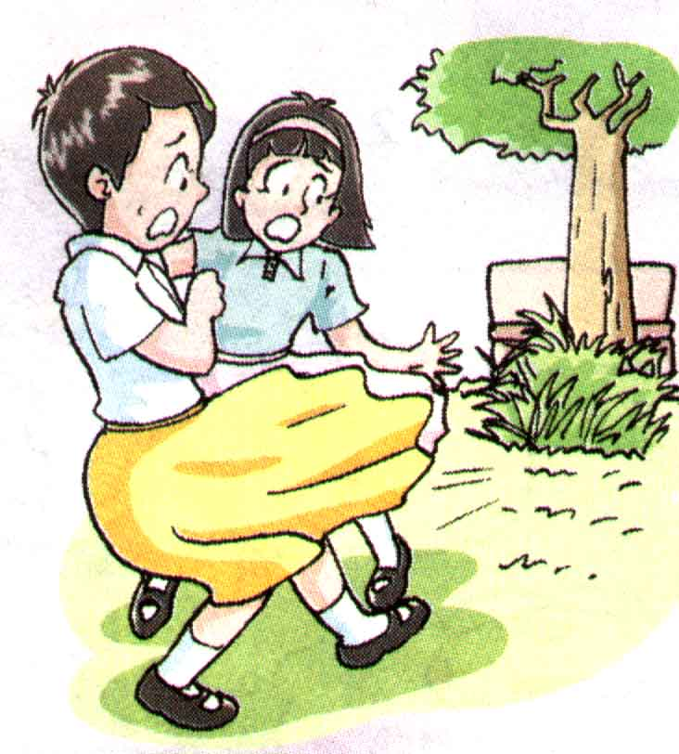

The ghost in the park
Pre-reading
Where was the “ghost”?
Who met the “ghost”?
What other aspects(方面) do you want to know about the story?

Slide 11
Read and match the new words with the meanings.
b
1. as usual 4. wondered
2. replied 5. searched
3. left 6. weak
a
As usual means ______.
a. the first time
b. as they often do
c. seldom
If you wonder, you _______.
a. want to know something
b. feel great
c. say something happily
c
c
To reply means ______.
a. to think
b. to say something again
c. to say or write something as an answer
To search means _______.
a. to find something
b. to shout at something
c. to look carefully for something
c
c
To leave means _____.
a. to find out
b.to look for
c. to go away
Weak means _____.
a. clever
b. small
c. not strong

Slide 12




While-reading
Structure
Skimming:
略读的目的不在于精确地理解文章，而在于了解大致内容，
比如文章的主旨大意，传达的主要信息或作者的基本观点。
Part1 (L1-7)
Part2 (L8-11)
Part3 (L12-16)
Andy searched
for the ‘ghost’
They found the
‘ghost’ was a cat .
Mille and Amy
heard a ‘ghost’.

Slide 13
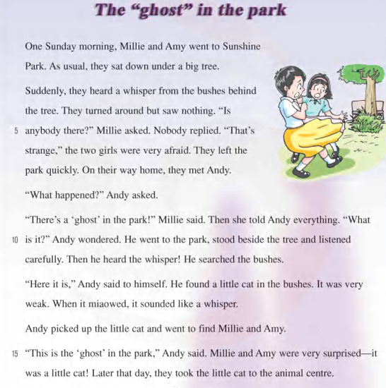
While-reading
Structure
Part 1
Millie and Amy heard a ghost in the park.
Part 2
Andy searched for the ghost.
Part 3
They found the ghost was a cat.

Slide 14


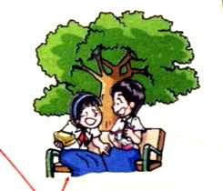
While-reading
Part 1 ( lines1-7 ) heard the ghost
when
One Sunday morning.
when
When did it happen?
In Sunshine Park.
where
Where did it happen?
where
They were very afraid.
How
How did they feel?
How

Slide 15
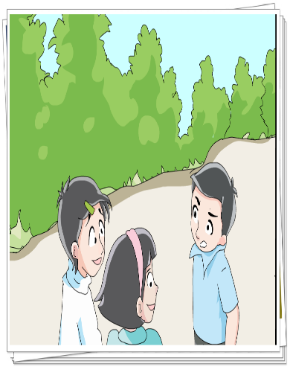

While-reading
Part 2 ( lines8-11 ) searched for the ghost
asked
Andy_______ Millie what happened. So she _____him everything. Andy __________ what the ghost was. So he _____ to the park, _______beside the tree, and _______ carefully. Then he _______ the whisper and ________ the bushes.
told
wondered
went
stood
listened
heard
searched
The simple past tense

Slide 16

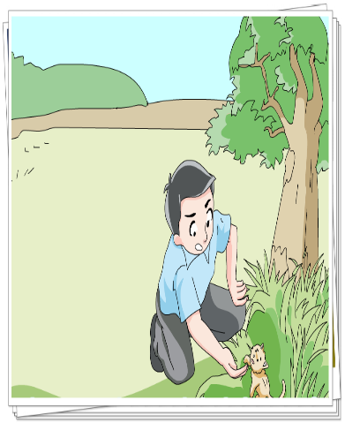
While-reading
Part 3 ( lines12-16 ) found the ghost
1. Who made the strange noise?
A. Andy. B. A ghost. C. A cat.
2. Why did the little cat sound like a ghost?
A. Because it was very weak.
B. Because it was very angry.
3. Which place did they take the little cat to?
A. Andy's home.
B. The animal centre.

Slide 17
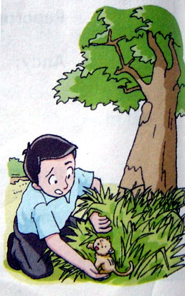
Post - reading
Rearrange the order.
( ) a. We ran away quickly.
( ) b. Andy found a little cat in the bushes.
( ) c. We sat under a big tree in the park.
( ) d. Suddenly, we heard a whisper.
( ) e. We turned around but saw nothing.
( ) f. Andy went to the park.
( ) g. I told Andy about the strange sound.
4
7
1
2
3
6
5

Slide 18
Post-reading
Do T or F questions.
1. I was afraid when I heard the whisper.
2. The whisper came from a big tree.
3. The girls went back to the park with Andy.
4. Somebody helped Andy find the “ghost”.
5. Andy found a small cat in the bushes.
6. Andy gave the little cat to Amy.
T
the bushes.
F
Andy went to the park.
F
Andy found the “ghost”.
F
T
They took the little cat to the animal centre.
F

Slide 19
Feedback
The ghost in the park
Last Sunday, Millie went to ______________ with Amy. _________, they sat under a big tree. Suddenly, they heard a ________ from the _______. They looked around but saw _________. Then they were _______ and ____________ quickly.
They met _______ on their way and told him __________. At last, Andy found a little _____ in the bushes. It was very _______. He brought it to Amy and Millie. They were ___________ to see the cat .
Later that day, they took the cat to the ______________.
What an unforgettable day!
Sunshine Park
As usual
whisper
bushes
nothing
afraid
left the park
Andy
everything
cat
weak
surprised
animal centre

Slide 20
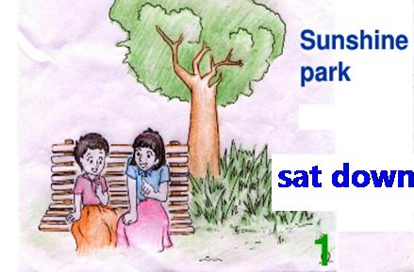
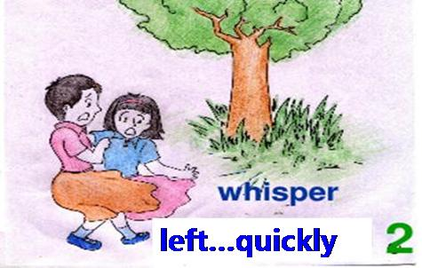
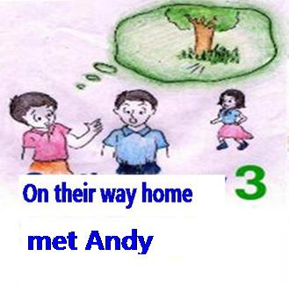
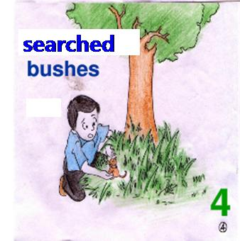
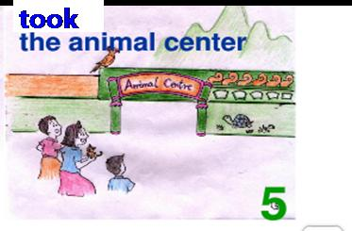
Try to retell the story
a whisper...bushes
turned around...saw nothing
afraid...left...
found a little cat...

Slide 21
Post-reading
B4. Henry, Andy’s friend, is asking Andy about the “ghost”.
Help Andy answer his questions.
Henry: What did Millie and Amy hear?
Andy: They heard a .They were very and left the park quickly.
Henry : What did you find?
Andy: I found a little cat in the _______.
Henry : Why did the little cat sound like a ghost?
Andy: It was very_____ , so when it_________, it sounded like a ghost.
Henry : Where is the little cat now?
Andy: We took it to the _______centre.
whisper
afraid
bushes
weak
miaowed
animal

Slide 22
Summary
1 There aren't any ghosts in the world. We shouldn't frighten ourselves.
2 We should look after animals because they are our friends.
3 When we meet something strange,do not be afraid. Try to find the truth.

Slide 23
1. As usual, they sat down under a big tree.
as usual 照例，像往常一样；作状语，位于句首或句末
than usual 比往常更
As usual
e.g.像往常一样，迈克是步行上学的。_______ _______, Mike went to school on foot.
他比往常更晚到校。He went to school later than usual.
usual adj. 通常的，平常的
unusual adj. 不寻常的
usually adv. 通常
一件寻常的事：
a usual thing
一个不寻常的故事:
an unusual story

Slide 24
I got an _________ gift on my birthday.
__________, I go swimming on Saturday. But this weekend, I will go fishing.
You can work it out in _____usual way.
unusual
Usually
a

Slide 25
2. Suddenly, they heard a whisper from the bushes behind the tree.
(1) suddenly adv. 突然，位于句首或句中
e.g. 他突然从自行车上摔了下来
Suddenly, he fell off the bike.
(2) sudden adj. 突然的，忽然的 suddenly= all of a sudden
e.g. 他的突然去世让每个人都很难过。
His sudden death made everyone sad.
(3) whisper n. 低语，耳语； v. 低语，小声说
in a whisper/ in whispers 小声地
e.g. 那个男孩在他妈妈耳边低声说了些什么。
The boy whispered something in his mother’s ear.
他们正在窃窃私语。
He suddenly fell off the bike.
They are talking in whispers.

Slide 26
hear sb. do sth. 听到某人做了某事（经常性或是动作的全过程） hear sb. doing sth. 听到某人正在做某事（强调动作正在进行）We can often hear them talk in the park.
Listen! Can you hear the boys singing in the next room?
类似的结构还有: see/watch sb.do/doing sth.

Slide 27
3. They turned around but saw nothing.
(1) turn around vi. 转身; vt. (使) 翻转
e.g. I turned my chair around to face the door.
(2) 与turn相关的常见短语
turn on 打开(开关) turn off 关闭
turn up (音量)调大; 露面 turn down 调低；拒绝
turn to 向……求助 turn into 变成，成为
turn out 证明是

Slide 28
4. Nobody replied.
reply vi. 答复，回答；多用于书面语
e.g. 我没有答复他。 I _______ ______ ______ him.
answer v. 回答；还可用于接听电话等，范围较广
e.g. 不用马上回答我的问题。________ ________ my queation at once.
reply to... 对...做出回答
didn’t reply to
You don’t have to answer
5. That’s strange.
strange adj. 奇怪的；陌生的
... be strange to sb ...对某人来说陌生
e.g. 起初，我对这个地方不熟悉。
At first, _____ _______ _____ ________ ____me.
stranger n. 陌生人
the place was strange to

Slide 29
6. They left the park quickly.
leave v. 离开
(1) leave sp
(2) leave for sp
e.g. 他什么时候动身去北京。When ____ ___ _______ _____ Beijing?
(3) leave A for B
e.g. 她下周就离开南京去杭州了。
离开某地
离开去某地
will he leave for
离开A地去B地
She will leave Nanjing for Beijing next week.
【拓展】leave v. 丢下，忘了带 leave sth + sp 把某物落在某地
e.g. 我把书落在公交车上了
I _______ my book ___________.
left
on the bus

Slide 30
7. On their way home, they met Andy 在回家的路上
on one’s/ the way to… 在去…… 的路上,
后接 home, here, there, back, abroad(国外) 等副词，to 要省略
in this way
in some ways
in one's way
用这种方法
在某些方面
挡住某人的路
在我们回家的路上
在我们去学校的路上
在他去公司的路上
on our way home
on our way to school
on his way to the company

Slide 31
8. What happened?
(1) happen vi．发生
sth happened to sb/ sth 某人/物发生了某事
e.g. 你发生什么事了吗？ ______ ________ ___ ____?
Tom 发生了一些不好的事. __________ ____ __________ ___ Tom.
What happened to you
Something bad happened to
(2) happen vi. 碰巧
happen to do 碰巧做某事
I happened to meet an old friend of mine yeaterday.

Slide 32
wonder vi． & vt． 琢磨，想知道；感到诧异
①想知道：wonder + what, who, why引导的宾语从句；
I wonder why Ann is late．
我想知道安为什么迟到了。
②感到诧异：wonder + at/about。
I wonder about his behaviour．
我对他的行为感到诧异。
wonder why
wonder about

Slide 33
9. He searched the bushes.
(1) search vt. 搜查
search sp 在某地搜查
search sb 搜身
【拓展】in search of … 寻找/搜寻…
e.g. 警察为什么搜这个男孩的身？ Why did the policemen ____________?
为什么不搜查一下那座大楼呢？ Why not __________________?
search the boy
search that building
(2) search vi. 查找，寻找
search for sth/ sb = look for sth/sb 寻找某物或某人
e.g. 你要用你的电脑搜索信息吗？
Do you use your computer to ____________________?
search for information

Slide 34
John _____everywhere,but he couldn't ____his key.
A.searched,look for
B.looked,found
C.searched,find
D.looked for,found

Slide 35
15.

Slide 36
声音
When it miaowed, it sounded like a whisper.
sound
泛指任何声音，不论其高低、是否悦耳等
I heard the sound of running water.
表示“噪音\喧闹”, 指的是人们不愿听到的声音\嘈杂声
I heard some strange noises last night.
noise
主要指嗓音，说话、歌唱或笑的声音。
用于其它方面时，常含悦耳之意，如鸟鸣声\乐器声音Please speak in a louder voice.
voice

Slide 37
10.Millie and Amy were very surprised—it was a little cat!
surprised adj. 吃惊的，惊讶的
surprising adj. 令人吃惊的
(1) be surprised to do sth． 做某事感到惊讶
e.g. 我很惊讶昨天在图书馆遇到了约翰。
I ____ __________ ___ _______ John in the library yesterday．
(2) be surprised at 对……感到惊讶
我对吉姆说的话感到惊讶。
I _____ _________ ____ what Jim said．
人
物
was surprised to meet
was surprised at

Slide 38
I must work harder than before! John said to himself(oneself)
The old man is ____to know about the ____fact in today's newspaper.
A.surprised,surprised
B.surprised,surprising
C.surprising,surprised
D.surprising,surprising
himself

Slide 39
用所给单词的适当形式填空:
There are some _______(bush) in our school.
Our English teacher told us to listen to the radio ________ (careful).
3. The ________ (follow) week, he was not late for school.
4. “Be quick”, I said to ______ (my).
bushes
carefully
following
myself

Slide 40
5. I found nothing in my school bag. but I knew there was something ________ (usual).
6. Tom is afraid __________ (see) that film.
7. Yesterday I ______(find) a little dog in my garden.
8. Just now Sandy ______(hear) a whisper and she ____ (run) away quickly.
unusual
to see
found
heard
ran

Slide 41
完成句子
1. 像平时一样, 他早早来到了学校。
____ _______, he came to school early.
2. 小偷看到警察转身就跑。
When the thief saw the policeman, he _____ ______ and_____ ______ .
3. “我会努力学习的”，男孩自言自语道
“I will work hard”, the boy _____ ___ _______.
4. 地板上有一支钢笔。让我把它捡起来吧。
There is a pen on the floor. Let me _____ ___ _____.
As usual
turned around
ran away
said to himself
pick it up

