Slide 1
( Checkout time）

Slide 2
1. 说教材
2. 说学情
3. 说教学目标
4. 说教学方法
5. 说教学过程

Slide 3
Enjoy a song

Slide 4
Quick respond
Family tree
Who is missing?
谁不在这里？

Slide 5
Welcome to my birthday party!
欢迎参加我的生日派对！

Slide 6
Guess!
Who will come to my party?
谁可能会来参加我的生日派对呢？

Slide 7
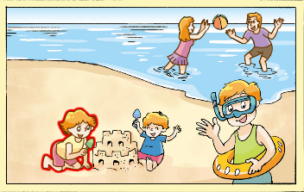
两人一组对话，认识一下Mike 的家人。你可以用到的句子：
A: Who is he/she？
Who is that girl/boy/man/woman?
B: He's/She’s …
Checkout time
Mike在介绍他的家人，你认识他的家人吗？

Slide 8
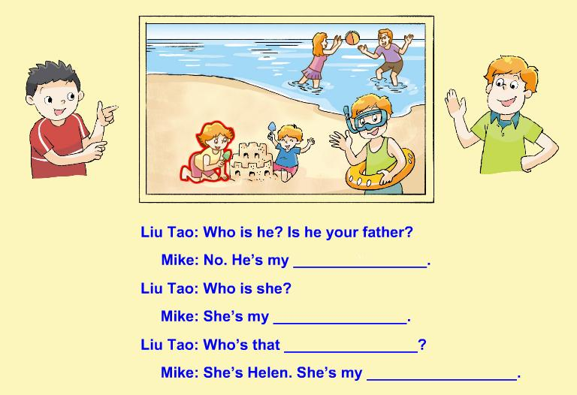
Checkout time
Checkout time
独立完成书上55页练习。注意书写工整、美观哦！

Slide 9
Checkout time
uncle
aunt
girl
sister

Slide 10
This is my family

Slide 11
Read and choose
1. The little tree’s brother is ---.
A. tall B.strong C.cute
2. The little tree’s father is ---.
A. beautiful B.nice C.tall

Slide 12
Let's share
Let’s tal
Try to introduce your family and friends!
来介绍下你的家人和朋友吧！
Take out your pictures and try to introduce!
拿出图片，试着介绍一下吧！

Slide 13
He's/She's my father/mother...
He's/She's ... years old.
He's/She's tall/short...
He's cool/strong...
She's beautiful/nice/cute...

Slide 14
Homework
Introduce your classmates to your family.
说一说，把你的同学介绍给家人。
2. Write down your introduction of your
classmates.
尝试把你的同学的介绍写下来。

