Slide 2
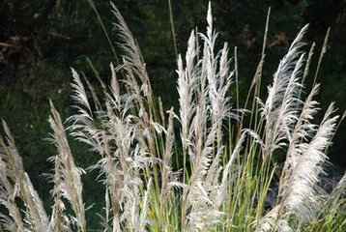

Slide 3
| X X X |
| XX XX |
| X X X |
| X X | X - |
| X X |

Slide 4

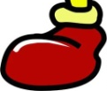




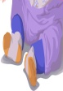









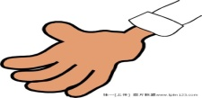

拔根芦柴花
| X X X | X X X | X X X | X X X | X X X | X X X |
| X X X | X X X | X X X | X X X | XX XX | XX XX |
| XX XX | XX XX | XX XX | XX XX | X X X | X X X |
| X X | X - | X X | X - | X X | X X ‖

