Slide 2
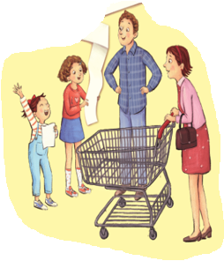
Back to school shopping

Slide 3
New Year's Day is coming.
What do you usually do
on New Year's Day?

Slide 4
Guess
What do I usually do
on New Year's Day?

Slide 5
Cover talk
封面解读
A.Shopping for food.
B.Shopping for clothes.
C.Shopping for school
supplies(学习用品).
Why do they do shopping
for school supplies?

Slide 6
Cover talk
封面解读
Why？
Cathy
shopping list
购物单
Amanda
What?
How many?

Slide 7
Why do they make a shopping list？
√
To save time.
(为了节省时间）
√
To induce unnecessary expenses.
(为了减少不必要的开销）
√
To make sure they don't forget
anything.
(为了确保他们不忘记要买的东西）

Slide 8
Fast reading
Shopping list
10 pencils 5 erasers
2 notebooks
3 folders
…
In the store, Dad asks, “
What's on your shopping list?”
Cathy and Amanda answer,“
ten pencils, five erasers, two notebooks, three folders...”
Mom says,“Okay. Let's go look for your school supplies.”

Slide 9
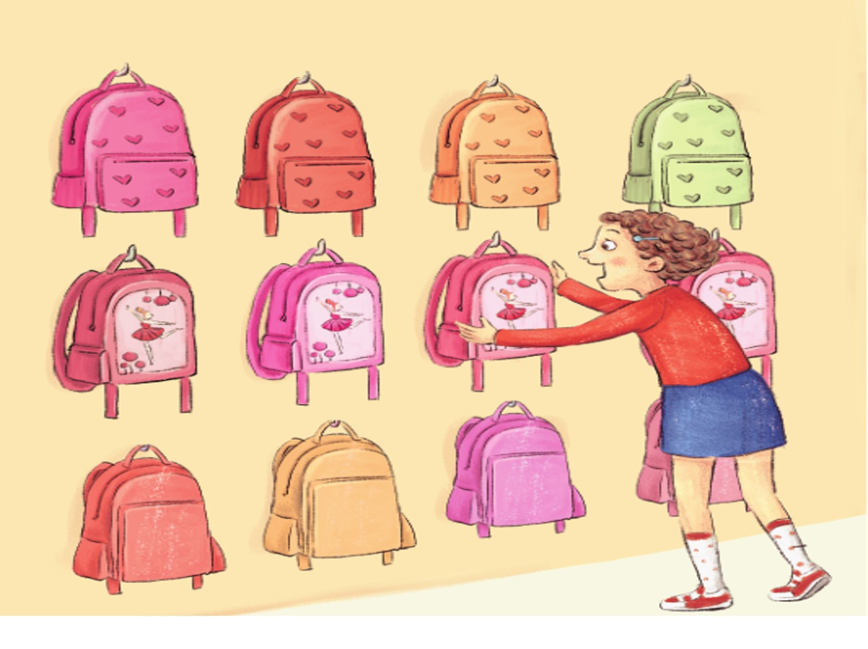
Look and say

Slide 10
Look at this schoolbag! It is pink. Pink is my favorite color. Can I buy it?

Slide 11
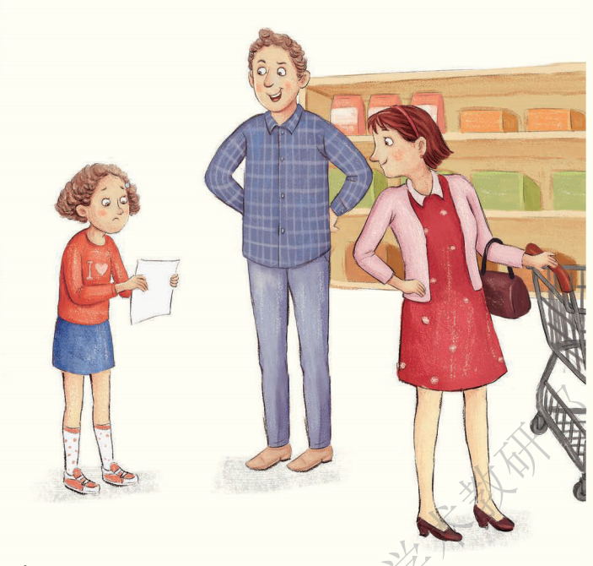
Look and say

Slide 12
Is it on your shopping list?
No, it isn't.
Remember our shopping rule（规则）: Only buy things on the shopping list.

Slide 13
Let's read.
Cathy shouts,“
Look at this schoolbag! It is pink.
Pink is my favourite color.
Can I buy it?”
Dad asks,“
Is it on your shopping list?”
Cathy answers,“No, it isn't.”
Dad says,“
Remember our shopping rule.
Only buy things on the shopping
list.”

Slide 14
Look and say
Go shopping with Amanda or Dad. Make one of the dialogues in a group of four.
If you have some questions, ask your teacher for help.
跟Amanda或爸爸一起去购物，4人一组编写其中一则对话。如果有问题，向老师求助。

Slide 15
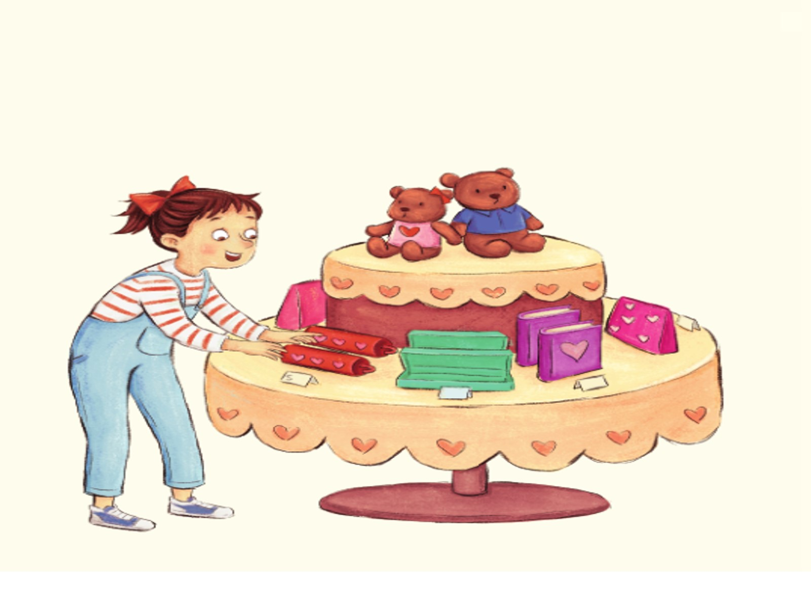
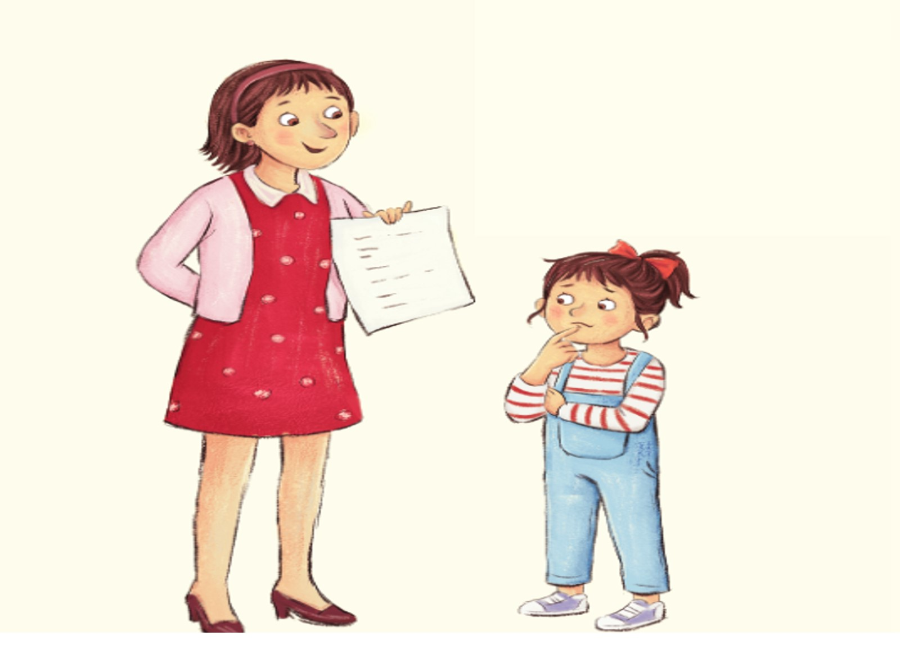
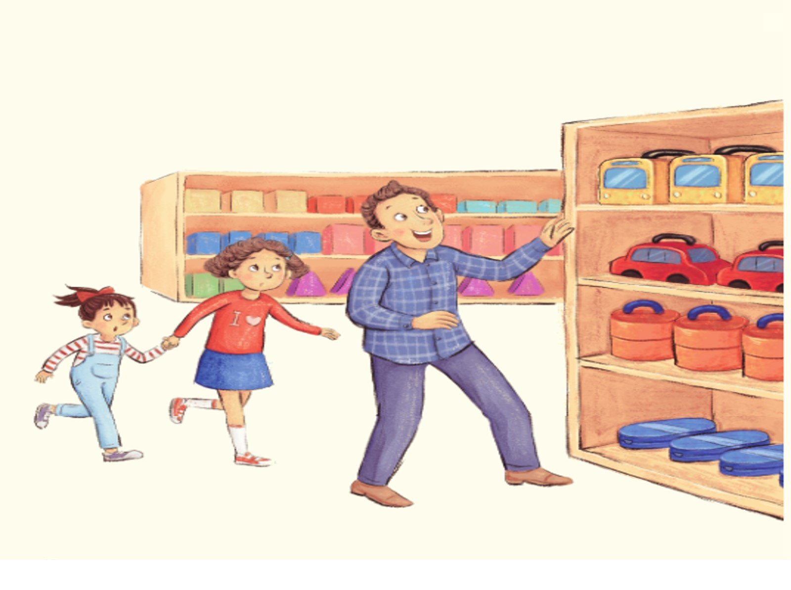
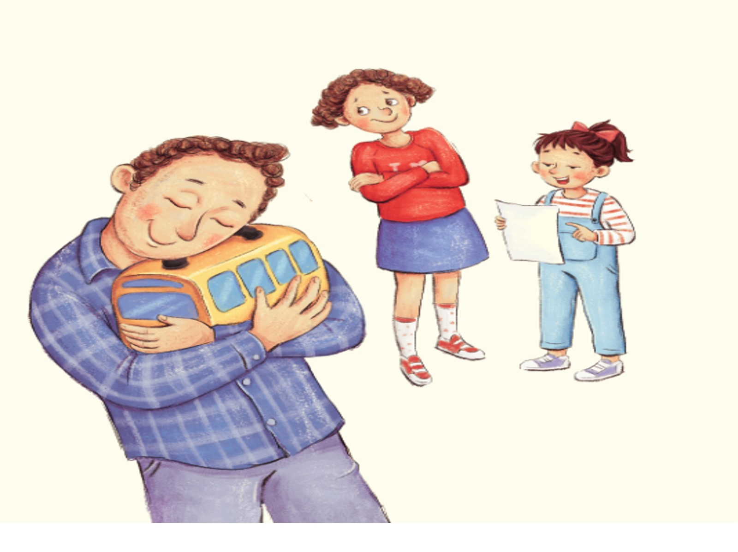
Amanda exclaims,“ .
.
”
Mom asks,“ ”
Amanda answers,“ ”
Mom says,“ .
”
（呼喊）
1
He exclaims,“Oh my goodness!
.
.”
Cathy says,“Uh, Dad…
.”
Amanda says,
“ .
2

Slide 16
Amanda exclaims,“
Look at this pencil case! It
is red. Red is my favourite
color. Can I buy it?”
Mom asks,“
Is it on your shopping list?”
Amanda answers,“
No, it isn't.”
Mom says,“ Remember our
shopping rule. Only buy
things on the shopping list.”
1

Slide 17
He exclaims,“Oh my goodness!
.
.”
Cathy says,“Uh, Dad…
.”
Amanda says,
“ .
2

Slide 18
He exclaims,“Oh my goodness!
Look at this lunch box.
It looks like a school bus.”
Cathy says,“Uh, Dad…
It is not on the shopping list.”
Amanda says, “Dad, remember our shopping rule.”
2

Slide 19
1
2
What do you know from these pictures?
I know...

Slide 20
Read Page 4 and find 'Why does Dad want to buy the lunch box?'
读绘本1-4页，找找“爸爸为什么想买这个午餐盒？”
When I was little, I took(带) the same lunch box to school. I have to (必须) buy it.

Slide 21
Let's enjoy.

Slide 22
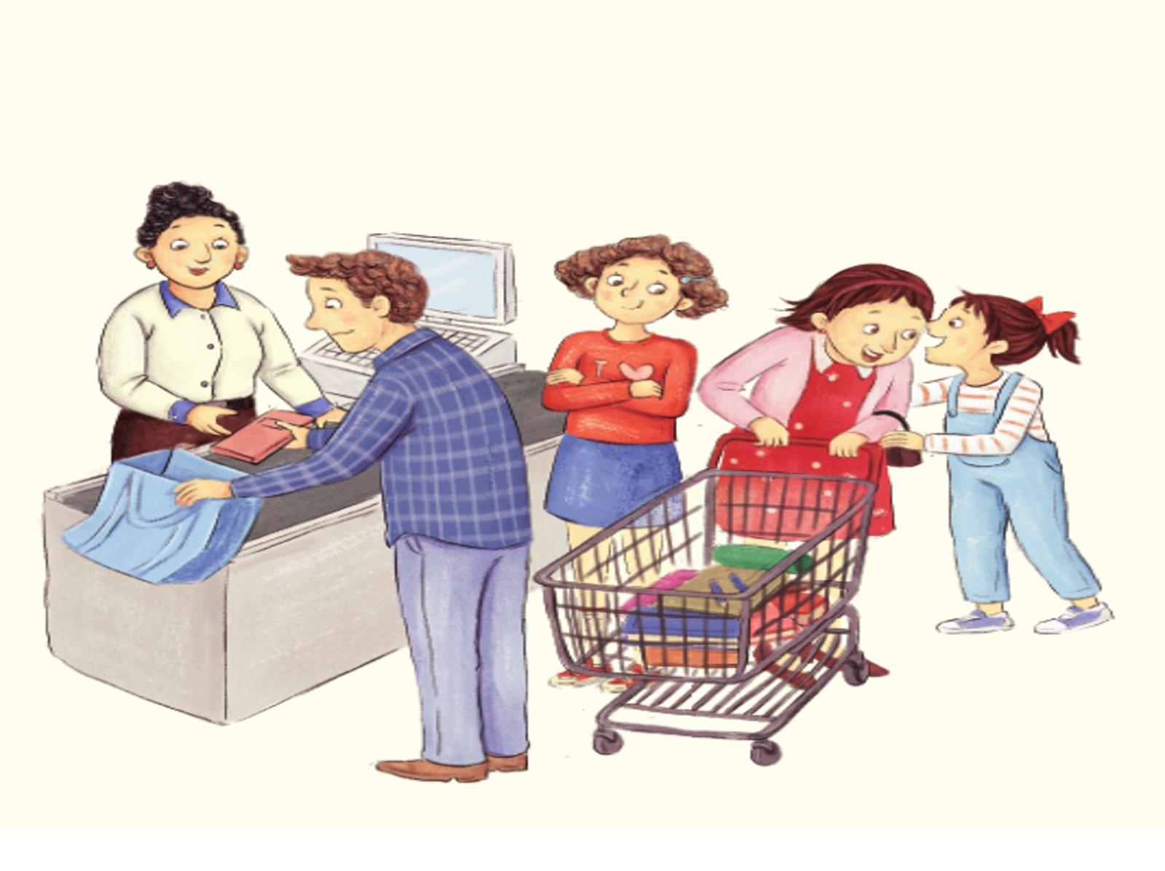
cashier desk
Soon, Cathy and Amanda find everything on the shopping lists.
Mom says, “Now, you are ready for the new school year. Let's check out.”

Slide 23
Look and guess
Does the story end? 故事结束了吗?

Slide 24
Try to find
Read Page 6-7 and find ‘What happens next?’
读绘本6-7页，看看接下来发生了什么？

Slide 25
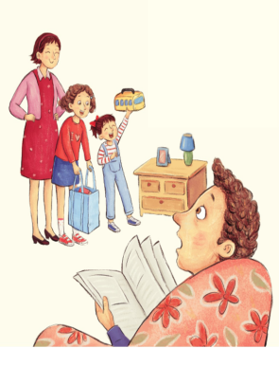
Amanda,“Let's buy the lunch box for Dad.
It can be a surprise.”
Mom,“You two are so sweet.”
After shopping, Amanda and Cathy go back home.
Cathy & Amanda,“Surprise! Surprise!”
Dad,“Is this for me? ”
(Amanda and Cathy nod their heads.)
Dad,“Thank you! This is the best surprise ever!”

Slide 26
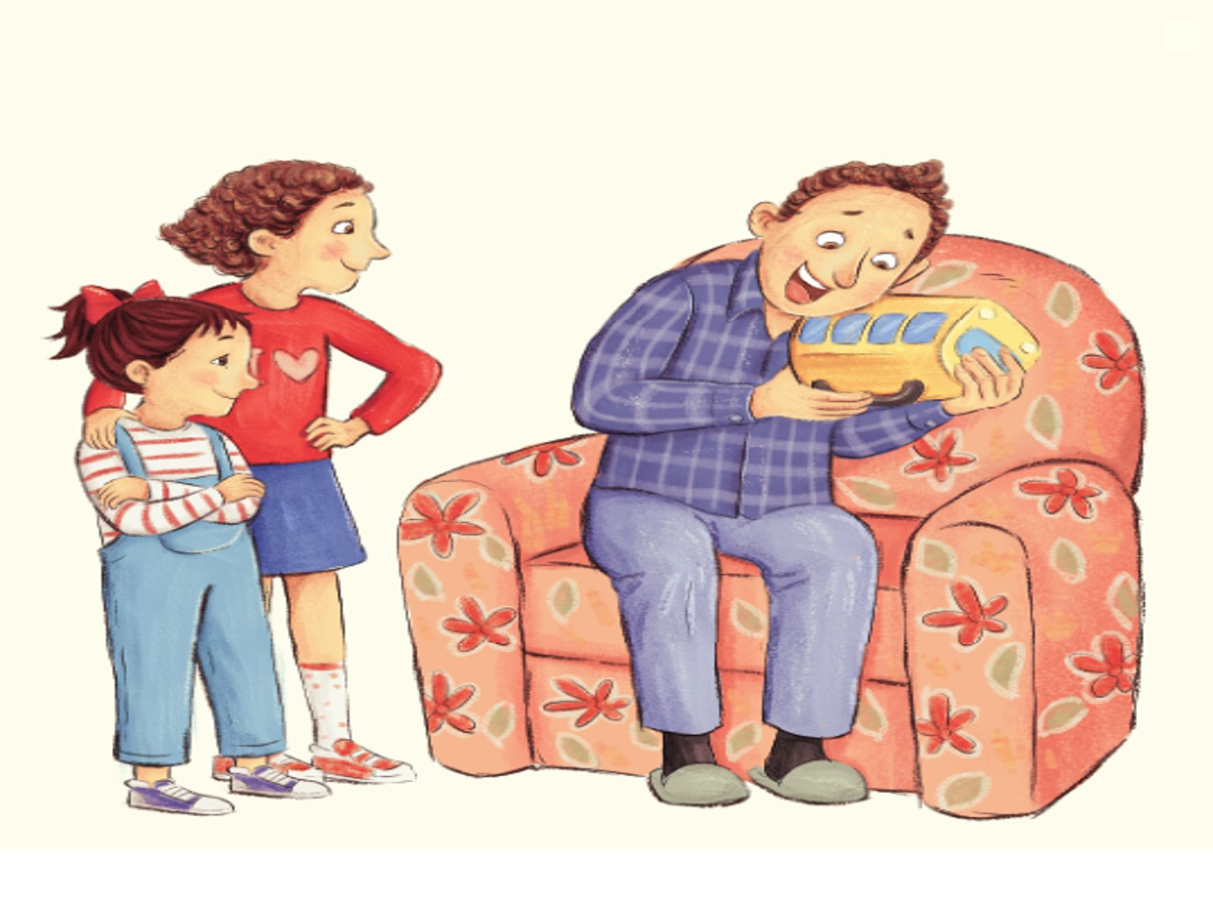
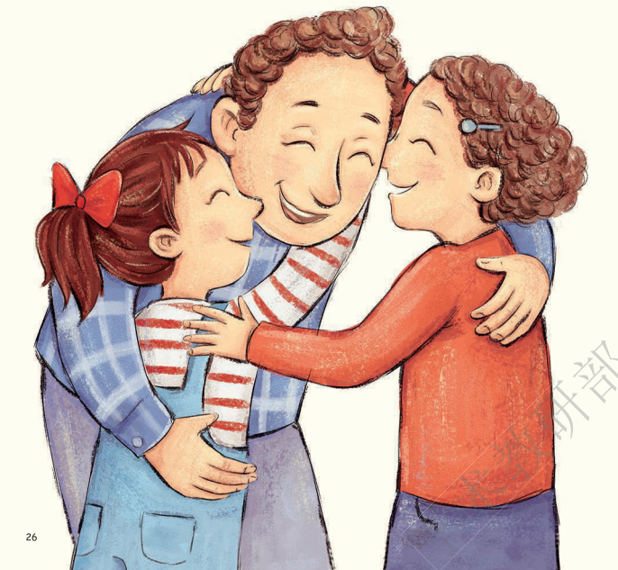
How is Dad？
How are Amanda
and Cathy？

Slide 27
Try to imagine
Try to say
Why do they love their dad so much?
Because Dad ...
The lunch box is not on the shopping list.
Why do they buy it for Dad?
为什么孩子们还是给爸爸买了不在购物清单上的午餐盒？
give Dad a surprise
love their Dad very much

Slide 28
What do you think of their family?
warm
Family
happy
sweet

Slide 29
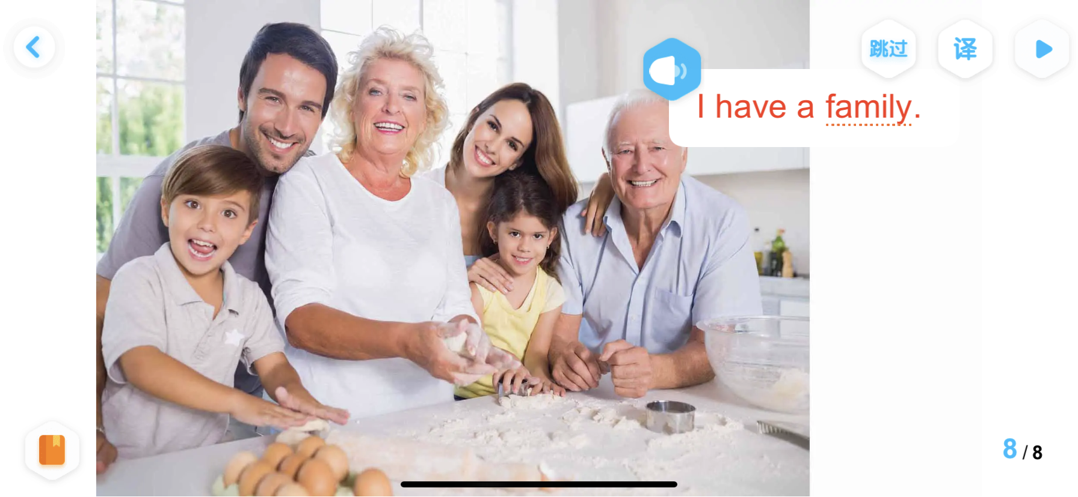
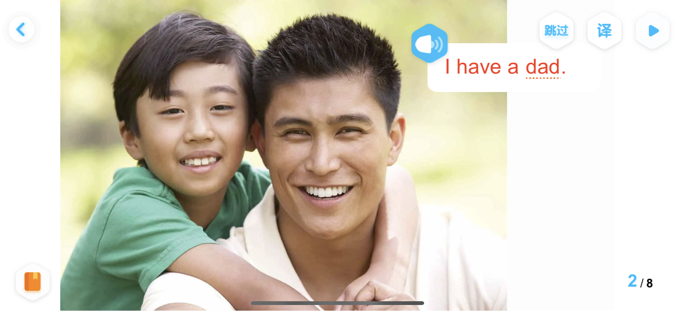
Do you have a happy family?
Why ?

Slide 31
What do you know from it ?

Slide 32
Homework
Try to share this story with your friends or family.
试着把这个故事讲述给你的朋友或家人听。

