Slide 1
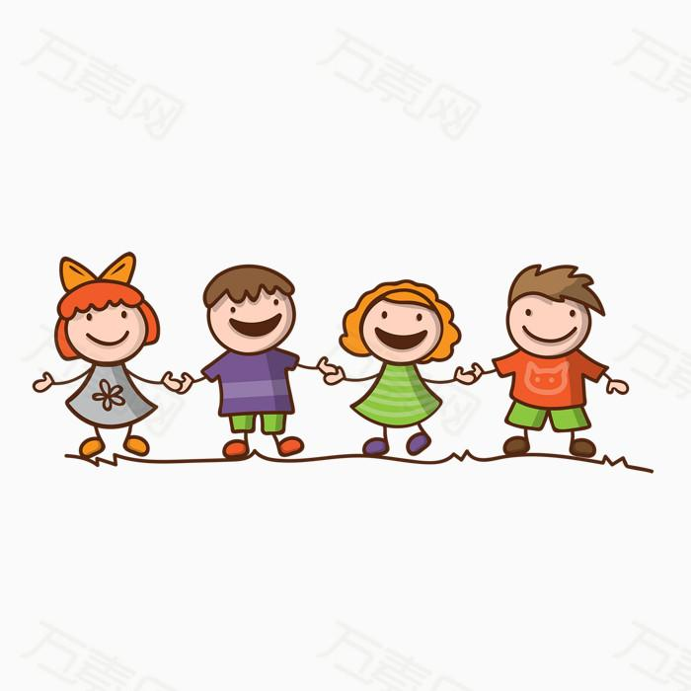
8A Unit 1 Best Friends
-- Reading （Ⅰ）
Dongqing Experimental School
Chen Yali

Slide 2
Best friends

Slide 3
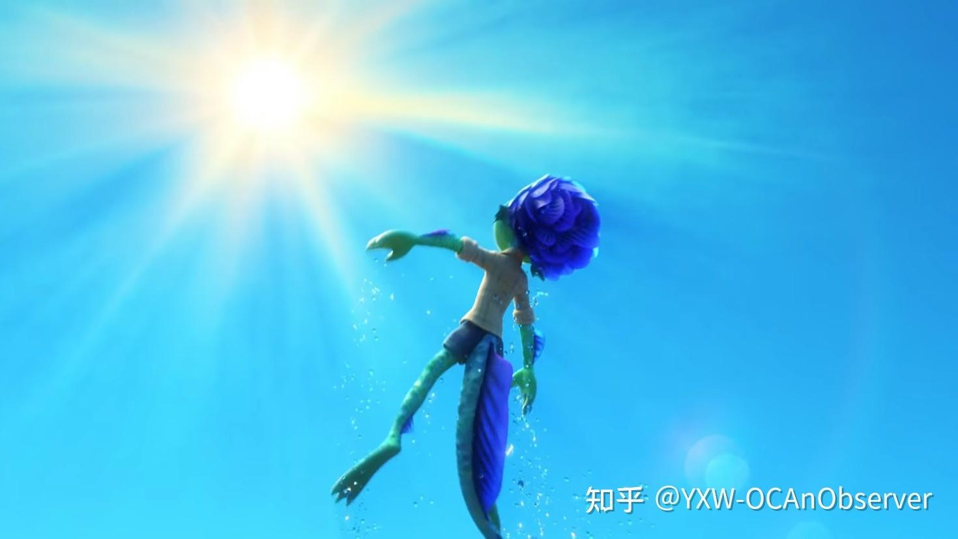
Have a guess
Luca is a sea monster(海怪).
Why do people still make friends with him?
What qualities does Luca have?
friendly/helpful...

Slide 4
Qualities of a friend
share... with...（分享）
have a sense of humor （有幽默感）
humorous（幽默的）
generous（慷慨的）
never feel bored（无聊的）

Slide 5
Scanning and answering
Why do the students write about their best friends?
____________________
Tip1: Don't miss the small characters （小字）in the beginning.

Slide 6
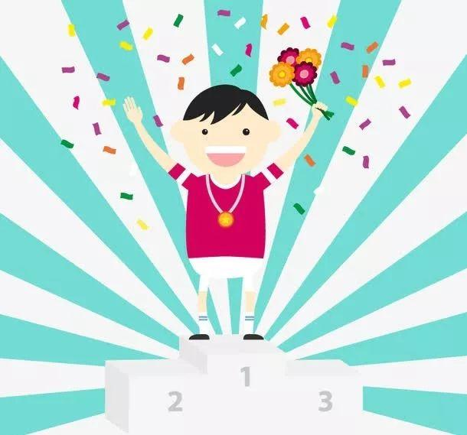
Mr Zhou,the editor(编辑）

Slide 7
Skimming
What are the friends' names?
Betty
Max
May

Slide 8
Careful reading:
Task1:Read silently and finish in the blanks
1.Betty always gives her seat on the bus to ______________.
someone in need
2._________ small round glasses makes him look smart.
Wearing
~
3.Max is so interesting and_________ that I never feel bored with him.
humorous
~

Slide 9
Careful reading
Tip2: Catch the key words.
Task2: Read loudly & answer
What does she look like?
How is she?
What does she want to be in the future?
What does each paragraph tell us about？
_________________
_________
Name
Looks
_______
__________________________________
______________________________________________________________________________________________________________
Personality(性格）
—
___________________________________
Future plans

Slide 10
Careful reading
Task3:Read to your classmate &fill in the blanks
Name | Max | May
Looks | the _______ boy --_____meters wears small _____ glasses look _______ has ______ legs don't ____ well ; _____ past ,he often ____________ | ________ than I am has big _____ eyes has long ________ hair _______
Personality | has ________________ tells ________ and makes me _____ never feel ______________ | ______ ____ often and never ____________ a _____friend something _____ me can _______________
tallest
1.75
shorter
round
bright
smart
straight
long
pretty
fit
walks
knocks ... onto
a sense of humor
sweet
funny jokes
smiles
says bad words
laugh
true
bored
worries
keep a secret

Slide 11
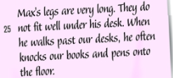
Careful reading
vivid
(生动的）
Task4:Read together & think further
opinions
What does the writer want to tell us in this paragraph?
What else does he say?Why?
The writer uses some facts to support the opinions.
What do you think of these facts?
Can you find more facts in the 3 passages?
~~~~~~~~~~
______
________________________________________________________________________
facts

Slide 12
Discussion
opinions
facts
Betty is generous.
She is helpful.
Max has a sense of humor.
May is pretty.
...
share...with...
homework;seat
jokes; bored
eyes; hair

Slide 13
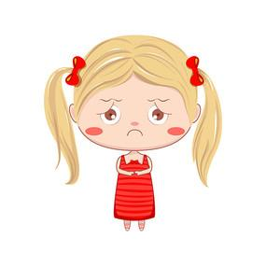
Careful reading
Task5:Read together & answer
What is her problem？
______________________________
Can we make friends only with those tall/pretty people？
Why can we become friends even though（尽管）May is shorter than me？
looks×
personality√

Slide 14
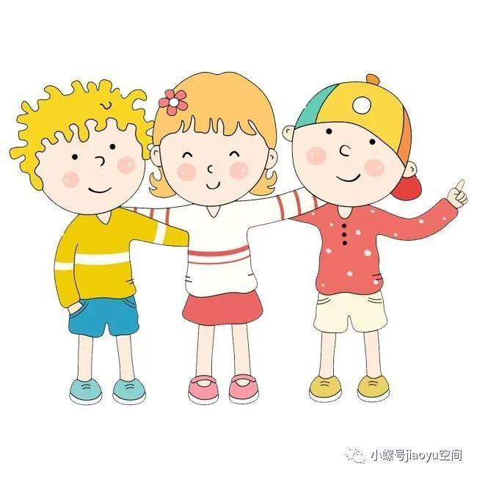
Post-reading :Making a summary
Betty、Max、May
facts&opinions
What did we learn?
qualities
generous、helpful、humorous...
Which quality is the most important?Why?

Slide 15
Task2:
If people around us have these qualities, will they surely become our best friends?
What can we do to have best friends?
be better together
have good qualities
accept the bad sides
love

Slide 16
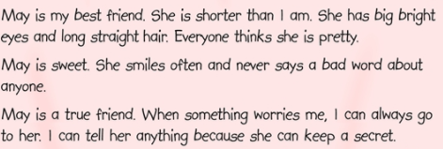
Task 3: Evaluation(评价）
Which one do you like best? Why?
A good passage=___________+__________+_____________.
a clear structure
vivid facts
a wonderful title

Slide 17
Friendship is like a flower.If there is a seed of love and care in your heart,it will bloom forever.

Slide 18
1.Write a passage about your best friend.
2.Try to make yourselves the best friends of others.

Slide 20
Task1:Pair work
Who would you choose as your best friend, Betty, Max or May? Use B4 as a model.

