Slide 1

Unit8
At Christmas

Slide 2

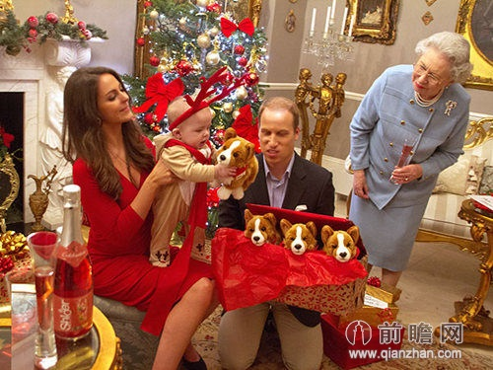
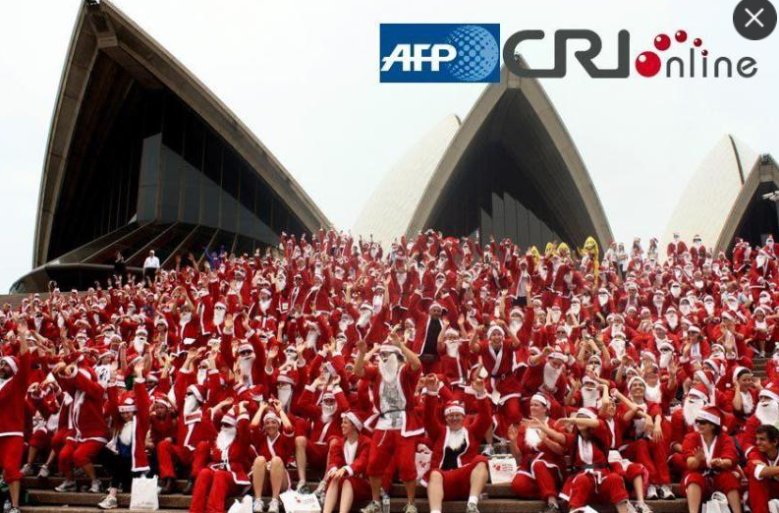
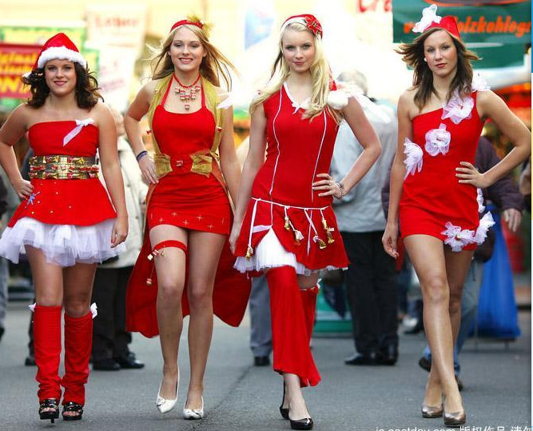
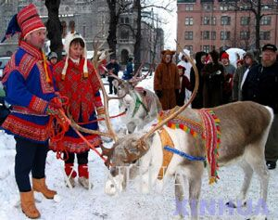
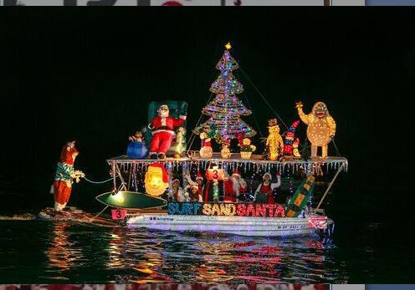
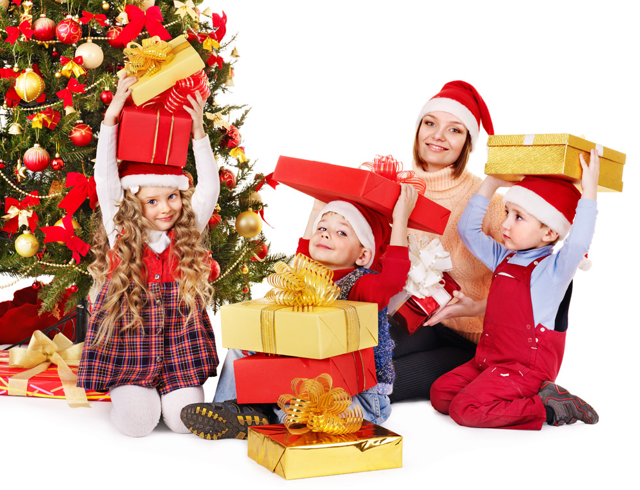
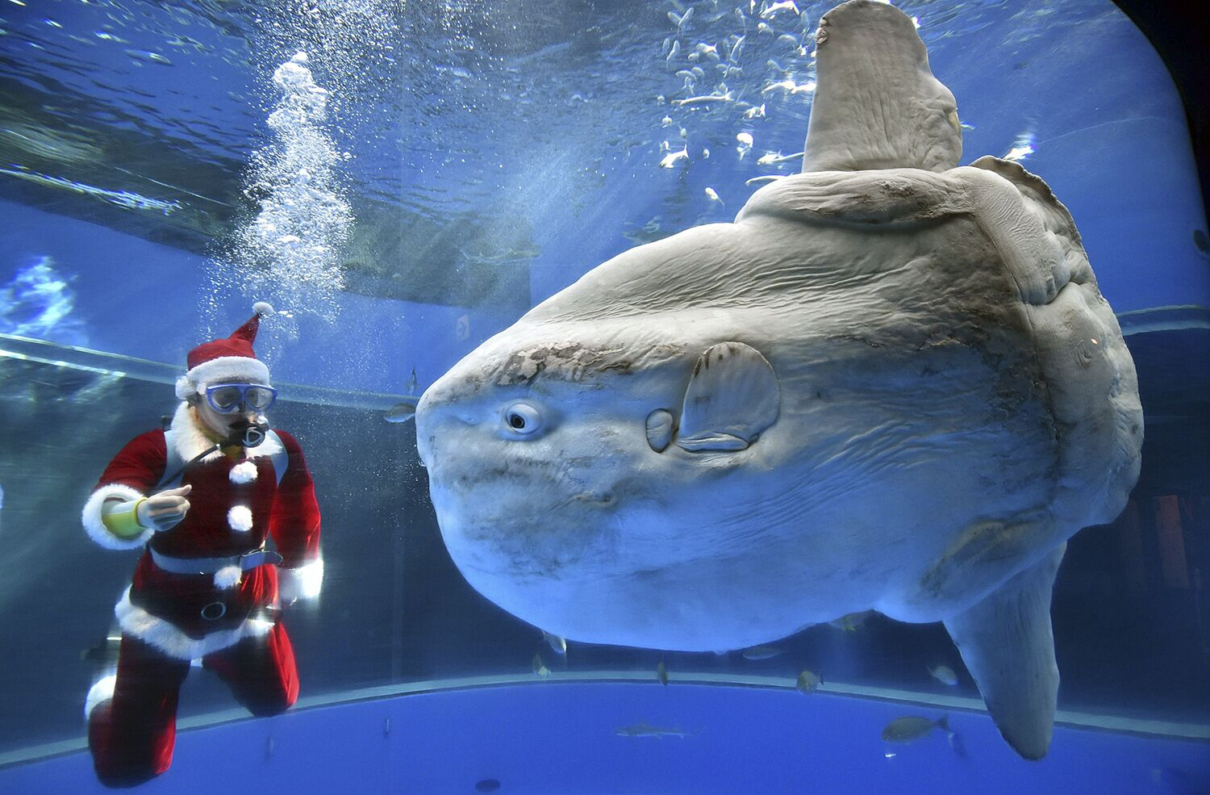
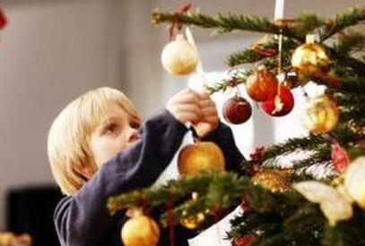
Australia（澳大利亚）
Germany（德国）
Finland（芬兰）
the UK（英国）
the US（美国）
Japan（日本）
Canada（加拿大）
Russia(俄罗斯）
Let’s enjoy.

Slide 3
What are these pictures about?
Christmas

Slide 4
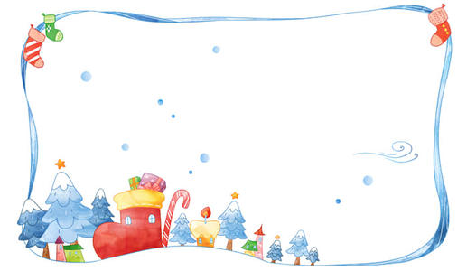

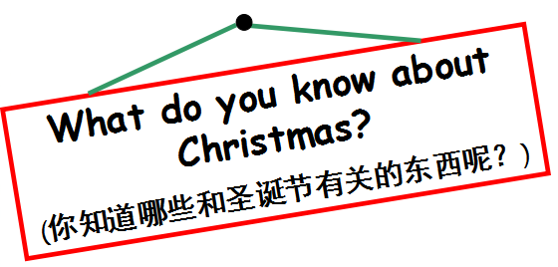
Let's talk

Slide 5
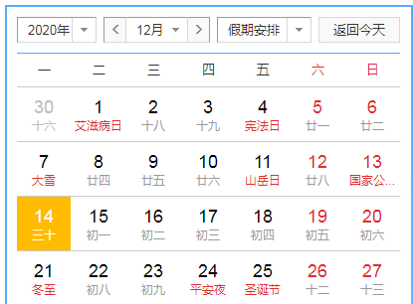
Let's talk
Christmas Eve
Christmas Day
before
Christmas
圣诞节之前

Slide 6
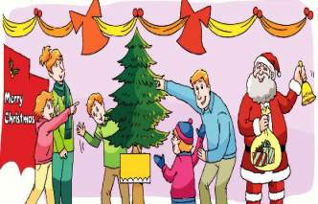

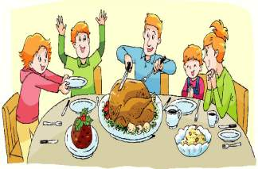
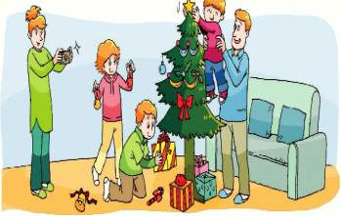
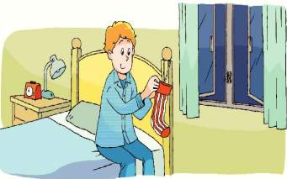

Slide 7

Listen and order
Listen and order
听录音，给下列图片排序。
What do Mike and his family do at Christmas?
( )
( )
( )
2
3
4
1
( )
A
B
C
D
Then
Finally
First
Next

Slide 8
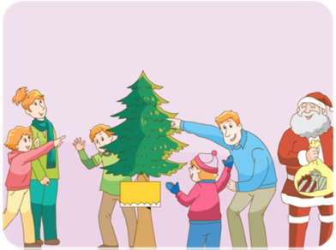
Read and find
First, what do they do?
首先，他们做了什么?
1.Read and underline
Read paragraph 1 quickly and underline what they do.
快速阅读第1段，用直线划出动词短语,独立完成。
2.Check in two
两人一组用“First,they...”说一说，一人反馈。
First, we buy presents for our family and friends. We also buy a Christmas tree. We sometimes go to see Father Christmas.

Slide 9
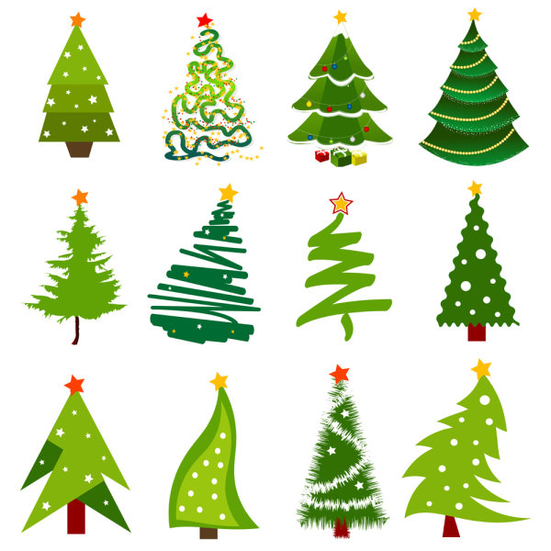
Let's talk
Next,what do they do ?
1.Read it by yourselves.
独立大声朗读课文第2段，划出关键信息
2.Ask and answer in pairs.
同桌两人问答反馈
A：Next，what do they do?
B: They...
Tip: 遇到不会读的单词可以向老师或者同桌求助哦~

Slide 10
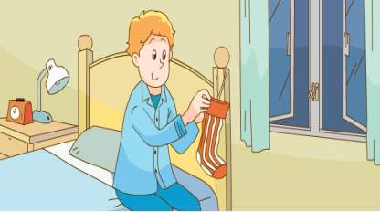
Look and say
Then,what do they do ?
Tip: Only children(孩子们) put a stocking on their beds and wait for presents.
Who also puts a stocking on the bed?
Then, they put a stocking on their beds and wait for presents.

Slide 11

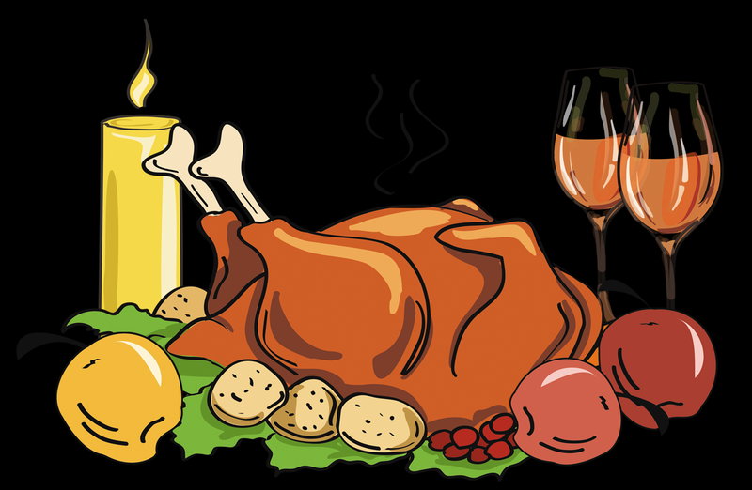

四人一组合作
1.仔细阅读第四小节，用直线划出圣诞活动的短语
2.有序地介绍一下
Talk and say
Finally,what do they do ?
first
next
then
finally
wake up early
have a big lunch
open their presents
turkey
Christmas pudding

Slide 12
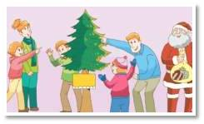
Reading time
TIPS:注意停顿/与重音
Before Christmas
We always have a lot of fun at Christmas.
First, we buy presents for our family and friends. We also buy a Christmas tree. We sometimes go to see Father Christmas.
/
/
-1-

Slide 13
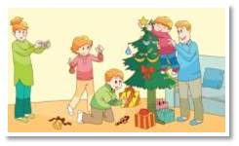
TIPS:注意停顿/与重音
Reading time
Before Christmas
/
Next, we put some pretty things on the Christmas tree. We also put our presents under the tree. It looks great!
/
-2-

Slide 14
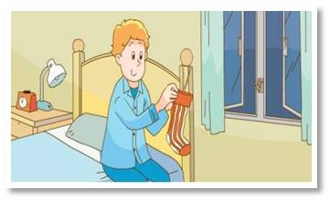
Reading time
TIPS:注意停顿/与重音
Christmas Eve
Then, Christmas Eve comes. We put a stocking on our beds and wait for presents.
/
-3-

Slide 15
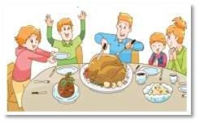
Reading time
TIPS:注意停顿/与重音
Christmas Day
/
Finally, it is Christmas Day! We wake up early and open our presents. We have a big lunch. We eat a turkey and Christmas pudding. We all have a good time.
/
-4-

Slide 16



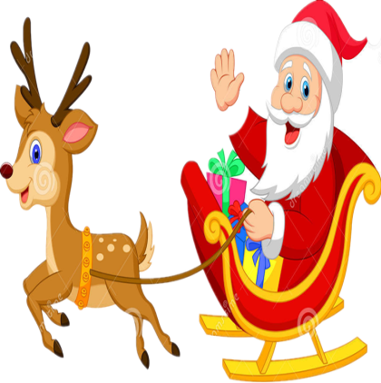

Read together 齐读
Read in pictures
每人读一幅图
Read after one
领读
Happy reading
四人一组选择喜欢的方式朗读Read in groups

Slide 17
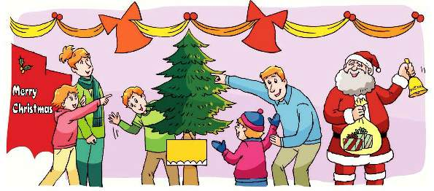
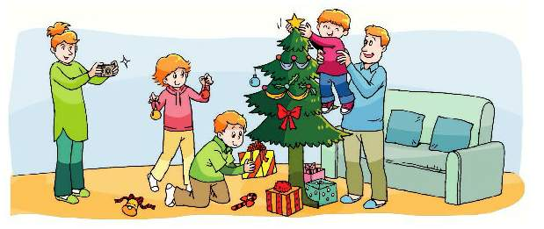
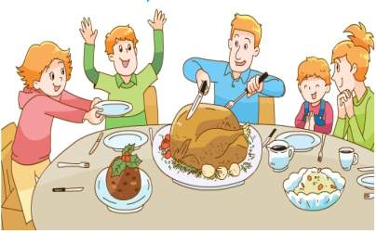
Let's retell
All: Mike and his family always have a lot of fun at Christmas.
First
Next
Tip:
四人小组合作，复述课文。不要忘记开头哦！
They buy...for
buy...
go to see....
They put...on...
put...under...
Finally
Then
They wake up early
open...
have a big lunch
They put...on...
wait for...

Slide 18



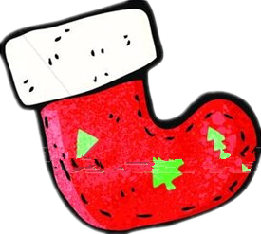

What do you think of
Christmas?你认为圣诞节怎么样？
Christmas
Christmas is __________.

Slide 19
Homework
1.Read the text after tape twice.跟课文两遍。
2.Retell the story to your friends and family.
将故事讲给你的朋友和家人听。
3.Find more information about Christmas and other western holidays.尝试了解更多有关圣诞节和其他西方节日的知识。
Change the Color of ANY of the items in this layout by double clicking on the item area in the graphic then right clicking on the graphic and choosing the fill tab. Chose your color and apply.
Another way to change the color is to go into the selection pane. Go to the “Home” tab (Upper Left) and select the “select” wording under editing and chose “selection pane”. From there you can select individual pieces of the object and change each one by clicking on the small arrow next to the objects.

Slide 20
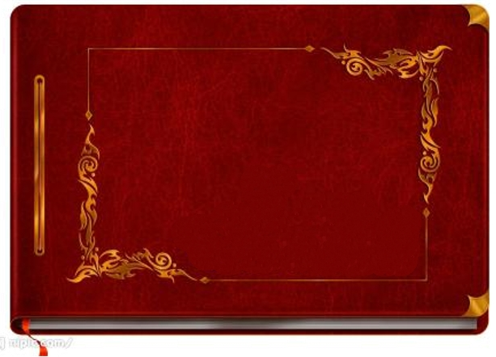
Let's read
Christmas

Slide 21

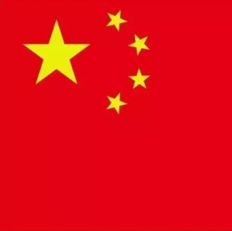


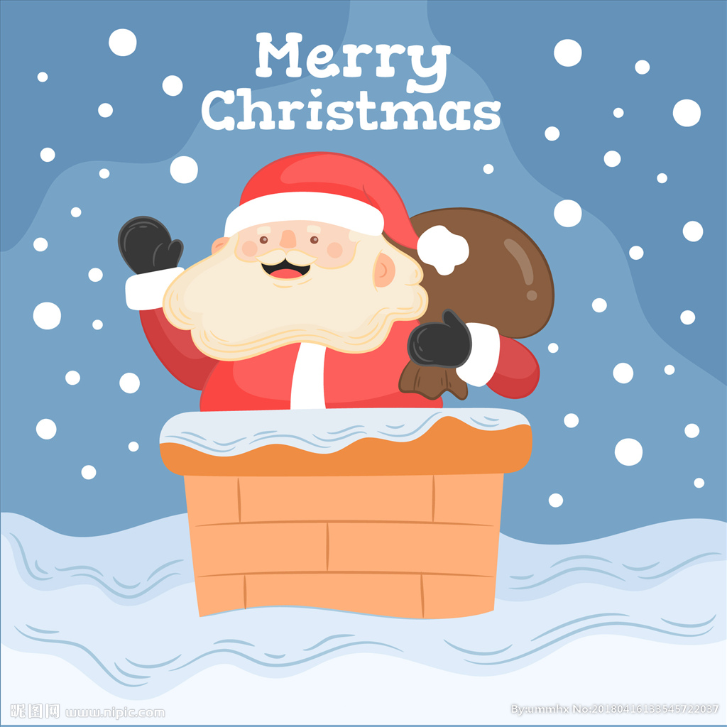
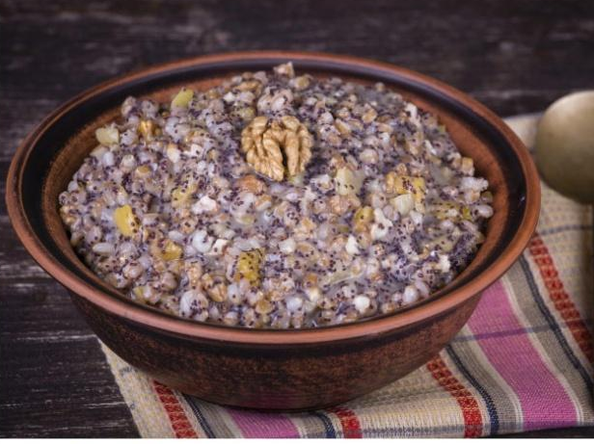
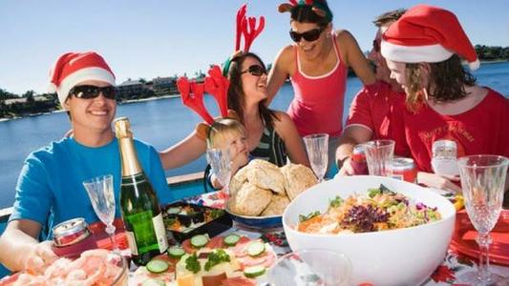
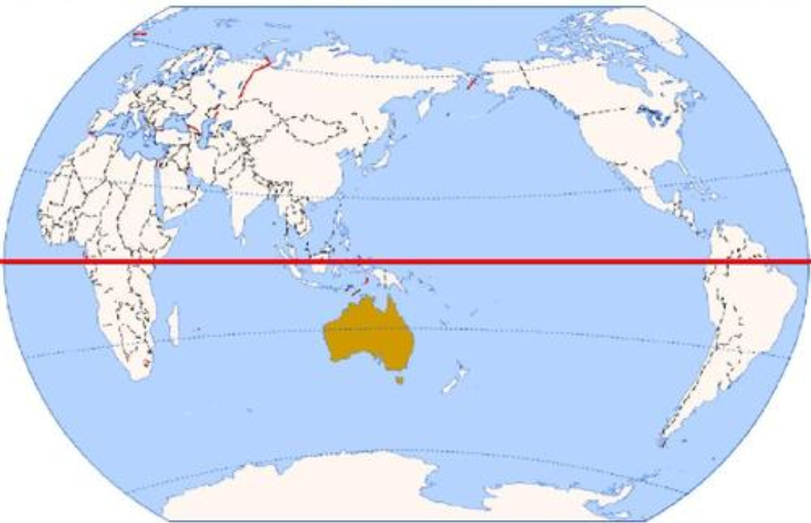
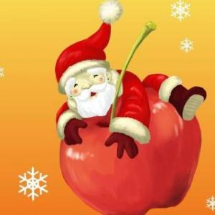
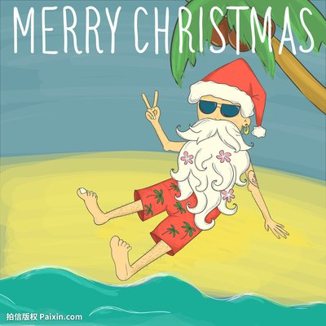
People celebrate Christmas in different ways.
世界各地的人们以不同的方式庆祝圣诞节。
the UK
Chinese tradition
“苹果”和“平安”谐音
People make a fast(斋戒) on Christmas Eve and they do not eat meat.
Australia
eat cold dishes
drink beer

