Slide 1
Chance and Change
By Gu Jingyun
Xuejia Middle School

Slide 2
A story of the documentary Tough Out (《棒！少年》)
Notes:
A real event

Slide 3
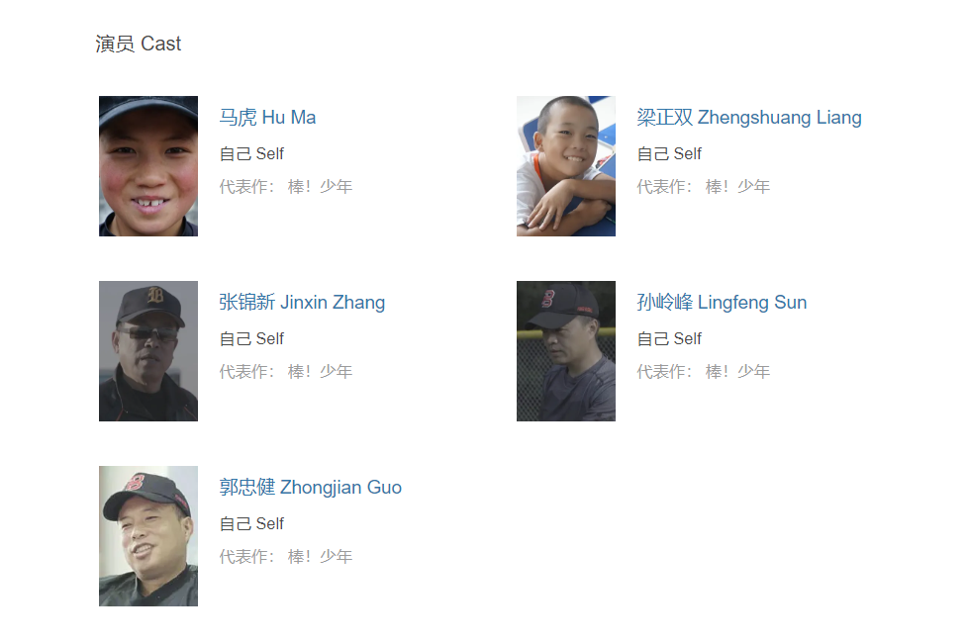
There are 40 million poor children in China. Many of them are left-behind children or orphans in poor conditions. They lack money, education and parental care.
Why do they play baseball?
What’s special about the baseball team?
The main actors are the baseball players in the real life

Slide 4
Fate can change
A charity programme
Power Baseball Angels

Slide 5
P1
Changes on Ma Hu
P2
Introduction of the documentary
P3
Changes on Sun Lingfeng
P4
The introduction of the baseball team
P5
The writer’s ideas
P6
The introduction of children

Slide 6
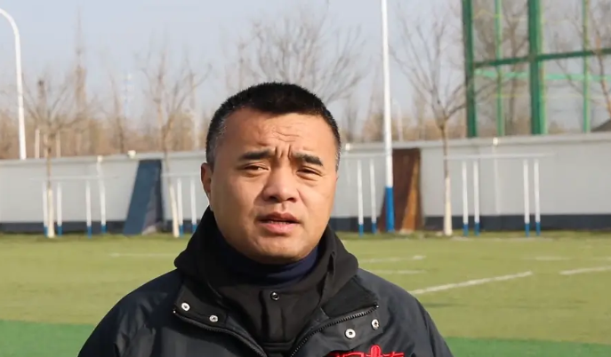
Two main characters in the passage:
Name:
Sun Lingfeng
Introduction:
Ma Hu
former captain
A ________________of China’s national men’s baseball team
One of the stars of the film
One of the members of the team

Slide 7
Main changes:
Para4 Personality
From
probably become a
thug
To
Have discipline
Learn how to live life
Sun Lingfeng
“Sun wants to help poor children the same way ”
Launch a charity programme
Power Baseball Angels
Notes:
Baseball change his life, he use baseball to change others’ life

Slide 8
Main changes: Para5
comfortable
adj.
Personality:
Learn to comfort his teammates
Fight with others
Never follow the rules
Join Power Baseball Angels
Future plan:
Dream to become a member of the national team
A poor boy raised by his grandmother

Slide 9
What helps him make these changes?
If he did’t join the baseball team,what will happen to him?
If he gave up after joining the baseball team, what will happen to him?
Society
Sun Lingfeng
team members
Love and care
……
Coaches
teach skills
care and guidance
Catch the chance and make full use of it
himself
Notes:
Let’s read together!

Slide 10
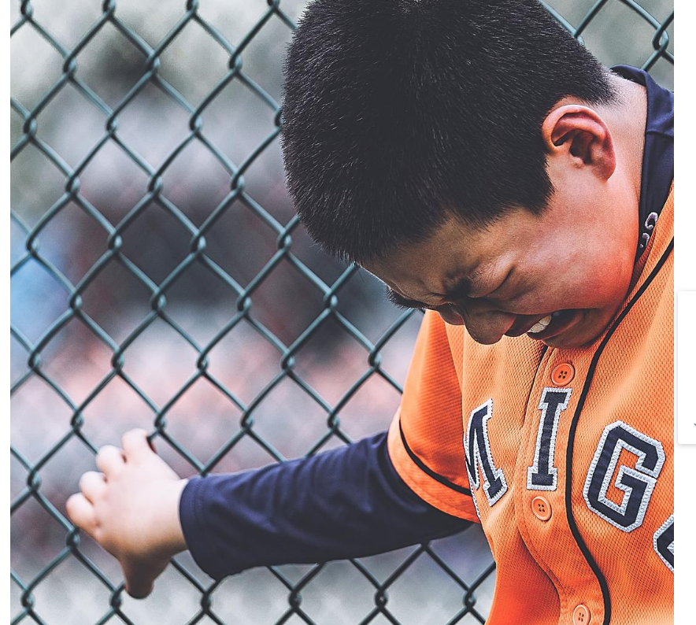
Touch Out是棒球中“触杀”局面的术语，意味着出局
Tough out 意思是咬牙坚持下去
1.Why is the documentary named ‘Tough out’ ?
2.Why does the writer write the passage?
The writer asked “How can these problems be solved?”
Catch the chance and keep trying !
Lack money, education and parental care
1.Raise the readers’ interest in this film
2.Draw people’s attention to these poor children, bring more help to them
3. Lead the readers to think about how to change one’s fate
4. ……

Slide 11
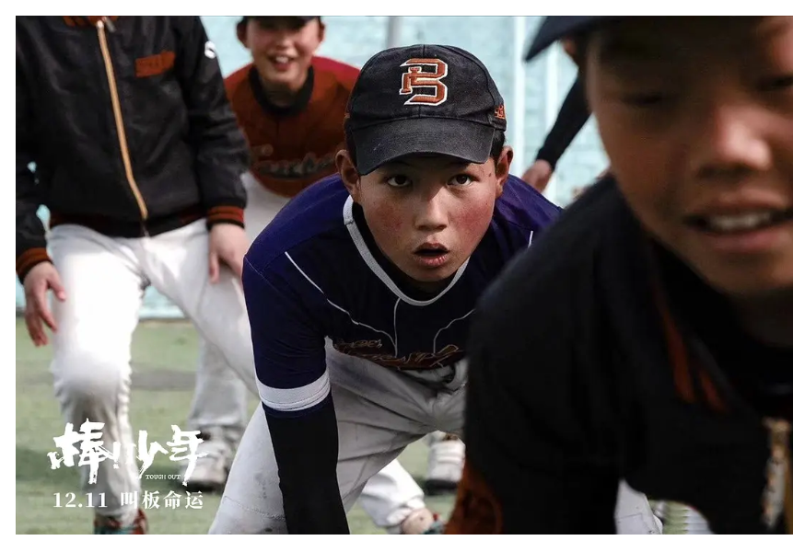
When the chance comes, we should catch it .
When the chance hasn’t come, what should we do ?
Chance favors(青睐) those who prepare well
Notes:
Because !!!

Slide 12
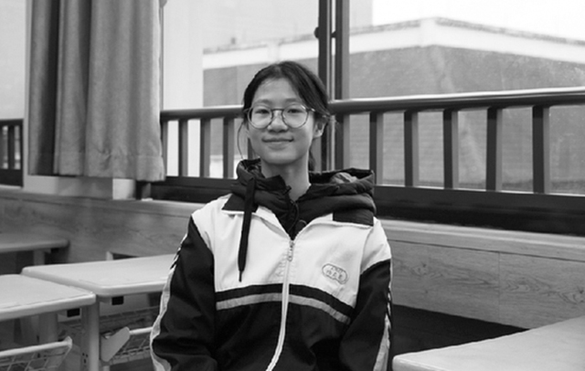
‘Faster than lighting’
Lu Qirui
a 15-year-old student in Hangzhou
Notes:
Before the chance comes, should we just wait for it? We should ……..

Slide 13
How fast can she run?
Set __________
______________
12.07 seconds in a 100-meter sprint
two new records
25.11 seconds in a 200-meter race
The speed is considered almost impossible for a teenager to achieve

Slide 14
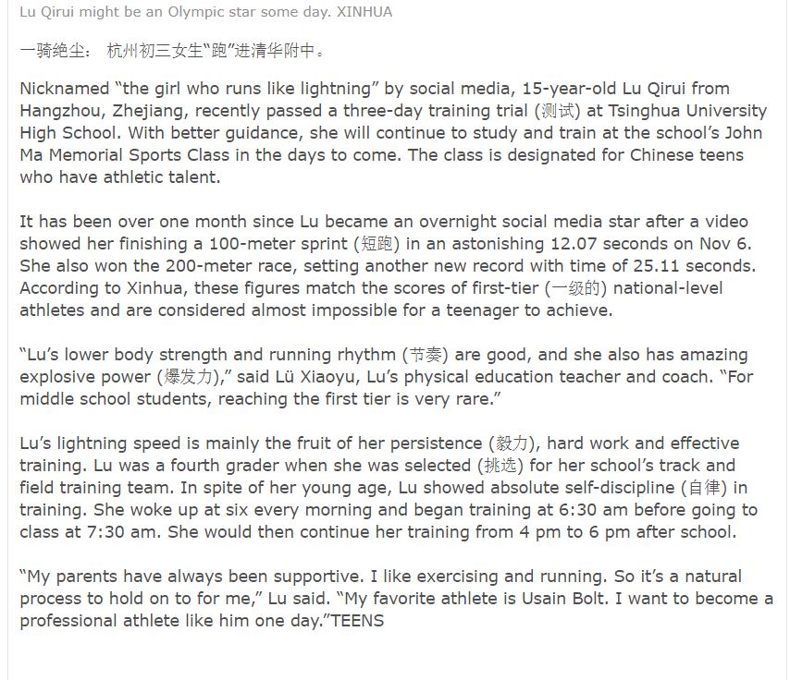
According to the passage, what help Lu Qirui to achieve the top speed at last?( )（multi choices多选）
Para 1
Para 2
A. Her physical conditions (身体条件)
B. Her personality
C. Her hard practice
D. Her interest and talent
E. Her parents and other people
Para 3
Para 4
Para 5

Slide 15
Pair work: How does Lu Qirui prepare well to reach the top speed?
Set two new records
Good lower body strength
…
Good running rhythm
Amazing explosive power
results
Hard work
Effective training
Para 2
Physical
Conditions
(身体状况)
Her persistence
Her absolute self-discipline
Hard practice
Para 3
Para 4
Personality
Para 5

Slide 16
Work in groups. Discuss and report in roles
What does Ma Hu do to change his fate?
Student1: Ma Hu____________________________________________________________
___________________________________________________________________________
What does Lu Qirui do to the change her future?
Student 2: Lu Qirui_____________________________________________________________
___________________________________________________________________________
Student 3: From them ,we know that when a chance comes, we should___________________________________________________________________.Before the chance comes , we should__________________________________________
Student 4: From now on ,as a student, we should/can____ ______________________________________________________________________________
______________________to change our future.

Slide 17
The lack of opportunity is ever the excuse of a weak,
vacillating mind.
意志脆弱优柔寡断的人，总是以缺乏机会作为借口。
Opportunities!
机会！
Every life is full of them.
在每个人的生活当中，无处不在。
Every lesson in school or college is an opportunity.
学校里的每一节课都是一次机会。
Every examination is a chance in life.
每一场考试都是人生的契机。
Every proof of confidence in you is a great opportunity.
每一份对你的信任，对你都是一次莫大的机会。

Slide 18
Homework
Learn more about other stories about how they change their fate and share them with your classmates
Polish your report carefully
Give a helping hand to the children like Ma Hu in your life

Slide 19
I am David, a Grade 9 student. Most classmates around me are trying their best to fight for their goals. But I have little interest in study now. I find the lessons are more and more difficult and I often get much lower marks than others. Maybe I’m really not clever. I want to give up. I just want to wait for the graduation and find a job. But in fact I’m not sure if my choice is right.
Group work: In group of 4
Make a report on how to help David change his situation.

Slide 20
To David
I’m sorry to hear that you want to give up study.
Study is really __________________________________________ ________________________________________
No one can achieve success easily. They get good marks because _______________________________
_________________________________________
Prepare yourself well and try your best, you will
find a better way.
Best wishes

Slide 21
I am David and I live in a poor family. I often feel unconfident not only about it but also about the low marks in my study. And I don’t want my mother to work so hard to support my family. I plan to find a job directly after graduating from the middle school. But I know my mother won’t agree with it. She hopes that I can study further. I wonder how I can change the situation.
Group work: In group of 4
Make a report on how to help David change his situation.

Slide 22
Work in groups: Discuss how they change their fate and report in roles
Student1: Today we learn about the stories of two students. They are almost of our age, but they have experienced a lot different from us.
Student2: Ma Hu is a boy lack money, … … and … … However, a charity baseball team came to him and he used it to change his fate. At first he often …… and almost……. But with the …..of his coaches, he learns to …………. instead. He is a good baseball player now and he dreams to become a member 0f …….. in the future. I believe he can do it.
Student3: Lu Qirui, a 15-year-old student in Hangzhou has prepared so long. Now the chance favors her. she is a girl with persistence(毅力)…………………..Since fourth grade, she has training hard. All these lead to her good………. and good…….and amazing ………….She sets up two new records in the training trial. She finished a ……..in ………seconds and finished a ……..in ……..seconds.
Finally Tsinghua University high school offered its invitation to her. I believe she can take part in the
Olympics in the future.
Student 4: From them ,we know if we want to change our fate, on one hand ,we should……………..before the chance comes. On the other hand,when the chance comes, we………

Slide 23
Show time:
Student1: Today we learn about the stories of two students. They are almost of our age, but they have experienced a lot different from us.
Student2: Ma Hu is a boy lack money, … … and … … However, a charity baseball team came to him and he used it to change his fate. At first he often …… and almost……. But with the …..of his coaches, he learns to …………. instead. He is a good baseball player now and he dreams to …….. in the future. I believe he can do it.

Slide 24
Show time
Student3: Lu Qirui, a 15-year-old student in Hangzhou has prepared so long. Now the chance favors her. she is a girl with persistence(毅力)…………………..Since fourth grade, she has training hard. All these lead to her good………. and good…….and amazing ………….She sets up two new records in the training trial. Finally Tsinghua University high school offered its invitation to her. I believe she can take part in the Olympics in the future.
Student 4: From them ,we learn that if we want to change our fate, on one hand ,we should……………..before the chance comes. On the other hand, when the chance comes, we……………

Slide 26
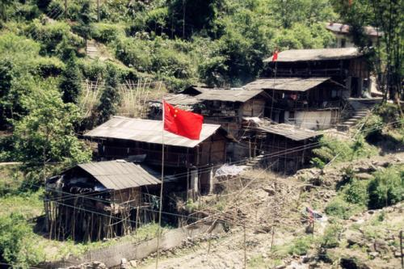
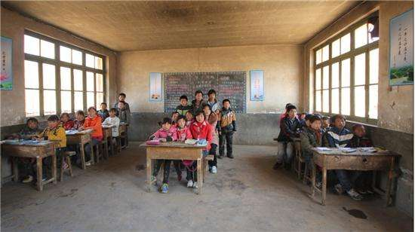
Group work: help them change their fates, choose one to make a report.
If you are a anti-poverty project(扶贫项目)member, you receive a letter from the people in a poor village. Please come up with some ideas to help change their life
We lived in a distant village. The roads are very narrow and the people here live in a poor life. It often happens that sick people can’t afford to go to hospital and the children have no chances to receive education. But we are rich in beautiful natural scenes and our village is famous for high-quality fruits.

Slide 27
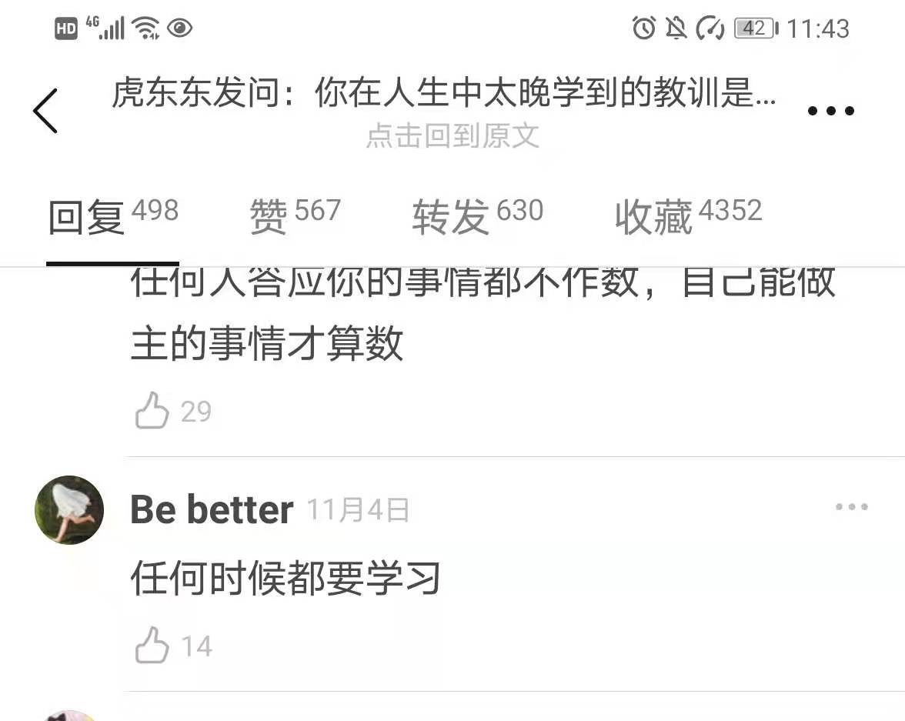
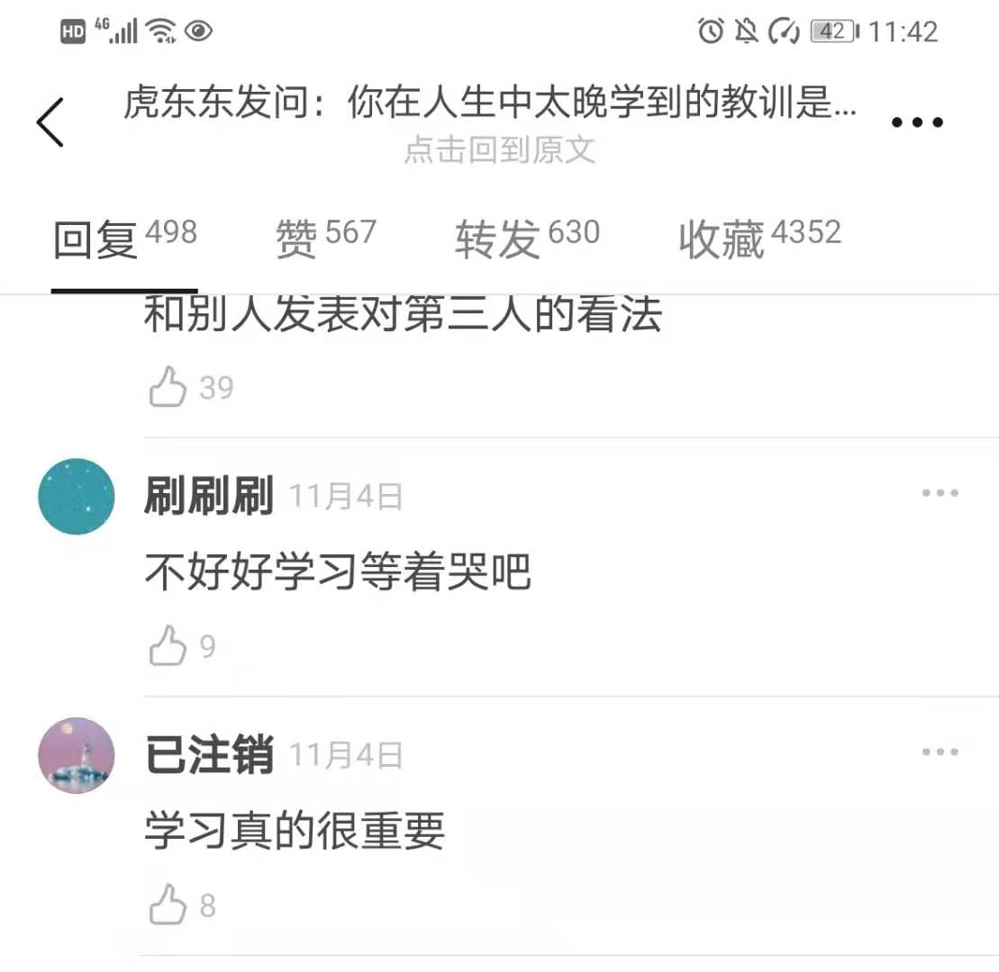
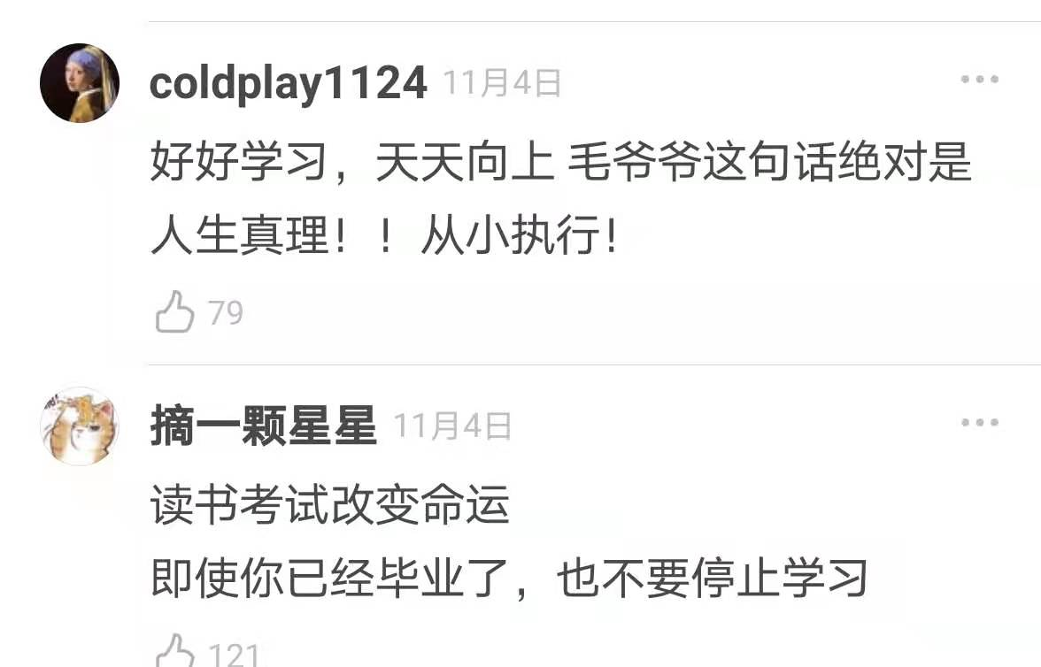
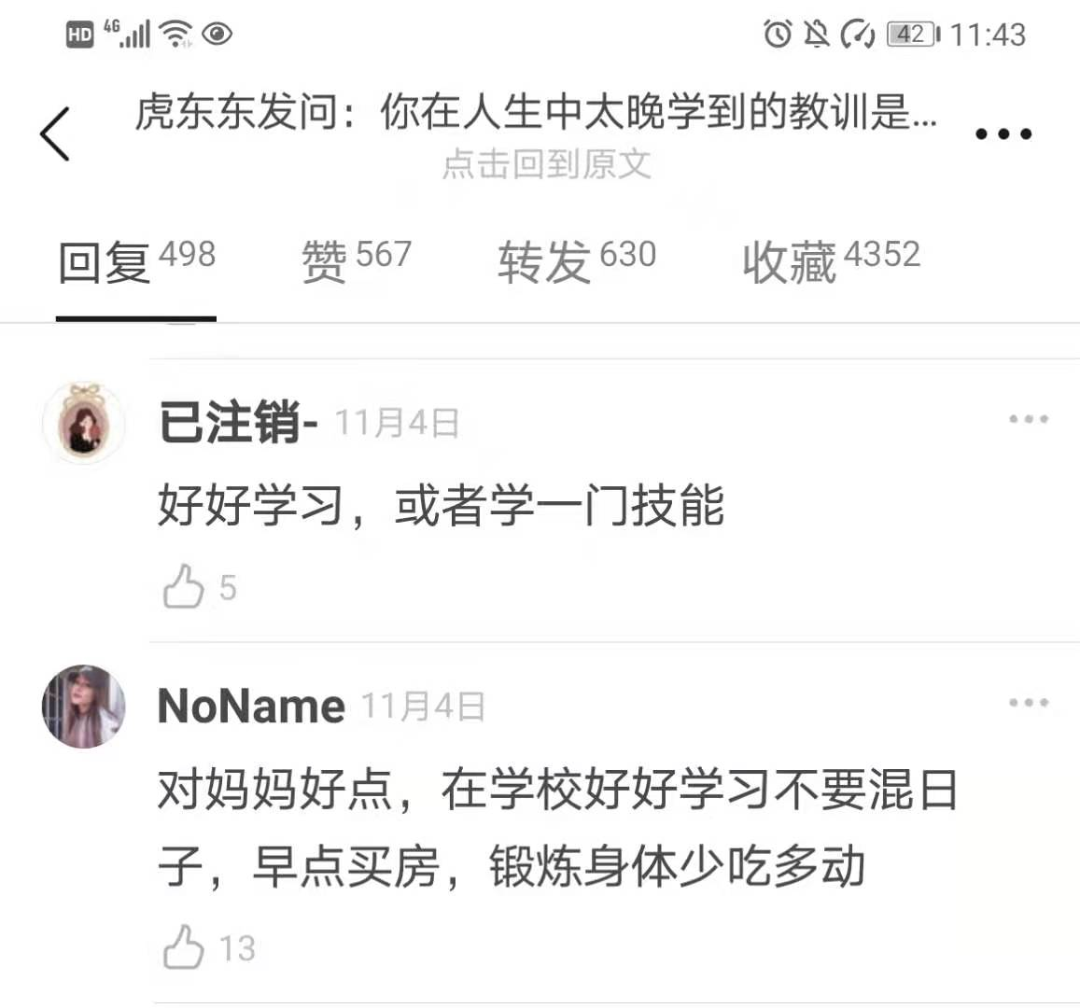
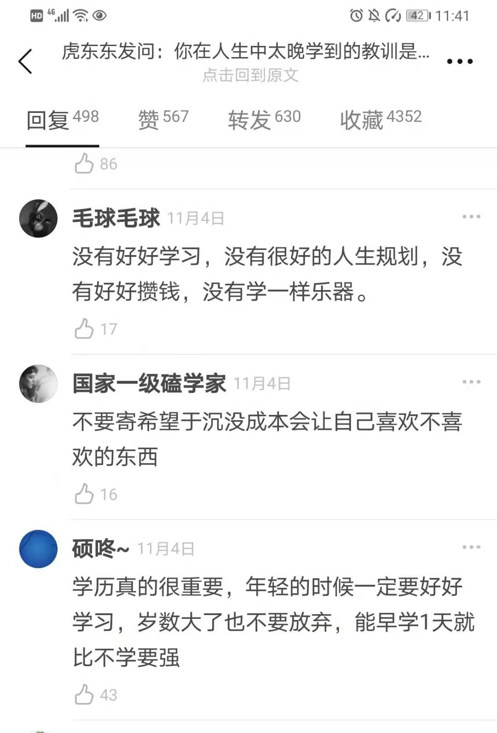
For you

Slide 28
Your life, your fate, your future
Lie in your hand
The only chance to change it for you at present
Is
To
Study well
Knowledge is power.
----Francis Bacon
知识改变命运。
———李嘉诚
Help yourself
Help others

Slide 29
result
set two records
Physical(身体条件) conditions
good lower body strength
good running rhythm
amazing explosive power
Personality
her persistence
hard work
______________
______________
Before the chance comes, we should
Since fourth grade, she woke up at _____ a.m.
she began training at ________ a.m.
she continued her training from_______ 4 p.m. to ______ p.m.
effective training
absolute self-discipline
prepare well step by step

Slide 30
Principal Zhang Guimei
builds a all girls’ high school for these girls in mountain areas

Slide 31
According to the passage, what help Lu Qirui to achieve the top speed at last?( )（multi choices多选）
Para 3”Lu’s lower body strength and running rhythm are good…”
A. Her physical conditions (身体条件)
B. Her personality
C. Her hard practice
D. Her interest and talent
E. Her parents and other people
Para4 “Lu’s lightning speed is mainly the fruit of her persistence…….”
Para 4 “She woke up at six every morning and began….”
Para 5”I like exercising and running…….”
Para5 “My parents have always been supportive”

Slide 33
Set two new records
Be admitted into Tsinghua University High School
Chances favour those who prepare well
Good lower body strength
Good running rhythm
Amazing explosive power(爆发力)
Persistence
Hard work
Effective training
Absolute self-discipline
Since fourth grade
Woke up at six every morning
Began training at 6:30
Continue her training from 4 pm to 6 pm
Her parents’ support
Her talent

