Slide 1
丽声北极星自然拼读绘本第四级
Nick's concert
尼克的音乐会
江苏省常州市新北区春江中心小学
执教者：张妍

Slide 2
Let’s sing!！

Slide 3
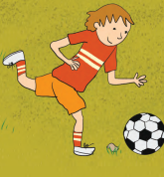
Nick
Nick's concert

Slide 5
symphony concert

Slide 6
Chinese orchestra concert

Slide 7
Rock concert
band乐队
Keyboard player
guitarist
Bass player
drummer
singer

Slide 8
Guess: What's this story about?
Nick wants to go to the concert.
Nick likes the concert.
Nick ... concert...

Slide 9
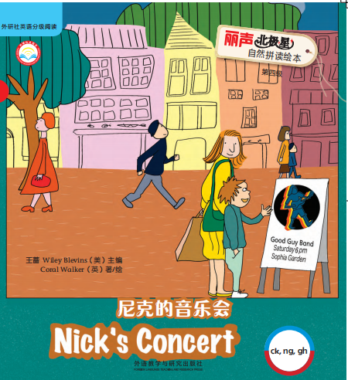
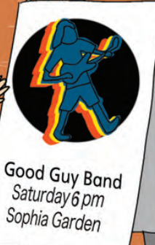
What can you see from the cover?

Slide 10
Read P3-5: Does Nick want to go to the concert?

Slide 11
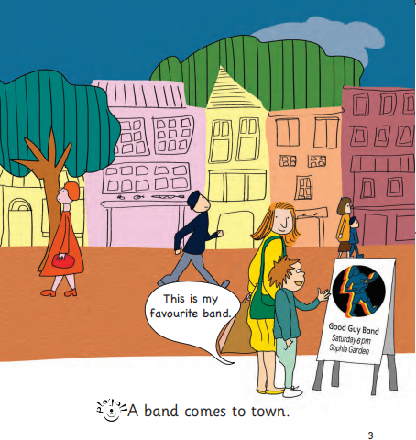
最爱的

Slide 12
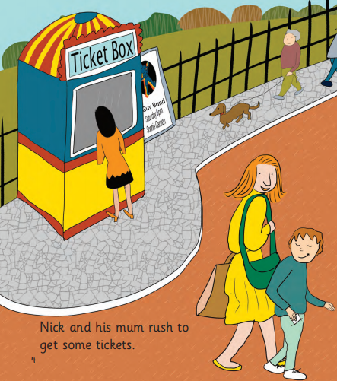
ticket
门票
冲过去

Slide 13
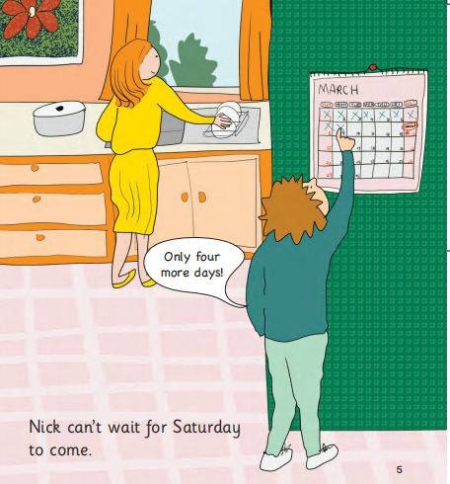
等不及

Slide 14
Does mum support（支持） him?
How does Nick feel?

Slide 15
Read P6-9: Can Nick go to the concert?

Slide 16
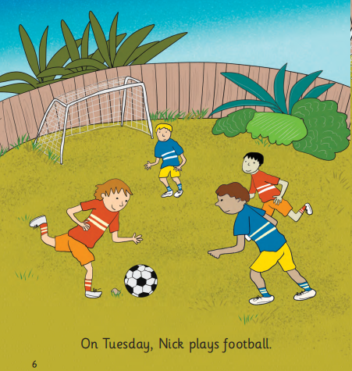

Slide 17
Can you read and act in two?
kick
rock
绊倒

Slide 18
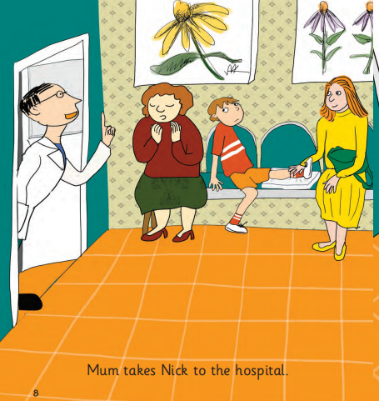

Slide 19
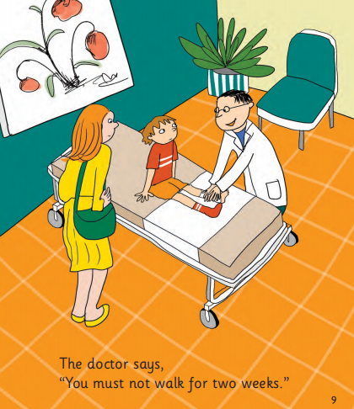
禁止走路

Slide 20
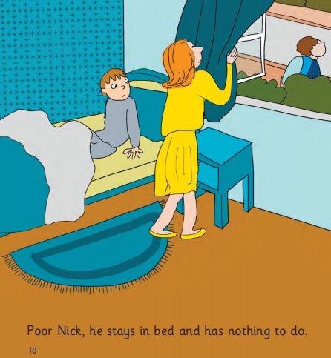
If you were Nick, how would you feel?
What will mum do when Nick is sad?
无事可做

Slide 21
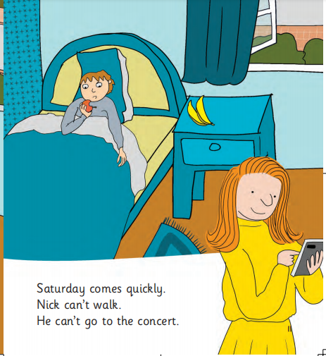

Slide 22
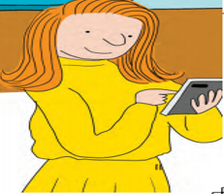
Read P12-14: Does Nick go to the concert at last?

Slide 23
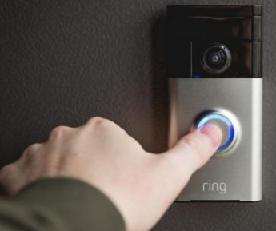
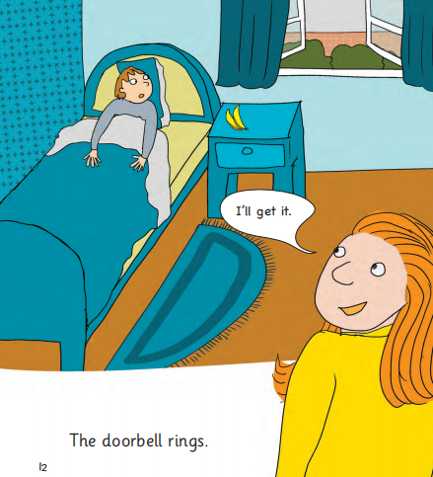

Slide 24
wheelchair
cough
smile
laugh
正巧赶上...

Slide 25
?
了不起的

Slide 26
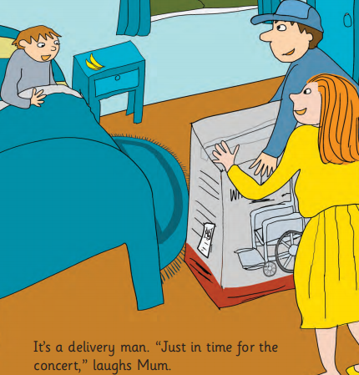
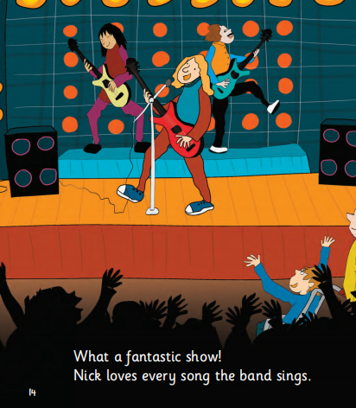
Act in groups, you can add more words!

Slide 28
If you want to go to a concert,
will your mother support you like this?
Do you have any sweet stories in your family?

Slide 29
Nick writes a rhyme about this story.
Nick
ticket
kicks
rock
song
rings
sing
laughs
_____ buys a ticket . He wants to go to the concert.
He ______a ball and trips on a ______. He can’t go to the concert.
Poor Nick, poor Nick. Saturday comes quickly!
He’s very sad in bed. Doorbell ______ , doorbell rings.
Mum laughs “Just in time for the concert”.
Nick goes to the concert.
He loves every _____ they ______.
Group work:
1. 四人小组，准确朗读8个单词；
2. 小组讨论，根据绘本内容，填入所缺单词；
3. 小组内读一读并展示。

Slide 30
Nick buys a ticket .
He wants to go to the concert.
He kicks a ball and trips on a rock.
He can’t go to the concert.
Poor Nick, poor Nick.
Saturday comes quickly!
He’s very sad in bed.
Doorbell rings , doorbell rings.
Mum laughs “Just in time for the concert”.
Nick goes to the concert.
He loves every song they sing.
Can you classify these words?

Slide 31
Nick
ticket
song
rings
ck
sing
laughs
kicks
rock
ng
Nick
kicks
gh
rings
ticket
rock
laugh
sing
song

Slide 32
Nick wants to play a game with you.
1
Ja
Jack
2
cou
cough
du
duck
lau
gh
laugh
ck
lo
lock
rou
rough
o'clo
o'clock
3
spri
spring
Try to read!
si
ng
sing
bri
bring

Slide 33
2
1
ne
tou
lo
rou
gh
ck
pi
enou
sti
Group task:
1. Choose one to fill in the blanks
2. Try to read in your group.
3

Slide 34
2
1
3

Slide 35
Jack
duck
lock
o'clock
duck
lock
Jack
o'clock

Slide 36
cough
rough
laugh
cough
laugh
rough

Slide 37
spring
sing
bring
bring
sing
spring

Slide 38
Homework:
1. Read this story with your family；
2. Try to record your family stories;
3. Try to find more words with “ck””ng””gh”.

