Slide 1
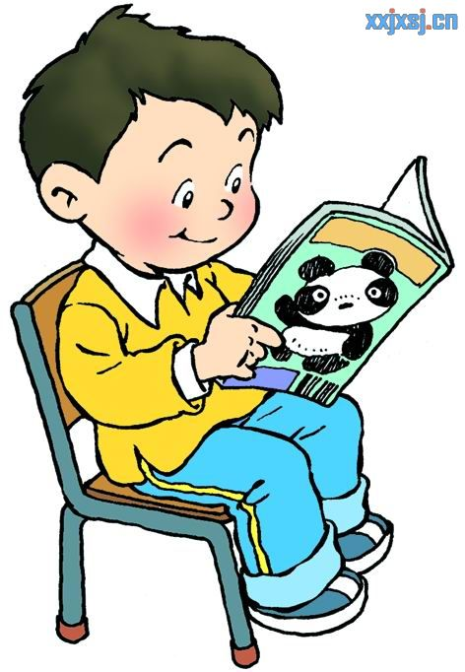
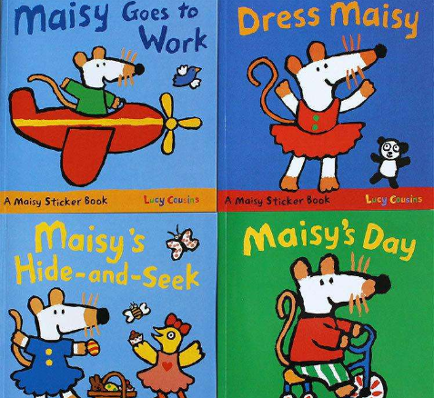
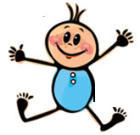
Let's learn
eat
read stories
a story
a lot of stories
a lot of=many
许多

Slide 2
Unit4 Hobbies
(Story time)
孟河实验小学 薛林

Slide 3
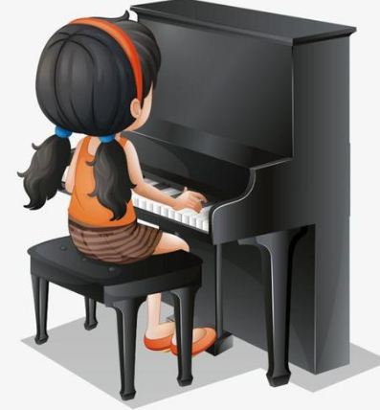
Let's know
I like playing basketball.
I can play basketball well.
弹钢琴
I like playing the piano.
I can't play the piano well.

Slide 4
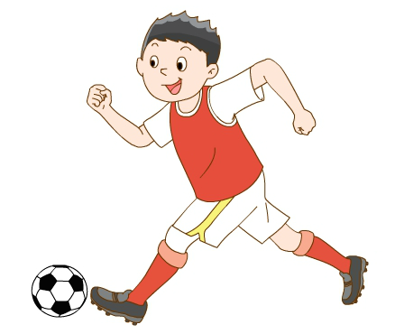
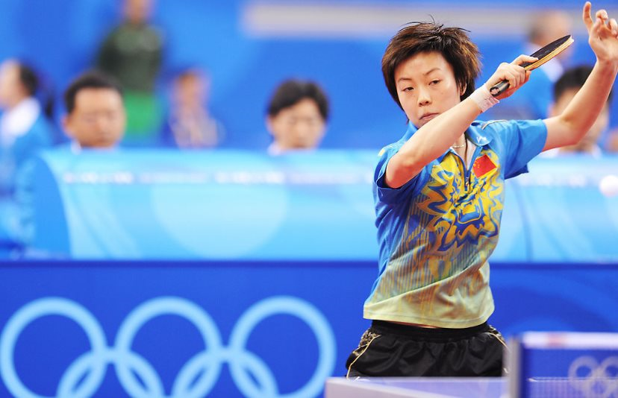
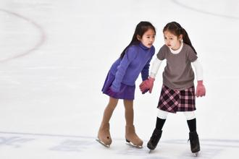
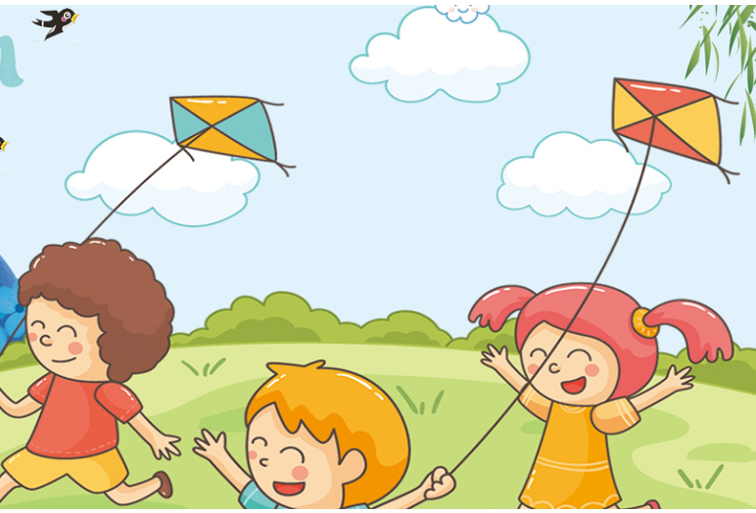
Let's talk
Tips：和你的同桌说一说
A:What do you like doing?
B:I like ____ing… .

Slide 5
hobby
hobbies
（爱好）

Slide 6
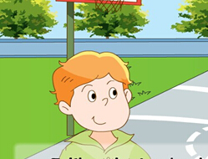
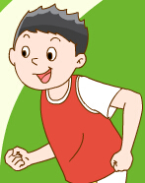
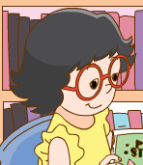
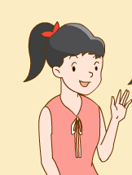
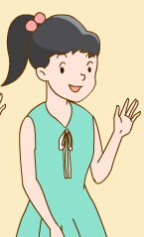
Watch and answer
writer
（作者）
Q1: Who is also talking about hobbies?
Who is talking about hobbies too?
谁也在谈论爱好？
Q2: Whose hobbies is he talking about?
他在谈论谁的爱好？

Slide 7
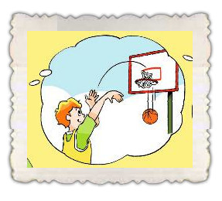
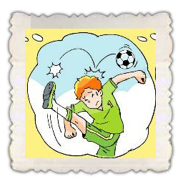
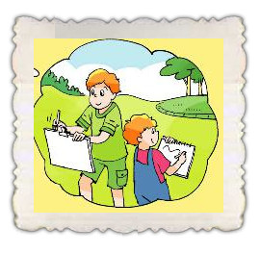
try to say
Tips:同桌讨论
I like ________ ____________and_________.
I can play _________ well,but I'm not good at _______.
I like __________too.
I usually ______ in the park with my brother Tim.
playing
basketball
football
basketball
football
I'm good at basketball.
I can't play football well.
drawing
和......一起
draw

Slide 8
listen and answer
Tips:小组问答式汇报
1. What does Liu Tao like doing?
He likes playing football.
He also likes playing table tennis.
2. What is Liu Tao good at?
He is good at football/ playing football.

Slide 9
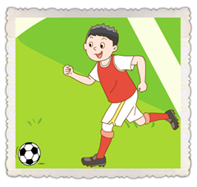
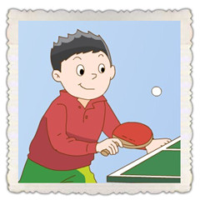
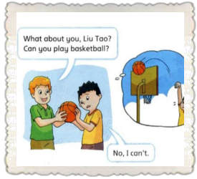
look and try to say
Try to say:
This is … . He likes … . He is … .
He also likes… .
(And he also likes... .But he isn't... .)
This is my friend Liu Tao. He likes playing football too.
He is good at it. He also likes playing table tennis.
(He also likes playing basketball.But he isn't good at it.)
it 指代football

Slide 10
read and complete
自读课文37页，用笔轻轻划出答案，完成下表
What are their hobbies?
Tip:阅读时，你会遇到一些生词。这时候你可以根据图片、联系上下文进行推测。
Tips:四人一组讨论，一问一答介绍每个人物的爱好：
A：What does...like doing?
B：Yang Ling likes…/Su Hai likes… /Su Yang likes…
Name
Hobbies
reading stories
playing the piano
likes
dancing
swimming
They both (两者都) like swimming.
watching films
swimming

Slide 11
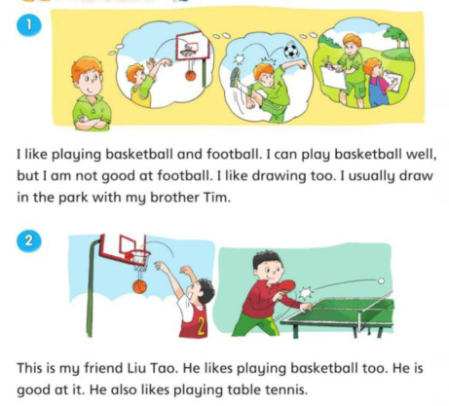
Let's read
Pay attention to your pronunciation and intonation！
football

Slide 12
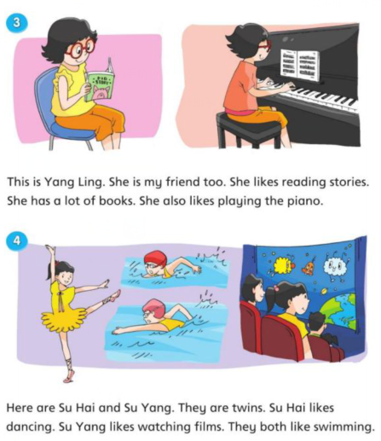
Let's read
Pay attention to your pronunciation and intonation！

Slide 13
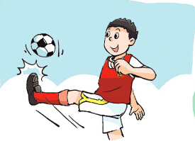
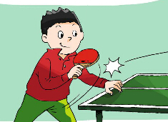
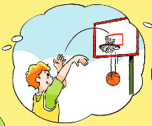
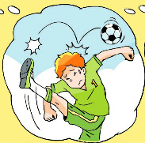
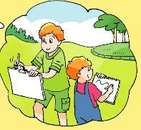
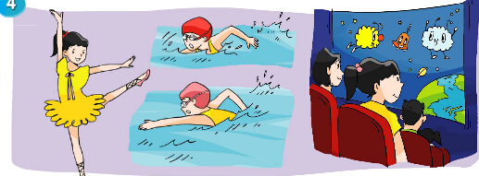
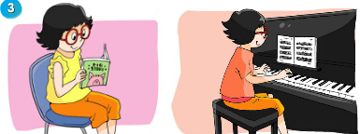
Let's retell
方式1：4人一组，每人选择一个片段
介绍他（她）的爱好。
This is …
He/she likes …
He/she can …well
He/she is（not）good at …
…
方式2：4人一组，以对话的形式
介绍他（她）的爱好
A：What does ... like doing?
B：He/She likes ...ing.
A：Is he/she good at ...?
B：Yes,he/she is.
No,he/she isn't.

Slide 14
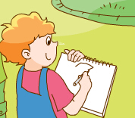
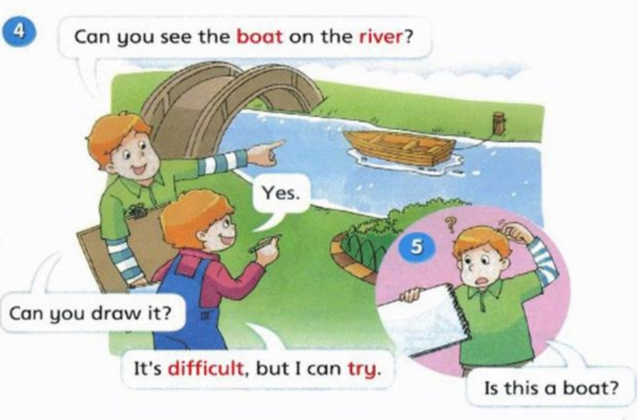
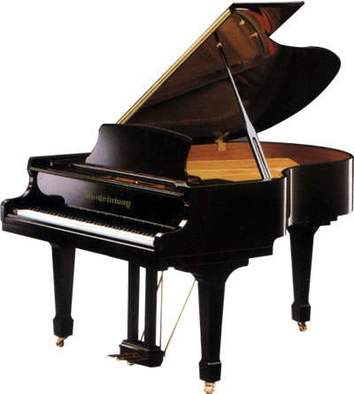
Let's talk
Tim's hobbies
This is Tim.
He likes ... .
He can...well./He is good at it.
He also likes ... .
But he isn't good at it.
He usually...with Mike .

Slide 15
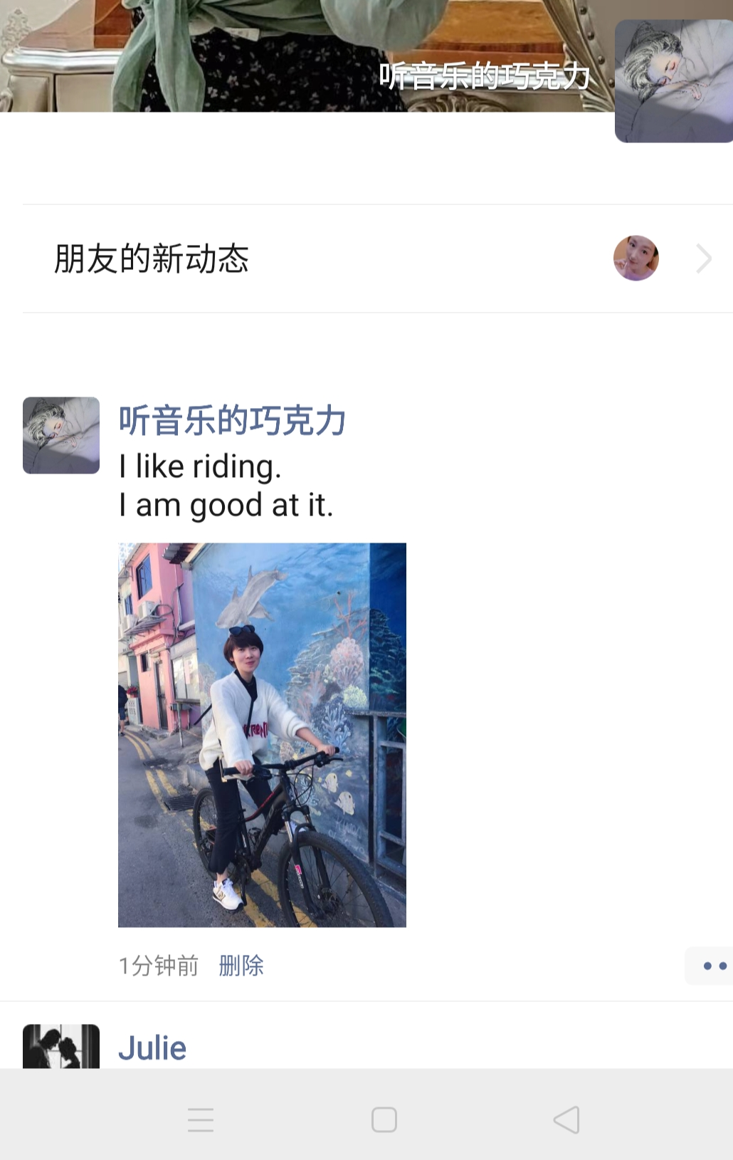
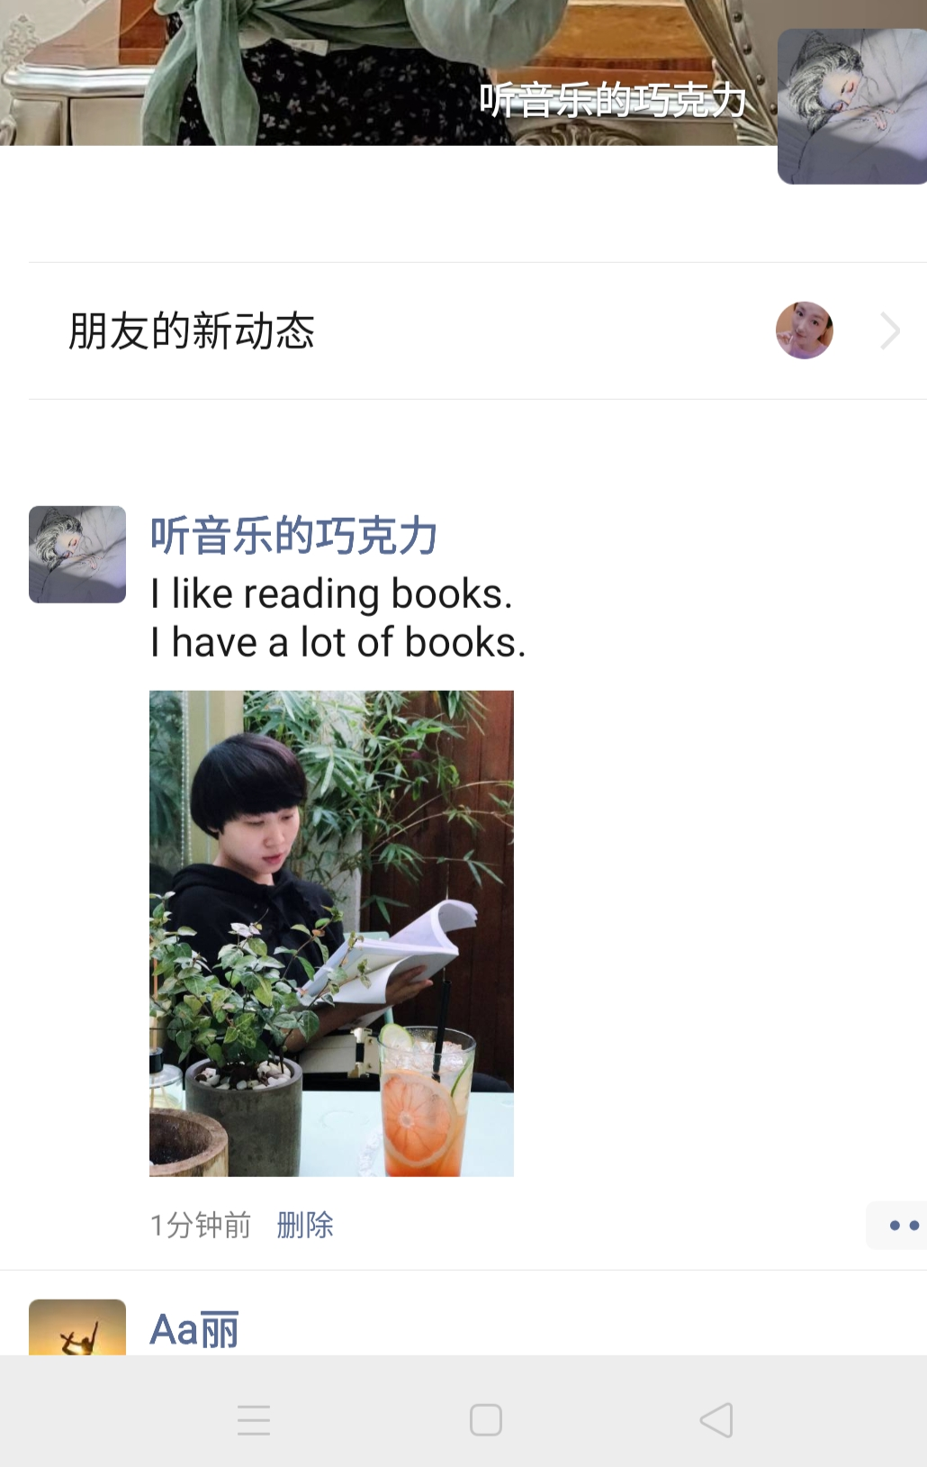
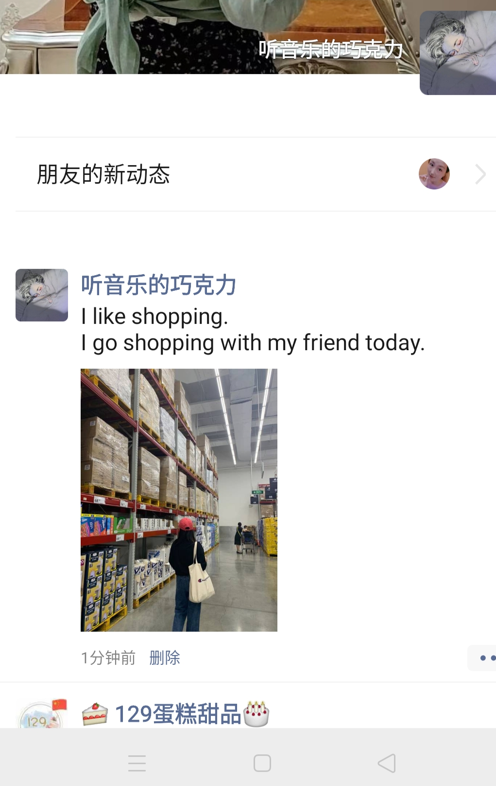
Let's talk
This is my friend Peggy.
She likes reading books.
She has a lot of books.
She likes riding（骑车）.
She is good at it.
She also likes shopping.
She usually goes shopping with me.

Slide 16
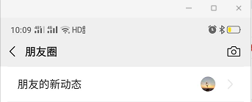
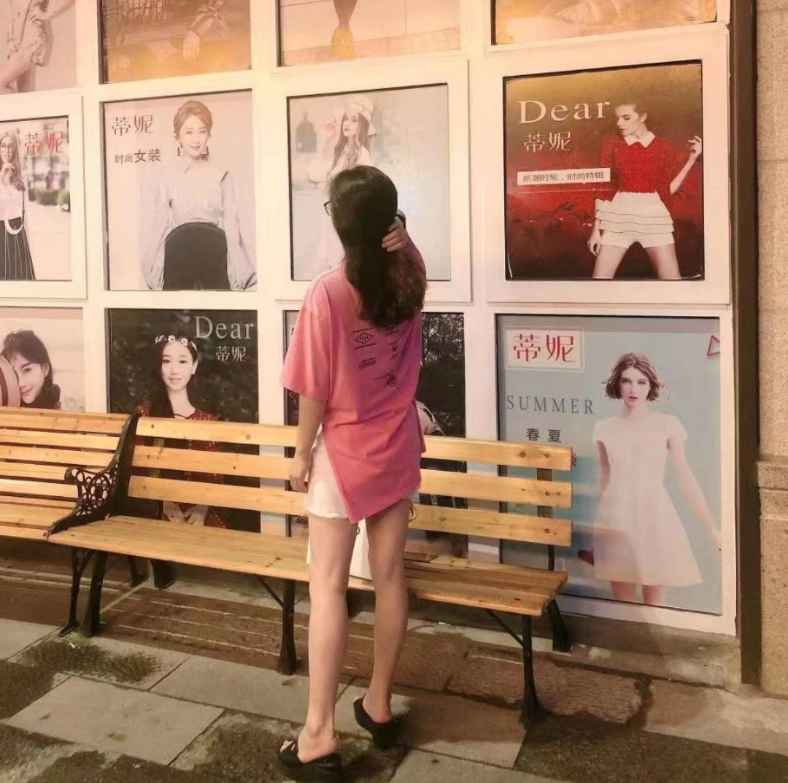
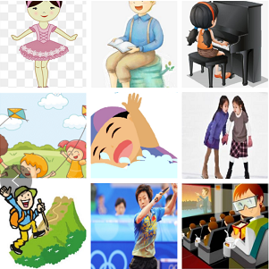
Let's share
Share your and your friends' hobbies.
两人一组，编辑微信朋友圈与我们分享你或你朋友的爱好。
我
My friend is….
He/ She likes …(ing).
He/ She can… well.
He/ She also likes…(ing).
He/ She is good at…(ing).
comment评论：
I like …(ing).
I can… well.
I also likes…(ing).
I am good at…(ing).
10分钟前
赞 评论
..

Slide 17
Let's enjoy
I have many hobbies to keep a good body.
我有很多爱好来保持一个好身体。
I like sports and rarely keep still in a spot.
我喜欢运动，很少呆在原地不动。
Good hobby makes good life!
好习惯成就美好未来！
I like books and always buy till I am broke.
我喜欢书，总是买到破产为止。
I like to dance and always keep in a nice stance.
我喜欢跳舞，总是保持优美姿势。
I like to eat so I eat everything a bit.
我喜欢吃，所以我什么都吃一点。

Slide 18
Homework
1. Read story time fluently and beautifully.
流利优美的朗读故事时间。
2.Talk about your friends’ hobbies.
说说你朋友的兴趣爱好。

Slide 19
Let's learn
fish
ill
film
A.电影
B.胶卷
1.We go to the cinema to watch films.
2.We use(使用) film to take photos（拍照）.
Tip:相同的单词在不同的情境中有不同的意思。

