Slide 1

Unit5 Reading(1)
Tan Dun's music
Music without boundaries!

Slide 2
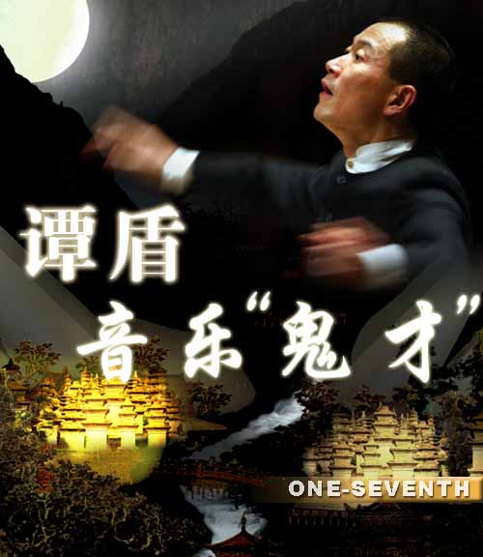
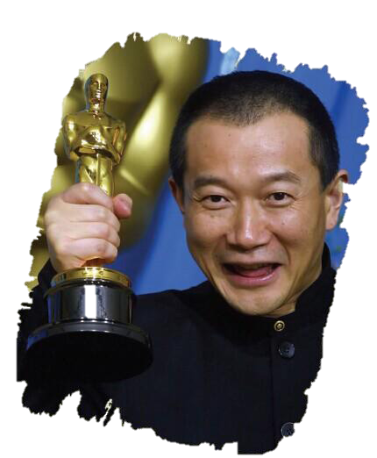
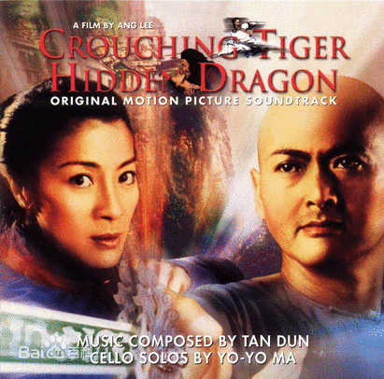
Tan Dun, a world-famous composer [kəmˈpəʊzə(r)]
a person who writes music
Crouching Tiger, Hidden Dragon
《卧虎藏龙》

Slide 3
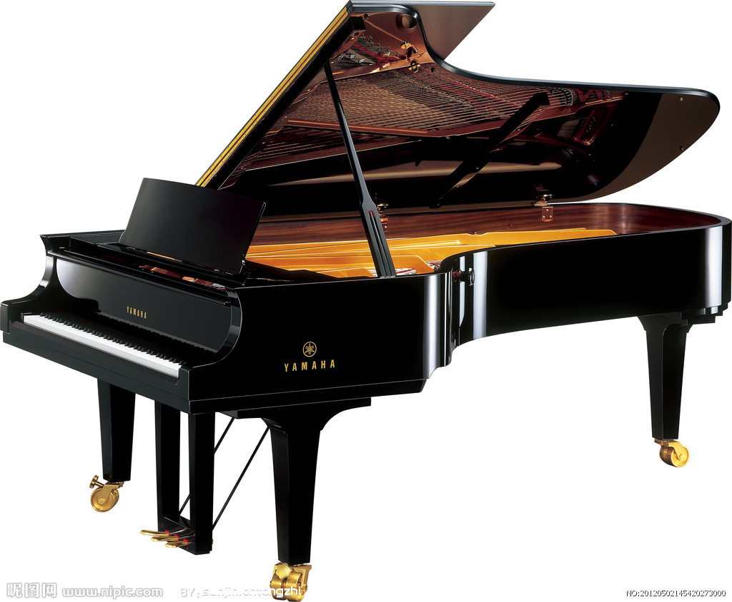



He is known for music.
No musical instruments
[ˈɪnstrʊm(ə)nt]
common objects.
[ˈkɒmən]
[ˈɒbdʒɪkt]

Slide 4
Prediction:
What’s your understanding of the title?
Tan Dun's music
------Music without boundaries
What are the

Slide 5
Read and Match
the structure of the article
Para. 1
Tan Dun's personal experience
Para. 2-3
Amazing music--- Water
Para. 4
Music without boundaries
Para. 5-6
Introduction

Slide 6
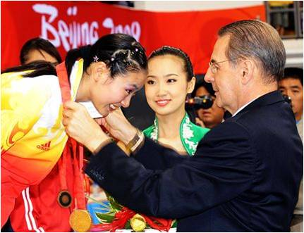
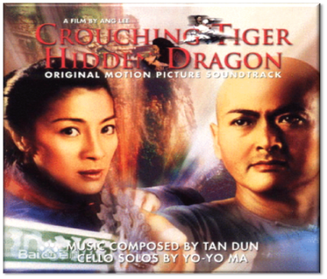
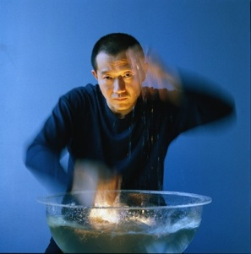
Read and find
Read the article again and pick out Tan Dun’s music works as quickly as you can.
present
Award music (Para. 1&5)
Crouching Tiger, Hidden Dragon (Para.3)
[kraʊtʃ]
['hɪdn]
《卧虎藏龙》
Music called Water (Para.4)

Slide 7

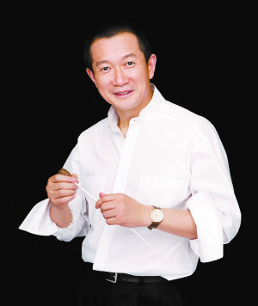
Detailed reading
Para 1:
An introduction to Tan Dun
When was the music played?
What can you hear in the song?
A traditional Chinese song in a Western style

Slide 8
Para 2
Tan’s interest in music
Tan’s special interest in music at a young age
He loves the sounds from nature.
He made music with common objects.
rushing water
blowing wind
stones
paper
Rich resources for Tan Dun’s later music

Slide 9


Para 3
Tan’s education
Read Para. 3 and find out Tan’s education
experience.
Education
traditional Chinese music
1.in 1978
*entered_____________________
___________ in Beijing .
the Central conservatory
of music
中央音乐学院
2.eight years later
*went on to study ____________,
*got to know great ___________
from around the world.
in the USA
musicians
modern Western music
Different education backgrounds bring him rich experiences

Slide 10
Para2-3 Tan Dun’s profile（档案）
Tan Dun’s basic information
Year of birth:_______________
Place of birth:_____________
Interest(s):__________________
Job:________________________
Education:
studied music at a university in ______
went on to study in ______________
Best known for:
winning an _________for the music in a film
1958
Hunan
music
a composer
Beijing
the USA
Oscar

Slide 11
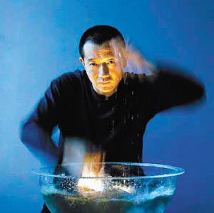
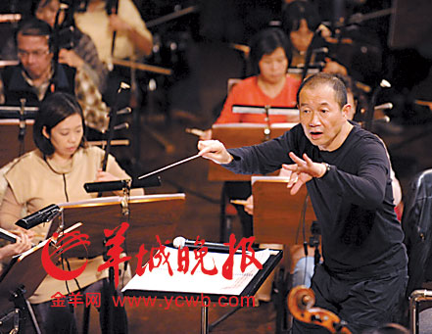
Enjoy
the music
Water
What do you think of Water?
amazing
beautiful
wonderful
excellent
fantastic

Slide 12

Para 4
Tan’s creativity
much; create; control the speed of water flow; sounds of nature; musical instruments;
What do you think of Tan Dun?
Why is Tan Dun’s music special?
Reason | uses a lot of _________________in his music instead of ____________, different pictures in different minds can ___________.
Example | Water: _____than 50 sounds are made by ______________________.
sounds of nature
musical instruments
be created
more
controlling the speed of water flow

Slide 13


Tan Dun’s Influence(Paras.5-6)
r
i
d
g
B
e
the east
the west

Slide 14
Para 5-6 Tan’s achievements
mix a lot of things together
the past
common objects
Modern Western music
Music
without boundaries!
traditional Chinese music
musical instruments
the present

Slide 15

Further thinking
Music without boundaries
What makes Tan Dun so successful?
his interest in music (interest is the best teacher)
his education (he learnt music not only in China but also in the USA)
his creativity
his hard work
……

Slide 16
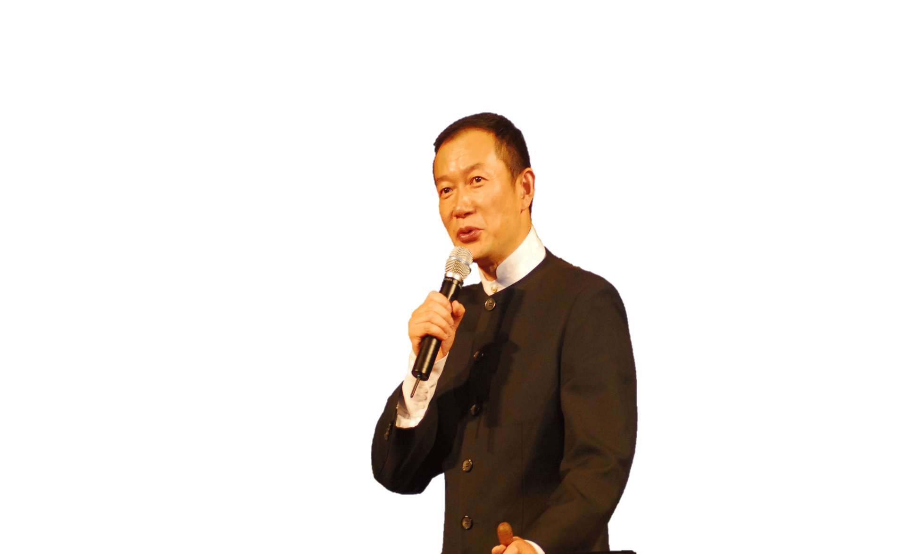
Group work
Show Time
Suppose the writer of this text will come to our class, we will have an interview.
Work in groups of 3 or 4.
One student is the writer and the other students will ask him 2-3 questions about Tan's life and work.

Slide 17
Sample：(The writer—W；students—S)
S1: Hello, Mr.Writer. We're glad to invite you to our classroom to have an interview about Tan Dun.
W: Thanks for your invitation. I hope I can help you.
S2: Ok, let's start.... (each student asks 2-3 questions)
1)…
2)…
W: ...
S3: And I want know…
1)…
2)…
W: …
S4: Thank you Mr.Writer.We are so happy to know that if someone wants to be excellent in his field, he should ……
for example:
1)What was Tan Dun interested in when he was young?
2) Where did he learn music ?
3) What do you think of ‘music without boundaries’
……

Slide 18
Group work: mind map-----how to introduce a celebrity
…..
childhood
His works
…..
education
Tan Dun’s music
creativity
…..
Mix……

Slide 19
Tan Dun’s
Tan Dun’s childhood
Tan Dun’s education background
Tan Dun’s dreams
Work in groups of 4
There is going to be show about Tan Dun in his hometown. Work in groups
to design a poster for him.

Slide 20
英文人物传记结构
General introduction
总体介绍
姓名、身份、地位
Para1
第一段
Each time ……by Tan Dun, a world-famous composer.
Born in 1958 in central Hunan, China, Tan Dun grew up
near the Liuyang River...Tan showed an interest in music…
Para2-4
Detailed introduction
细节介绍
第二段
成长经历、兴趣爱好
In 1978, Tan entered the Central Conservatory of music in Beijing…USA… Oscar for his music in the film …….
第三段
教育经历、突出成绩
As he likes the sounds of nature… His amazing piece of music Water does not use any musical instruments……
经典作品、性格特点
第四段
第五段
Tan has helped build a bridge between the East and the West…
“My music is to dream without boundaries,” Tan once said
…music without boundaries.
Para5-6
影响、启示
the evaluation
人物评价
第六段

Slide 21
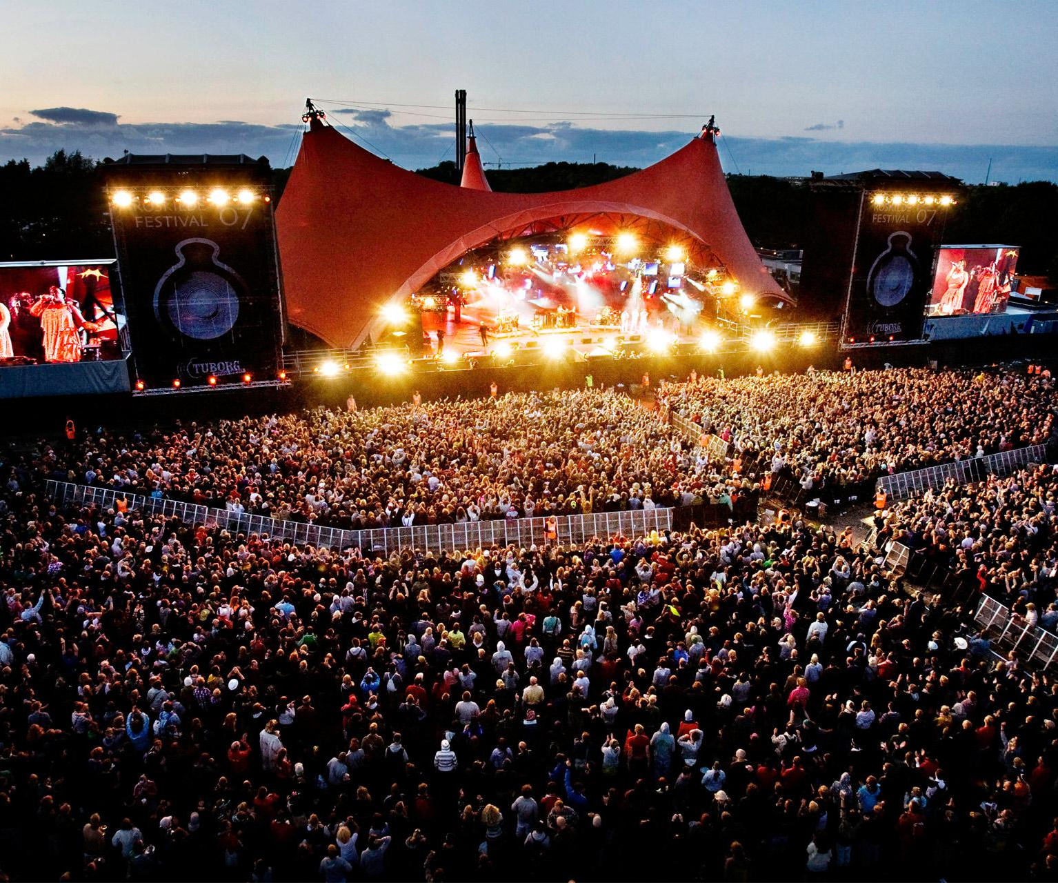
Homework
1. Get more information about Tan Dun and his works after class.
2. Try to introduce Tan Dun in your own words.

Slide 22
THANK YOU

Slide 23
Words Study
boundary
medal
present
winner
/ 'baʊnd(ə)rɪ /
n.边疆，边界
n.奖牌，奖章
/'medl /
/ prɪˈzent /
Vt 颁发，提交
/'wɪnə /
n.获胜者
composer
central
instrument
common
object
n.作曲家
/kəm'pəʊzə /
/'sentr(ə)l /
adj.中心的，中央的
/'ɪnstrʊm(ə)nt /
n.乐器、工具、器械
/'kɒmən /
adj.普通的、一般的
/'ɒbdʒɪkt /
n. 物品、东西

Slide 24
Words Study
stone
musician
be known /famous for
control
flow
/ ' stəʊn /
n.石头
/mjuː'zɪʃ(ə)n/
n.音乐家
因…而出名
vt.控制、支配
/kən'trəʊl /
n.流动
traditonal
bell
though
dividing line
/fləʊ] /
/trə'dɪʃ(ə)n(ə)l /
adj.传统的
n.钟、铃
/bel /
/ðəʊ /
conj.虽然、尽管
/ laɪn /
n.分界线、界限

