Slide 1
Unit 1
By Wendy Wang

Slide 2
It has many rooms and windows.
People of different ages go there.
Children spend a long time there. It’s a second home.
There are many quizzes.

Slide 3
SCHOOL

Slide 4
Unit 1 | Personal and Social Experience
Key concept 重大概念
Related concepts 相关概念 | Structure结构, Message信息
Content 内容 | Life experience, School life, Sports etc.
Connections 联系

Slide 5
Question raiser
Before-reading
Factual Questions What is school life made up of?
What is special about schools in some countries?
Conceptual Questions How can we get the structure of passage?
How can we use various reading strategies?
How can we compare and contrast messages?

Slide 6
Passage A
Teens Junior Issue No. 194
Fast-reading
Short answers:
1. Which country does the passage talk about?
2. Do students have a lot of homework there?
Tips
: Skimming快读- read fast to spot KEY WORDs(关
键词). Don’t forget the TITLE(标题)!

Slide 7
Para. 1
While-reading
A gift/present

Slide 8
Para. 2
Q: Can you spot THREE time points?
school starts
school ends
10am.
8am.
2pm.
short break
Tips
: A Timeline(时间线) can easily show much information.

Slide 9
Para. 3
Three Wh- questions
What subjects do they learn?
When do they start foreign language study?
Which languages can they take up in Grade 5 & 7?
Assessment opportunities
In this activity you have practiced skills that are assessed using Criterion B : Reading

Slide 10
Related concept: Structure 结构
After-reading

Slide 11
Summary
* Multiple choice:
A. It is an exciting experience to study abroad.
B. A brief description about what school life in Germany is like.
C. There are many subjects to choose.

Slide 12
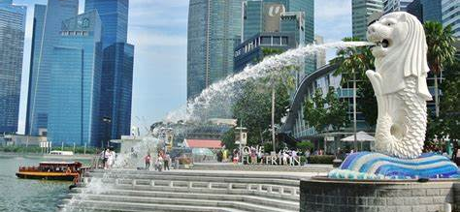
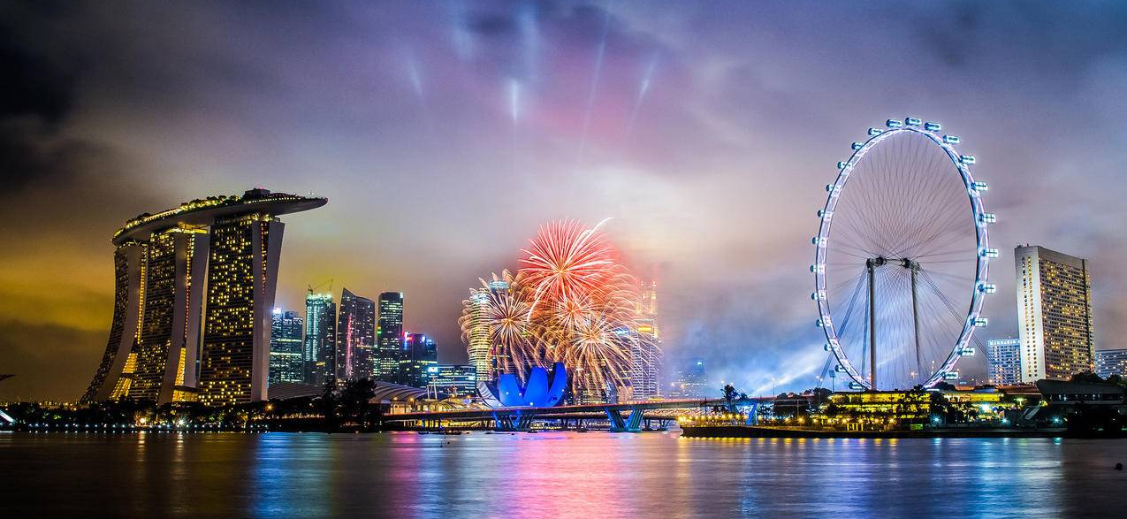

Slide 13
Teens Junior Issue No. 248
Passage B
We’re different
but the same
Tips
: Predict猜测 what can be talked about.

Slide 14
Let’s think: Which Structure is correct?
Introduction 开篇
|
Part 1 + Part 2 + Part 3
A
Part 1 + Part 2 + Part 3
|
Conclusion 结论
B

Slide 15
T or F
Part. 1
half
F
In Singapore, classes last for more than an hour.
Usually there are no breaks between classes.
Singaporean students do eye exercises.
School ends early at 1.50pm.
T
\
F
T
Tips
: Scanning寻读- Look for detailed information(具体信息) first.

Slide 16
Compare and Contrast 对比
➔ ________ school day
Shorter
 | Singapore | China(CBS)
Lesson duration时长
…
…
…
Assessment opportunities
In this activity you have practiced ATL skills
Thinking— Critical thinking

Slide 17
Part 2
groups
languages
cultures
Many
Many
Many
Multicultural
Singapore

Slide 18
Anything special about the language classes?
CBS Local Students | CBS Foreign Students
Language Acquisition | Language and Literature

Slide 19
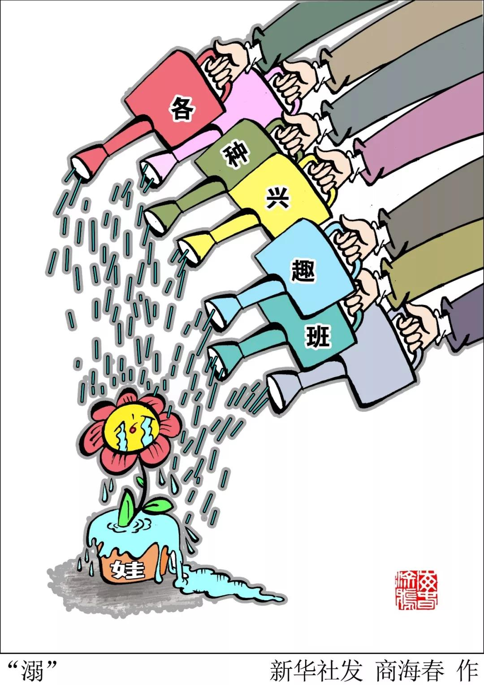
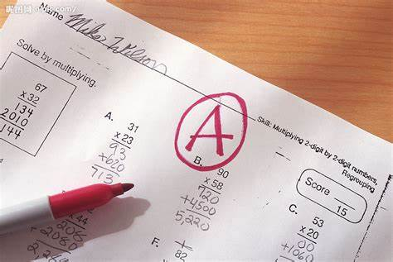
Part 3
_________ Pressure
Same
Assessment opportunities
In this activity you have practiced skills that are assessed using Criterion A : Listening

Slide 20
Poem Appreciation 英文诗欣赏

Slide 21
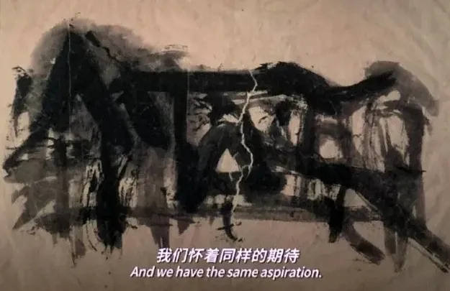
My People My Homeland

Slide 22
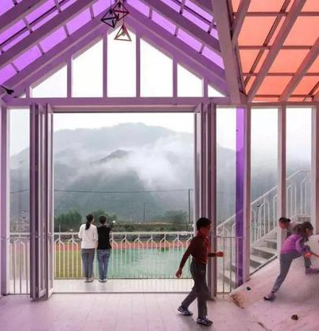
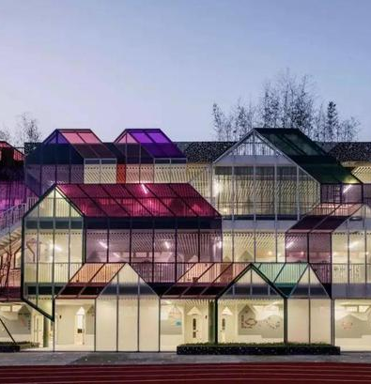
Debatable question: Is your dream school like this?

Slide 23
Final project- My Dream School Life
Step 1 Group discussion. Draw a draft of the campus(the location, appearance, functions etc. ).
Step 2 Introduce your dream school life. Step 3 Group presentation.
Assessment opportunities
In this activity you have practiced ATL skills
Communication— Communication skills

Slide 24
Example:
MY dream school is fantastic! Classrooms are in a large playground. There are many plants around the school. We have lunch in a canteen. No one wastes food, because we can have the food we like. After class, there is little homework. We always do sports, like playing basketball and badminton.
How much I hope this is not a dream!

Slide 25
Homework
1. Finish your DREAM school poster and describe in 100+ words. 完成理想学校海报绘制，配文介绍100字以上。
2. Take a deep read of the two passages.深入阅读。

