Slide 1
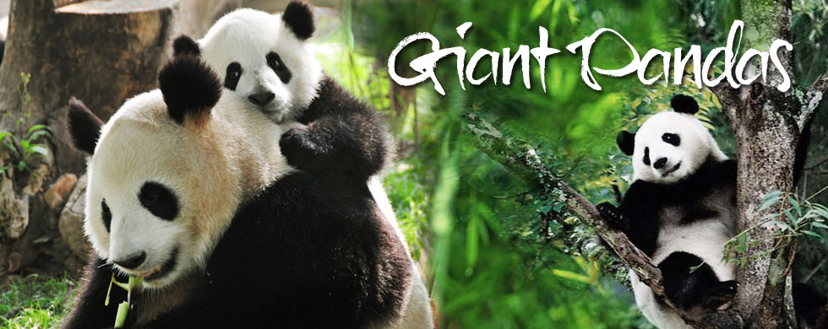
8A Unit 5 Reading I
The story of Xi Wang
By Qishanshan

Slide 2
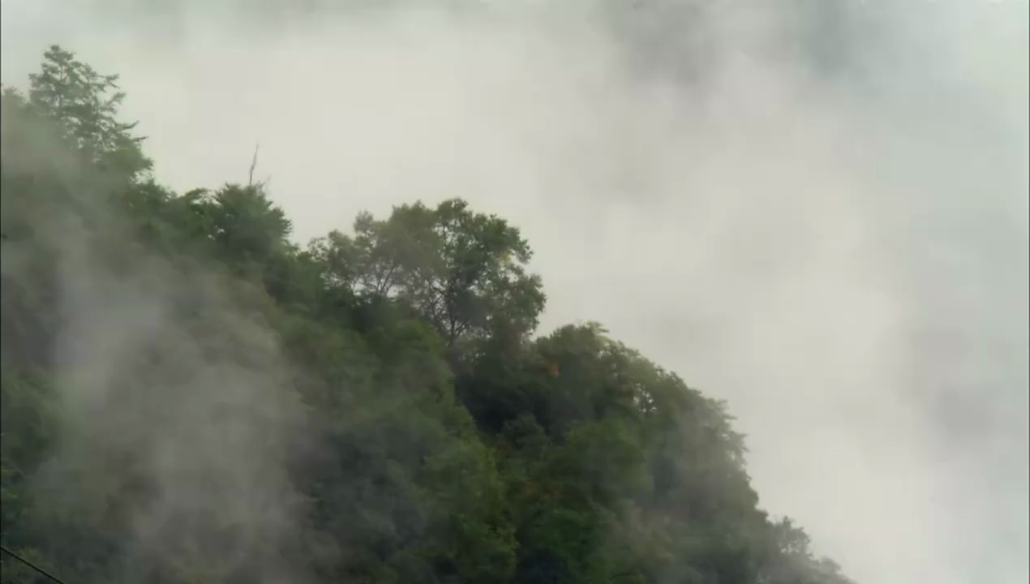
giant pandas

Slide 3
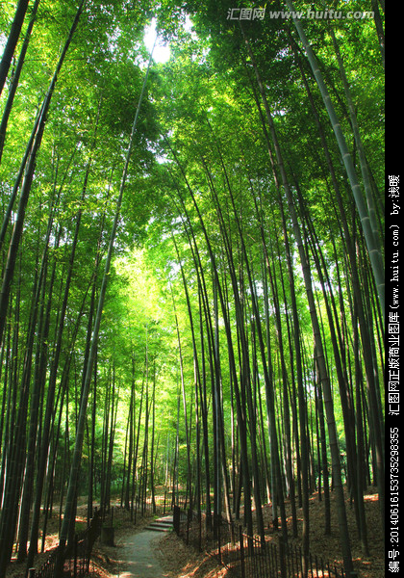
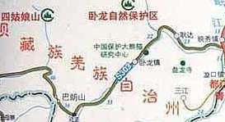
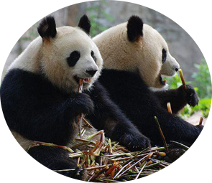
a special place
for protecting wild animals
Wolong Nature Reserve
bamboo
[bæm'bu:]
bamboo forest
live on
以食…为生

Slide 4
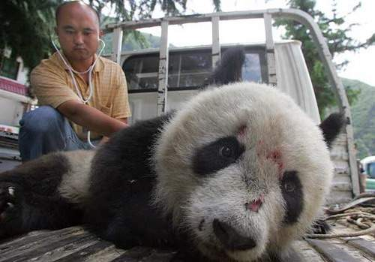
take action to protect
do something useful
in danger
serious problems

Slide 5
single work &
pair work
Task1：Fill in the blanks.
Giant pandas
serious problems
reserve
in danger
smaller and smaller
take action
live on
look after
___________ are famous in China. Most of them live in Wolong nature ________ . People there __________ them very well. When they are sick, doctors will help them. They mostly ___________ bamboo. However, the bamboo forests are becoming _________________. So, They are __________ now. We should __________ to help them face______________. Or there may be no pandas in the future.

Slide 6
pair work
If you need to write a story about pandas, what aspect(方面) can you write?
Hobbies
Looks
Food
Pandas
...
Weight
Problems

Slide 7
class work &
single work
Task2：Fast reading
How many paragraphs are there in the story?
Can you use one word to tell the main idea of each part?
______
(Para__-- Para__)
action
1
3
The story of Xi
Wang
problems
______
(Para__)
growth
4
weight
______
(Para__-- Para__)
food
5
6
Notes:
Today Mrs Li will show you to learn a story of a panda named Xiwang. How many paragraphs …? We can divide it to three parts. Now read the whole passage quickly and find out the answer, at the same time think about what’s the main idea of each part?

Slide 8
single work &
pair work
Task3：Careful reading
The story of Xiwang
Growth | When she looked like a white mouse, she __________ just 100 grams. She started to go outside when she was four months old, and she weighed about _________ kilograms. Eight months later, she weighed over 35 kilograms and was no longer a _______ baby.
Problems | They face ___________ problems. It's not _________ for them to have babies. And baby pandas ______ at a very young age. What's more, the _____________ forests are becoming samller and smaller. As a result , they may have no food to eat.
Actions | Help pandas have more babies. Build more panda _____________. Make laws to protect them.
weighed
eight
small
serious
easy
die
bamboo
reserves

Slide 9
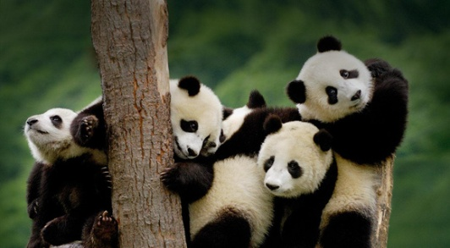
class work &
pair work
Further reading
The story of Xi Wang
Growth | When she looked like a white mouse, she weighed just 100 grams. She started to go outside when she was four months old, and she weighed about eight kilograms. Eight months later, she weighed over 35 kilograms and was no longer a small baby.
Problems | They face serious problems. It's not easy for them to have babies. And baby pandas die at a very young age. What's more, the bamboo forests are becoming samller and smaller. As a result , they may have no food to eat.
Actions | 1. Help pandas have more babies. 2. Build more panda reserves. 3. Make laws to protect them.
weight
It means so...
Are the three words important here? Why?
They shows that pandas grow very quickly.

Slide 10
single work &
pair work
Task4：Have an interview
A reporter is interviewing a worker in Wolong.
1. Finish the dialogue on your own.
2. Practise it with your partner.

Slide 11
Reporter: Did Xi Wang grow very quickly after she was born?
Worker: Yes. She weighed only _____________ at birth, but she weighed over ____________ when she was one year old.
Reoprter: Is it easy for giant pandas to live in the wild?
Worker: No, it isn't. They face ________________.
Reporter: So what should we do?
Worker: We should help pandas ___________________, build more _______________and ______________to protcet them.
100 grams
35 kilograms
serious problems
have more babies
panda reserves
make laws

Slide 12
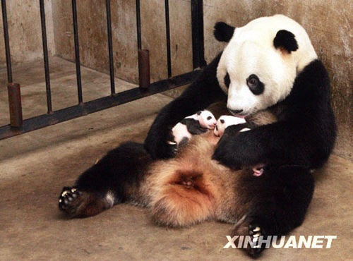
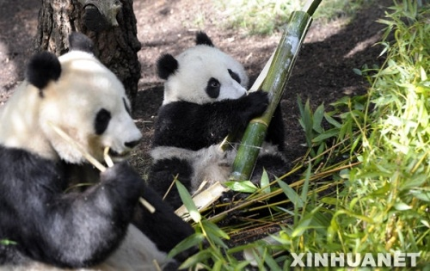
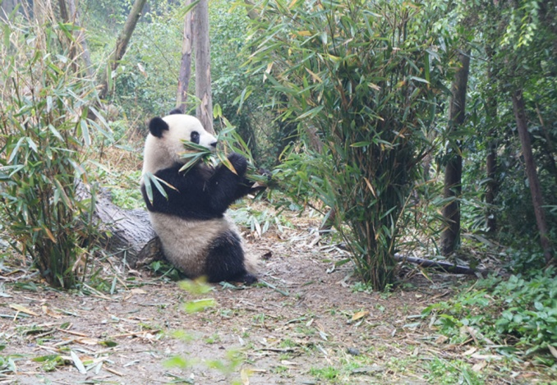
pair work
Task5: Further discussion
drank her mother’s milk
bamboo
_______________
(in the beginning)
______________
(6 months old)
amazing!
learnt to look after herself
_____________
((20 months old)

Slide 13

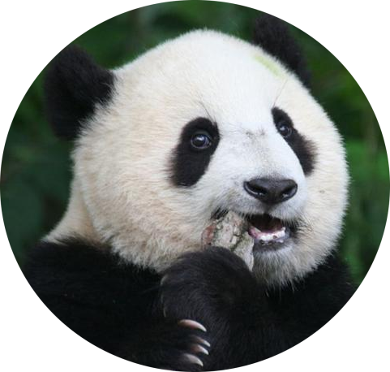
pair work
Discuss:
Pandas’ problems
1.
2.
3.
4.
Why
Difficult to have babies
Die at a young age
Have no food
Have no place to live
Notes:
Ask one student to read Para4 try to find out pandas’ problems

Slide 14
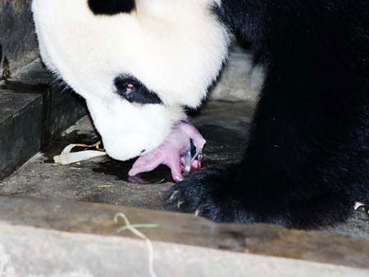
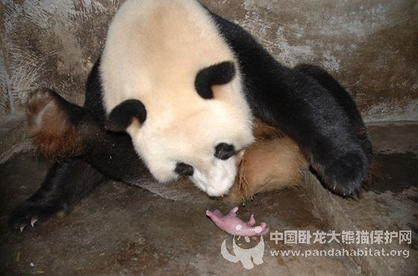
have one or two babies at a time
The babies are hard to look after.

Slide 15

Futher discussion
pair work
Pandas’ problems
1.
2.
3.
4.
Why
Difficult to have babies
Die at a young age
Have no food
Have no place to live

Slide 16
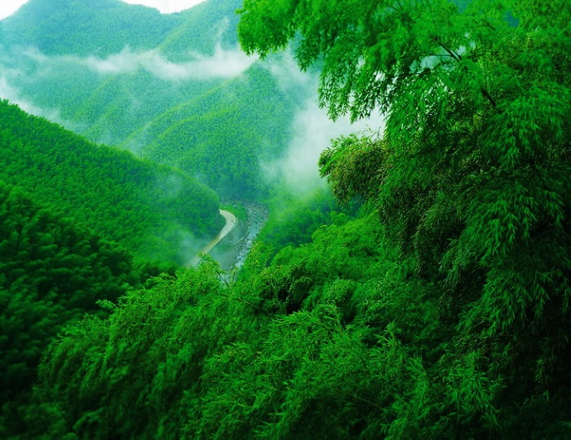
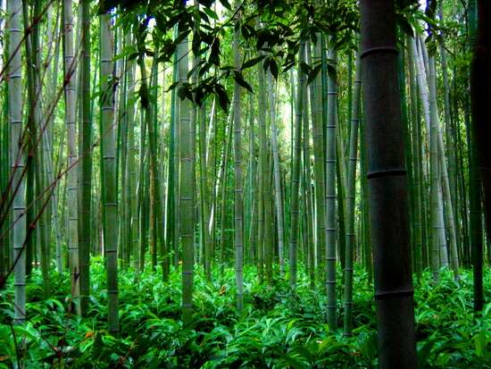
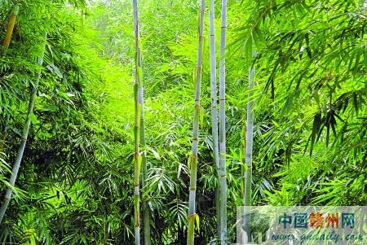
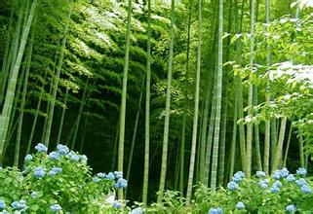
bamboo forests
live mainly on a special kind of bamboo

Slide 17
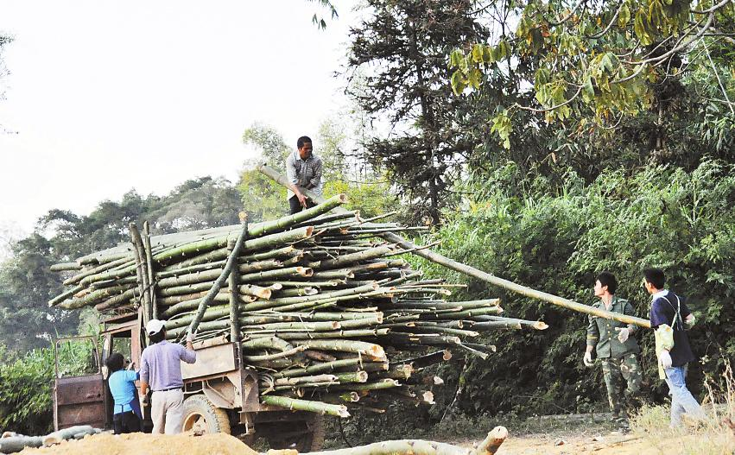
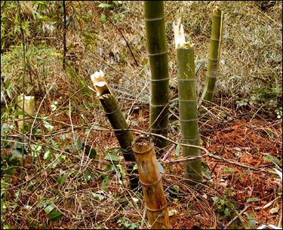
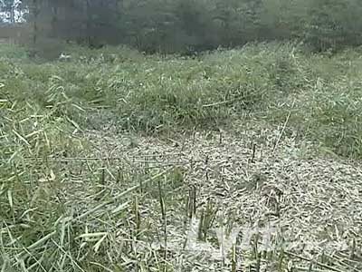
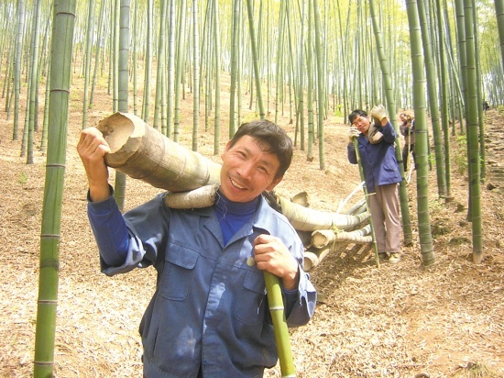
cut down
As a result, the bamboo forests
are becoming smaller and smaller.

Slide 18

________ bring
many problems
to pandas.
Humans
Pandas’ problems
1.
2.
3.
4.
Difficult to have babies
Die at a young age
Have no food
Have no place to live

Slide 19
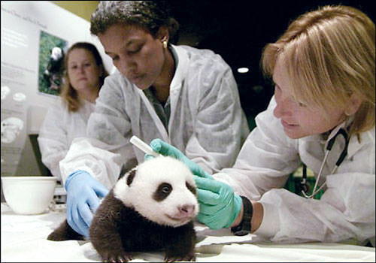
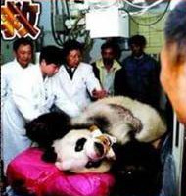
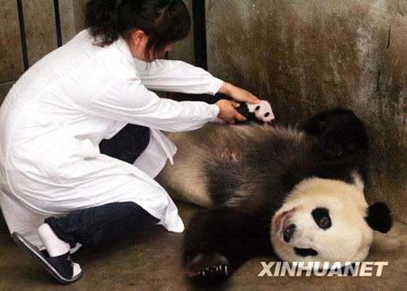
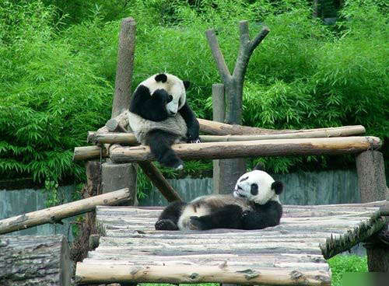
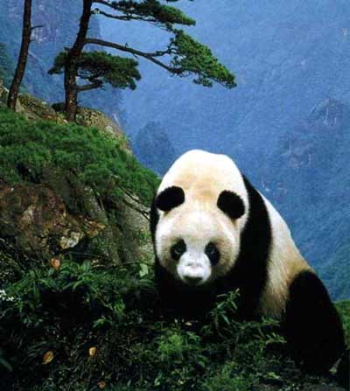
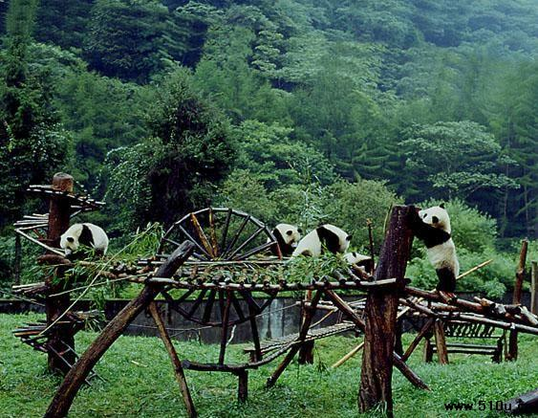
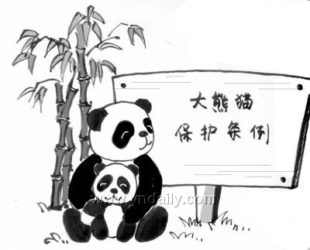


Learn more about actions
help pandas
have more babies
2. build more
panda reserves
3. make laws to
protect pandas

Slide 20
single work
Task7 Retell the story
Visitors in Wolong want to know more about the pandas. Please tell the story to him.
Use the words like : However, what's more, as a result...
Growth | weight: at brith; 4 months old; eight months later... food: In the beginning; 6 months old; 20 months old...
Problems | it is difficlut... many pandas... have no... because...
Actions | help... build... make...

Slide 21

Task8 Guess and discuss
There are now only 1,600 pandas in the world.
If we do nothing, soon there may be none left!
Can you guess why the writer write this story?
Ask all of us to take action to protect pandas.

Slide 22
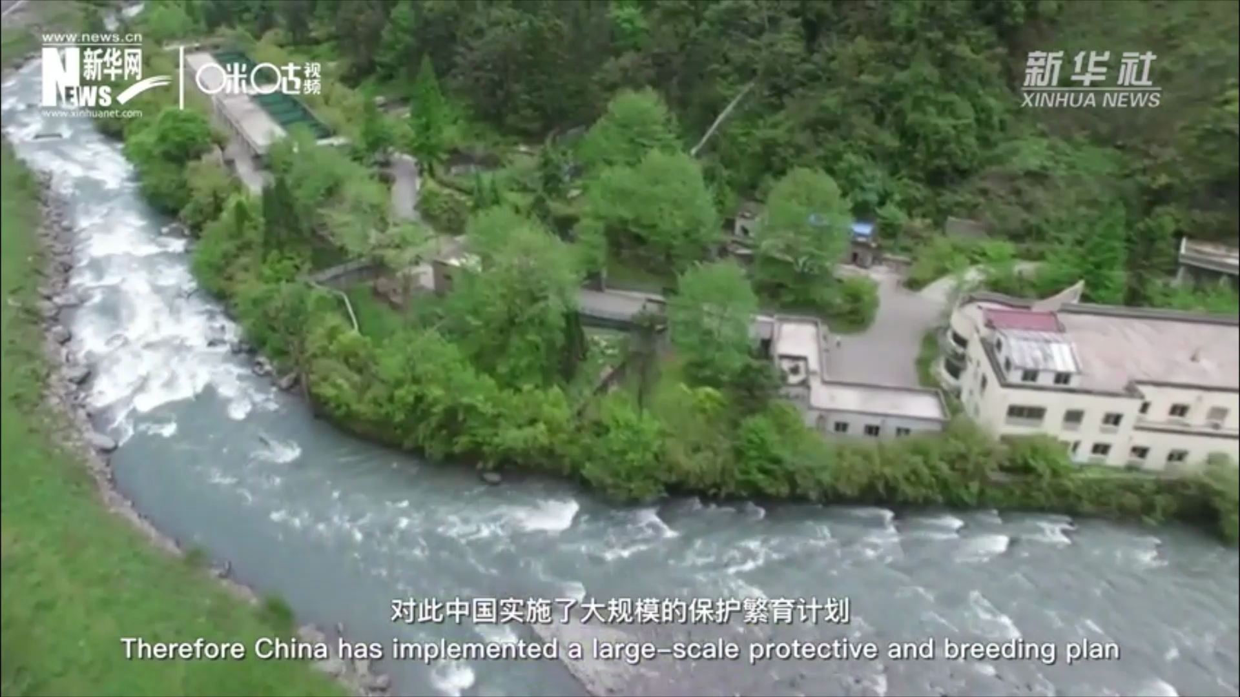
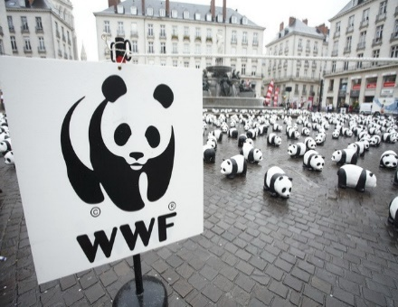
group work
Discuss other actions!
Can you think out more actions to protect pandas?
★
Join some clubs and organizations .
Donate money to help protect pandas.
Don’t buy things made of animal fur.
Call on more people to join you.
Keep the world clean.
…
★
★
★
★

Slide 23
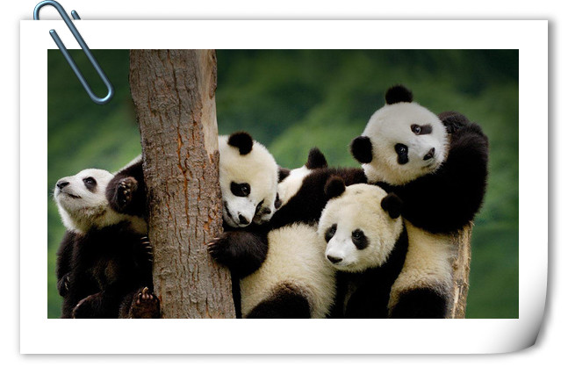
Wolong nature reserve wants to organinze a show to ask people to take actions to protect pandas. Please make a poster for the show
The poster should include the problems pandas have and actions we should take

Slide 24
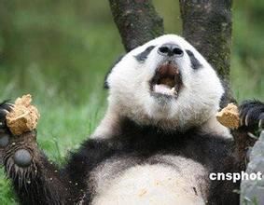
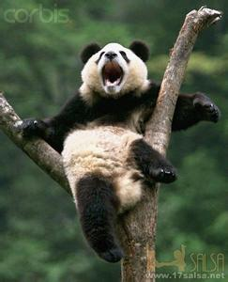
I want to live
harmoniously
with you！
(和谐)

Slide 25
Where there is a will, there is a way.
有志者事竟成
Where there is life, there is hope.
生命不息，希望常在

Slide 26



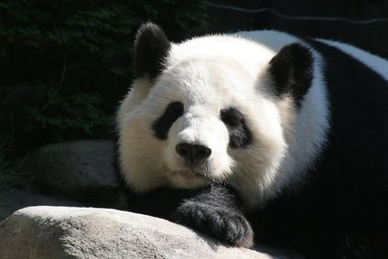
Assignment
Read the story and tell the story to your parents.
2. Write a short passage to tell people
to protect giant pandas (at least 80 words).

