Slide 1
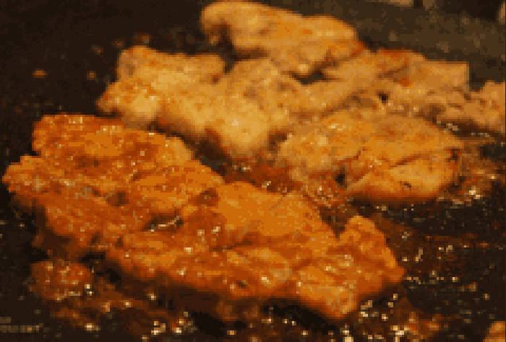
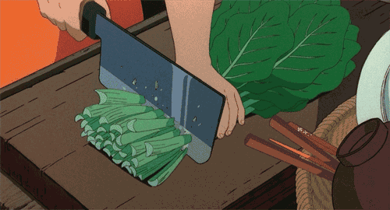
Meat VS Vegetable
Do you like eating meat or vegetables?
What is the advantages and disadvantages of having meat?

Slide 2
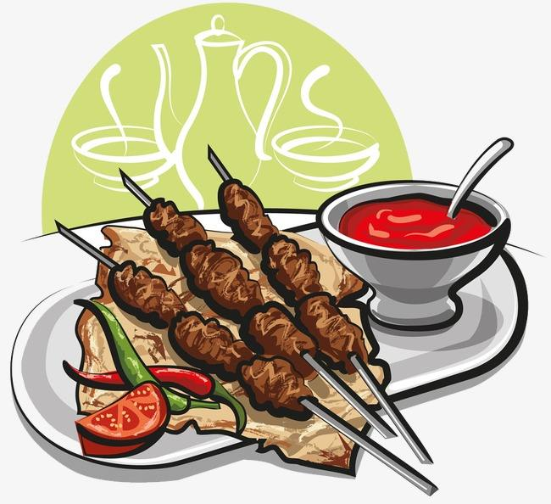
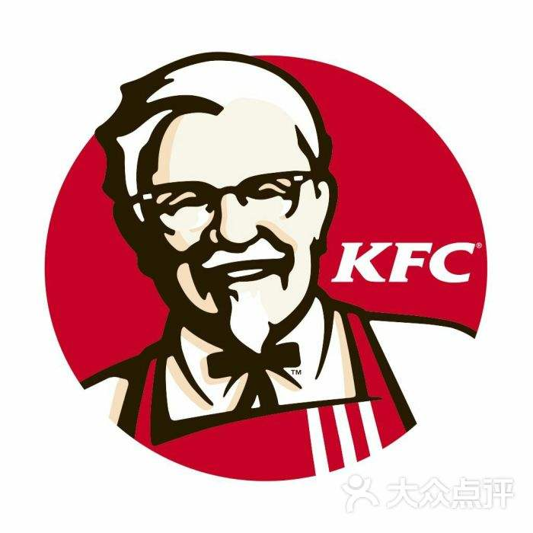

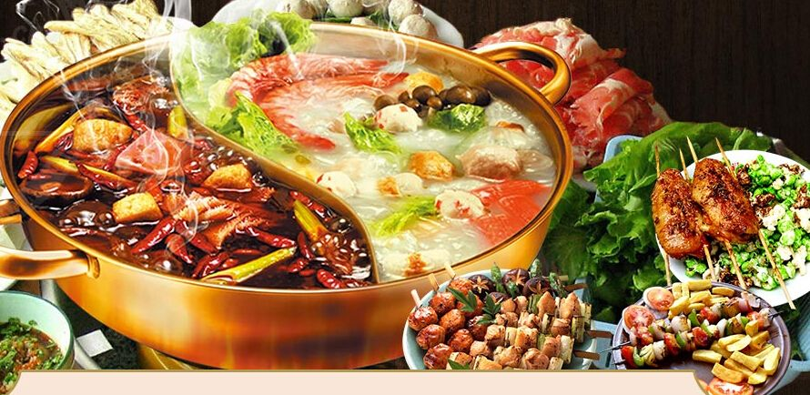

However!!!
BBQ
KFC
Zhengxin Chicken
Hotpot
We ate too much meat every day, and this is harmful to our health!

Slide 3
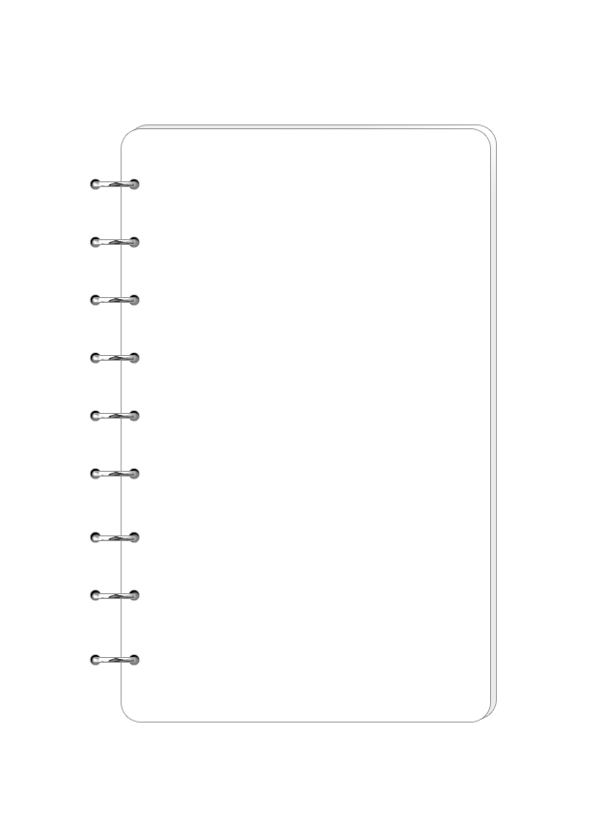
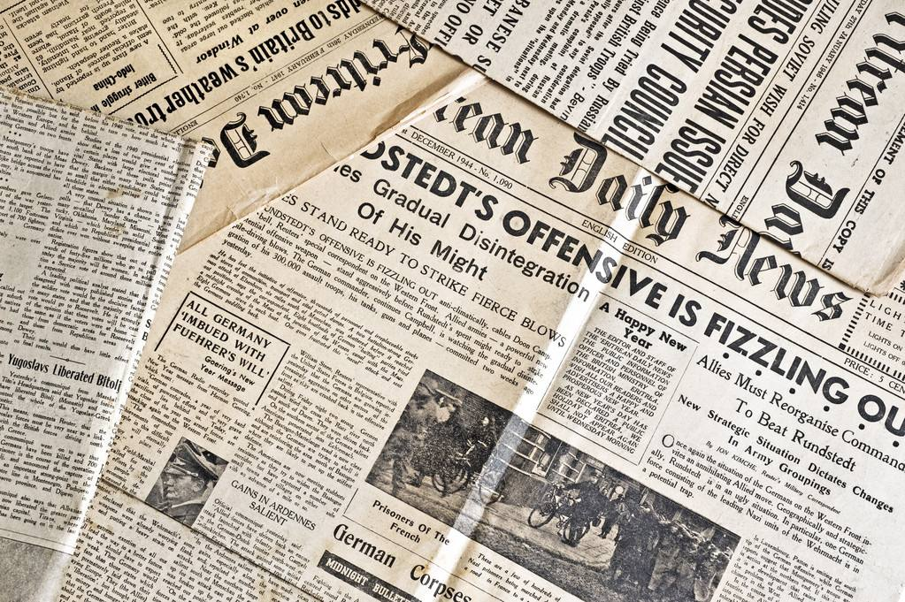
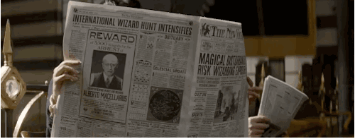
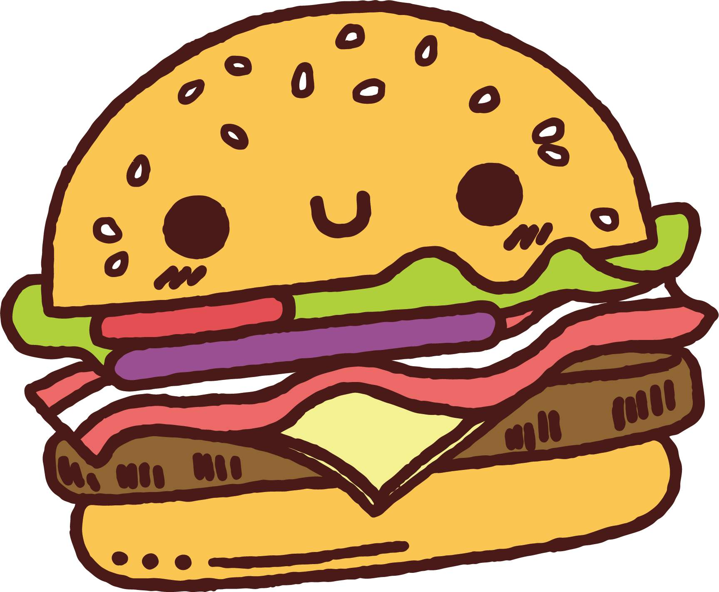
New Way to Eat Meat

Slide 4
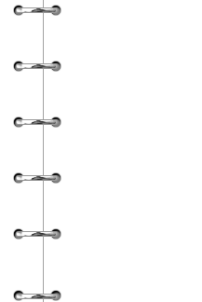









目
Study English by reading newspapers
·New way to eat meat
录
Background Information
contents
·Your Preference
·Discussion & Debate

Slide 5
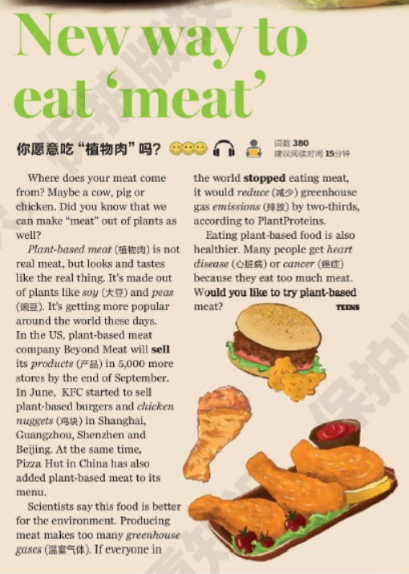
About English News
Title
The form of the English News
Title, introduction, body
Introduction
Title : The topic of the news
Introduction: a brief summary of the
whole passage
Body
Body: the main part of the passage

Slide 6
About Title
Title
What can we get from the
Title?
1、What do you think the article is mainly about?
2、Why does the word ‘meat’ have quotation marks ‘ ’?
3、What kind of meat is it？Is it healthy or
unhealthy?

Slide 7
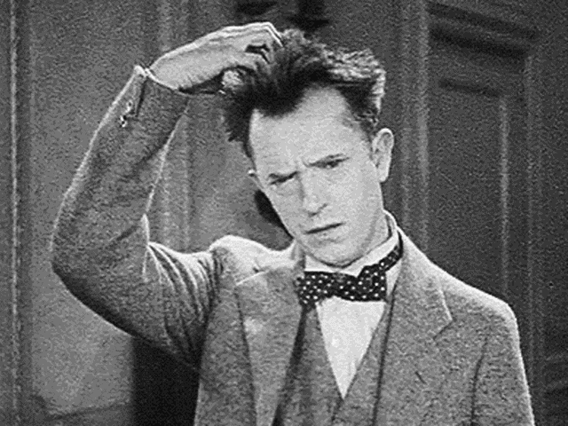
About Title
Title
What makes a good title?
Short and precise
The main idea instead of the whole story
Keep the readers curious

Slide 8
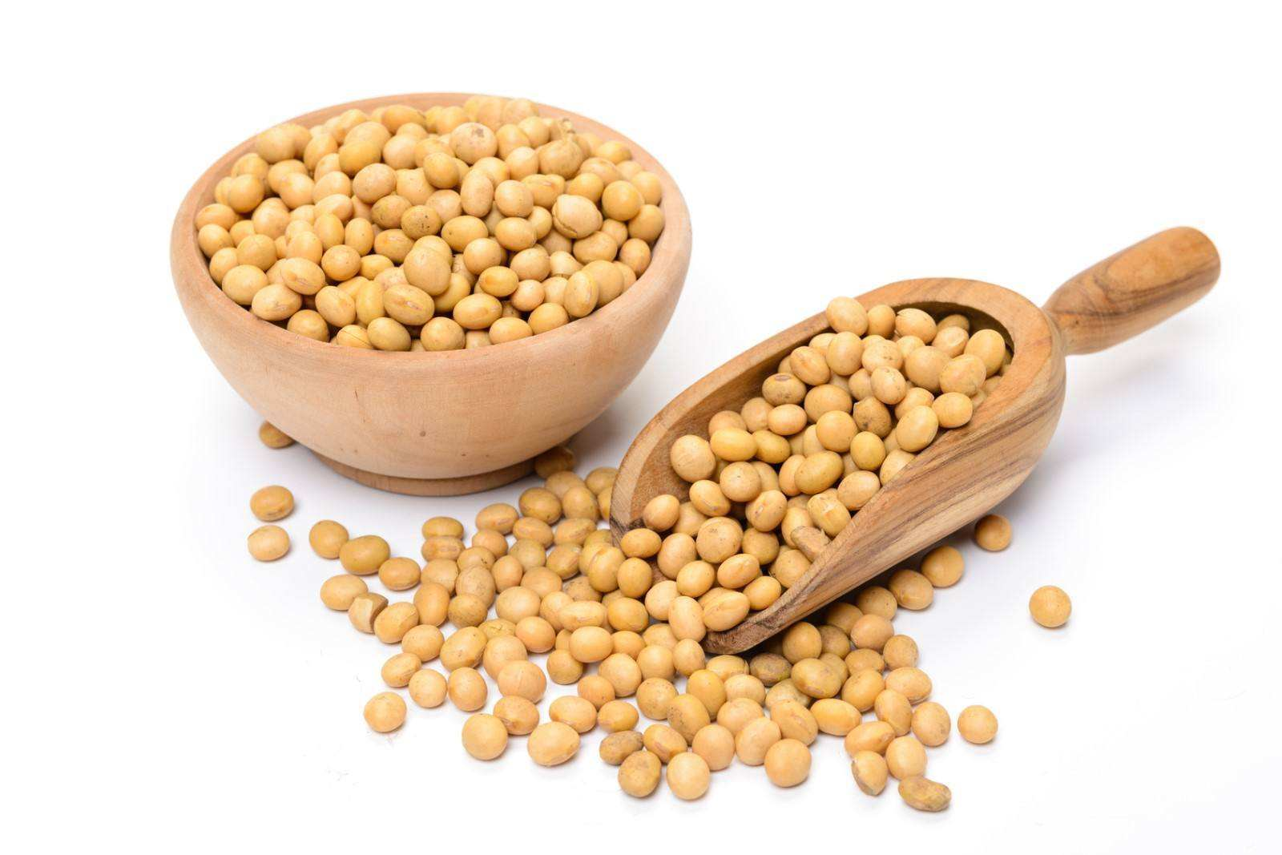
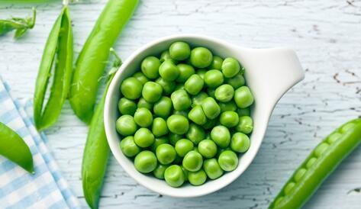
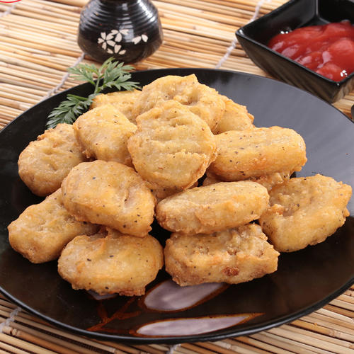
What can we learn?
Vocabulary
Vocabulary and language points
Plant-based meat 植物肉
Soy 大豆
Peas 豌豆
Product 产品
Nugget 鸡块
Greenhouse gases 温室气体
Reduce 减少
Emission 释放
Heart disease 心脏病
Cancer 癌症

Slide 9
About English News
Read the first two paragraphs and find out these key factors.
What Why How
1、What is it? How popular is it?
It’s plant-based meat. It’s getting more popular around the world.
2、Where is it sold?
Plant-based meat is sold in both USA and China. And it is sold in cities like Shanghai, Guangzhou, Shenzhen and Beijing.

Slide 10
About English News
Read the last two paragraphs and find out these key factors.
What Why How
3、Why？What are the advantages of plant-based meat?
Plant-based meat is healthier and better for the environment.
P.S. Why is plant-based meat better for the environment？

Slide 11
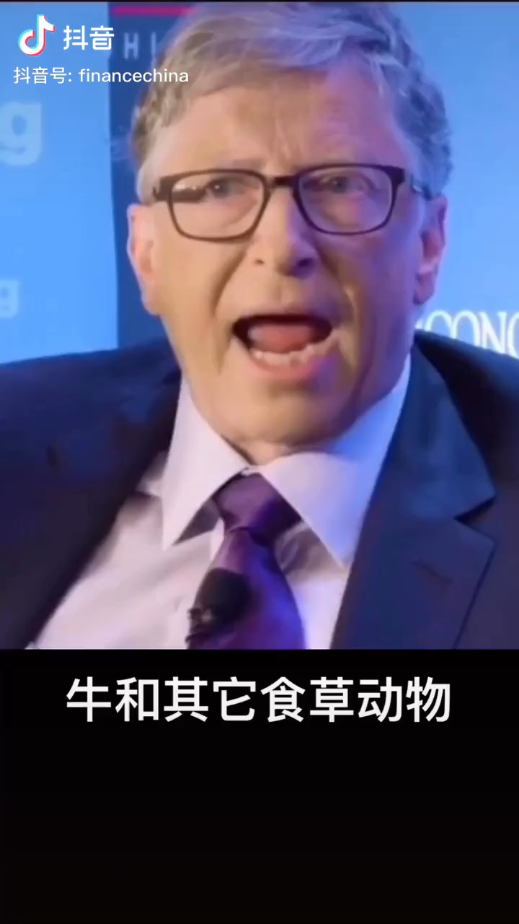

Why is plant-based meat better for the environment？
Newspaper Reading

Slide 12
About English News
Read the last two paragraphs and find out these key factors.
What Why How
4、How？Can you find the answer to the question?

Slide 13

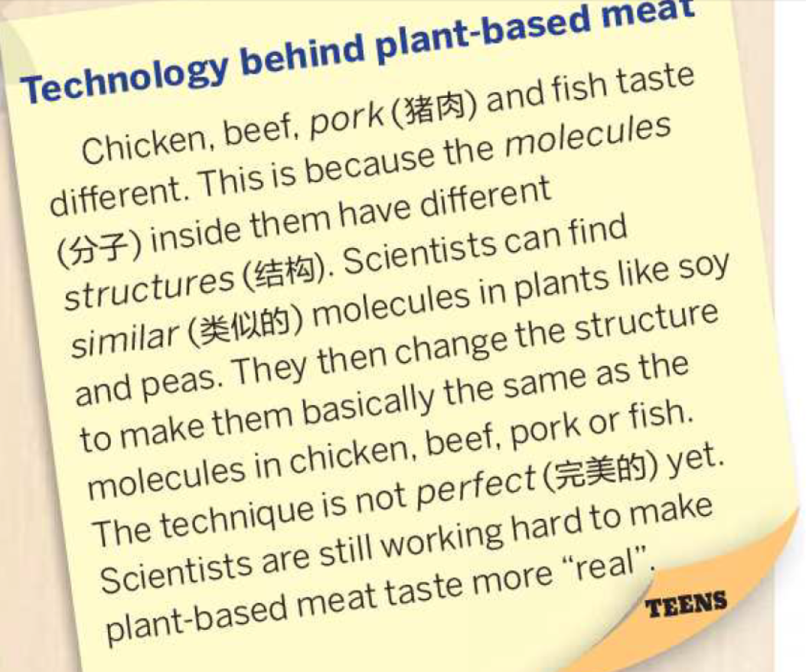

Background Information
1、Can you guess the meaning of “technology and technique”? What kind of things are they?
They are what the scientists do to make things different with science.

Slide 14


Reading Tips
Don’t stop every time you meet with new
words or difficult sentences, just move on.
After reading, look back to see if you can
guess the meanings.
01
Tips: Some proper nouns(专有名词）are
spelled with a capital letter. We only need to
know it refers to a person, time, a place or an
organization.
02

Slide 15


Detailed Reading
Read the article again and tell your classmates whether these sentences are True or False. And Why?
Chicken, beef, pork and fish have the same structures.
Plants like soy and peas have the similar molecules as those in meat.
Scientists mix meat and plant together to make the plant-based meat.
The technology is perfect now so that the new meat tastes exactly the same as the real meat.

Slide 16

Summarize the News
c
In order to be for people and better for the , scientists use new to create the . They are sold recently in both , like .
d
e
Scanning
b
Scanning means looking for key words
Read carefully to get some more details.
e
a
a、KFC and Pizza Hut
b、Plant-based meat
c、healthier
d、environment
e、USA and China
e、technology

Slide 17
3W Questions help us get the
general idea of scientific news.
What
What is it about?
Why
How
Why does it happen?
How does it happen?

Slide 18

News Types
Talk about a kind
of opinion like: Is
smoking good or
harmful?
Argumentative
Writing
Expository
Writing
Tell others what sth. is，
like：what is an iPad?
Narration
Poems
Short sentences like:
When winter comes
will spring be far away?
Tell the readers a
story like: Tom got
lost at night
What type of news do you
think New Way to Have Meat is?

Slide 19
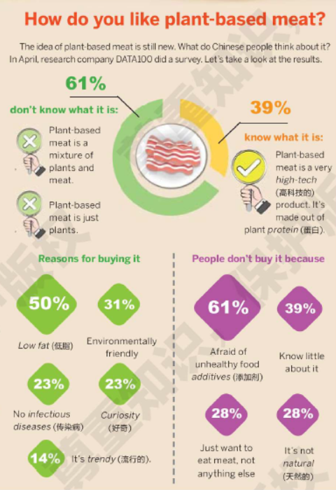
How to read forms and charts?
Plant-based meat.
What do you know from the pie chart?
01
What does the green 61% and orange 39% mean?
61% means over half of the people being interviewed don’t know what planted-based meat is, while the other people know about it.

Slide 20
How to read forms and charts?
Plant-based meat.
What do you know from the picture below?
02
What are the reasons for buying it?
Planted-based meat has low fat and they are environmentally friendly. Besides they have no infectious diseases. What’s more, some people are just curious and think they are trendy.

Slide 21
How to read forms and charts?
Plant-based meat.
What do you know from the picture below?
03
What are the reasons for not buying it?
They are worried about the unhealthy food addictives and they know little about it. Besides, they are not natural and they are fake meat.

Slide 22

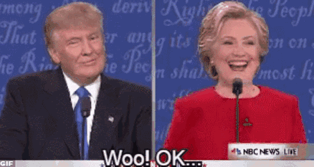

Debate
Task: Boys and Girls, try to win each other!
Hey! Woman! I think plant-based meat is fake meat!!!
Trump, tell the truth, I think all the things you said are fake!!!
Woo! Trump! I don’t think we can believe you!
Oh! Hillary! At least the meat I produce in the future is real!

Slide 23


Boys VS Girls
-Can you accept the plant-based meat? Why?
Plant-based Meat
Real Meat
Take some notes and try to persuade each other!

Slide 24
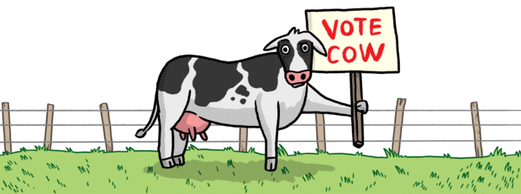
Group Discussion
-Can you accept the plant-based meat? Why?
(Girls)low fat, will not make you look fat, prevent you from getting heart disease, have more vegetables happily, there will be less green-house gas, stop the whole world form getting warmer, stop the ice melting, and the sea level will not go on rising, it can help protect the reserves of some sea animals, there will not be COV-9 Virus, will not lose precious life, will not be sudden pain, and it’s fashionable to be healthy, slim and beautiful …

Slide 25
Group Discussion
-Can you accept the plant-based meat? Why?
(Boys) there are a lot of harmful things, meat like beef and chicken will not make you fat, there may be harmful colorings in the meat, people always feel different with fake meat, and it tastes not like real meat, pigs and chicken and cow will not be sold and farmers will be poor, fake meat lack protein and some other things, the traditional Chinese dishes can’t be done without real meat, this will stop the development of traditional Chinese food.

Slide 26
Boys VS Girls
Plant-based Meat
Real Meat
Try to persuade each other with suitable reasons!

Slide 27
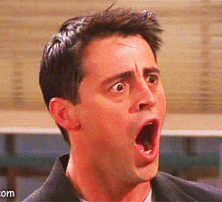
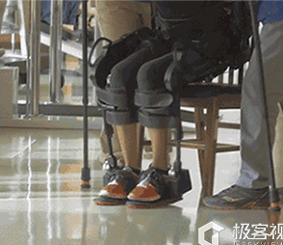
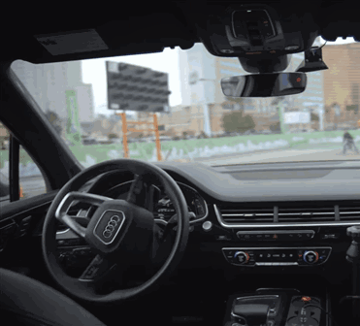
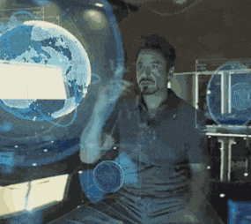
How can Technology help us?
Further Thinking
A
B
C
Artificial bones can
help disabled people
to stand up again!!!
Self-driving Car can help
us drive safely and save
more time for us.
Holographic projection
helps us talk to the beloved
people who have already
died.

Slide 28

2020-10-30

