Slide 1
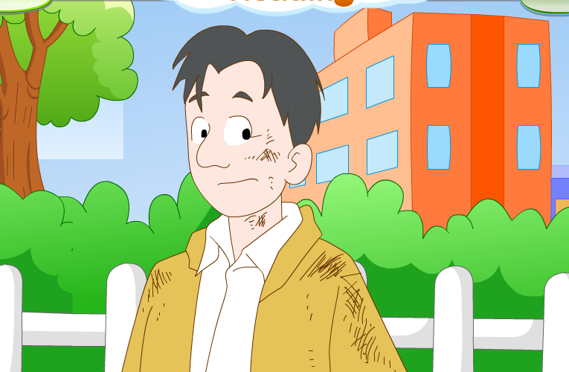
U7 Abilities Reading I
What a brave young man!
奔牛初级中学 范颖欣

Slide 2
fire
People started to use it millions of years ago.
It is very important in our life.
It can give bright light to us.
It can also help us to keep warm and cook delicious food.
However, it is also dangerous sometimes.

Slide 3
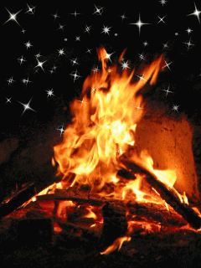
Brainstorming
Fire is very useful in our life.
Why is fire useful to us?

Slide 4
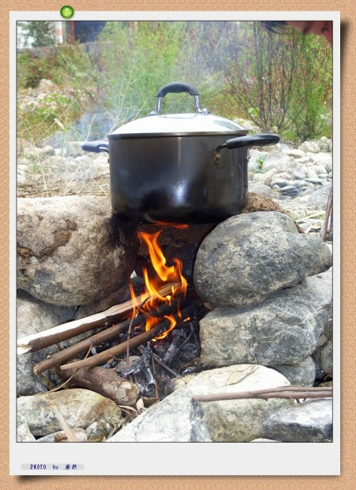
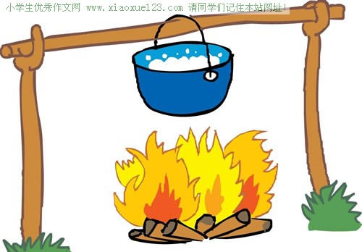
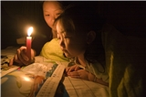
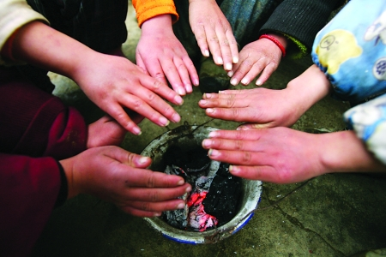
cook food
make water hot
give us light
keep us warm

Slide 5
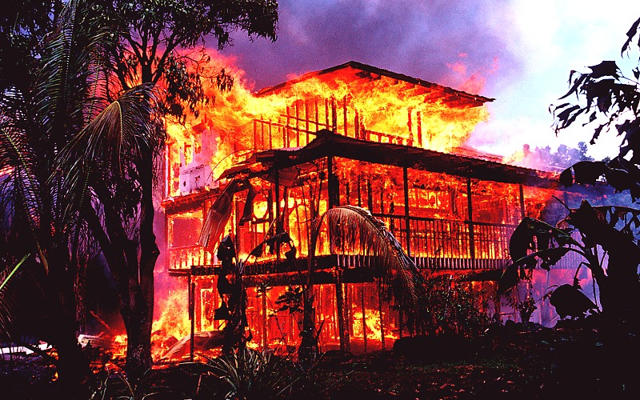
Fire is useful.
If we aren’t careful with it, it will be dangerous.

Slide 6
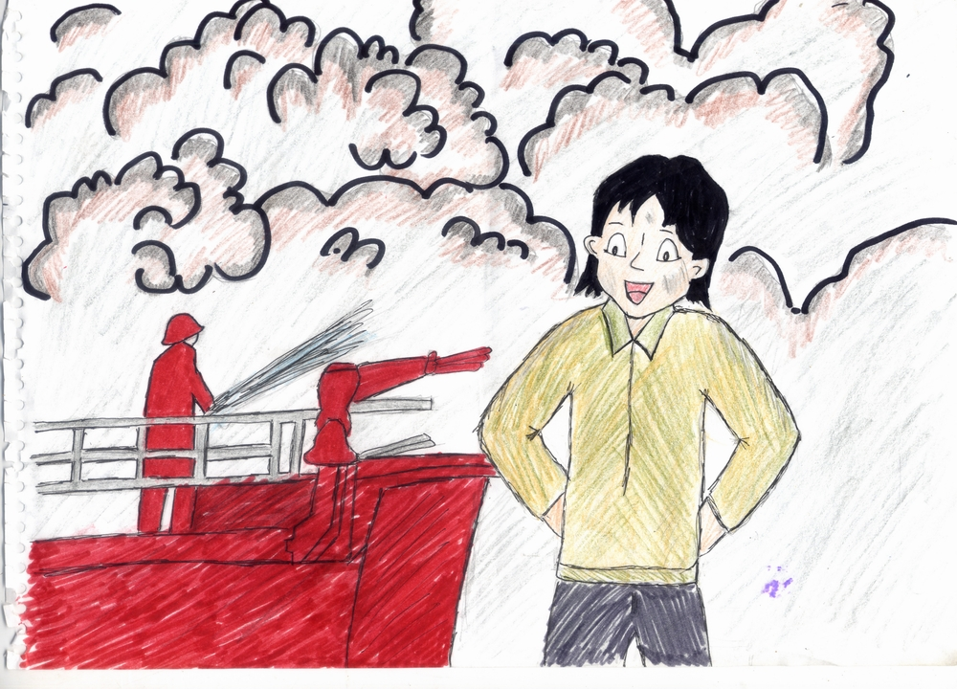
Today we’ll learn a story about a big fire .
A brave young man!

Slide 7
Task 1: Watch and answer.
What was the story about ?
Lin Tao lives by himself.
Mrs Sun is Lin Tao’s neighbour.
Lin Tao saved Mrs Sun from the fire.
Mrs Sun’s house was on fire.

Slide 8
Task 1: Watch and answer.
What was the story about ?
Lin Tao lives alone.
Mrs Sun is Lin Tao’s neighbour.
Lin Tao saved Mrs Sun from the fire.
Mrs Sun’s house was on fire.
save from

Slide 9
Task 1: Watch and answer.
What was the story about ?
Lin Tao lives by himself.
Mrs Sun is Lin Tao’s neighbour.
Lin Tao saved Mrs Sun from the fire.
Mrs Sun’s house was on fire.
save from

Slide 10
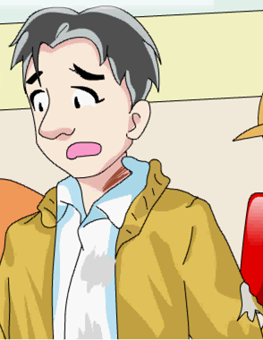
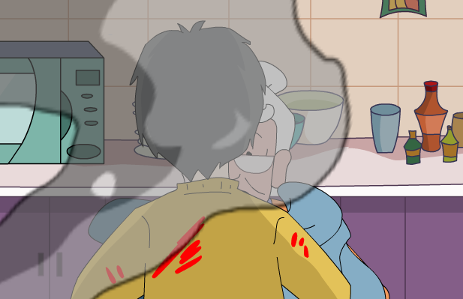
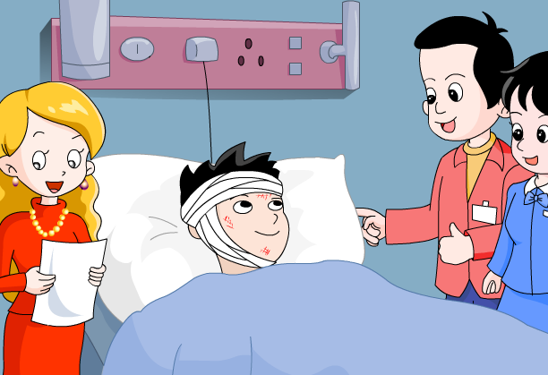
Task 2: Skim and divide
Part 1
Introduction of Lin Tao
Para?
Para 1
Part 2
During the fire
Para?
Para2---3
Part 3
After the fire
Para4---6
Para?

Slide 11
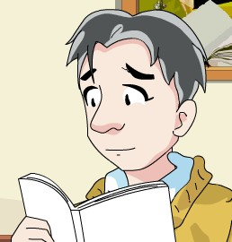
Task 3: Further reading(Para 1)
1. How old is Lin Tao?
He is 20 years old.
2.Why was he brave?
Because he saved his neighbour from a fire.
（一场火灾）

Slide 12
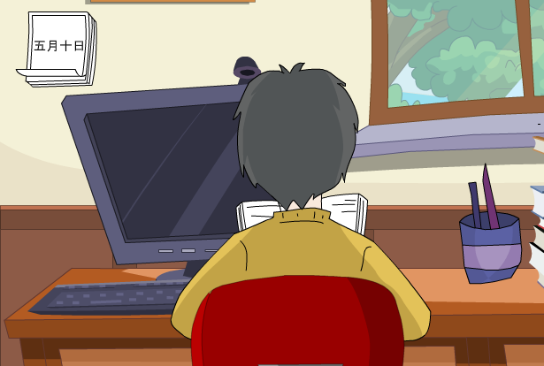
Task 3: Further reading(Para 2)
When | Who | Where | Hear | DO | See
Was Lin Tao afraid at that moment?
10 May
Lin Tao
at home
run outside
smoke
Fire! Fire!Help!

Slide 13
Task 3: Further reading(Para 3)
Read Para 3 and put the actions into the right order.
went in
1
He and found Mrs Sun in the kitchen.
He water his clothes.
He a wet blanket Mrs Sun.
He the kitchen.
He quickly Mrs Sun’s bathroom.
He Mrs Sun fire.
3
poured over
5
put over
4
rushed into
2
ran into
6
helped out of

Slide 14
Task 3: Further reading(Para 3)
The actions into the right order.
Retell with the key actions.
the order of time.
went in
First
1.He and found Mrs Sun in the kitchen.
2.He quickly Mrs Sun’s bathroom.
3.He water his clothes.
4.He the kitchen.
5.He a wet blanket Mrs Sun.
6.He Mrs Sun fire.
ran into
Then
poured over
.
At last
rushed into
put over
helped out of

Slide 15
Task 3: Further reading(Para 4---6)
1.Was Lin Tao badly hurt at last? Why?
2.What do people think of Lin Tao?
3.What did Lin Tao say to us about fire?

Slide 16
Task 3: Further reading.
1.Was Lin Tao badly hurt at last? Why?
Yes. Because the fire burnt LinTao’s arms, necks and face.
2.What do people think of Lin Tao?
How brave he is！
3.What did Lin Tao say to us about fire?
Fire is very dangerous, we should be careful with it!

Slide 17
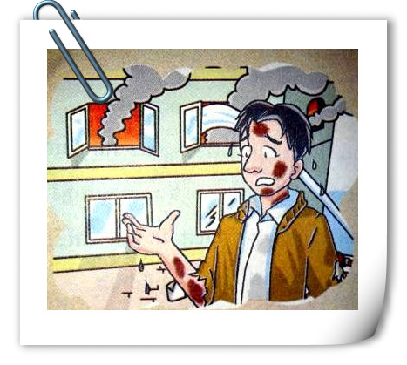
Task 4: Selected reading(选读).
What do you think of Lin Tao? Why?
brave
He was brave enough to save his neighbour from a fire. ...
helpful
He put a blanket over Mrs Sun and helped her out.
clever
He poured water over his clothes to protect
himself.

Slide 18
A
Task 5: An interview with Lin Tao
R: You’re a brave young man, Lin Tao. How old are you?
L: _____________ .
R: Can you tell us about the fire?
L: First, I heard __________________, and then I saw_________
from next door.
R: How did you save Mrs Sun?
L: I ________ her kitchen, _____________over her and ____________.
R: Did you do anything to protect yourself?
L: Yes, I did. I _______________ my clothes.
R: Were you afraid at that moment?
L: __________.
R: Fire is dangerous. What advice do you want to say to people ?
L: .We should ____________fire.
I’m twenty
someone shouting for help
a lot of smoke
rushed into
put a wet blanket
helped her out
poured water over
A little
be careful with

Slide 19
Learn more about fire safety用火安全.
How to be careful with fire .
a Be careful with fireworks.
b Do not play with matches.
c Do not put anything hot into the rubbish bin.
d Keep your hair away from fire.
We should keep ourselves safe.
Safety is above all!
安全高于一切!
b
a
d
c

Slide 20
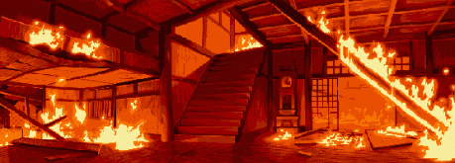
Discussion
If we are in fire, what should we do?
Calm down and be brave
Rush out of the room
Call 119 or 110 for help
Pour water over your clothes
Pour water over one’s body / clothes
Cover your nose with wet cloth when leaving

Slide 21
Homework
Finish exercises on Pages 83 & 84.
Search for more information about fire safety.

Slide 22
Thank
you!

