Slide 1
Unit6 Reading1
What we eat and how we live
常州市中天实验学校 王洁

Slide 2
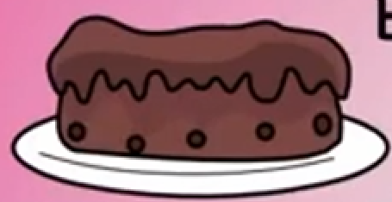
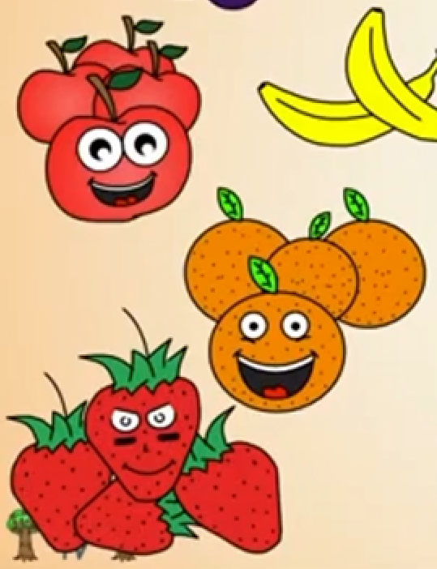
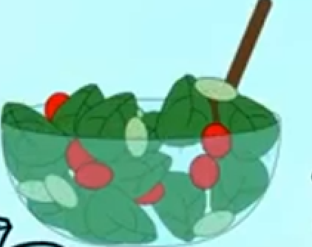
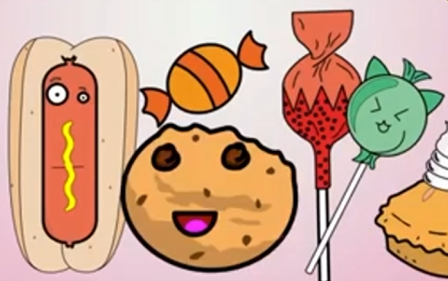
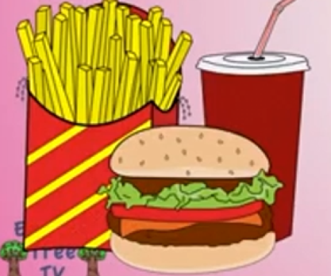
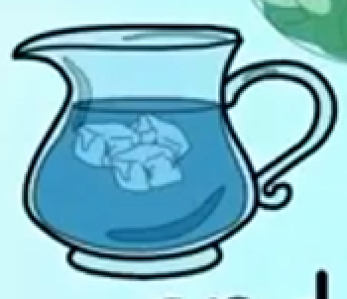
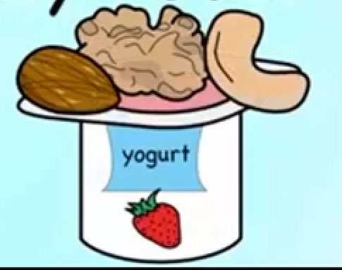
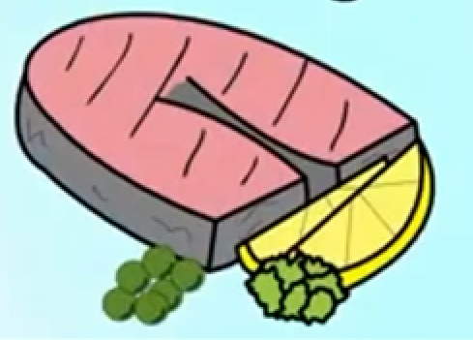
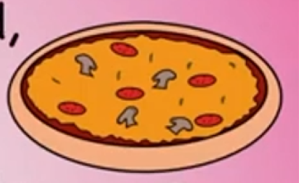
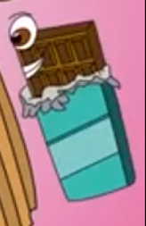
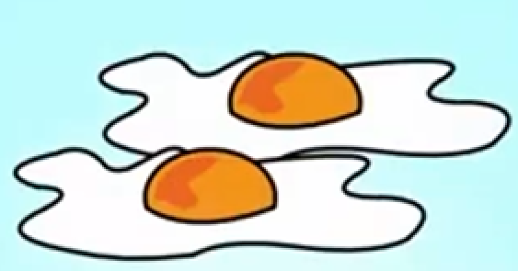
Lead-in
chips薯片
fruit and vegetables
salad
hotdog
lollipop
French fries薯条
yogurt
fish and meat
cola
pizza
cookie
hamburger
Junk food
Healthy food
chocolate

Slide 3
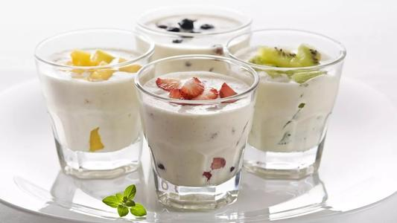
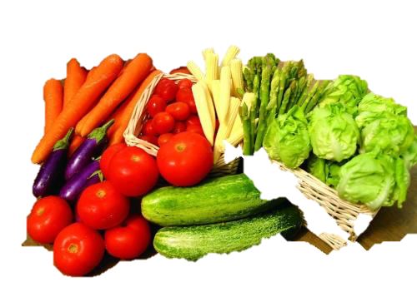
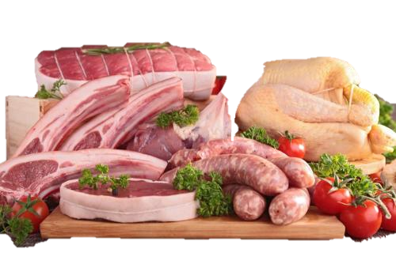
Before-reading
Healthy food
★ help us get ready for the day
★ be good for our health
★ give us energy ['enədʒɪ] n.

Slide 4
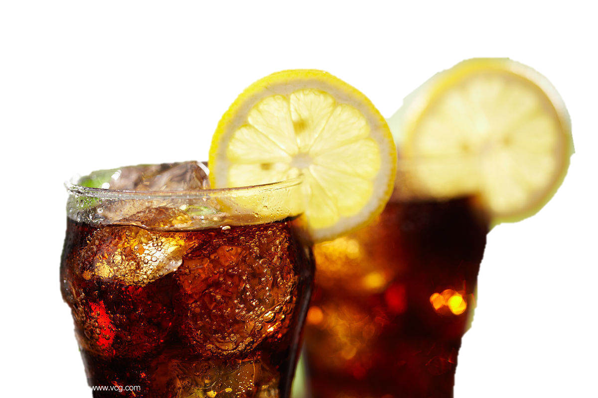
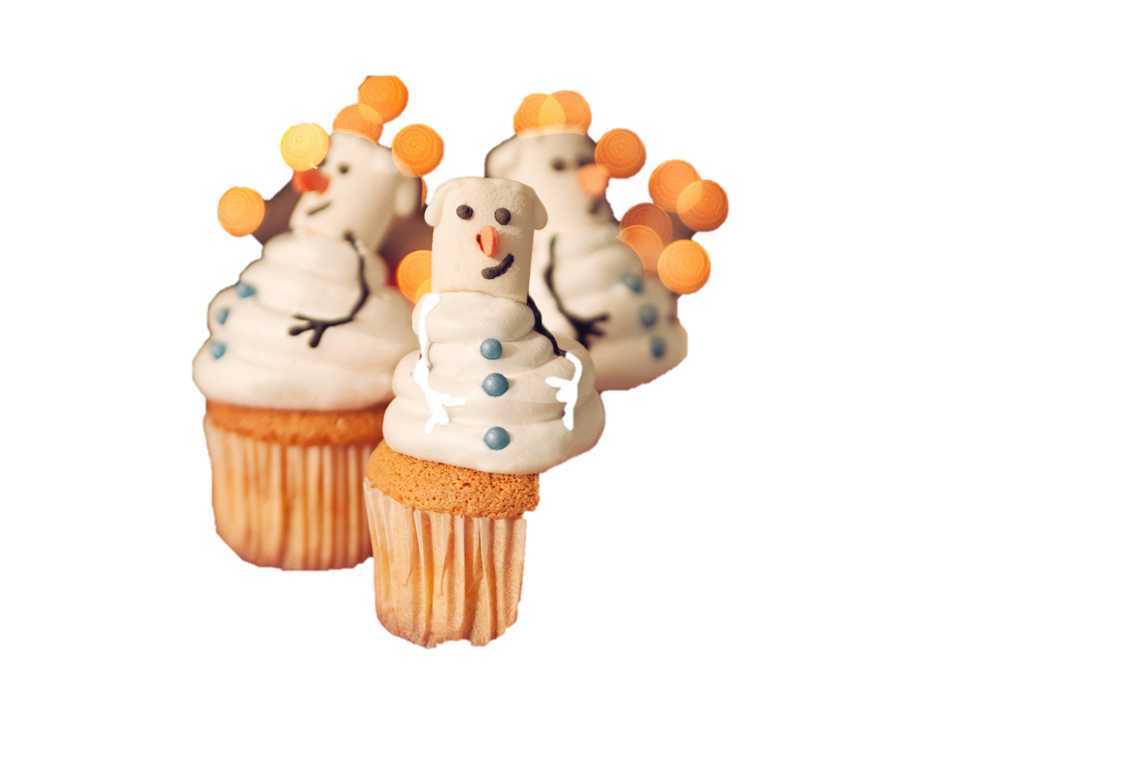
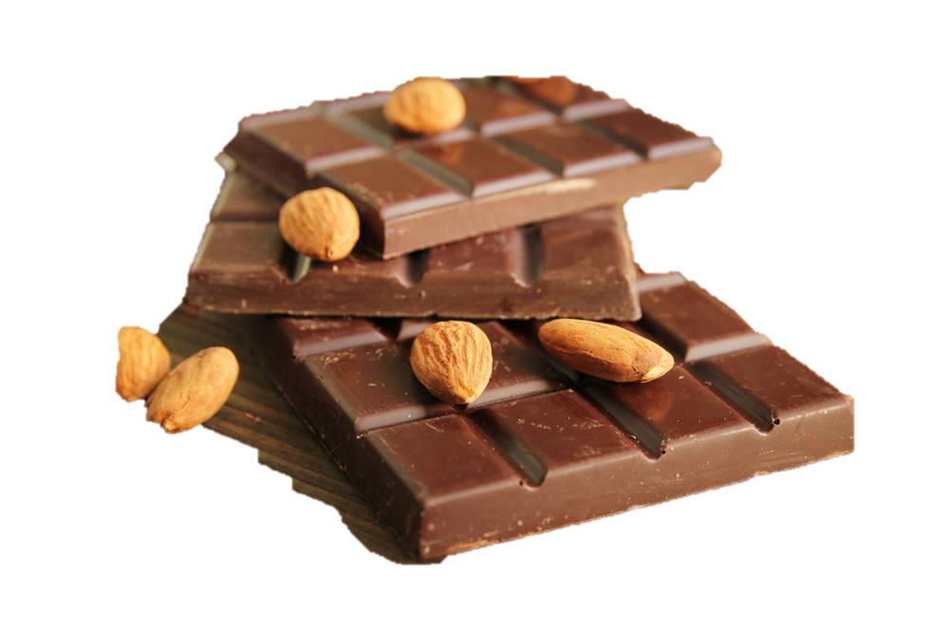
Before-reading
★ have too much sugar/ˈʃʊgə/
★ be bad for our teeth
★ be bad for our health /helθ/ n.
Junk food
★make us fat
★make us slim

Slide 5
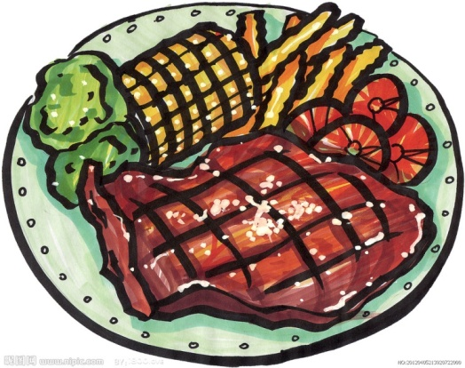
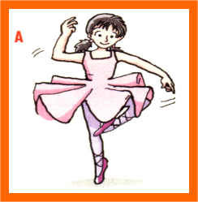
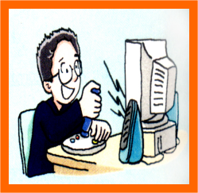
Title
What does the article talk about?
Diet(饮食)
Lifestyle
(生活方式)
What we eat
How we live
Tip1:Try to find the main idea（主旨思想） from the title.

Slide 6
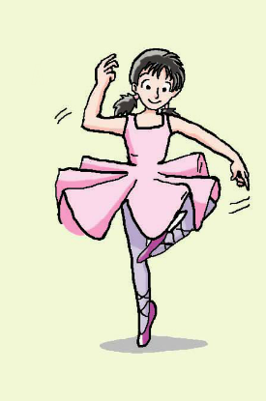
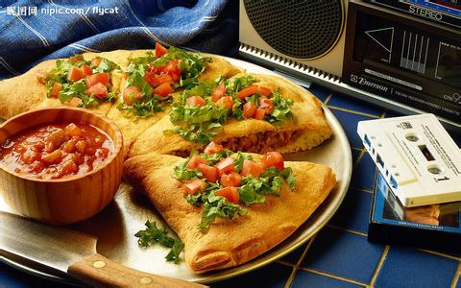
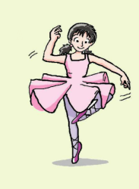
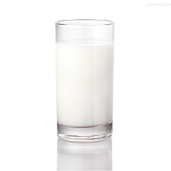
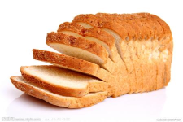
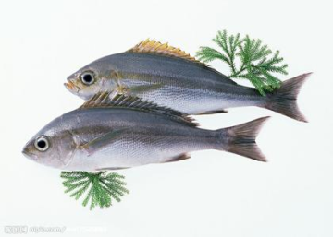
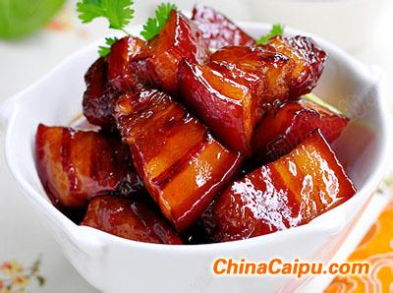
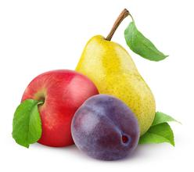
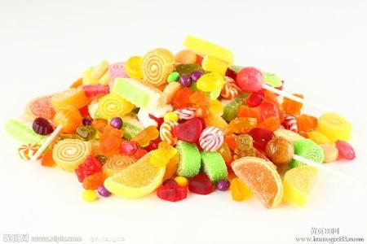
Guess before reading
Looks
Hobby
What she may eat
Exercise?
Kitty
tall, slim
dancing

Slide 7
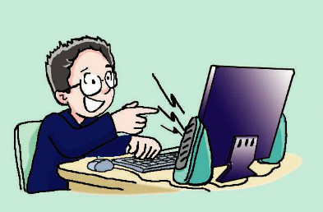
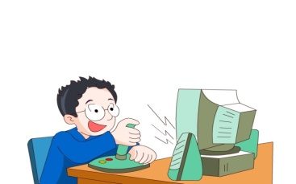
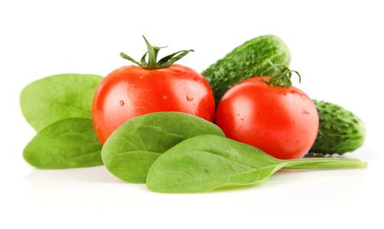
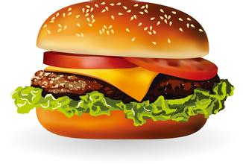
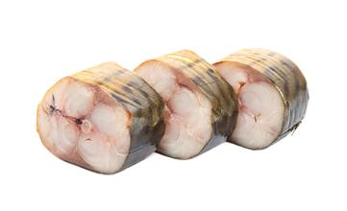
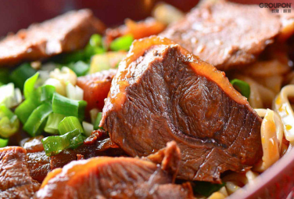
Looks
Hobby
What he may eat
Exercise?
Daniel
a little fat
playing computer games
Tip 2:
We can get some information from the picture.

Slide 8
While-reading
What does Kitty love doing?
How long does she dance every day?
Why does she seldom eat cakes or sweets?
She loves dancing.
She dances for half an hour every day.
Because they have too much sugar and are bad for her teeth.

Slide 9
While-reading
F
D
Hi! My name is Kitty. I love dancing. I dance for half an hour every day.
Healthy food is important for me. I need to keep fit. I always have milk and bread for breakfast. For lunch and dinner, I usually eat fish and vegetables.
Sometimes I feel hungry between meals, so I eat an apple or a pear. I seldom eat cakes or sweets. They have too much sugar and are bad for my teeth.
Circle the adverbs of frequency.(频率副词)

Slide 10
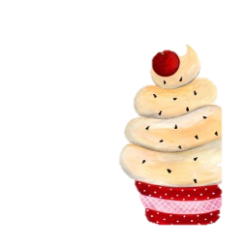
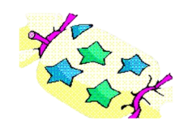
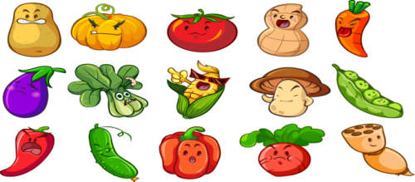
While-reading
Seldom
Kitty’s Food
Pyramid
Sometimes（between meals)
[ˈpirəmid]
金字塔
Usually（lunch&dinner)
Always（breakfast）
A: What does Kitty ... have for ...? B: She ... has ...

Slide 11
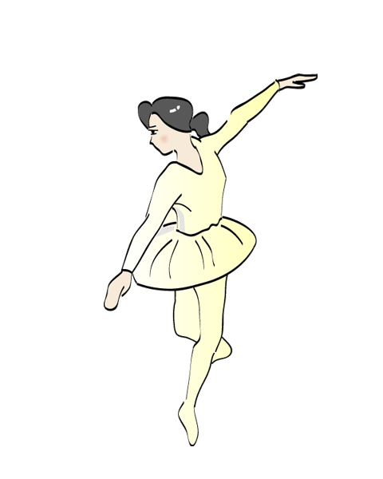
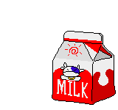
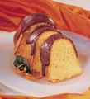
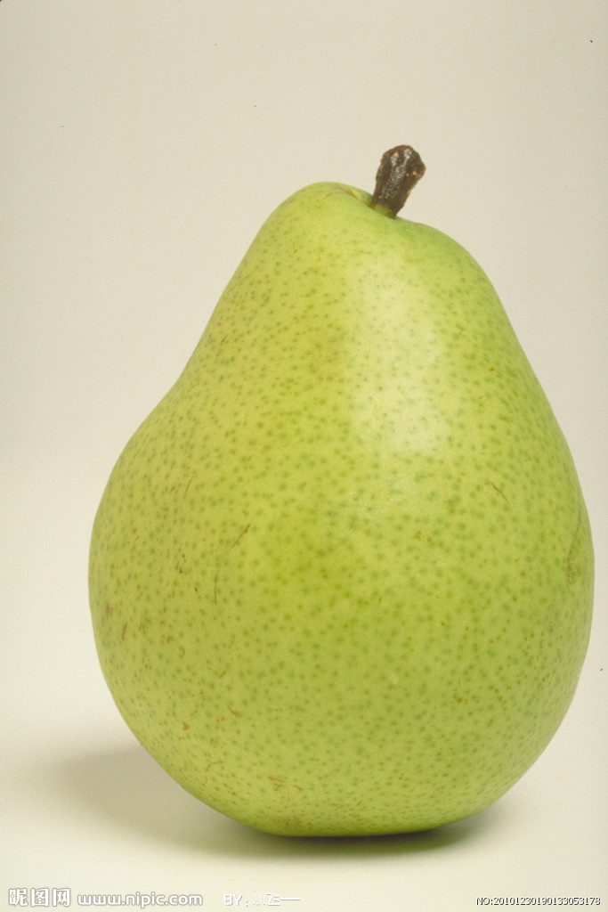
She is Kitty, she ……
Name:
Hobby:
Kitty
Need to keep fit
dancing
Need healthy food
has…
for breakfast
for lunch and dinner
between meals

Slide 12
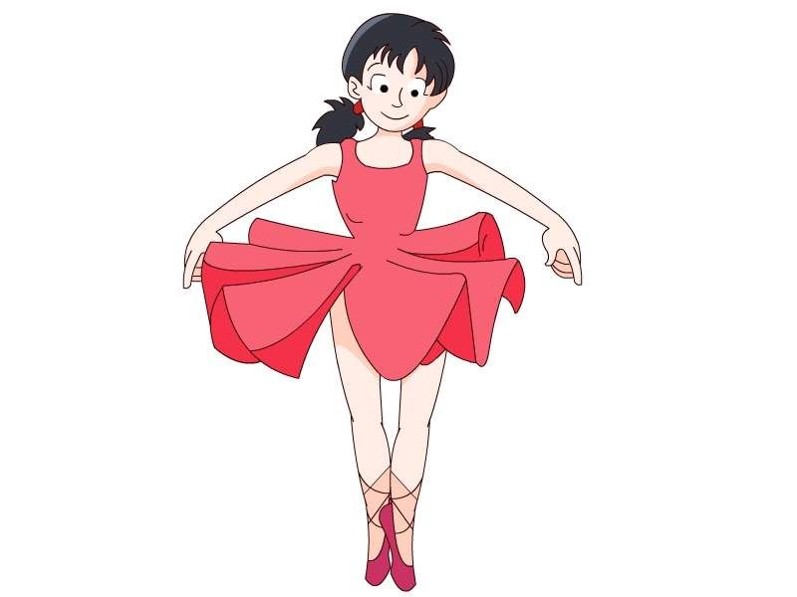
I am healthy!
What about me?

Slide 13
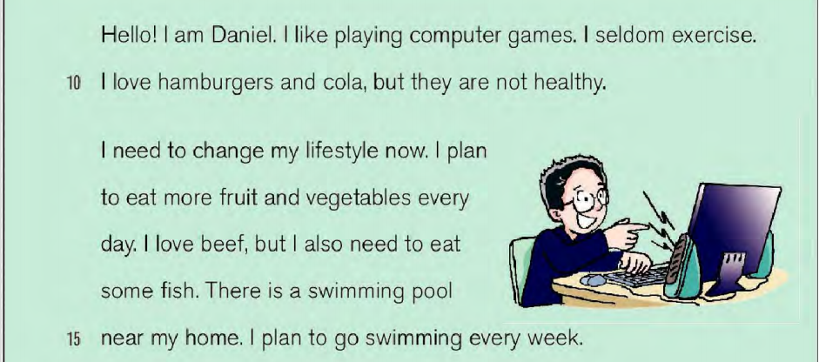
While-reading
Skimming
F
O
Read and match
Para1
A.How does he plan to change?
Para2
B. Why isn't he healthy?
Topic sentence(中心句）
Tip3:You can usually find the topic sentence at the beginning or the end of the paragraph.

Slide 14
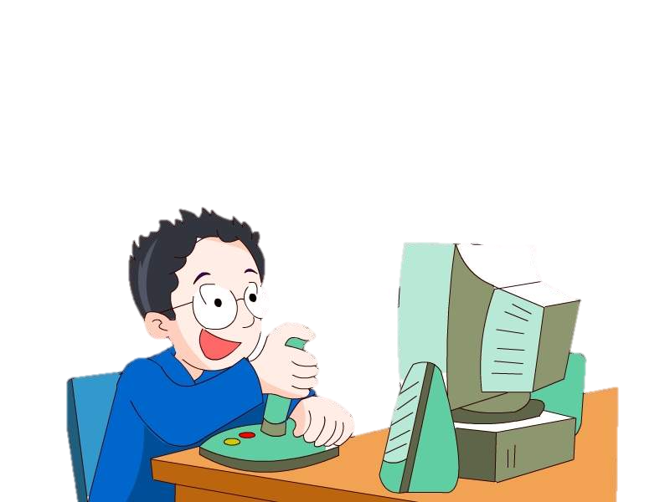
While-reading
Scanning
Part Two
Why isn't he healthy?
·He likes playing computer games.
·He seldom exercises.
·He loves hamburgers and cola.

Slide 15
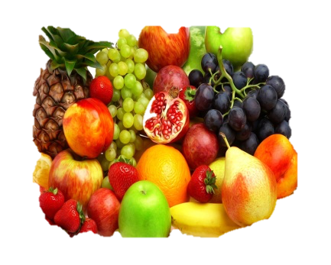
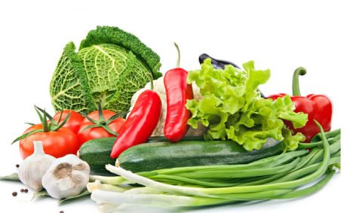
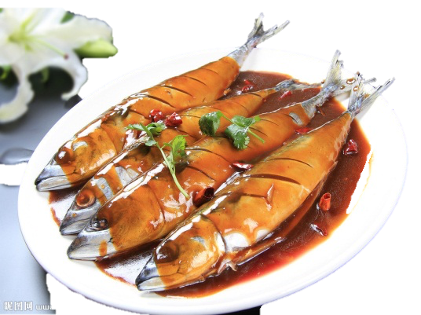
While-reading
Scanning
I need to change.
Daniel's plan
He plans to eat _____________________
___________________.
He plans to _____________ every week.
more fruit， vegetables
and some fish
go swimming

Slide 16
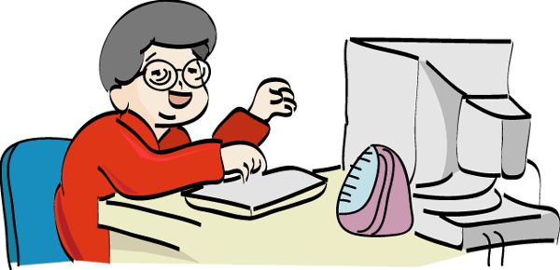
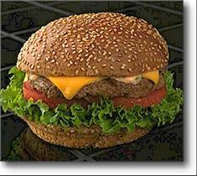
Hi, I’m Daniel
Love
Hobby
Plan to:
playing computer games
every week

Slide 17
Discussion
More ways to keep healthy

Slide 18
Group work
Ways to keep healthy
Groups of 6 students
Design a poster
Slogan(口号)
Logo(标志)
Ways
A student show the poster and give a report

Slide 19
Homework
Make a healthy diet and exercise plan for yourselves.
Put up your posters after class and learn useful information from them.
3. Search the Internet for more
ways to keep healthy.

Slide 20
Thank you for your listening

