Slide 1
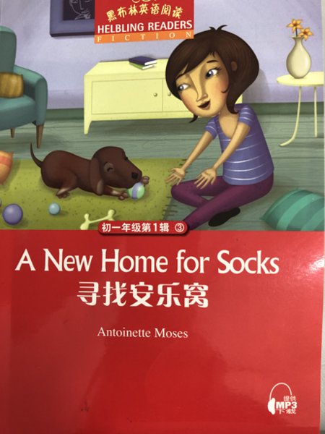
A New Home for Socks
Binjiang Middle School Ding Jiayan
2020.9.29

Slide 2
Reading Circles
Roles | Duties
Word master | look for words or short phrases that are new or difficult to understand
Summarizer | write a summary of each part of the story in your own words
Setting investigator | investigate the background of the story and raise 3 questions to ask your circle members to make them understand the story better
Mind map maker | draw a mind map or a flow chart to help you understand the story better
Character analyzer | analyze the characters' personality
discuss & share & show

Slide 3
Main ideas of each part
Beginning
(Chapter1-2)
Development
(Chapter3-8)
Climax
(Chapter9-14)
Ending
(Chapter15)

Slide 4
Background information
Every year, we find thousands of unwanted dogs on the streets. People leave them on motorways, in public toilets, in rubbish bins or outside shops and restaurants. The dog rescue group finds the most dogs around Easter time. People buy puppies for Christmas presents. The puppy grows. It is difficult to look after. It chews the rugs and it runs round the house breaking things. Dogs need a lot of space and they need a lot of exercise. They are also expensive. It costs around £10,000 to keep a dog for its lifetime. Think with your head and not your heart when you buy a puppy.

Slide 5
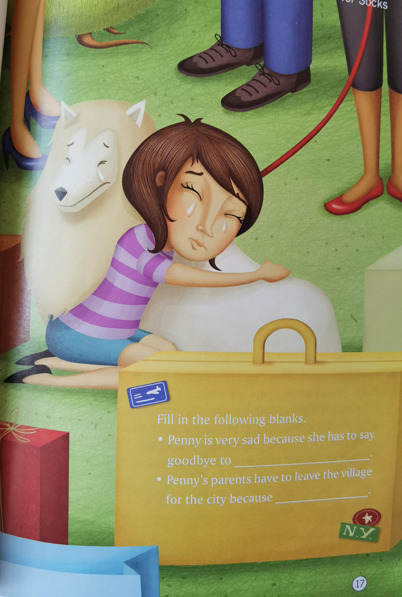
Background information
Nowadays, many people who once lived in the village have moved to the city mainly because they want to hunt for a better job. Therefore, their children also follow their steps to big cities in the hope of a better life. However, sometimes things are totally different from what they thought. Some children can’t adjust to(适应) the new life in the city and some children find it difficult to make friends in the new school. What’s worse, their parents are too busy working to take good care of them.

Slide 6
isn't a home;
not belong there
A New Home for Socks
Penny's old school
Q: Why isn't the bin/Penny's
home/... suitable for Socks?
The story is written in order.
space
Climax
make the changing room in a mess
Penny's new school
Sara's home
Bruce--not like, jealous
Jane's home
Ending
Socks-- chew,make puddles, naughty
Lucy's home
Development
small, parents-- don't want pets
Penny's home
Try to retell the story according to the space order.
One day, .... Finally,....
(because, but, however...)
dark, bad smell, cold, isn't a home
in the bin
beginning

Slide 7
Q1: How does Penny feel each time she finds a home for Socks?
Q2: How does she feel when she finds the place not suitable for Socks?
Q3: What can we learn from Penny?
Sara's home
Q4: Why doesn't she give up trying?
Penny's old school
isn't a home
hopeful
Penny's new school
hopeful
cheerful
frightened
make a mess
Jane's home
Never give up.
hopeful
cheerful
disappointed
sad
Bruce--not like, jealous
Lucy's home
Keep trying.
hopeful
cheerful
disappointed
sad
Socks-- chew,make puddles, naughty
Penny's home
Face the problems positively.
disappointed
sad
small, parents-- don't want pets
in the bin

Slide 8
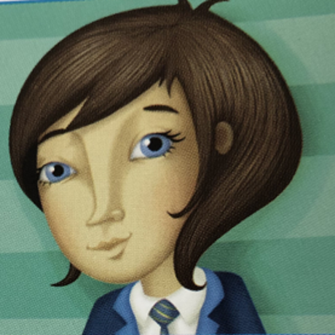
Title: A New Home for Socks
Q: Who else has a new home in this book?
in the village
in the city

Slide 9
Beginning(P13-16)
Compare
A Different Life
environment
living conditions
friendship
parents
small
big
a lake, hills, woods
a park
live in the house, a big garden
live in the apartment,
empty, small
own a dog, have many friendly friends
often on her own;
have no dog/friends
father works at a factory
father out of work
mother at home
mother works
happy
sad
life in the village
life in the city

Slide 10
Appreciation
Penny and her friends often play with Holly. Sometimes they throw sticks into the lake and Holly brings them back. Then she makes everyone wet. Penny and her friends laugh at Holly. (P14)
often play with
Sometimes
throw into
life in the village
brings
back
makes
everyone wet
laugh
at
detail description
（细节描写）
action description
in sharp contrast(鲜明对比)
Penny is on her own. She is often on her own. She's on her own at school and she's on her own at home. Penny often feels lonely. (P13)
on her own
on her own
life in the city
on her own
on her
own
How happy she was with her friends and her dog!
lonely
Q: What does the word “lonely” mean?
Q: Why does the author repeat “on her own” four times?

Slide 11
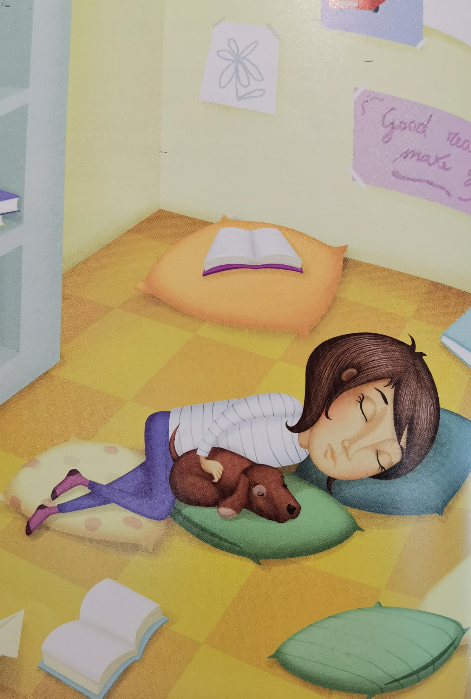
make the changing room in a mess
Development (P18-35)
her teachers would not be happy about it
Q: Why does Penny take Socks back to her village?
the police would take Socks away and her to the police station
miss her old friends
not like the city
her parents would cry
like the village
be in a big trouble
(P35)
look for an ideal home for Socks
look for an ideal
home for herself
in the village
in the city

Slide 12
Climax (P36-55)
Number the events in the order of time.
( ) ring the police
( ) call a press conference
( ) show on the TV news
( ) call Penny's headteacher
( ) her parents find Penny is missing
( ) phone all her classmates
( ) the local police and villagers find the footprints
( ) tell the journalists
( ) Jane and Lucy call the police
( ) a family Penny knows brings her to the city
( ) the village teacher finds Penny and Socks
( ) Jane, Sara and her mother visit
3
5
7
2
1
4
10
6
8
12
11
9

Slide 13
Discussion
Q1: Do you think going off on her own is a good way to solve the problem? Why/why not?
Q2: What do you want to say to Penny?

Slide 14
Ending (P56-59)
After Penny comes back, what does she and her parents say and do to each other?
Ending
in the village
in the city
Beginning
Development
Climax

Slide 15
Read silently by yourselves (P56-57)
Penny sees the police cars and she is frightened.
“It's OK,” says her mother. “The police are here because you are missing. You are not in trouble.”
“I'm so sorry,” cries Penny. She understands now how worried her parents are.
“Don't go off on your own again!” says her father. “And always keep your phone on. We were very worried.”
“I'm very sorry,” says Penny. And they all hug each other.
“We are a family,” says her mother. “We must talk about everything together as a family. We love you,” she tells her daughter. “And we worry about you.”
“I love you, too,” says Penny.
“And we're so sorry,” say her parents.
“Why are you sorry?” Penny asks them.
“Because you feel lonely and you don't want to tell us. And you find a puppy and you can't tell us,” they say.
What can you know from their conversation?
It's OK
I'm so sorry
We were very worried.
I'm very sorry
they all hug each other
We love you
we worry about you
I love you, too
we're so sorry
Because you feel lonely and you don't want to tell us. And you find a puppy and you can't tell us

Slide 16
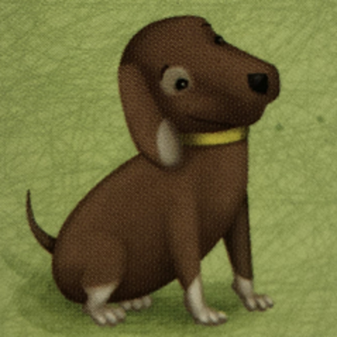
Ending (P56-59)
Will Sara's home be suitable for Socks?
How do you know that?
what they say and what they do

Slide 17
Comment on the main character
What do you think of Penny?
kind
thoughtful
strong-willed
have a heart full of love
never give up
independent
positive（正面的，积极的）
shy
unwise
reckless(鲁莽的)
...

Slide 18
further thinking
beginning
ending
Socks: in the dustbin
(unwanted, abandoned)
Socks: live with Sara
(adopted)
Penny: no dog
no friend
parents care little about her
Penny: help the dog
get a friend
parents care more about her
?
sad
happy

Slide 19
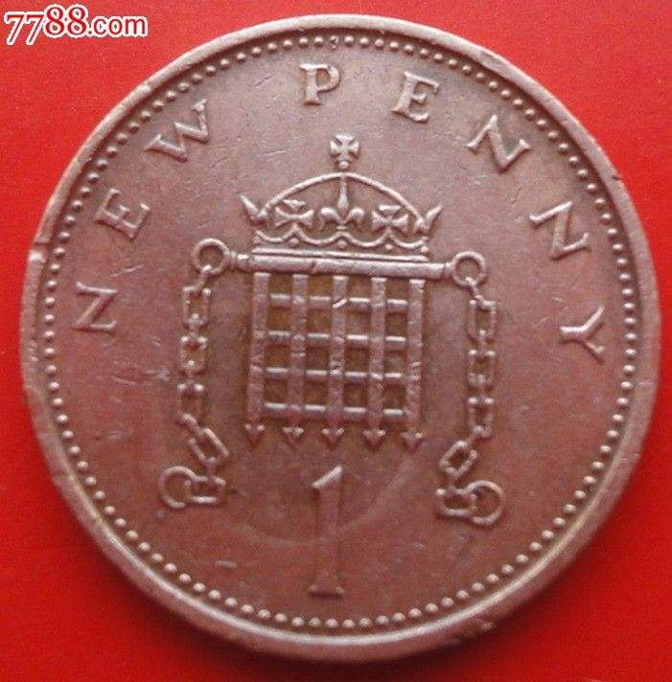
Names: Socks & Penny
critical thinking
Q1: Why does Penny call the dog 'Socks'?
Q2: 'Socks' also means '袜子' in Chinese. What else can socks remind you of?
Q3: Why does the author name the girl 'Penny'?
Because his white feet looks like socks. (P21)
protection
companion(陪伴者)
warmth
represent Penny's love for the life in the village
the least important
inconspicuous(不起眼)
the most ordinary/common(普通)
A penny is a British coin.
1 pound=100 pennies
If you say you do not have a penny,
you are emphasizing that you do not have any money at all
If you say something does not cost a penny,
you are emphasizing that something did not cost you any money at all.
--From Collins

Slide 20
Homework
Choice A: Continue to write the story
Q1: Will Socks like his new home?
Q2: Will Penny get used to the life in the city?
Q3: Will her father get a new job?
Q4: ...?
Choice B: Write an article about your pet
Q1: Do you have a pet?
Q2: What does it look like? What is it like?
Q3: How do you look after it?
Q4: Do you have fun playing with it?
Q5: Do you have problems getting along with it?

