Slide 1
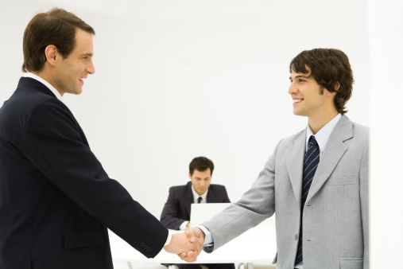
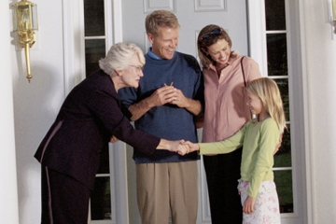
Unit 5 Good manners
Reading Ⅰ
常州市实验初中天宁分校 严玉萍

Slide 2
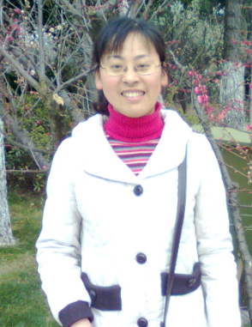
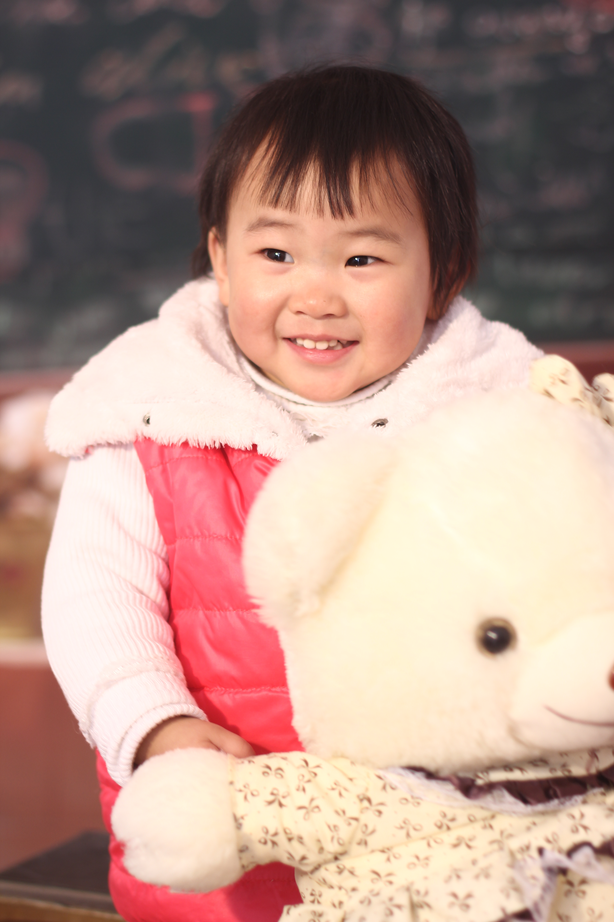
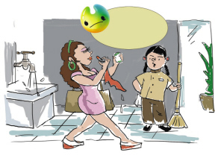
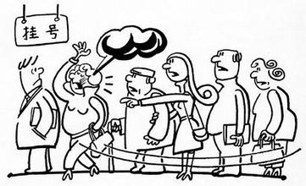
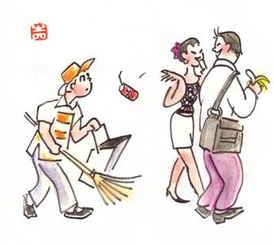
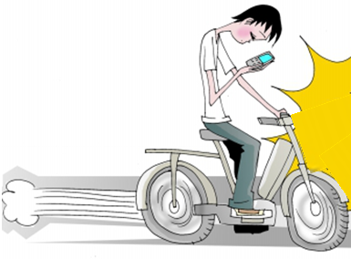
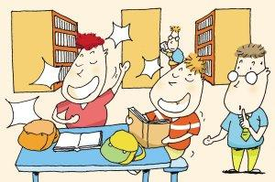
▪ I often ask my daughter Coco
to have good manners.
▪Can you help her find out the good manners or bad manners?

Slide 3
Find out the good manners or bad manners
Don’t
leave the tap running

Slide 4
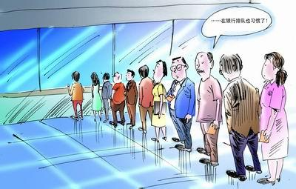
Find out the good manners or bad manners
插队
Don’t
push in \cut in .
queue for our turn .

Slide 5
Find out the good manners or bad manners
They should not
drop litter everywhere

Slide 6
Find out the good manners or bad manners
They should not
talk loudly in the library .
Keep quiet in public ( in the park ,in the library …)

Slide 7
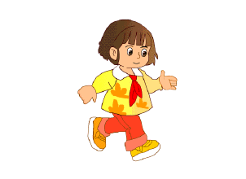
Find out the good manners or bad manners
bump into each other
hit

Slide 8
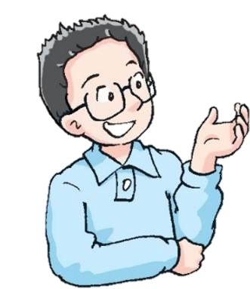
Learn about manners in the UK
Jenny, as an exchange student, has just been to the UK, and has learned some good manners from the people in the UK .
The UK is considered to be one of the countries which pays great attention to the good manners.

Slide 9
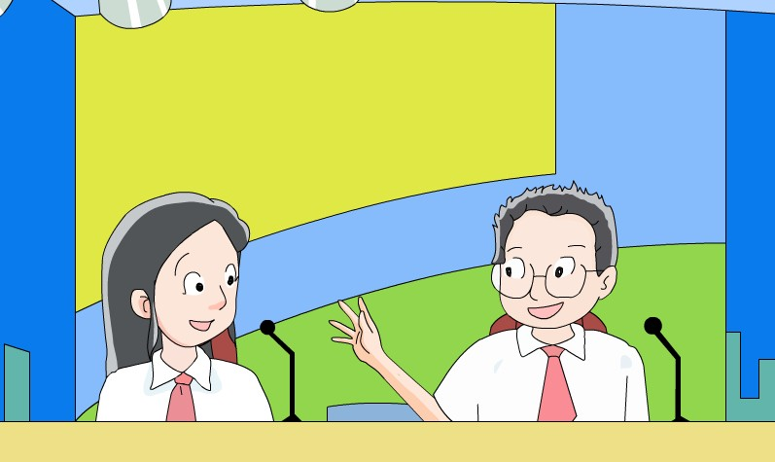
1.What is the passage mainly about?
2.What is the last sentence and what’s
the Chinese meaning of it?

Slide 10
While-reading
Skimming
1.What is the passage mainly about?
Good manners in the UK
2.What is the last sentence and what’s
the Chinese meaning of it?
“When in Rome, do as the Romans do.”
入乡随俗

Slide 11
Skimming some new words for you.
avoid doing sth./ sth.
push in before sb.
bump into
in one’s way
push past sb.
避免做某事/某事
插队
碰，撞
挡路
从某人身边挤过去

Slide 12
Read line 1-9 and finish the table
Good manners in the UK
How to greet people | Do (s) | Don’t (s)
How to start a conversation
say “hello” or “nice to meet you” and shake hands
greet with a kiss
weather, holidays, music, books …
age, weight, money
Why?

Slide 13
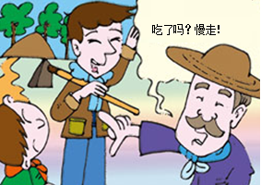
differences between China and the UK
Chinese people often begin with: Have you eaten yet?
Where are you going?
It is a nice day, isn’t it?
You look beautiful today!
...
What does the Englishman often begin with?

Slide 14
Read line10-17 and fill in the blanks
 | do | don’t
In public | always_________ | ______before others
 | say____________if bumping into someone
 | say_________________if someone is in their way. | ______or______ past.
queue
push in
sorry
“excuse me”
touch
push

Slide 15
differences between China and the UK
One day, a man from the UK meets a Chinese couple.
He said, “How beautiful your wife is!”
The husband thought for a while and answered, “Where! Where!”
The Englishman was very puzzled, and then he said politely, “Everywhere!”

Slide 16
Read line 18-26 and answer the questions:
(1) Are British people polite at home?
Yes, they are.
(2) What else should we pay attention to in public?
We should keep our voice down in public.

Slide 17
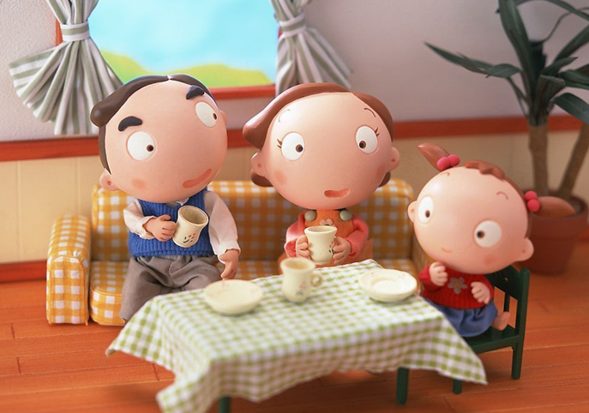
differences between China and the UK
Do you always say “please” and “ thank you” at home? How?
Mum, please give me my coat.
Dad, would you please turn off the TV?
…

Slide 18
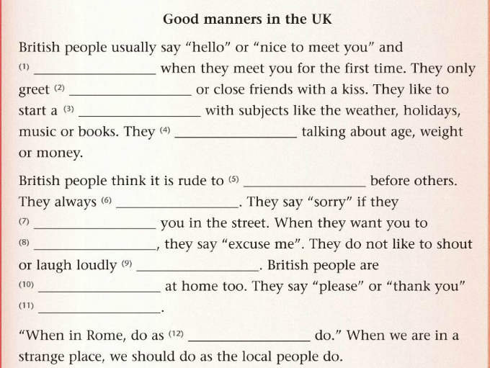
shake your hand
relatives
conversation
avoid
push in
queue
bump into
move
in public
polite
all the time
Romans

Slide 19
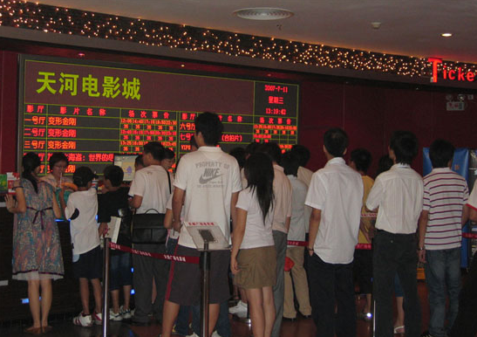
In the cinema
Make a dialogue using these phrases as much as possible.
excuse me push me why in my way queue buy a ticket be late for the film push in sorry
A:_______________
B:_______________ A:_______________
B:_______________
…

Slide 20
Mr know all万事通先生
True or False
1. In Europe, standing very close to the person with
whom you are talking is quite common. ( )
2. Talking loudly in public is allowed in China. ( )
3. It is better to keep your voice down in public . ( )
4. A guest(客人) in a Chinese house never finishes a drink. He leaves a little to show that he has enough. ( )
5. In England, a guest always finishes a drink to show that he enjoys it. ( )
6. If you want to go across the bridge , someone is in your way, you should say “excuse me” and push past him or her. ( )
7. If you want your mother to get a coat for you at home , you may say “Mum, get a coat for me.”( )
F
F
T
T
T
F
F

Slide 21
Mr know all万事通先生
A: India B: Japan C: China D: America and Europe
E: Thailand F: Germany G: England
1. In which country do people bow when they meet?
2. In which country does “nodding” mean “no” and “shaking” mean “yes”.
3. In which country do people hardly shake hands when they meet for the first time.
4. In which Asian country mustn’t people touch others’ head?
B
A
F
E

Slide 22
Discussion in your group :
Please discuss with your group members about how to behave politely in different occasions :
If you want to buy a ticket in a cinema , what should you do ?
If you bump into an old man in the street , what should you do or say ?
If you want to go across the bridge , what should you do or say to the people in your way ?
If you want your mother to get a coat for you at home , what should you say ?
If you are visiting the Oxford University in the UK ,
what should you do ?
If you are visiting the Oxford University , what should you do ?

Slide 23
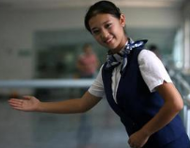
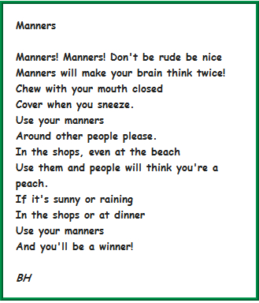
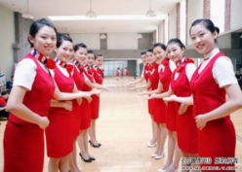
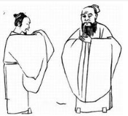
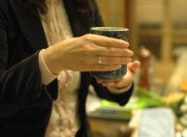
When in China, do as the Chinese do. When in the UK, do as the British do. When in Rome, do as the Romans do.

Slide 24
Manners make the man.
礼貌造就人。
I hope each girl can behave like a lady and each boy can behave like a gentleman after class

Slide 25
Homework
Read the text frequently after class.
2. Try to find out more differences about good manners between the UK and China.

