Slide 2
r
Learning objectives:
1. Understand the usual schedule for a debate
2. Master the basic elements in a debate
3. Figure out the relationship between the economy and the environment

Slide 3
r
Debate
A formal discussion of an issue at a public meeting. An argument or discussion expressing different opinions.
--Oxford Advanced Learner’s English-Chinese Dictionary

Slide 4
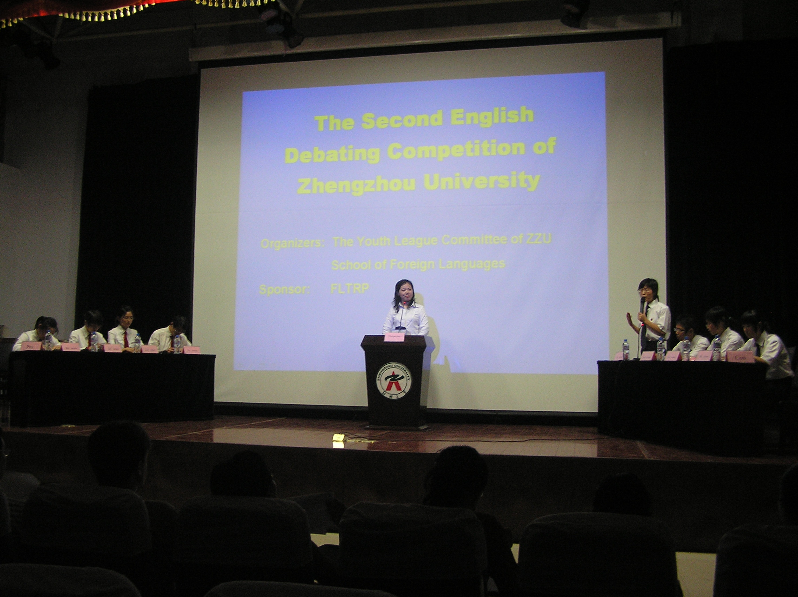
Usual schedule for a debate
chairperson/host
正方
反方
proposition
opposition
a debate --- a contest
two or more speakers try to persuade one another

Slide 5
r
Should senior high school students have smartphones?

Slide 6
Senior high school students should have smartphones.
proposition
opposition
Senior high school students should not have smartphones.

Slide 7
How to make your point persuasive?

Slide 8
r
M5U2
Reading
The economy or the environment
must we choose?

Slide 9
Reading strategy 1
Usual schedule for a debate
James Long
Host
Qian Liwei
Lin Shuiqing
The other side
One side
VS.
a spokeswoman
from Green Society
a business development
consultant

Slide 10
Fast reading
Find out the two debaters’ arguments.
Ms. Lin thinks that human beings should not
_____________________ at the expense
of ___________________.
Mr. Qian believes that ___________________
and _________________ should be possible at
the same time.
develop the economy
the environment
a healthy environment
development

Slide 11
Critical thinking
Ms Lin Shuiqing’s view
Economic development is bad for the environment.
Mr Qian Liwei’s view
A healthy environment and development should be possible at the same time.
Is Qian Liwei’s view opposite to Lin Shuiqing’s?

Slide 12
Clear views
One side (Lin Shuiqing)
Economic development is bad for the environment.
The other side (Qian Liwei)
Economic development isn’t bad for the environment.

Slide 13
Detailed reading
1. Which of the following is NOT mentioned in Lin Shuiqing’s speech?
A. Industrial waste destroyed many places and killed many plants and animals.
B. Factories producing poisonous chemicals should close.
C. Fishes died because of more than one reasons.
D. Polluted atmosphere can make human beings sick.

Slide 14
2. What can be inferred from the speech?
Though we caught large numbers of fish, they develop so quickly that we’ll still have enough to eat.
B. It’s likely that we’ll not have enough to eat if we keep producing people rapidly.
C. Lin Shuiqing is for the idea of recycling, while Qian Liwei is against it.
D. An economist is often seen as being against the environment.

Slide 15
3. After the debate, what may be accepted by people?
A. The development of the economy and the environment should go at the same time.
B. The environment comes before the economy.
C. The economy should be paid more attention than to the environment.
D. There is no co-operation between the governments, either in the economy or the environment.

Slide 16
Fill in the blanks with proper forms of given words.
1.Today vast areas of the world _________________(damage) by chemical waste.
2.Other types of waste flow into our water,_____________(kill) river and sea life.
3.It is our duty _________(cut) back on production and reduce the number of things we make and buy.
4. The people __________(operate) the factories are deeply concerned about the environment.
5.What we need are better laws to preserve the environment and still allow our country _____________.(grow)
6.______(ask) around, I find many people ______________(will) to pay a little higher price for things that are friendly to the environment.
are damaged
Convincing evidence
killing
to cut
operating
Persuasive language
to grow
Asking
willing

Slide 17
Reading strategy 2
Basic elements in a debate
1. Clear views
2. Convincing evidence
3. Persuasive language

Slide 18
Group discussion
I agree with Ms. Lin Shuiqing. In my opinion, the
environment is more important than the economy.
Firstly,__________________________________.
Secondly,________________________________.
To sum up, we should ______________________.
I agree with Mr. Qian Liwei. In my opinion, we
shouldn’t stop developing economy to protect the
environment.
Firstly,___________________________________.
Secondly,_________________________________.
To sum up, we should _______________________.

Slide 19
Open discussion
The economy
the environment
or
must we choose?？
Achieve a balance

Slide 20
How to achieve a balance between the economy and the environment?
An ______________________
way of economic development
environmentally friendly

Slide 21
Group work
How to achieve a balance between the economy and the environment?
Requirements:
Discuss what the government , factory，and citizen can do
2. Write your advice down briefly
3. Make a report (the group leader)

Slide 22
Useful expressions
raise people’s awareness of …
teach people about … ways of living
educate people to … the environment
pass … laws to…
pay heavy …. for producing pollution
use … materials / energy
cut back on/ reduce….
……………………………………………

Slide 23
Group work
How to achieve a balance between the economy and the environment?
Requirements:
Discuss what the government , factory，and citizen can do
2. Write your advice down briefly
3. Make a report (the group leader)

Slide 24
Group discussion
Government | Factory | Citizen

Slide 25
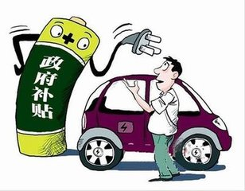
consumer
supportive policy from the government
Government

Slide 26
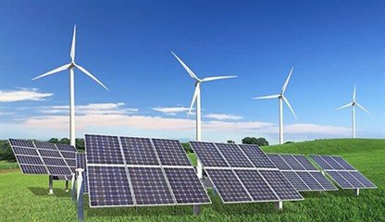
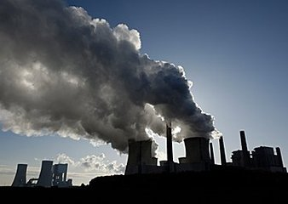
consumer
new energy
or
fossil fuel
（化石燃料）
Factory

Slide 27
consumer
disposable products
（一次性的）
or
environmentally friendly
products
Citizen

Slide 28
90
Group discussion
Government | Factory | Citizen
pass effective laws educate people control the use of resources ……. | recycle material use the advanced technology deal with the waste water ……. | buy the environmentally friendly product reduce the use of disposable product save resources …….
...

Slide 30
A nation destroying its
environment
destroys itself.
Your actions will determine your fate.

Slide 31
Homework
1.Write down your opinion on the debate topic “Should senior high school students have smartphones”with no less than 120 words and try to apply the basic elements of a debate in your writing.
2. Write a passage about “ How to achieve a balance between the economy and the environment” with no less than 120 words.

Slide 32
Thank you

