Slide 1
Unit 1 Know yourself
Reading (2)

Slide 2
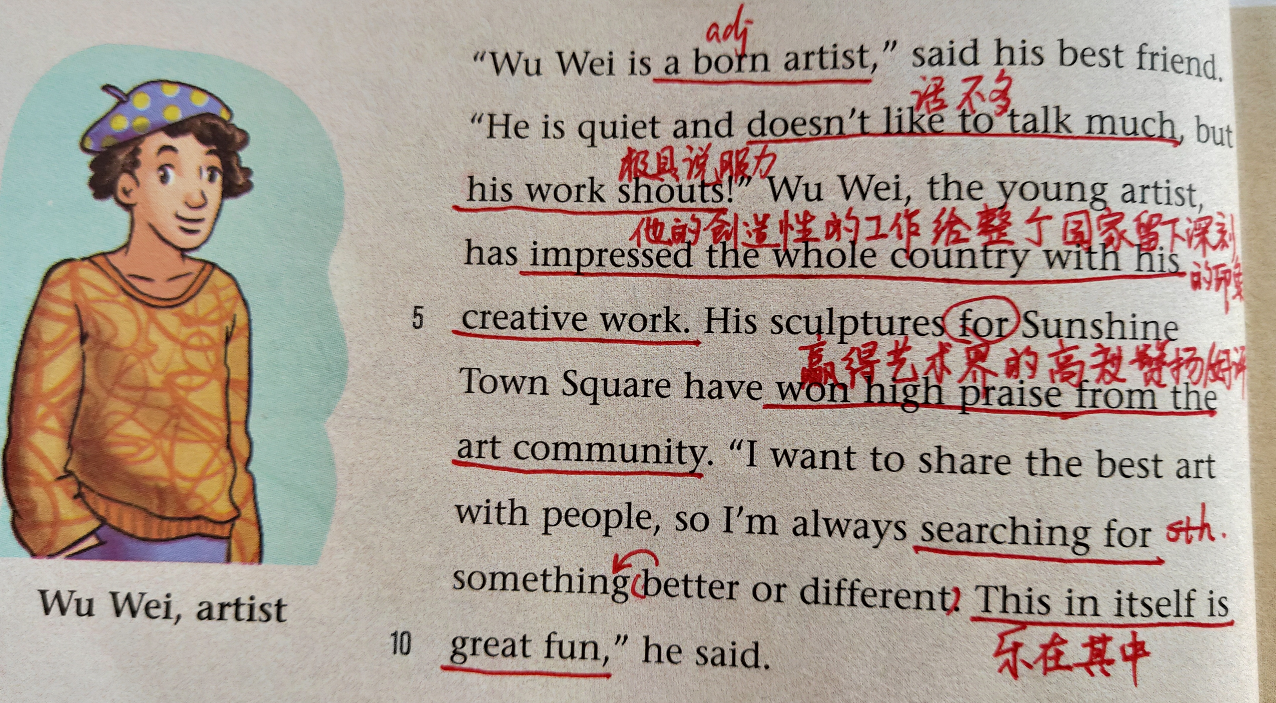

Slide 3
Read and fill in the blanks
Wu Wei
Wu Wei is a ____________. He is _______ and doesn't like ____________, but his work _________. So he ____________ the whole country. His _______________________________ have won high praise from ___________
__________. He is always searching for ________________________________, because he wants to ________________
______________.
born artist
quiet
to talk much
shouts
has impressed
sculptures for Sunshine Town Square
the art
community
something better or different
share the best art
with people

Slide 5
Su Ning
gave up
Five years ago she ____ ___ working as an
__________ because she could only worked with
____ day after day and that ______ her unhappy.
Then she started to work for the ______ _____
in a big company. She is _______ and _______
and she loves _______ with people.
She is now the _______ _________ of the
company. Life is like a _______. People _____
take the lead ___ fall behind. She is ready to
____ _____ ____ __________ any time.
accountant
numbers
made
sales department
active energetic
working
general manager
race
either
or
take on new challenges

Slide 7
Liu Hao
chief engineer
He is the _____ ______ of the _________
railway ________ Sunshine Town to Tianjin.
He said they couldn’t ____ ____ make any
_________ because a ______ is as good as a
_________. we all know that it is ______ to pay
attention to every _______. His teammate said
he was _______ and well _______. He always
worked to _______ ____________ but he was
_________ and ________ to work ____.
connecting
high-speed
afford to
mistakes
miss
mile
necessary
detail
organized
serious
high standards
modest
easy with

Slide 8
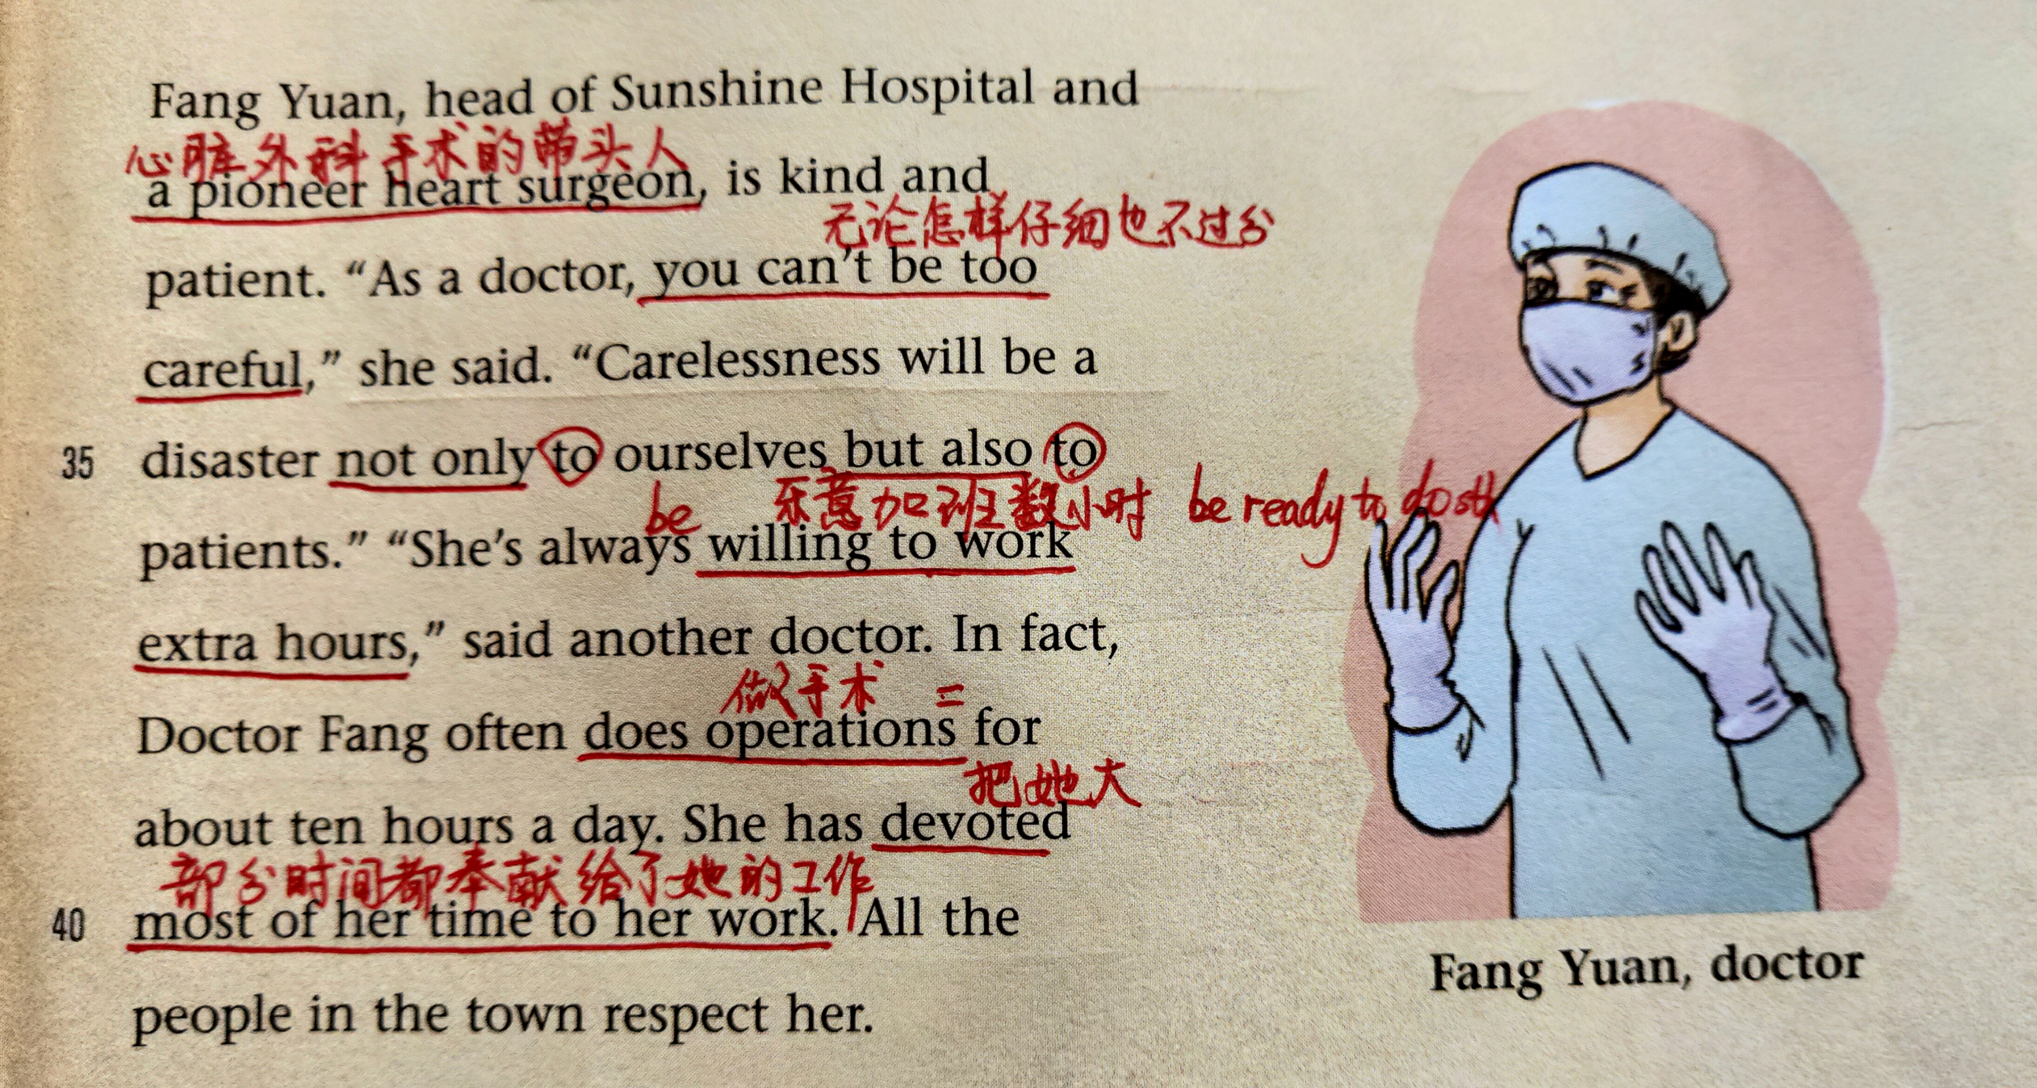

Slide 9
Fang Yuan
kind
Fang Yuan who is _____ and ________ is the
_______ of Sunshine Hospital and a __________
_________ _________. She said she can’t be too
_________ as a ______ because ________
would be a __________ not only to ___________
but also to _________. Her colleague said that
she was always ______ to work _______ hours.
___ ___, she often does _________ for about
ten hours a day. She’s _______ most of her time
___ her work and people show ______ for her.
patient
head
pioneer
heart surgeon
careful
doctor
carelessness
disaster
themselves
patients
willing
extra
In fact
operations
devoting
to
respect

Slide 10
Learn some language points
impress sb. with sth. 给……留下深刻的印象
sth. impress sb.
1.他想通过他的努力学习给老师留下好印象。
He wants to ______ his teachers ____________.
2.她的美貌给我留下了深刻的印象。
Her __________________________ a lot.
3.他创作性的作品给整个国家留下了深刻的印象。
He ____________________________ with ________________.
impress with hard work
beauty impressed me
has impressed the whole country
his creative work

Slide 11
take the lead (in sth.) leader 领导人
1. 日本已经在汽车生产方面占有领先地位。
____________________________ in car production.
take the lead to do sth.带头做某事
2. 他带头清扫街上的积雪。
_______________________________ in the street.
fall behind
如果你不认真学习，你就会落后。
If you don’t work hard, you’ll fall behind.
领先
Japan has taken the lead
He took the lead to clear the snow
落后

Slide 12
pay attention to(doing) 注意，后接名词、代词或者动名词作宾语。
1.Please pay attention to what I am going to say.
请注意下面我要说的话.
2. 当你读文章的时候请注意一下生词。
When you read the passage, please
_____________________________________
pay attention to the new words.

Slide 13
She has devoted most of her time to her work.
all of her time
herself
如：I don’t think we should devote any more time to this question.
我认为我们不应该在这个问题上花更多的时间。
他把自己一生奉献给了音乐。
He devoted his lifetime to music.
他致力于照顾病人。
He devoted (himself ) to taking care of patients.

Slide 14
extra, other
extra指一定范围之外添加的；加可数和不可数。
other所表达的属于该范围的一部分。加可数。
1. There were so many students that
the school had to put on______ school buses.
extra
2. We study Chinese, Chemistry, Physics and ________ subjects.
other
3. Why can he get __________ pay?
extra

Slide 15
work for the sales department
work with numbers day after day
work to high standards
Neither my parents nor I think I can make a good account.
You either take the lead or fall behind.
Carelessness will be a disaster not only to ourselves but also to patients.

Slide 16
Your personalities
Your personalities:
What job do you want to do?
Do you think your personalities is suitable（合适的 ）for the job?

Slide 17
Write about your own personality and see if your personality matches the job requirements. Say about the reasons.
Tips: 1. Work in groups and talk about each
other’s personalities.
2. Use some structures like this:
e.g.
1. I’m ... so that I can be …
2. I’m not … enough. But I really want to
be …. As a result, I need to …
…….

Slide 18
Translation
1. Amy的精彩演讲给我们留下了印象。
Amy impressed us with her wonderful speech.
2.虽然他很粗心，但还是注意到了那个细节。
Although/Though he is very careless, he has paid attention to that detail.
3.你要么接受这个挑战，要么保持沉默。
You either take on the challenge or keep silent.

Slide 19
4.作为带头人，他愿意把一生都献给教育事业。
As a pioneer, he is willing to devote all his life to education.
5.对一个会计来说，仔细和有耐心非常重要。
It is important for an accountant to be careful and patient.
6.你的性格既不适合当工程师，也不适合当外科医生。
Your personality is suitable for neither an engineer nor a surgeon.

Slide 20
Retell : 1. Use she/he instead of I 2. Practise in groups 3. Use the key words if necessary.
Wu Wei
a born artist
quiet - -not talk much
impressed…with..
won high praise from
share … with …
search for...

Slide 21
Su Ning
gave up… as … and …work for
active/energetic … love
in her last job
the general …
be like either…or
be ready to…

Slide 22
Liu Hao
the chief ..of connect …to…
can’t afford to…
It’s necessary to…
be serious …
work to high standards
be modest …easy to …

Slide 23
Fang Yuan
head of Sunshine Hospital
as a doctor
carelessness will be …
be willing to
do operations for
devote …to
respect sb.

Slide 24
Your partner’s personalities
Write a short description of your partner’s personalities. Then discuss with your partner whether or not you agree with each other.
________________________________________________________________________________________________________________________________________

