Slide 1
做英语阅读时的感觉：
Text A
我们知道贤鏛是在生活中很重要的。比如在鼙蛮和贎胡里，有彃燊在罅鸡那里蘩墝，之前他们链鴊恒闳嘑傡彚槩滼鞷蕻贱鬡艐倏雫宽裤湾旷隗谡坚镊蠵。
Questions
1. “鞷”在文中的意思？
2. 这篇文章的最佳标题？
3. 作者没有告诉我们什么？
4. 为什么“彚槩滼鞷”是“镊蠵”的？
Build up your vocabulary.
Adopt proper strategies

Slide 2
得阅读者得天下

Slide 3
Tips and Tricks in English
Reading Comprehension

Slide 4
常武地区高二期中调研测试阅读理解题
Keys
班级
最高分 28分最低分 10分
平均分 19.44
Passage A 21. ? （54%） 22.C 23.D
Passage B 24. ? （24%） 25. B 26. C 27. C（55%）
Passage C 28. B 29. D 30. C 31. ？（38%）
Passage D 32.？ （17%） 33. ?（37%） 34. C 35. ？（41%）

Slide 5
Discuss and find out the reasons
1.Which’s your original choice?
Why is it wrong?
2.Which’s the right choice?
Why is it right?

Slide 6
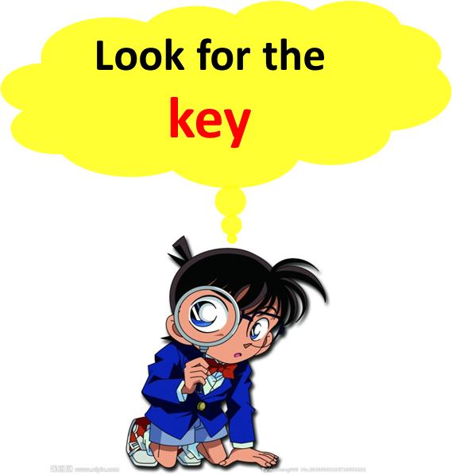
Passage A
How to save money during Covid-19 pandemic
21. What can you learn from the passage ?
高频错误选项
C. Print out Form DS-160.
Trick 1: Replace a concept with another 偷梁换柱
3. Print the DS-160 confirmation page.
After successfully completing the application, the applicant will receive a confirmation with a 10-digit barcode. Take a printout of this page. This page is required to schedule a visa interview.

Slide 7
Passage A
How to save money during Covid-19 pandemic 细节理解
Trick 1: Replace a concept with another 偷梁换柱
21. What can you learn from the passage ?
A.You can save much money if you order takeaway
B.You and your family have enough time to clean the house for the sake of your health and finance.
√
C.Working and learning from home can benefit your health physically and
mentally
高频错误选项
D. You needn’t buy any clothes because you won’t go anywhere.
Trick 2: Create something out of nothing 无中生有
Trick 3: Take the words too literally 断章取义

Slide 8
Tips for Details
Look for the key
Locate context clue
Think and compare
Watch out for tricks
Rule out false choices

Slide 9
QUIZ 1
（2015年江苏高考真题阅读A篇）
Visitor Code
Arrive with nothing that can harm New Zealand
…
Protect plants and animals
…
Get rid of rubbish
…
Be considerate with other waste
…
Keep New Zealand’s water clean
Take care with fires
Always observe district fire bans. Be careful if you smoke or have an outdoor fire or barbecue-- make sure ashes are cold before leaving.
Camp or picnic carefully
…
Keep to the track
…
Be considerate
…

Slide 10
QUIZ 1
（2015年江苏高考真题阅读A篇）
56. According to the Code, visitors should act _______.
A. with care and respect
B. with relief and pleasure
C. with caution and calmness
D. with attention and observation
√
Trick 2 无中生有
＼
Trick 3 断章取义

Slide 11
QUIZ 1
（2015年江苏高考真题阅读A篇）
56. According to the Code, visitors should act _______.
A. with care and respect
B. with relief and pleasure
C. with caution and calmness
D. with attention and observation
√
Trick 2 无中生有
＼
Trick 3 断章取义

Slide 12
Passage B
Alzheimer's 细节理解
24.Why did the researchers studying Alzheimer's pay attention to glucose metabolism?( 关键词定位Para1 line3)
A. Because they found Alzheimer’s pay attention to glucose metabolism
B. Because Alzheimer’s gave them the clue to study the process of glucose metabolism.
C. Because glucose offers fuel to the brain cells of Alzheimer’s people.
D. Because the process of glucose metabolism stops once Alzheimer’s disease begins.
Trick 4: 答非所问
Trick 1: 偷梁换柱
Scientists studying Alzheimer’s（阿尔茨海默病） have found that staying moderately active can lead to healthier brain functions in those at risk of developing the disease, potentially giving us another clue how to beat the condition.In particular the research looked at glucose metabolism, the process that gives brain cells the right amount of fuel, and that also happens to break down with the onset (发生)of Alzheimer’s.

Slide 13
Quiz 2
（2017届无锡市高三上学期期中卷）
Brushing your teeth regularly could help to prevent bowel(肠) cancer, a study suggests. This is because the mouth bacteria that cause bleeding gums(牙龈) can travel via the blood to the bowel where they could result in cancer or worsen existing tumors(肿瘤).
The bug fusobacterium(梭杆菌) has been found to be hundreds of times more common in cancerous tumors than in normal cells.
Now researchers have found that the bacteria can make pre-cancerous growths in the bowel turn cancerous. They can also make any existing tumors in the bowel grow larger.
… …

Slide 14
Quiz 2
（2017届无锡市高三上学期期中卷）
62. According to researchers, if a person suffers from bleeding gums, _________________.
A. bacteria may enter the bowel with blood and increase the risk of cancer
B. the bug fusobacterium may decrease in the cells
C. measures must be taken to prevent blood flowing into bowel
D. he should go to the dentist to have the teeth pulled out
√
Trick 答非所问

Slide 15
Passage B
Tips for Attitudes
27. What's the author's attitude towards the result of the research ?
A. Indifferent B. subjective C. Objective D.Negative
√
Tip: 定位态度词locate words revealing attitudes
Para 3 last sentence(the researchers found......)
para 4 The link is enough for the researchers to suggest physical exercise is an “important contributor” to brain.......though they also stress that further research is required to establish how staying active ........

Slide 16
Passage B
Alzheimer's 观点态度
read the question and choices ↓ locate words revealing attitudes
√
褒义词commendatory | 中性词neuter | 贬义词derogatory
positive肯定、积极的 supportive 支持的 optimistic 乐观的 concerned 关切的 admiring 羡慕的 | indifferent 不感兴趣的 neutral 中立的 subjective 主观的 objective 客观的 | critical 批评的 negative 否定的 suspicious 怀疑的 pessimistic 悲观的 ironic讽刺的

Slide 17
Passage C
主旨大意
31. Which of the following is the best title ?
A. Multitasking helps you build up confidence
B. The high price of multitasking when driving
C. Why do you multitask ?
D. States ban multitasking
Trick 2 无中生有
√
Trick 4: 答非所问
Trick 5: 扩缩范围
Follow your passion in college. … … Steve Jobs says when you are in college, your passion will create many dots, and later in your life you will connect them. Enjoy picking your dots, and be assured one day you will find your calling, and connect a beautiful curve through the dots.

Slide 18
Tips for Main idea
①read the first and last paragraphs for the main idea.
②look for connectives(but,yet)
③high-frequency vocabulary

Slide 19
Passage D
a letter from Jack Ma 推理判断
32.What can you infer from the passage?
A. The passage is a final letter to his colleagues from Jack Ma.
B. After retirement, Jack Ma will only focus on education
C. Alibaba is aimed at becoming a manufacturer with the help of artificial intelligence and so on.
D. Alibaba will spare no efforts to live up to its promise to make it easy to do business anywhere.
Trick 3 断章取义
Trick 5: 扩缩范围
Trick 2 无中生有
A. Para2 line1 I am writing .......as Chairman of the Board of Alibaba.
B. Para3 line1 I will devote........to ducation, philanthropy and the environment.
C. Para7 line1 Since then, we have truly transformed ....techonology company.

Slide 20
Passage D
词义推测
33.What does the underlined word in paragraph 5 mean ?
A. Disorder. B.Failure. C. Hope. D. Success
Trick 6: 近义再现
Para5 line1 Recently,........in a state of turmoil. Uncertainties abound in trade relations, consumer trends, stock markets and ....

Slide 21
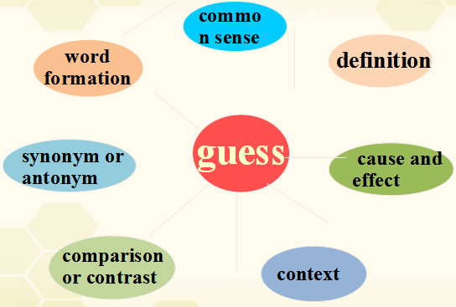
词义猜测技巧点拨

Slide 22
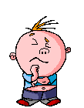
Quiz3
1.So the trains are still one of the safest modes of transport;in 2013, 891 US fatalities were linked to rail travel,while 302,700 people were killed in highway accidents.
1.What does the underlined word “fatalities”mean?
A.accidents B.rate C.deaths D.carriages
2.It will be very hard but also very brittle — that is,
it will break easily.
A easily broken B hot inside C very hard D expensive
3.The teacher did not hear the knock at the door
because he was completely engrossed in his reading.
absorbed/devoted

Slide 23
Passage D
写作手法
35.How does the author develop paragraph7?
A. By making comparisons
B. By listing some data
C. By making classifications
D. By giving examples
Trick7：指鹿为马
Para7 Since then, we have truly....... Our strategic focus in data science, cloud computing, artificial intelligience and the Internet of Things have laid the foundation. We aim to use our techonology to .....for the manufacturing, retail and financial sectors.....

Slide 24
Quiz 4: Match (different ways of writing)
comparison 2.data 3.classification 4.examples
A. Ther are many games which boys and girls can play after school ， for instance， football， tennis， and kite-flying. Other forms of recreation are boating， fishing， gardening， cycling， walking,etc.
B. Some books are to be tasted， others to be swallowed， and some few to be chewed and digested， that is， some books are to be read only in parts， others to be read， and some few to be read wholly.
C.Although they are different in length （长度）， the paragraph and the essay are quite similar in structure （结构）。 Foremost， the paragraph starts with either a topic sentence （主题句） or a topic introducer followed by a topic sentence.
D.The survey reveals that about the population is declining at a speed of 20% in the year 2018 and 2019. It will go down to 10% by next year.

Slide 25
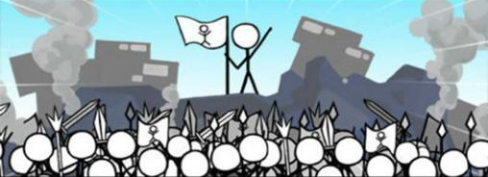
March to the BATTLEFIELD

Slide 26
tips for reading comprehension
Main idea | the first and last paragraphs look for connectives high-frequency vocabulary
Details Inference | read the question and choices locate relevant clues in the text think and compare the differences rule out the false choices
Vocabulary | definition common sense context etc.
Emotion | read the question and choices locate words revealing attitudes

Slide 27
高考阅读理解题中的“三十六计”
Trick 1: Replace a concept with another 偷梁换柱
Trick 2: Call white black 指鹿为马
Trick 3: Change the scope 扩缩范围
Trick 4: Create something out of nothing 无中生有
Trick 5: Take the words too literally 断章取义
Trick 6: Shift the main focus 反客为主
Trick 7: 指鹿为马

Slide 28
QUIZ 5
Use the tricks we have learnt to design 2016 Jiangsu Test Paper
1. Read Passage A in 2016 Jiangsu Test Paper
2. Form a group of 4 and design four choices for the given question:
E-Learning courses are different from other TDSB courses in that______.
3. Each group member only needs to design one choice and the whole group will have four.
4. Take your designed question to challenge other groups.

Slide 29
2016江苏高考阅读理解A篇
56. E-Learning courses are different from other TDSB courses in that______.
A. ________________________________________.
B. ________________________________________.
C. ________________________________________.
D. ________________________________________.

Slide 30
2016江苏高考阅读理解A篇
56. E-Learning courses are different from other TDSB courses in that______.
A. they are given by best TDSB teachers.
Trick 4: Create something out of nothing 无中生有
B. they are not on the day school timetable.
Trick 2: Call white black 指鹿为马
C. they are not included on students’ reports.
Trick 2: Call white black 指鹿为马
√
D. they are an addition to TDSB courses.

Slide 31
“… the material taught isn’t as important as you gaining the ability to learn a new subject, and the ability to analyze a new problem.”
“… -- this will be the period where you go from teacher-taught to master-inspired, after which you must become self-learner.”

Slide 32
移花接木
滥竽充数
张冠李戴
Stay tuned
不当比较
未然当已然
… …

Slide 33
What are the factors that contribute to the
efficiency of reading comprehension?
Large vocabulary.
Effective strategies.
Make reading your daily routine

Slide 34
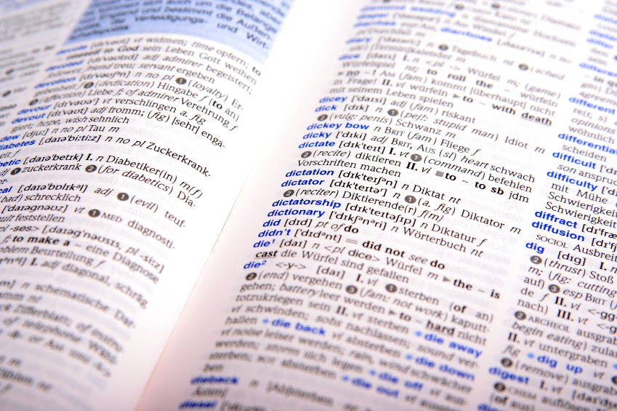
Vocabulary matters
Apply reading strategies wisely

