Slide 1


M8 Unit1 Project Reciting a poem
Poetry is a deal of joy and pain and wonder, with a dash of the dictionary.
— Kahlil Gibran
诗是大量的欢乐、痛苦和奇迹，再加上少许文辞。
---- 纪伯伦
Mia
No.1 Middle School of Linli

Slide 2

Lead-in
Enjoy a song

Slide 3






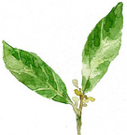



Slide 4



Everybody, everybody wants to love
Everybody, everybody wants to be loved
Oh-oh oh
Just let the love, love, love begin
Everybody, everybody wants to love
Everybody, everybody wants to be loved
Oh-oh oh
Just let the love, love, love begin

Slide 5




Lead-in
How do people show their love?

Slide 6

在座的

Slide 7
各位

Slide 8

小宝宝们

Slide 9

小可爱们

Slide 10
你们

Slide 11
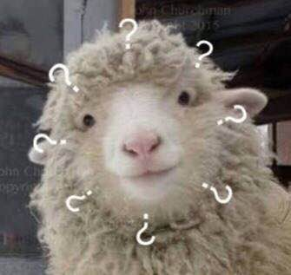
如何表达爱意？

Slide 12
送礼物？

Slide 13
为ta唱歌？

Slide 14
写信？

Slide 15
还是比心？

Slide 16

No！No！No!

Slide 17
这些都太low了！

Slide 18
不够洋气！

Slide 19
不符合我们

Slide 20
共产主义接班人
的身份

Slide 21
今天给
你们

Slide 22

介绍一种
上档次
大气
高端
的方式

Slide 23
快跟着Mia

Slide 24
认真学习吧！

Slide 25


Slide 26

To Wang Lun by Li Bai
I’m on board; We’re about to sail,
When there’s stamping and singing on shore,
Peach Blossom Pool is a thousand
feet deep,
Yet not so deep, Wang Lun, as your love for me.

Slide 27
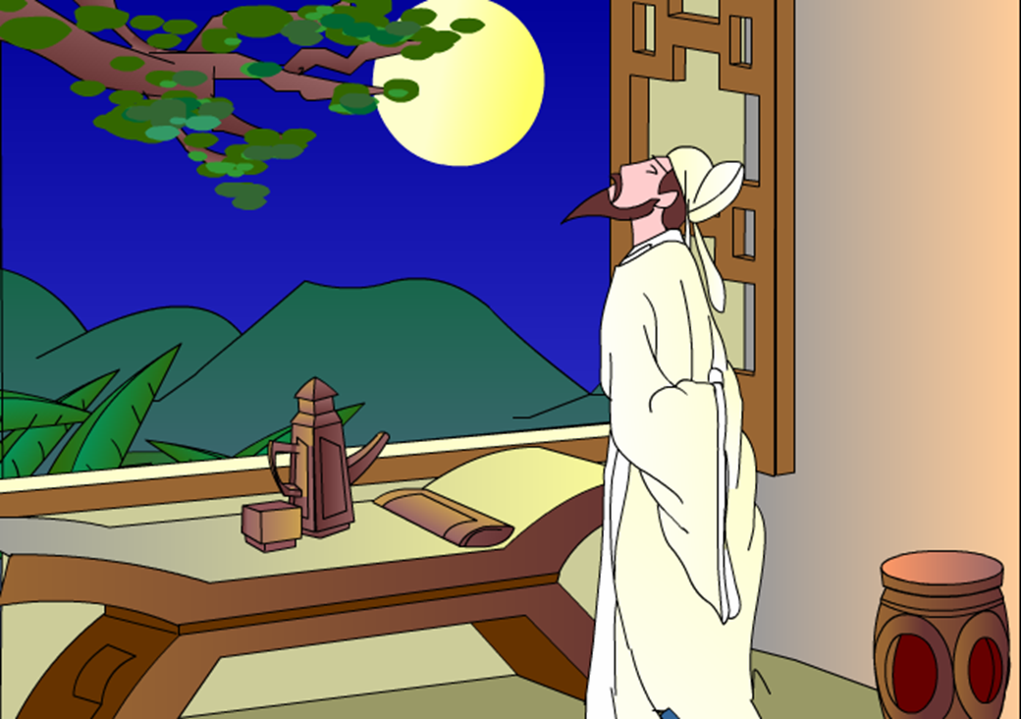
赠汪伦
李白
李白乘舟将欲行，
忽闻岸上踏歌声。
桃花潭水深千尺，
不及汪伦送我情。

Slide 28
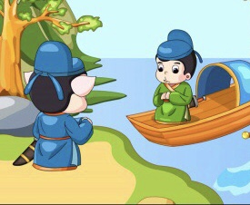
Goodbye!Li Bai!
I will miss you ,Wang Lun!

Slide 29

Brainstorming
What’s poetry?

Slide 30

Brainstorming
What’s poetry?
Mr. Li:
“Poetry is a form of literature which often focuses on love or other feelings.”

Slide 31
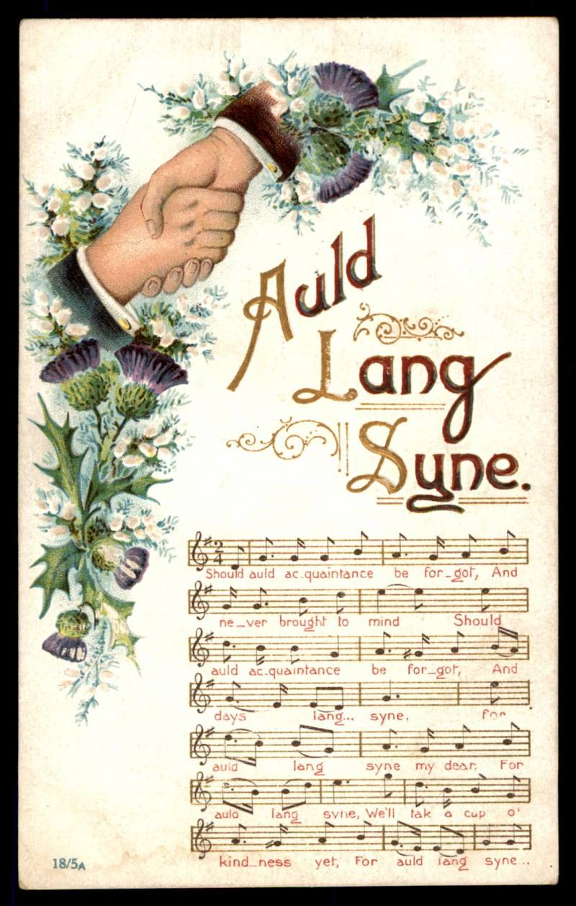
Do you know who wrote it?
Auld lang syne
Should auld acquaintance be forgot
And never brought to mind
Should auld asquaintance be forgot
And days of auld lang syne
For auld lang syne my dear
For auld lang syne
We'll take a cup of kindness yet
For auld lang syne

Slide 32


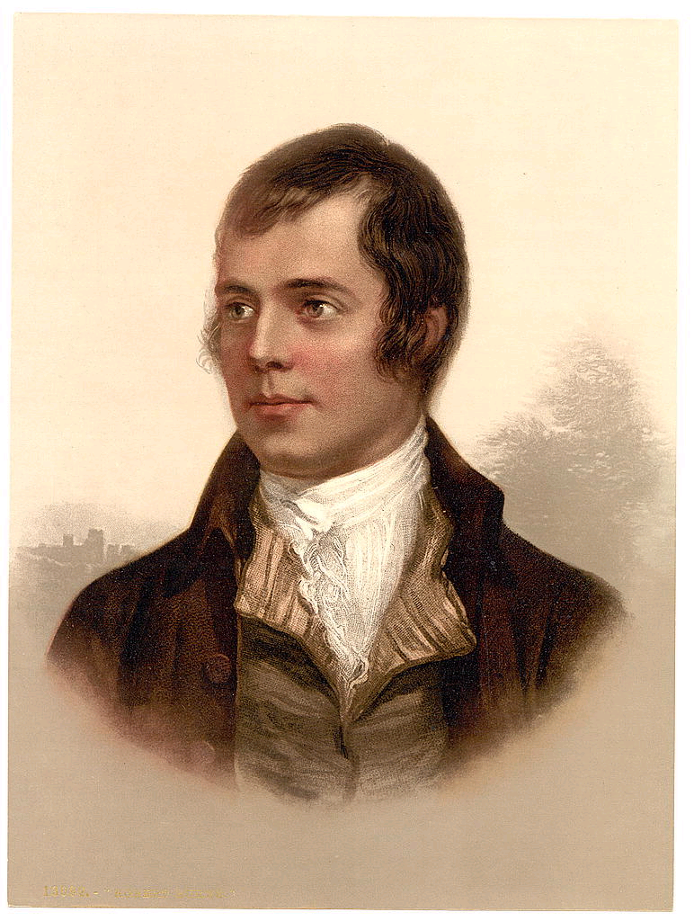
A supreme Scottish poet and lyricist(抒情诗人，抒情歌曲作者)
Robert Burns

Slide 33
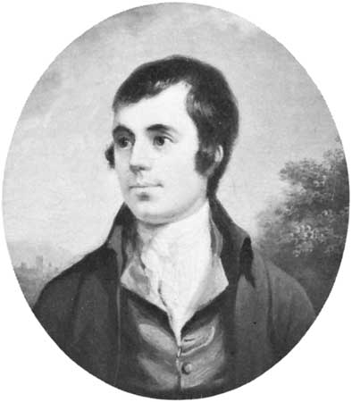

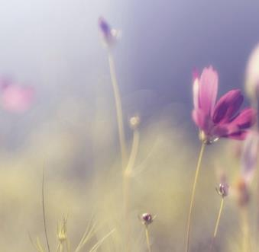
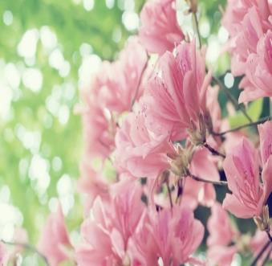

Robert Burns and his poetry

Slide 34
match the main meaning with each part:
Fast reading
Part One (1-4)
Part Two (5-7)
Part Three (8-9)
A.some information about a movement of poets called the Romantic Movement
B.the poem ‘A Red, Red Rose’ with its introduction and explanation
C.introduction of Robert Burns

Slide 35


Competition

Slide 36


A.score:1'
B.score:1'
C.score:2'
D.score:2'
E.score:3'
F.score:3'
G.score:4'
H.score:4'

Slide 37

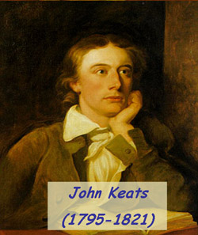
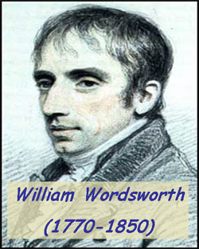
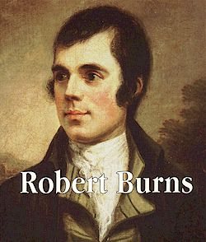
Task 1 1'
Answer the question
Q:
List 3 representative poets of the Romantic Movement

Slide 38
Task 2 1'
Answer the question
Q: List 3 main poems of Robert Burns
A Red,Red Rose
To a Mouse
The Holy Fair

Slide 39
Task 3 2'
fill in the blanks
Features of the Romantic themes
The poetry of the Romantic Movement often focuses on concepts like_________ and_________, and tends to use______________ and touch on_____________________.
freedom
beauty
imagination
strong feelings

Slide 40
Task 4 2'
Fill in the blanks
The poet compared the girl he loves to ___________ and ___________.
a red rose
a song

Slide 41
Task 5 3'
What does “sands o’ life” mean?
A. Time flies quickly, so we should treasure time.
B. Love is great, but it has its limits.
C. Life consists of happiness and sadness.
D. Life is worthless like sands.

Slide 42
Task 6 3'
Focuse on para1-4 and fill in the blanks
The way people memorize him | 1. All of Scotland ________________, and afterwards many people ______________ to support his widow and children.
 | 2. The __________ in honor of him was first shown to the public in 1877 and about 30,000 people ___________________________.
 | 3. The house in Alloway where Burns was born, is now___________________________.
mourned his death
donated money
monument
came out to watch
a museum of his life and work

Slide 43
Task 7
4'
Put the old English in this poem into modern English
Old Scottish English | Modern English
luve | love
melodie | melody
thou art | you are
thee | you
gang | go
Till a’ the seas | Till all the seas
wi’ the sun | with the sun
the sands o’ life | the sand of life
Tho’ it were | Though it were
fare thee weel | fare you well

Slide 44



Task 8
4'
point out the name of the structure in this poem
section
line
O my Luve’s like a red, red rose
That’s newly sprung in June:
O my Luve’s like the melodie
That’s sweetly play’d in tune!
Till a’ the seas gang dry, my dear,
And the rocks melt wi’ the sun;
I will luve thee still, my dear,
While the sands o’ life shall run.
And fare thee weel, my only Luve,
And fare thee weel a while!
And I will come again, my Luve,
Tho’ it were ten thousand mile.
As fair art thou, my bonnie lass,
So deep in luve am I:
And I will luve thee still, my dear,
Till a’ the seas gang dry:
sections/stanzas
This poem has four ___________, each of which
consists of four __________.
lines

Slide 45

Recite the poem

Slide 46
Tips: WHEN you recite the poem,you should pay attention to the rhetoric in this poem
③ comparison 比拟
②repetition 重复
O my Luve’s like a red, red rose
That’s newly sprung in June:
O my Luve’s like the melodie
That’s sweetly play’d in tune!
Till a’ the seas gang dry, my dear,
And the rocks melt wi’ the sun;
I will luve thee still, my dear,
While the sands o’ life shall run.
① rhyme 押韵
And fare thee weel, my only Luve,
And fare thee weel a while!
And I will come again, my Luve,
Tho’ it were ten thousand mile.
As fair art thou, my bonnie lass,
So deep in luve am I:
And I will luve thee still, my dear,
Till a’ the seas gang dry:

Slide 47
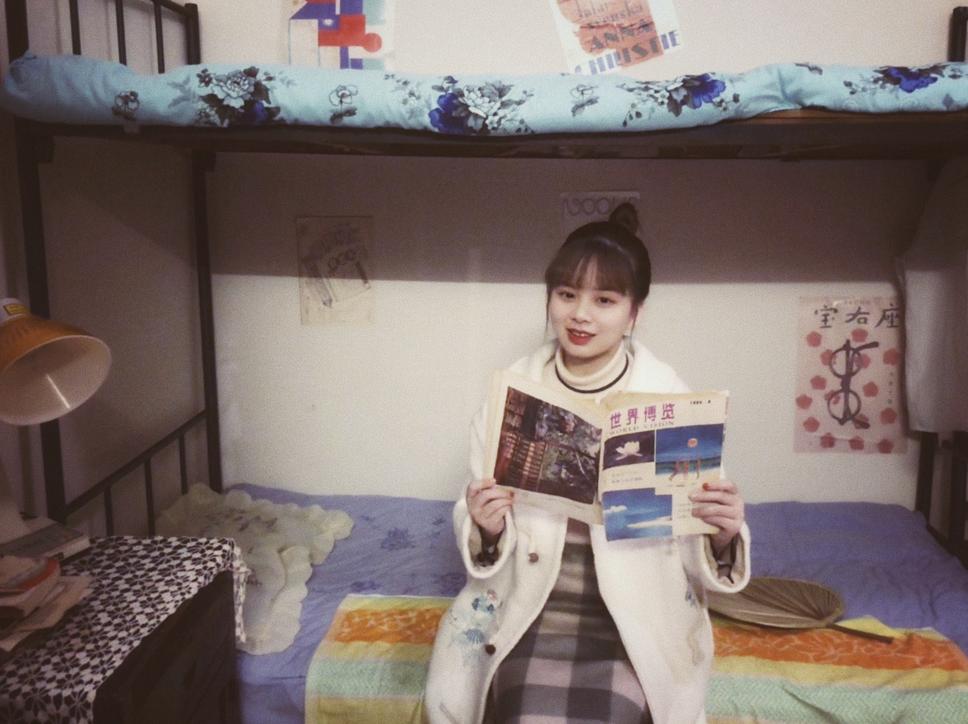

A RED, RED ROSE
Mia为你读诗~
BY ROBERT BURNS
O my Love’s like a red, red rose
That’s newly sprung in June:
O my Love’s like the melody
That’s sweetly play ’d in tune!
Till all the seas go dry, my dear,
And the rocks melt with the sun;
I will love you still, my dear,
While the sands of life shall run.
As fair you are, my beautiful girl,
So deep in love am I:
And I will love you still, my dear,
Till all the seas go dry:
And fare you well, my only Love,
And fare you well a while!
And I will come again, my Love,
Though it were ten thousand miles.

Slide 48
A RED, RED ROSE
BY ROBERT BURNS
O my Love’s like a red, red rose
That’s newly sprung in June:
O my Love’s like the melody
That’s sweetly play ’d in tune!
Till all the seas go dry, my dear,
And the rocks melt with the sun;
I will love you still, my dear,
While the sands of life shall run.
As fair you are, my beautiful girl,
So deep in love am I:
And I will love you still, my dear,
Till all the seas go dry:
And fare you well, my only Love,
And fare you well a while!
And I will come again, my Love,
Though it were ten thousand miles.

Slide 49
一朵红红的玫瑰
罗伯特·彭斯
啊，我的爱人像一朵红红的玫瑰
在六月里含苞绽开；
啊，我的爱人像一首乐曲
演奏得甜美而合拍！
你是那么美丽，我的好姑娘，
我爱你那么深切：
我会永远爱你，亲爱的，
直到四海枯竭：
直到四海枯竭，亲爱的，
岩石被太阳溶解；
亲爱的，我会永远爱你，
只要生命永不停歇。
再见吧，我惟一的爱人，
我和你暂时别离！
我会回来的，我的爱人，
即使相隔万里。

Slide 50


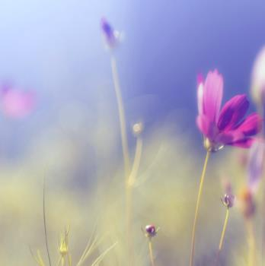

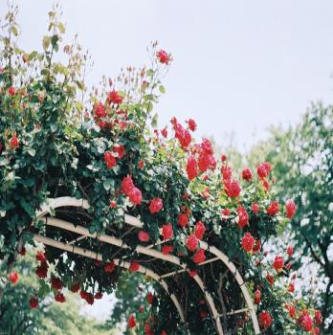
Assignments
1.Read the reading materials again.
2.Try to read and appreciate more poems .

Slide 51
Thank you!

