Slide 1

Unit 7 International charities
Reading (I)

Slide 2

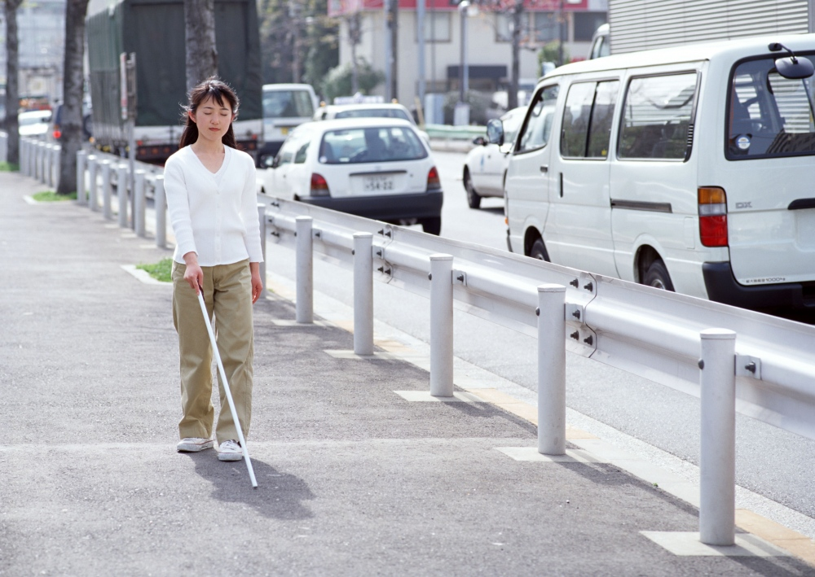

What does the logo look like?
Pre-reading
an eye
blindness
A charity that helps people with eye problems.
a special plane
a plane
ORBIS
Why is there a plane in the logo?
Why is it a special plane?

Slide 3
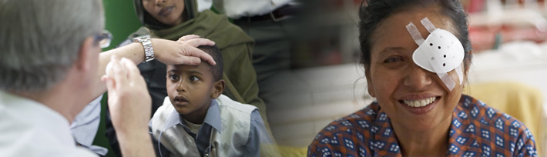
Doctors on board treat (治疗) and cure (治愈) patients or help them prevent (预防) blindness

Slide 4
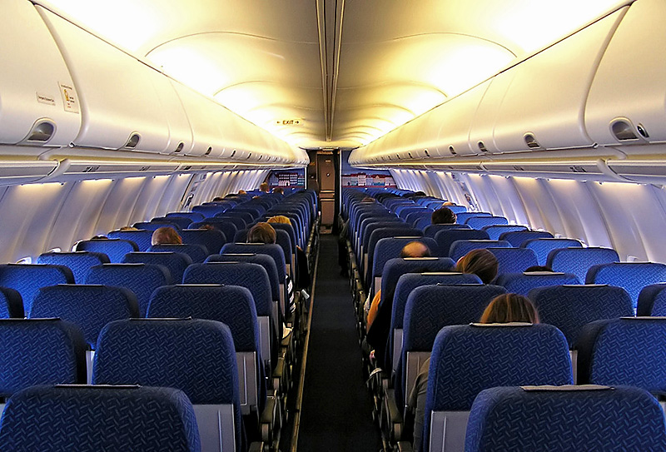
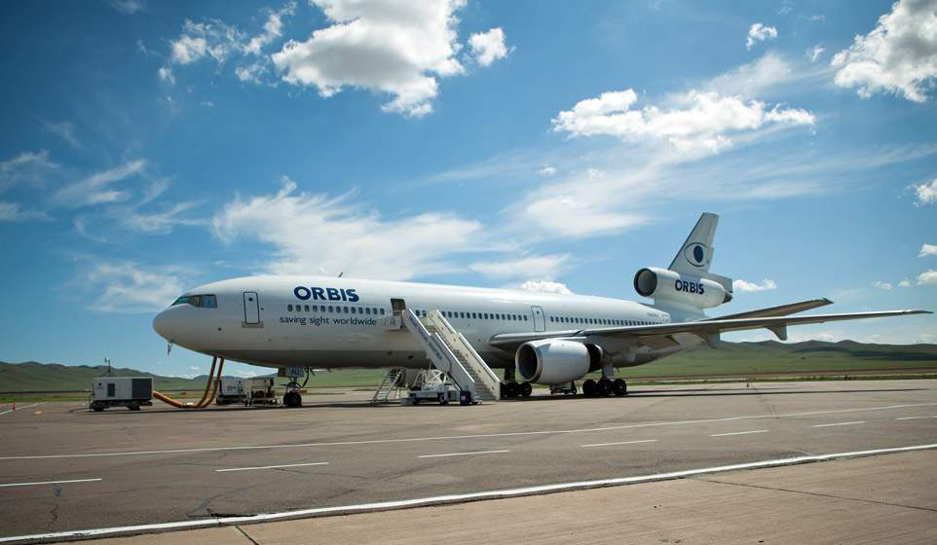
What is the plane inside like?

Slide 5
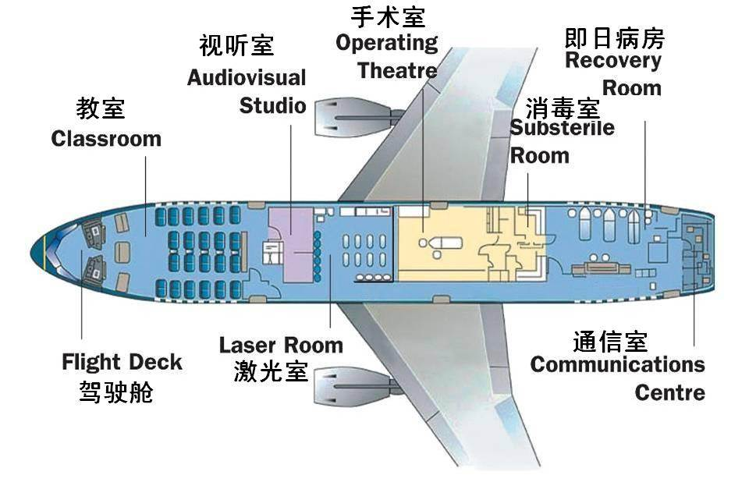

Slide 6

New words and phrases
全班朗读，小组呈现
blindness n.
prevent vt.
cure vt.
treat vt.
patient n.
on board
失明
预防，阻止
治愈
治疗 treatment n.
病人
在飞机（船、火车）上

Slide 7
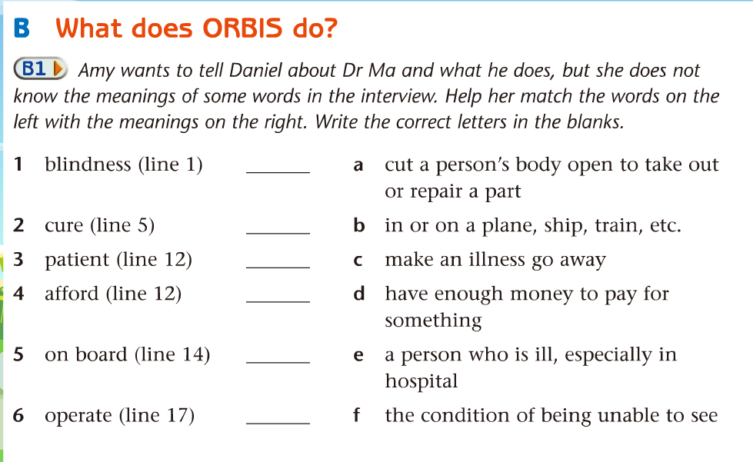
独立完成，同桌校对，小组呈现
f
c
e
d
b
a

Slide 8
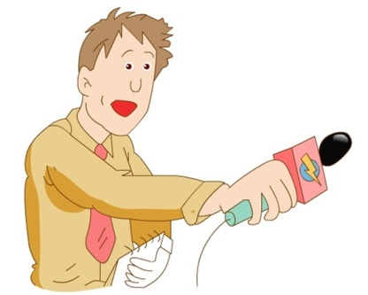
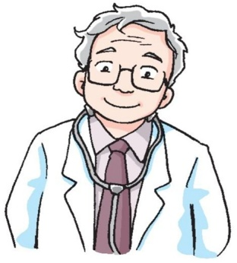
While-reading
a. Read and answer (skimming)
How many questions
does the interviewer ask? What are they?
an interviewer
Dr Ma
an ORBIS doctor
Interview: Dr Ma, please tell us something about blindness.
Interview: How does OBRIS help?
Interview: Why don’t you work in a hospital?
Interview: How many operations do you do during a visit?
Interview: Is there anything else you’d like to say to our
readers?

Slide 9
Read and match
两人合作， 一人呈现
Parts
Main ideas
Question :
Dr Ma’s work and hope
1
Question :
2-3
Something about blindness
Question :
Work of ORBIS
4-5

Slide 10


scanning
b. something about blindness (Lines 1-6)
the condition of being unable to see
blindness
285 million
__________people are blind or have other eye problems.
80 per cent
___________of these cases
can be ________________.
They are mostly in __________.
poor areas
prevented or cured
Many people don’t have money for _________________.
medical treatment
medicine n.
medical adj.
医学的；医疗的；医药的

Slide 11
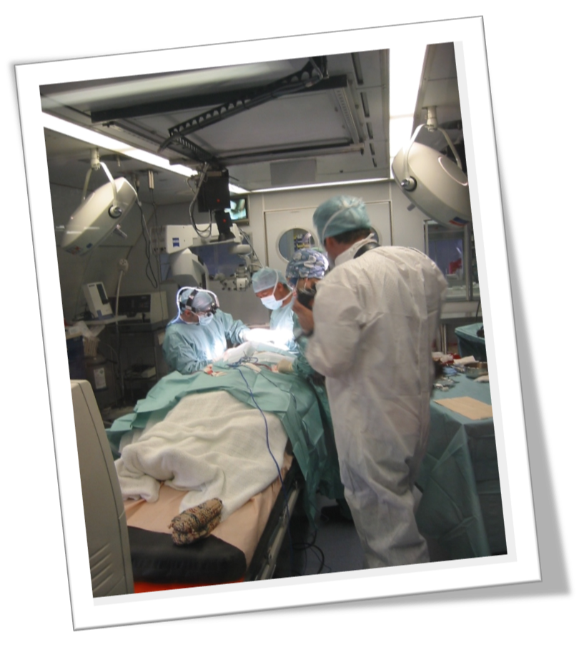
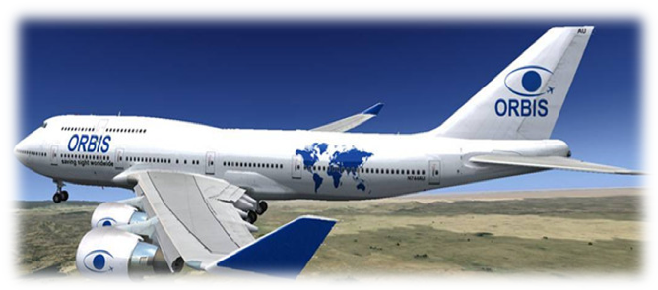
the work of ORBIS (Lines 7-15)
operate on patients
Flying Eye Hospital
an operation room
a training centre
What can it be used as ?

Slide 12
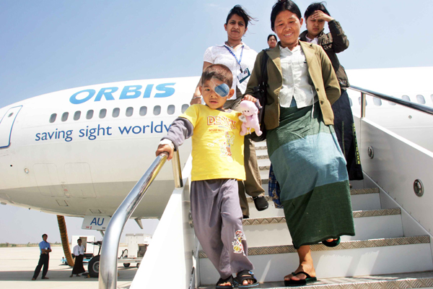
the work of ORBIS (Lines 7-15)
Why don’t doctors do operations in a hospital?
Flying Eye Hospital
operation room
training centre
local doctors and nurses
volunteer doctors
Who?
Who?
Many of the patients can’t afford to go to hospital, so they have to go to their hometown to help them.
new skills
They can learn ___________ and __________.
help more people
have enough money to pay for sth.

Slide 13
the work of ORBIS (Lines 7-15)
Try to retell
have eye problems
mostly in …
can’t afford to …
patients
local doctors
and nurses
are invited to learn …
&
do operations on …
teach …
volunteer doctors
小组讨论，两人呈现

Slide 14
How ORBIS helps people (Part B2)
小组讨论，校对答案，两人呈现
ORBIS, a charity
uses its _________________ to visit poor areas
Flying Eye Hospital
treats people with ______________
eye problems
does _____________
on the plane
doctors and nurses
eye operations
invites local __________
________ on board
helps people _______
teaches them _________
see again
new skills

Slide 15


Dr Ma’s work and his feeling (Lines 16-20)
How many operations do you do during a visit?
During my last visit, 150 patients were operated on.
busy
Dr Ma is very _________.
important
Dr Ma’s work is very ____________.
proud
Dr Ma feels very ____________.
I’m proud to help people see again and improve their lives.

Slide 16


Dr Ma’s hope (Lines 21-26)
Read the line of 21-26 and answer the questions.
Q1. Can most eye problems and diseases
be treated and cured? Why?
Read the passage after the tape.
Yes. Because modern medicine is developing quickly.
Q2. ___________is needed to carry on （继续开展） with ORBIS.
More money
Q3. What does Dr. Ma hope?
He hopes more people will support them.

Slide 17
Try to fill in the blanks (Part B4)
The ORBIS plane travels all around the world and helps people with eye problems in poor areas. Most of the people there cannot (1)_______ to go to hospital, so ORBIS doctors go to them. Operations are done to help people with eye problems see again. The (2)_________ do not have to pay because ORBIS is a charity.
小组讨论，校对答案，整组呈现
afford
patients

Slide 18
Local doctors and nurses are also invited on (3)_______ to learn new skills. By (4)________ them, ORBIS doctors hope to help more people.
Dr Ma is a doctor on the ORBIS plane. He feels (5)_______ to help people see again. Dr Ma thinks that modern (6)_________ is developing quickly and now most eye problems can be treated and (7)_______, but more money is needed to (8)_________ their work.
board
training
proud
medicine
cured
support

Slide 19
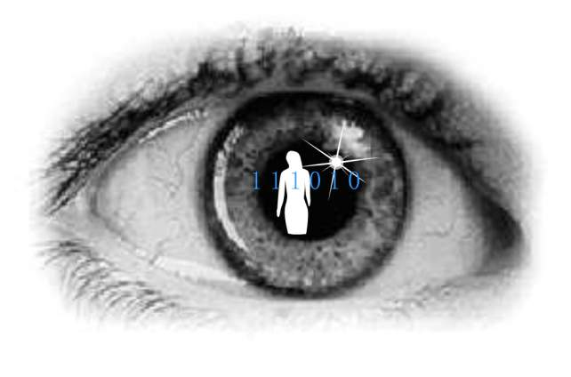

Discussion
小组讨论，聚类呈现
1 . As a student, what can we do to
protect our eyes and help ORBIS?

Slide 20

Advise for supporting ORBIS
1. Donate our pocket money to ORBIS.
2. Ask local government for help.
3. Hold a charity show to collect money.
4. Advertise on the Internet to let more people know about ORBIS.
5. Work for ORBIS when we grow up
.…

Slide 21

Give a helping hand.
Many hands make light work.

Slide 22

Homework
1. Read the interview three times after the tape.
2. Try to retell the interview.
3. Finish B3 on Page 97.

