Slide 1
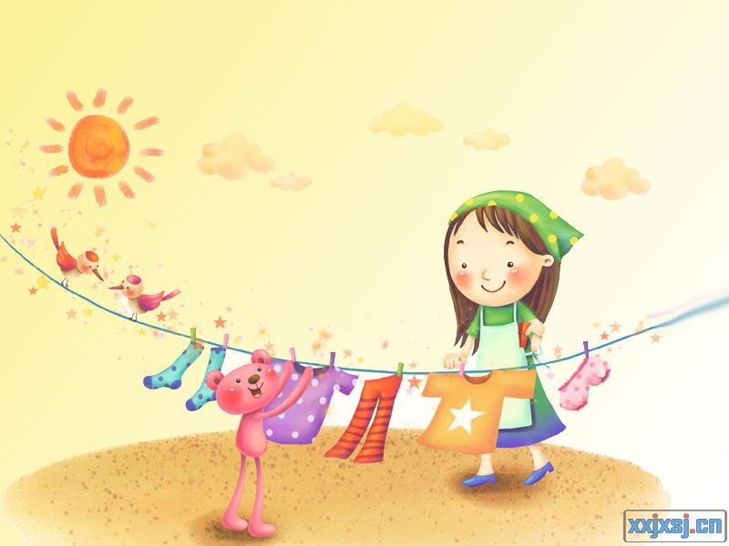
Unit 6
Whose dress is this?
Period 3
政平小学 许春香

Slide 2
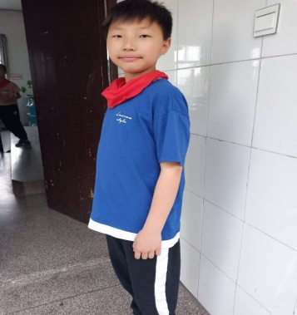
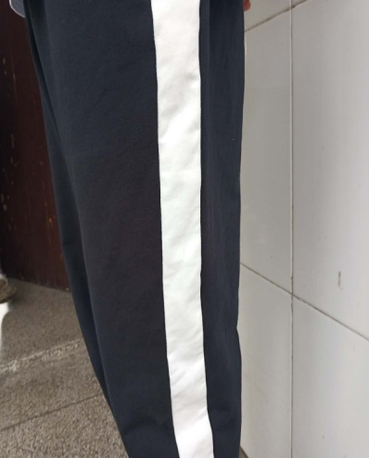
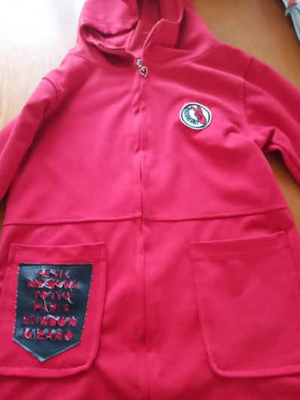
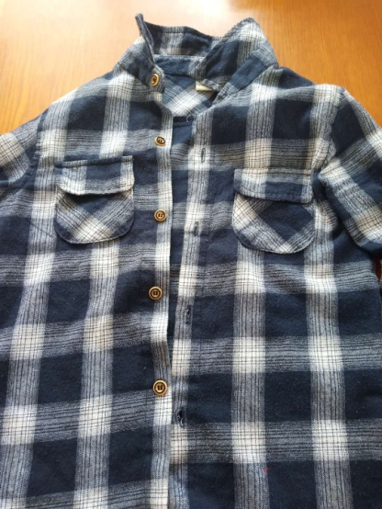
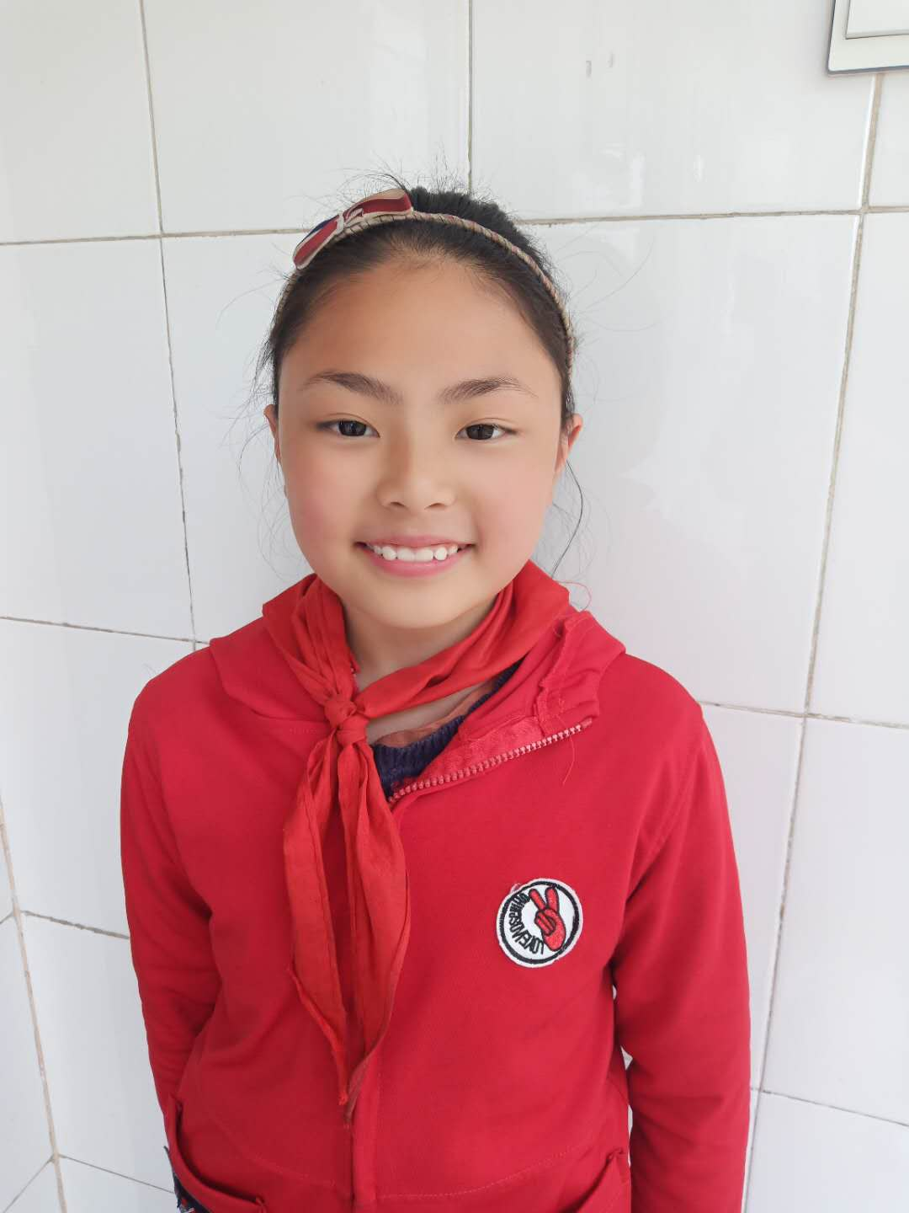
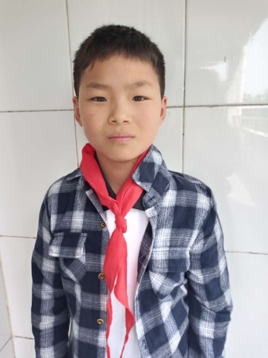
I can guess and talk
庆祝五一节日活动结束了，会场落下
了物品，让我们来找一找失主吧！
A: Whose …is this/are these?
trousers
coat
shirt
thank
B: I think(想) it's/they're ...'s.
c
s
t

Slide 3
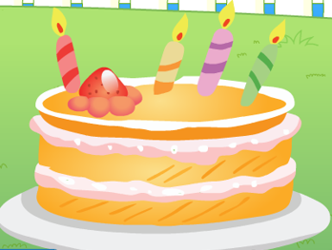
I can guess
A: Whose cake is this?
B: I think(想) it's ...

Slide 4
Let's watch.
Whose cake is this?

Slide 5
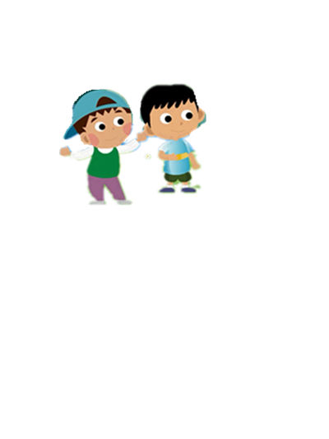
I can answer
Whose cake is this?
Oh, Chris! Oh, Chris!
克里斯
Let’s eat it by the lake.
连读

Slide 6
Rhyme time
读歌谣时，要注
意节奏和韵律哦
Whose cake is this?
Oh, Chris! Oh, Chris!
Whose cake is this?
It’s my cake.
Let’s eat it by the lake.
food
四人一组，读一读。

Slide 7
I can read
试着自己朗诵以下两首歌谣吧！
clothes
Whose gloves are these?
Oh, Mike! Oh, Mike!
Whose gloves are these?
They are my gloves. They are funny.
Let’s try them at the party.
toys
Whose car is this?
Oh, Liu Tao! Oh, Liu Tao!
Whose car is this?
It’s my car. It’s nice.
Let’s have a toy car match.

Slide 8
Rhyme time
四人一组，展开想象，创作新的歌谣写下来，并读一读。
food
clothes
Whose ?
Oh, ! Oh, !
Whose is this / are these?
.
.
Well done!
……
toys

Slide 9
I can tick
√
I can say the rhyme “Whose cake is this?”
我能说小诗“Whose cake is this?”

Slide 10
I can find
Whose cake is this?
Oh, Chris! Oh, Chris!
Whose cake is this?
It’s my cake.
Let’s eat it by the lake.
/ I /
读单词，你能说出字母i发什么音吗？

Slide 11
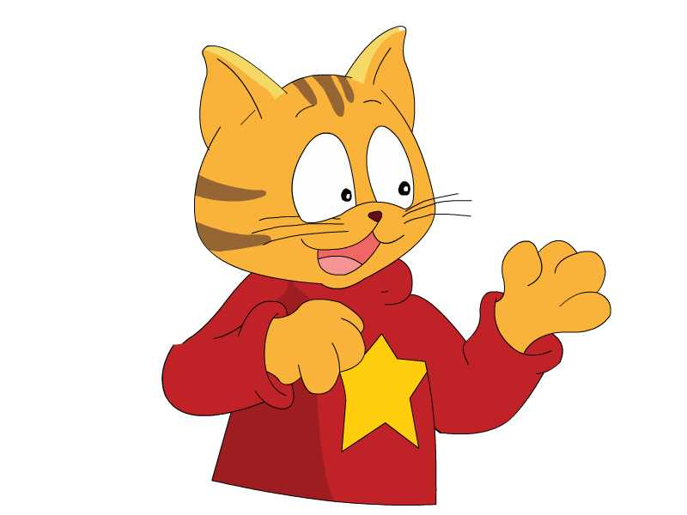
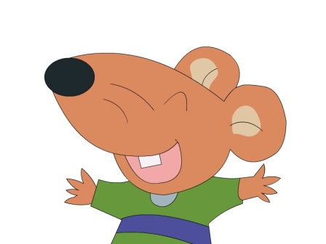
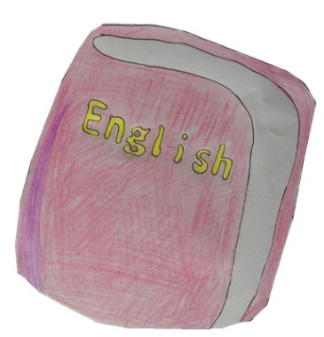
I can make
你能用下面的词造句吗？同桌先说一说。
Sound time
English
fish
listen
/ I /
Before eating ________.
Let’s ________ to some ________ .
English
你能说出更多含有字母i发/ I /的单词吗？

Slide 12
Sound time
你能说出更多含有字母i发/ I /的单词吗？
is for “ ”.
fish
/ I /

Slide 13
I can read
快来挑战一下吧！看谁读的对？
ink
list
lift
fit
/ I /
gift
kid
drink

Slide 14
I can tick
I know the sound of the letter “i”.
√
我知道字母i的发音。

Slide 15
After eating fish,
let’s go and play.
Notes:
先出鱼，Sam likes fish. Now he’s eating a fish. Bobby is talking. What may he say? Listen.
15

Slide 16
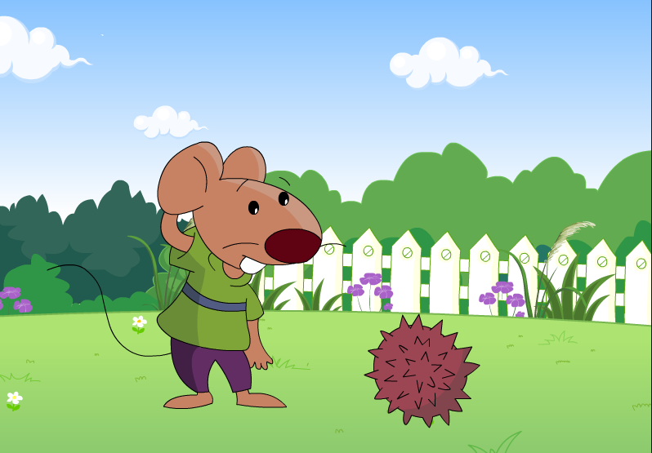
It can move.
移动
Notes:
球滚动 move理解 音效出 hedgehog

Slide 17
Watch and answer
What’s this? Is this a ball?

Slide 18
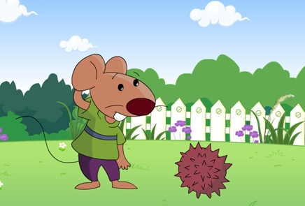
cartoon time
What ’s this?
A. It’s a .
hedgehog
B. It’s a .

Slide 19
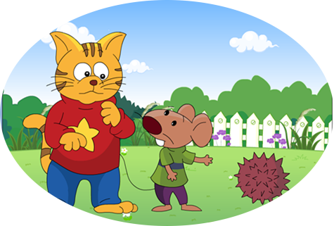
Let’s read.
confused 困惑的
Is this a ball, Sam?
升调可表示“不确定”哦！
I think so.
Let’s play.
A. 我想是这样的。
B. 我想不是这样的。
I don't think so.

Slide 20
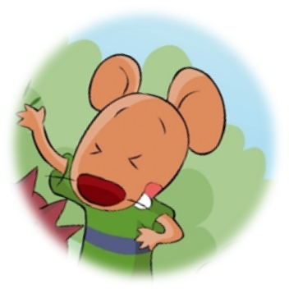
/ æ /
What's the matter?怎么了？
mat
cat
What’s the matter?是朋友之间的关切用语。当你看到朋友心情不好或身体有不适时，就可以用What’s the matter?询问情况，以示关心。还可以说What's wrong with you?What's up to you?等等。
Notes:
After eating, Bobby and Sam want to play. （点图，听Ouch！） Why? What’s the matter?(怎么了？) 出示A、B选项，理解朗读hurt
20

Slide 21
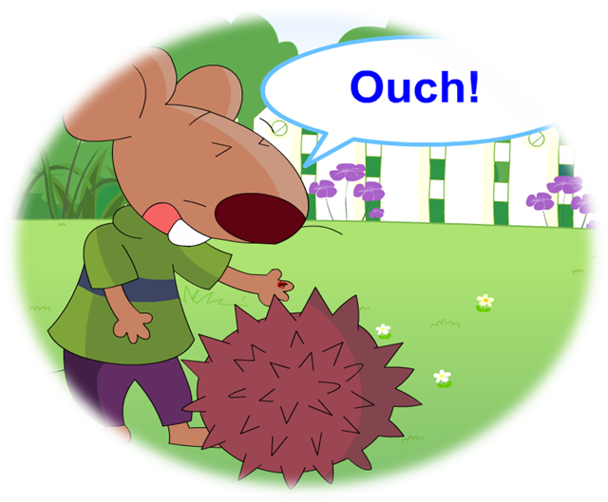
打开书本，读一读，找一找。
What's the matter?怎么了？
Thursday
cats
Bobby’s hand _____.
hurts
Notes:
After eating, Bobby and Sam want to play. （点图，听Ouch！） Why? What’s the matter?(怎么了？) 出示A、B选项，理解朗读hurt
21

Slide 22
Let’s follow.
同桌之间，分角色扮演。
Ouch!
What's the matter?
My hand hurts.

Slide 23
Hi! Nice to meet you.
Hi! Nice to meet you too.

Slide 24
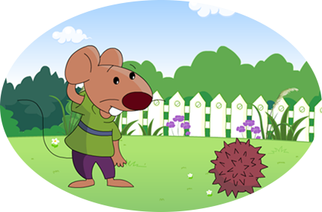
Happy reading
What’s this?
Look! It can move.
Listen carefully and try to imitate the pronunciation and intonation.
仔细听，注意模仿语音语调！

Slide 25
Happy reading
Is this a ball, Sam?
I think so.
Let’s play.

Slide 26
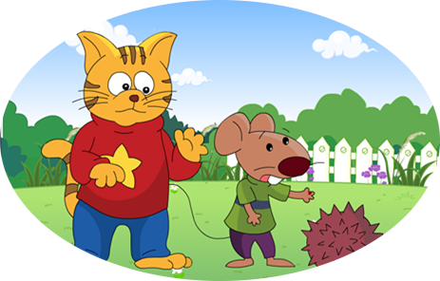
Happy reading
What’s the matter?
Ouch!
My hand hurts.

Slide 27
Happy reading
Hi! Nice to meet you.
Hi! Nice to meet you too.

Slide 28
Showing time
三人一组，选择你喜欢的方式，朗读课文。
Read in roles.
(分角色读)
Read together.(齐读)

Slide 29
I can tick
√
I can read the cartoon time.
我能读和表演卡通故事。

Slide 30
Summary
1、当你想问某样东西是谁的，你可以这样问：
Whose …is this/are these?
2、当你不能确定某样东西是谁的，你可以这样说：
I think it's/they're ... 's.
3、当你看到朋友心情不好或身体有不适时，你可以
这样问：
What's the matter?
4、当你身体的某个部位受伤了，可以说：
My...hurts/hurt.
5、我想是这样的。
我想不是这样的。
I think so.
I don’t think so.

Slide 31
Homework
To read: 本单元Sound time，Rhyme time
和Cartoon time内容。
To collect:含有 i /I/发音的单词。
To write: 改编新歌谣并朗诵。

Slide 32
Summary
What do you learn from this lesson?
从这节课中你学到了什么？

