Slide 1
Lesson 6
The Great Depression and The Roosevelt 's New Deal

Slide 2
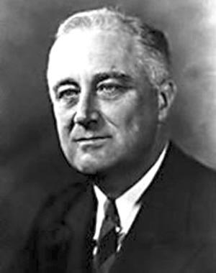

Slide 3
Frankin Delano Roosevelt
What historical contributions did he make?

Slide 4
He implemented the New Deal and made many contributions during World War . He led the American people slowly out of the difficult.

Slide 5
He was the 32nd president of the United States(1933-1945) and a central figure in world events during the mid-20th century, leading the United States during a time of worldwide economic crisis and world war.

Slide 6
The only American president elected to more than two terms, he forged a durable coalition that realigned American politics for decades.

Slide 7
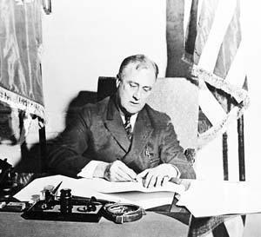

Slide 8
Such a great man comes among us and comes to our class. We are cheering and clapping.

Slide 9
Background
The Great Depression---a sever worldwide economic depression
The failure of President Hoover̓ reform
Keynesianism

Slide 10
The voice of the calls for reform is rising.
Roosevelt as the Presedent of the United States.

Slide 11
In the early 1930s, on a cold winter night, a coal miner̓s family.
The child asked his mother:Why don’t we make a fire at home?
Mom replied: Because dad lost his job.

Slide 12
The child asked: Why did dad lose his job?
Mother replied: Because there is too much coal.

Slide 13
Why don’t we make a fire at home?
Because dad lost his job.
Why did dad lose his job?
Because there is too much coal.
Let’s perform this dialogue

Slide 14
The blind production of capitalism leads to overproduction and economic crisis.
The great economic crisis that began in the United States quickly swept across the capitalist world.

Slide 15
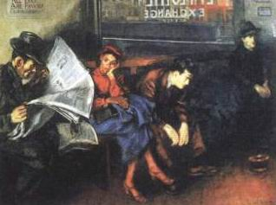
Unemployed Americans are anxiously waiting.

Slide 16
Unemployed Americans are anxiously waiting.

Slide 17
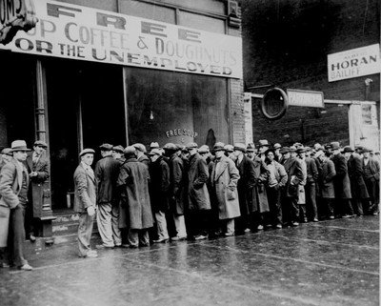
Unemployed Americans form a long line.

Slide 18
Unemployed Americans form a long line.

Slide 19
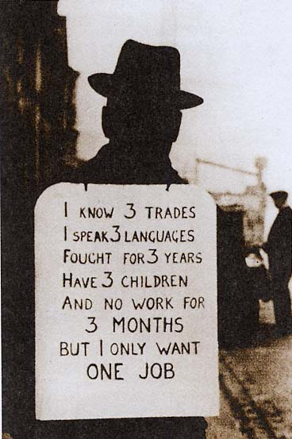
This is a job seeker on the street, with billboards hanging on his body.

Slide 20
I know 3 trades, I speak 3 languags, fought for 3 years, have 3 children, and no work for 3 months. But I only want one job.

Slide 21
Franklin Roosevelt̓s election aroused people̓s hopes, smiles and confidence in life, won him the election and became the 32nd president of the United States. On the day when he was swon in, nearly 100,000 people braved the cold to listen to his speech.

Slide 22
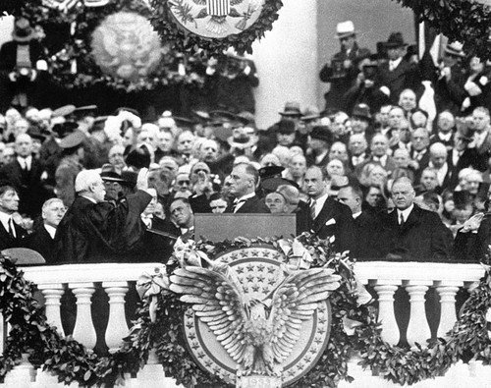

Slide 23
This great Nation will endure as it has endured, will revive and will prosper. So, first of all, let me assert my firm belief that the only thing we have to fear is fear itself---nameless, unreasoning, unjustified terror which paralyzes needed efforts to convert retreat into advance.
This is his inaugural address

Slide 24
In every dark hour of our nation life a leadership of frankness and vigor has met with that understanding and support of the people themselves which is essential to victory. I am convinced that you will again give that support to leadership in these critical days.

Slide 25
This great Nation will endure as it has endured, will revive and will prosper. So, first of all, let me assert my firm belief that the only thing we have to fear is fear itself---nameless, unreasoning, unjustified terror which paralyzes needed efforts to convert retreat into advance.
We will take this sentence as our motto and encourage ourselves all the time.

Slide 26
With the trust and support of the people, they still need strong means and methods to get through the crisis.

Slide 27
content
The New Deal was a series of federal programs, public work projects, financial reforms, and regulations enacted in the United States during the 1930s in response to the Great Depression.

Slide 28
The programs focused on what historians refer to as the “3Rs”: relief for the unemployed the poor, recovery economy back to normal levels, and reform of the financial system to prevent a repeat depression.

Slide 29
First , rectify the financial system. Roosevelt ordered the bank to close temporarily , while straightening out through the establishment of the Federal Savings Guarantee Corporation to restore the bank̓s credit.

Slide 30
Second, strengthen the industrial planning. Congress passed the industrial rehabilitation law requiring business to establish fair competition rules and regulations to prevent blind competition and overproduction.

Slide 32
Blue eagle sign

Slide 33
All the business that abserve by the law hang the Blue Eagle sign.
Roosevelt said:“This country has a unity that I have not seen with you since April 1917.”

Slide 34
Third, adjust agricultural policy. Farmers were awarded to compress output , for restricting agricultural production, overcoming overproduction to raise agriculture prices and improving agricultural production environment.

Slide 35
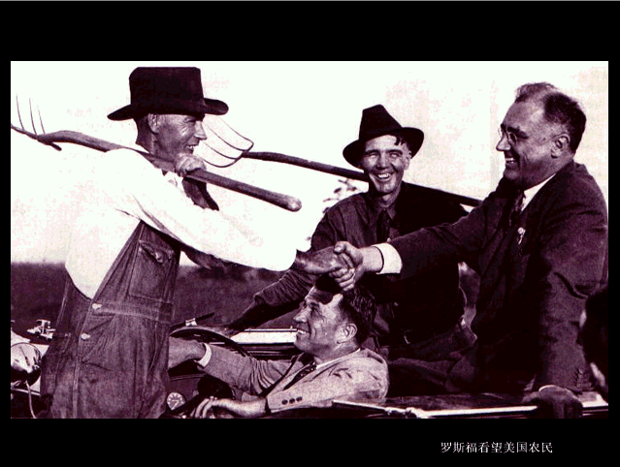
Roosevelt visits American farmers.

Slide 36
Roosevelt visits American farmers.

Slide 37
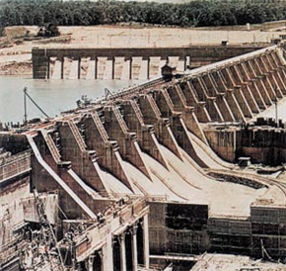

Slide 38
Work relief
Tennessee Valley Authority
Tennessee River Water Conservancy Project

Slide 39
Fourth, implement the “welfare—to –work”. The Roosevelt administration while relieving the unemployed by the Federal Emergency Relief Act, implemented the labor welfare policy, and set up public works, to reduce unemployment and thus stimulate production and consumption and stabilize the social order.

Slide 40
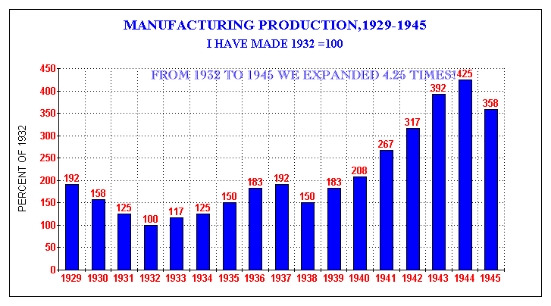
U.S. Production Recovery Histogram
U.S.Economy Recovered

Slide 41
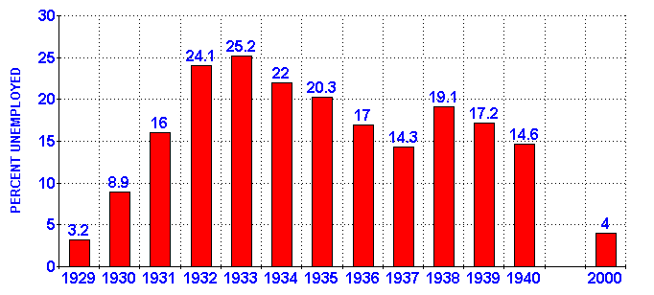
U.S. Unemployment Rate Decline Chart
People’s lives have been improved

Slide 42
Influence
New Deal was a systematic, radical reform within the capitalist system in order to rescue dying capitalism. Roosevelt̓s New Deal is the model that Westen society succeeds against economic crisis.

Slide 43
background
The great depression
Rectify the financial system
Strengthen the planning guidance for industry
Adjust agricultural policies
Implementation of Work Relief
Social welfare
Content measures
Roosevelt's New Deal
Strengthening State intervention and guidance in economy
Characteristics
It enabled the United States to survive the great economic crisis and had a profond impact on the capitalist world.
Influence
Without changing the nature of capitalism ,the fundamental contradictions in American society cannot be solved.

Slide 44
1.Roosevelt’s New Deal measures, are mainly “new”( )
Ａ.It took the form of nationalization
Ｂ.Free enterprise system has maintained capitalism
Ｃ.The social welfare system has been generally implemented
Ｄ.The way the state intervenes in the economy is adopted
D

Slide 45
2、Roosevelt said:“In order to correct the serious shortcomings of our economic system forever, we rely on the new application of the old democratic order.”This shows that ：（ ）
A．Policy adjustments made on the premise of maintaining the capitalist system
B．To eliminate the economic crisis by increasing the degree of state monopoly
C．On the premise of protecting the interests of capitalists,improve the situation of workers and small producers
D．The state exercises macrocontrol over the economy and expands the composition of the state-owned economy
A

Slide 46
The Golden Age of Capitalist Development
Summary of this unit

Slide 47
The Great Depression
1929—1933
Get rid of the crisis and find a way out

Slide 48
New Deal
German,japanese
fascist regimes

Slide 49
This is a precious photo taken during World War‖

Slide 50
Churchill,England

Slide 51
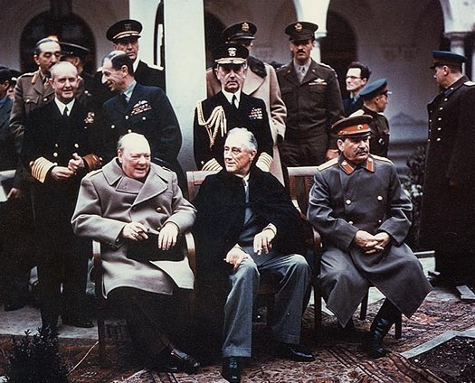
Yalta Conference's Big Three

Slide 52
Yalta Conference's Big Three

Slide 53
Yalta Conference's Big Three

Slide 54
Stalin in the Soviet Union

Slide 55
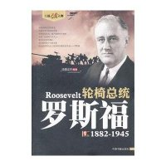

Slide 56
He is the only US president in a wheelchair.
He is the most popular U.S. president after Washington and Lincoln.

Slide 57
We salute this great man of the century together!

