Slide 1
Developing Writing By Using Reading Texts In Graded Readers
Chunmei Yan闫春梅
Central China Normal University
华中师范大学
April 26, 2019

Slide 2
Presentation Outline
Background:
1.1 Goals of English education at primary school level
1.2 Challenges in primary English education in China
Ways of developing writing by using Graded Readers texts
Concluding remarks

Slide 3
Background

Slide 4
1.1 Goals of English education at primary school level
Starting primary English education in 2001 for international political, economic and cultural exchange
Developing students’ comprehensive language competence by making learning a process during which students can develop language proficiency, form positive attitudes, improve thinking skills, increase cross-cultural awareness, and learn to use learning strategies so as to gradually become independent learners (Ministry of Education 2001: 7).
Promotion of activity-based approach: learner-centred communicative activities

Slide 5
Developing students’ core competences (Ministry of Education 2017):whole-person development, quality-oriented education
Language competence语言能力
Learning ability 学习能力
Thinking literacy思维品质
Cultural awareness文化意识

Slide 6
英语学科核心素养（程晓堂、赵思奇， 2016）

Slide 7
1.2 Challenges in primary English education: teachers’ voice
核心素养如何落地英语课堂，落实于英语教学中?
为什么学生一听就懂，一做就错？学生读了背了也写了，就是不会用？英语到底该怎么教？
我从教两年多，但是教学方式已经从最初知识与乐趣相结合，变成现在的纯知识输入。第一个是因为上课时间，一周只有三节课；第二个是因为考试成绩竞争激烈。一直很苦恼.
我希望能够多学些好的教学方法，使孩子们感兴趣，我们学校英语老师所带班级都特别多，希望能够得到事半功倍的辅导孩子的方法。

Slide 8
每个班级都有将近60名学生，尽管努力的去兼顾全部，但仍然存在部分后进生。如何去补差？尤其在班级多、班容量大的前提下。
英语课时少，孩子们缺少语言环境，不能自觉完成老师布置的口头作业，家长不重视。由于训练达不到一定的量，孩子们学了后面忘了前面。有的学生早早的失去了学习英语的兴趣！
听过许多花里胡哨的示范课，自己也尝试过，可觉得效果并不好。想起自己初中的英语老师（我们那时是从初中才开始学英语的），上课并没有现在的这些方式，比如全英文教学，课件，卡片诸如此类，但我觉得效果也挺好的。

Slide 9
1.2 Challenges in primary reading instruction: academics’ voice (王蔷、敖娜仁图雅、罗少茜，2017：16-22)
一、认识上有偏颇: 语言知识的直接灌输和语言技能的机械练习，侧重解码能力的培养，忽视真正意义上阅读活动的发生，忽视阅读素养、尤其是阅读品格的培养。
二、阅读材料匮乏: 1）常规教材具有局限性；2）引进材料不完全符合我国学生特点；3）分级绘本不成体系；4）阅读材料缺乏阅读指导和教学支持。

Slide 10
1.2 Challenges in primary reading instruction: academics’ voice (王蔷、敖娜仁图雅、罗少茜，2017：16-22)
三、教学方法缺失: 1）教学方法的选择理据不足；2）教学目标的设置不够清晰；3）教学活动流于表面。
四、阅读评价片面:1）忽视阅读评价；2）评价不全面；3）评价不系统；4）缺少评价工具。
五、阅读体验缺失: 1）缺少阅读思维；2）很少有机会独立阅读（默读）；3）缺乏对阅读的内部动机。

Slide 11
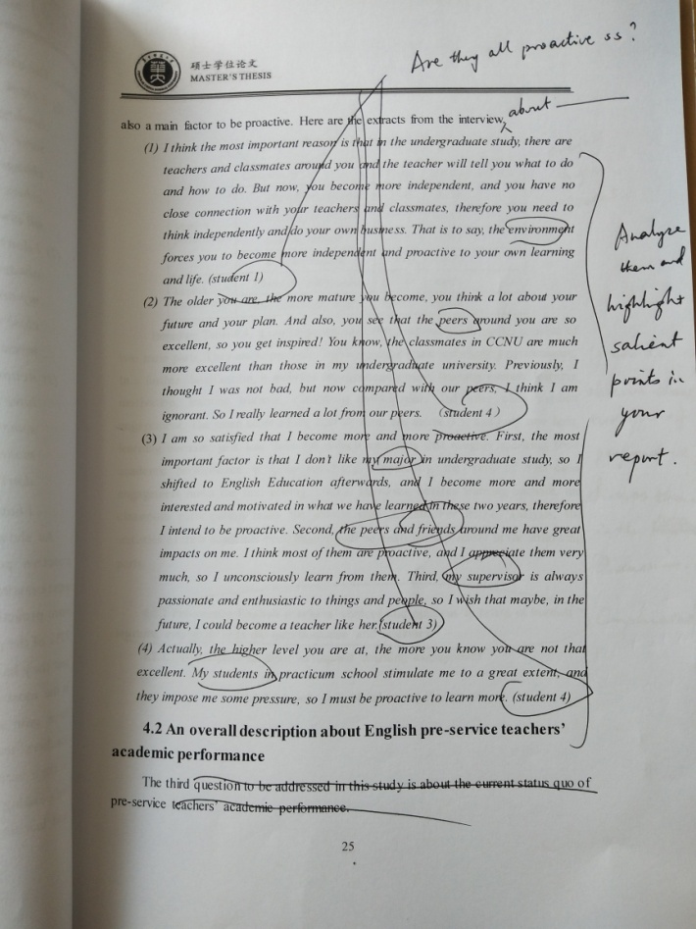
Chinese postgraduates’ inadequacy in English writing

Slide 12
Some teachers’ lack of English thinking
18:10:48 2019/4/16 18:10:48 Thinking is the hardest thing. But it's also the happiest moment when you are thinking. Unfortunately, I always feel I've lost it since I entered into college. For me, maths makes me think, but English just makes me memorize. 18:14:07 2019/4/16 18:14:07 Since I took English as a major, I have taken so many exams which just requested me to re-cite, recite, recite.

Slide 13
Developing writing
by using “Graded Readers” texts

Slide 14
2.1 Goals of Using Graded Readers
To establish a long-term view to nurture reading and writing.
Reading as pleasure: positive values, humanistic qualities
Writing as a form of expression rather than lifeless writing (purple passages, sentences without meaning, decorative adjectives and humbug generally. George Orwell, 1946).
To increase students’ access to the world.
To develop language competence, thinking and learning abilities, and cultural literacy (核心素养).

Slide 15
2.2 Ways of developing writing by using “Graded Readers” texts

Slide 16
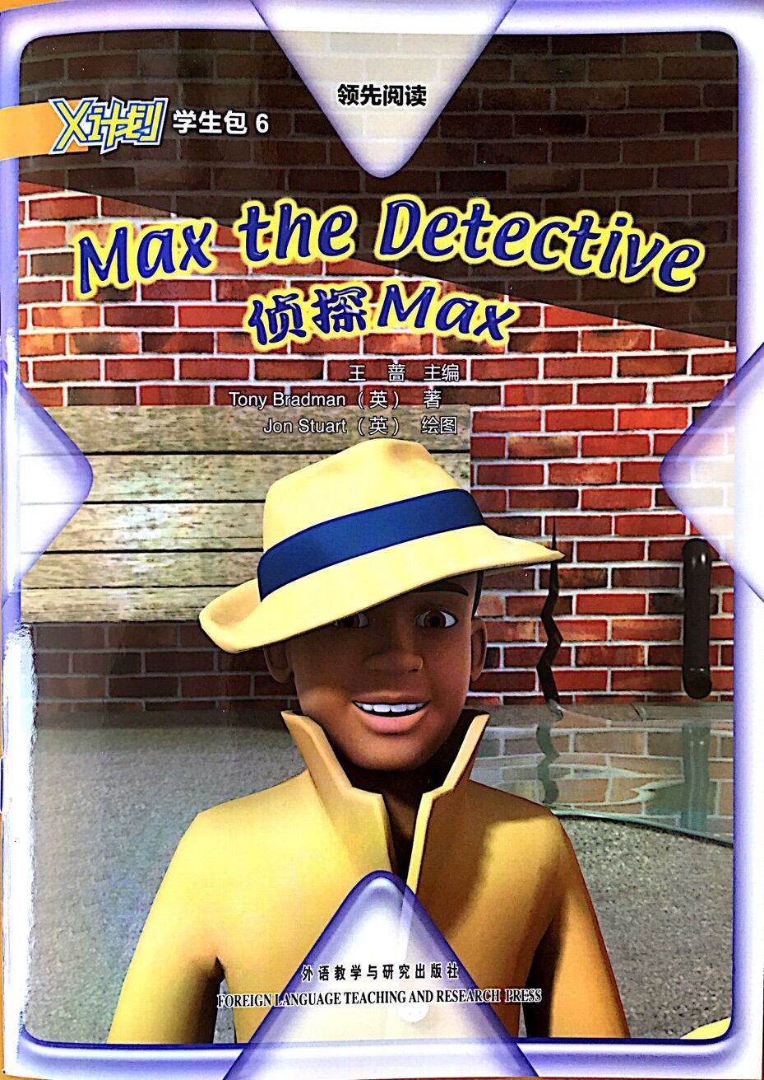
Sample story: Max the detective

Slide 17
Example 1: Making stories based on pictures reading
Invite students to go through all the pictures and make their own stories. Provide a cue paragraph.
Students share their stories.
Students compare their stories with the original story.
Tips
Encourage students’ imagination.
Encourage students’ use of dictionary.
Encourage students’ independent and collaborative learning.

Slide 18
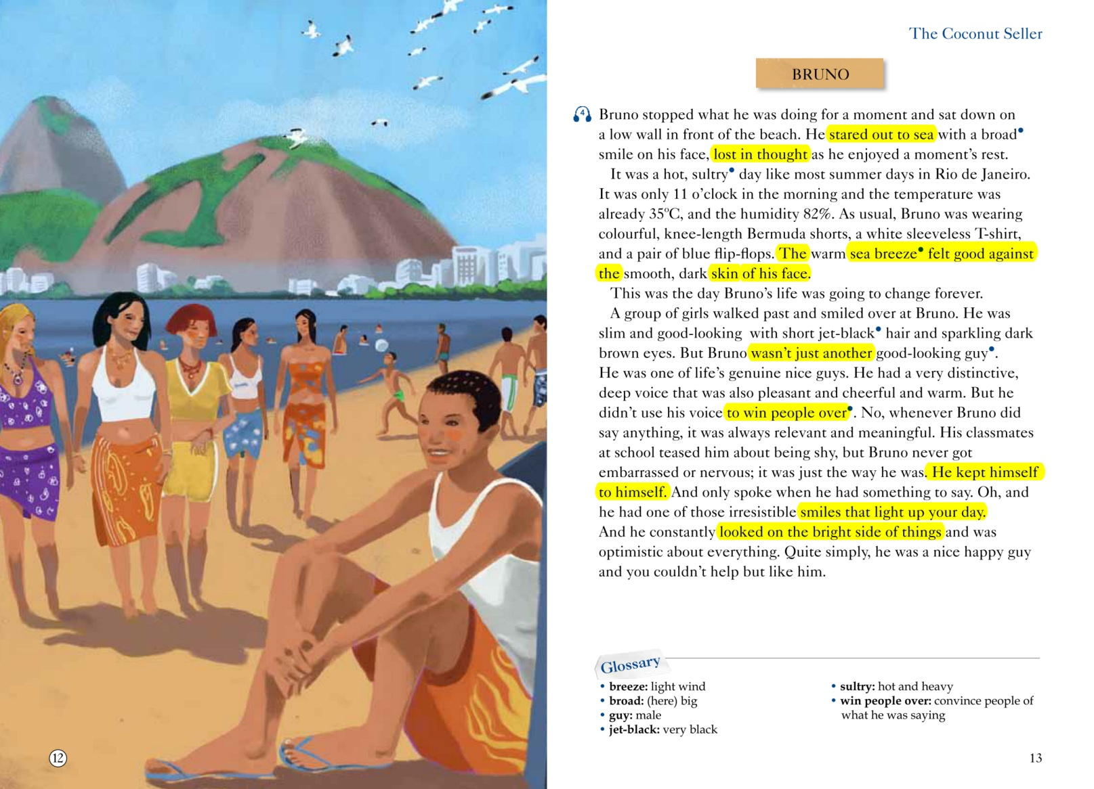
Example 2: Step by step approach to writing practice
Highlight the text for language ideas

Slide 19
Language ideas in “Max the detective” (1)
A story line: simple past, past progressive, past perfect
That was odd. … What was going on?
Tiger’s football had landed in a big puddle.
He squeezed through the crack in the wall near the drain.
Then he went round a corner and saw the problem.
Water was leaking out.
That was why there was a puddle in the playground!
Max put his plan into action. He put a sticking plaster over the hole.
He was looking forward to solving his next case.

Slide 20
Language ideas in “Max the detective” (2)
There be (is, was) …
There is a flood in the staff room.
There was only a dribble of water in the taps.
There was no water in some places and too much is others!
There was a hole in the water pipe!
There was nothing he could do.
Key words
detective, odd, pipe, leak out, puddle, flood, dribble, squeeze, hole, tunnel, solve a problem, sticking plaster

Slide 21
2) Comment on the text
Comment on the plot.
What problem did Max detect?
How did Max detect the problem? How did he become small?
How did he solve the problem?
Comment on the characters’ behaviour.
Do you like Max? What do you like about him? Give your reasons.
Imagine what you would do if you were Max. Would you be able to detect the problem? How would you solve the problem?

Slide 22
3) Take notes and rewrite the text
Sentence making
Practise spelling, collocations and sentences.
Connect sentences within a meaningful context.
Rewrite highlighted information (individually or in groups)
The first step in rewriting is to write the highlighted information.

Slide 23
4) Keep reading journals and write summaries
Reading journals
A personal account of the reading experience.
Help students organise their thoughts by giving them questions to answer for every journal entry, e.g. the plot, the characters’ attitude, what they liked or did not like about the text.
Summary writing
Stay as close to the ideas and the story as possible.

Slide 24
5) Write an essay or questions
Teacher prompts questions for students to write an essay.
Analytical and philosophical questions let students reflect on the text from a personal point of view.
Write questions.
Ask students to generate questions during reading, which is an indicator of students’ level of understanding of the chapter.

Slide 25
6) Extended imaginary and engaging writing tasks
Write a letter to Max about one of your problem-solving experiences in school. Describe how you ran into the problem, how you solved it, and who helped you solve it.
Write up your own story. Please indicate where your story is different from the original one.
Make a small picture book for your story, and exchange it with a peer as a present. (optional)

Slide 26
3. Concluding remarks
Writing and reading should be organically integrated to develop students’ language competence, learning ability, cultural awareness and thinking literacy.
Teachers need to creatively use such learning materials as Graded Readers to serve students’ learning needs, and their own development needs.

Slide 27
References
程晓堂，赵思奇. 2016.英语学科核心素养的实质内涵是什么http://www.sohu.com/a/87150173_392410？
王蔷、敖娜仁图雅、罗少茜 (2017).小学英语分级阅读教学. 北京：外语教学与研究出版社.
Ministry of Education. (2001) National English Curriculum Standard. Beijing: People’s Education Press.
Graded readers at Oxford University Press website: Oxford teachers’ club https://elt.oup.com/teachersclub/subjects/gradedreading/?cc=cn&selLanguage=zh
https://elt.oup.com/teachers/readers/articles/oxford_big_read?cc=cn&selLanguage=zh&mode=hub
https://elt.oup.com/teachers/readers/articles/oxford_big_read?cc=cn&selLanguage=zh&mode=hub
The Extensive Reading Foundation http://erfoundation.org/wordpress/graded-readers/
Read to Write: Improving Writing Skills Using Graded Readers, February 18, 2014 by Nora Nagy, at http://blog.helblingreaders.com/read-to-write-improving-writing-skills-using-graded-readers/

