Slide 1

Unit4 Finding our way
Integrated skills
By Wang Yujie

Slide 2

Brainstorming
How can we ask the way?
How can we show the way?

Slide 3


Asking the Way
Where is …?
How do I get there?
Which way should I go to...?
Could you tell me the way to …?
Can you tell me how to get to...?
Which is the way to …?
Do you know the way to...?
He will go to the English corner at
英语角
the Sunny Garden.

Slide 4


Showing the Way
Go out and turn left/right.
Walk straight on, and you'll see...
Just cross the road.
Walk past...
Turn left at the first crossing.
Then you will see...at the corner of the street.
Listening tips （1）
听力技巧：
Just write down some key letters and words.(当听到长单词和词组时，记录开始的几个字母和关键单词。)

Slide 5
a house
a library
walk to...
walk past...
walk across ...
walk along...
cross...

Slide 6
Showing the Way
Turn left/right.
Walk straight on, and you'll see...
Just cross the road.
Walk past...
Turn left at the first crossing.
Then you will see...at the corner of the street.

Slide 7
Turn left at the first crossing.
Turn right at the first turning.
=Take the first turning on the right.

Slide 8
Showing the Way
Turn left/right.
Walk straight on, and you'll see...
Just cross the road.
Walk past...
Turn left at the first crossing.
Then you will see...at the corner of the street.

Slide 10
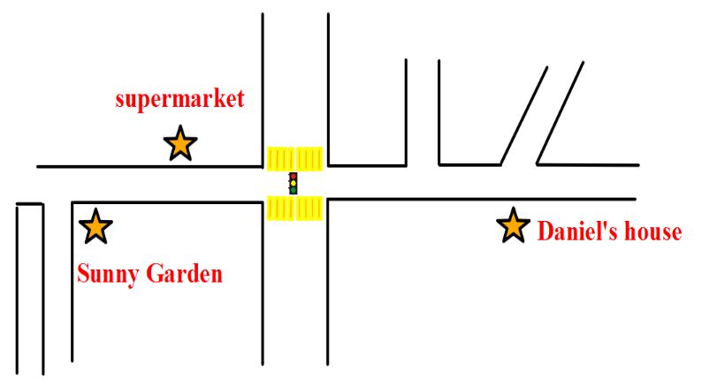

How can he get to Sunny Garden from his house?
Tip：When we ask the way, we should say 'Excuse me' first. After getting others'help, we should say 'Thanks...' to them. If they don't know the way, we should say'Thank you all the same(仍然要谢谢你)'
First, he should go … and turn…
1) Walk ... and he'll see the ...
2) Just ... the road at the...
3) Walk ... the supermarket and turn...at the...

Slide 11

When he arrives, Daniel is surprised to find his teacher Mr. Wu and some of his classmates are also there.
They are going on a treasure hunt.

Slide 12
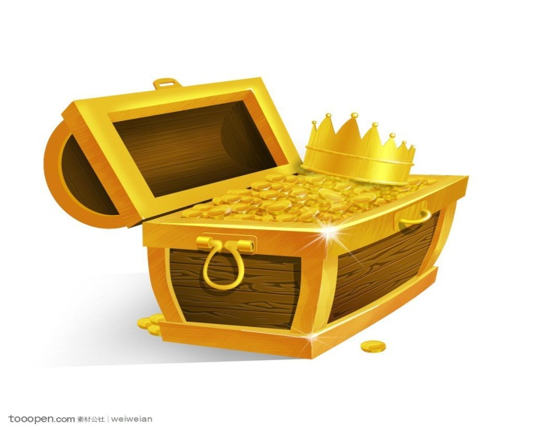
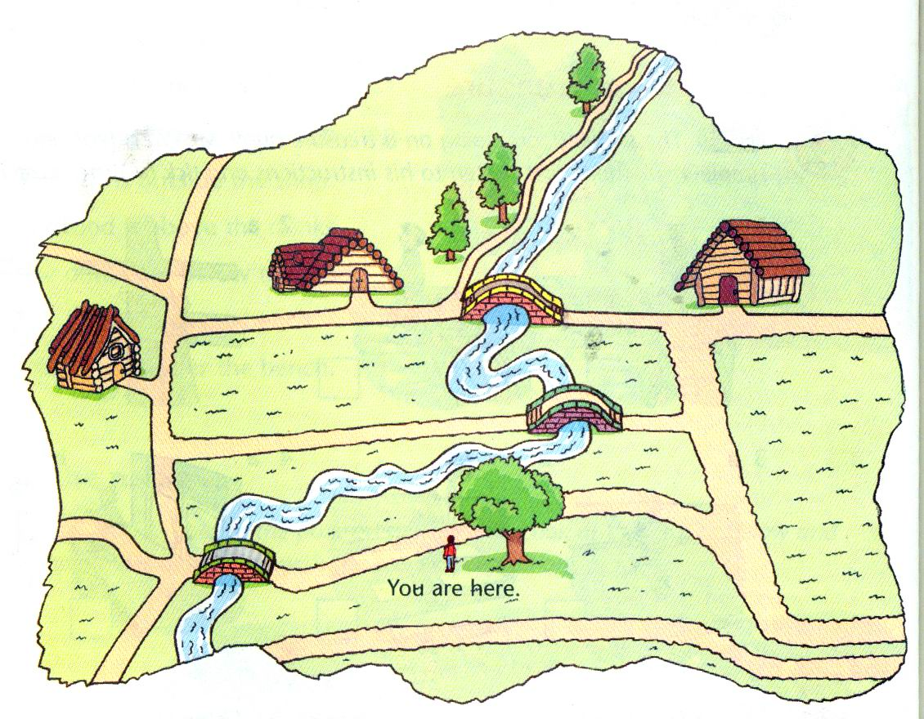



方向之钥
顺序之钥
路线之钥

Slide 13
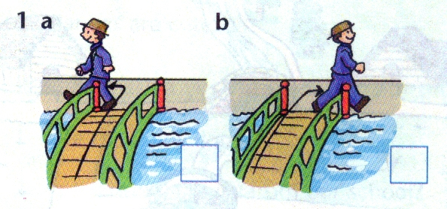
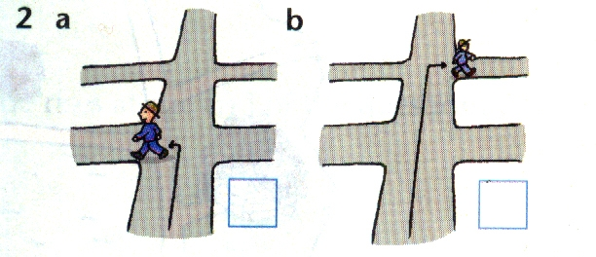

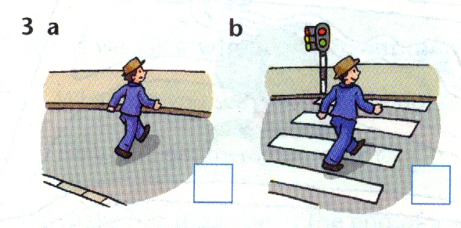
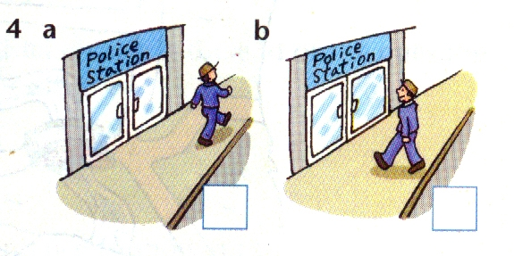
To win the key of direction!
Listen to Mr Wu’s instructions and tick(√) the correct boxes.
Listening tips （2）
听力技巧：
1.You can find out the differences between picture a and picture b. (找出两副图不同之处)
2.Listen to the information which we need carefully.(仔细听我们所需要的信息）
√
√
key of direction
√
√

Slide 14
To win the key of order!
Listen and put the instructions into correct order.
a. Walk past the house, turn left and walk along the path next to the river.
b. Walk along the path, and you 'll see a house on your left.
c. When you are at the big tree, turn left and walk to the bridge.
d. Cross the bridge, turn right and walk straight on.
e. The treasure is under the ground in front of the third tree on the left.
f. Take the second turning on the right.
5
Listening tips （3）
4
听力技巧：
1.You can guess which is the first sentence and the last one. (根据句子猜测第一句和最后一句)
2.Pay attention the key words like take.../walk...You can underline them(划出关键信息）
1
2
6
3

Slide 15

To win the key of route!
Listen to the instructions again and draw the route on the map.

Slide 16
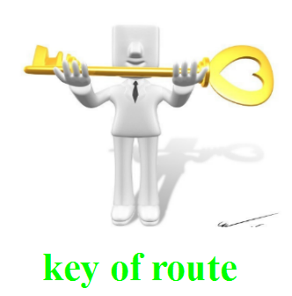


Is there another way to find the treasure?
When you’re at the big tree, turn ...and walk to...
Cross ...turn ...and walk ...
Take ...turning on ...
Walk along..., and you’ll see ... on ...
Walk past ....turn .... and walk along ...next to ...
The treasure is under ... in front of ... on ....
All roads lead to Rome.
We should show the way simply and directly(直接明了) to make others understand .

Slide 17
Show time
1. Try to find my treasure.
2. Try to find your treasure.
Try to make a dialogue to ask and show the way.

Slide 18
Routes are countless, safety is foremost.
道路千万条，安全第一条！
learn about traffic signs
Follow simple instructions
Ask and show the way

Slide 19
Homework:
1. Review the traffic signs and instructions.
2. Write down your dialogue that you have made.

