Slide 1

Unit 4 Finding your way
Welcome to the unit

Slide 2
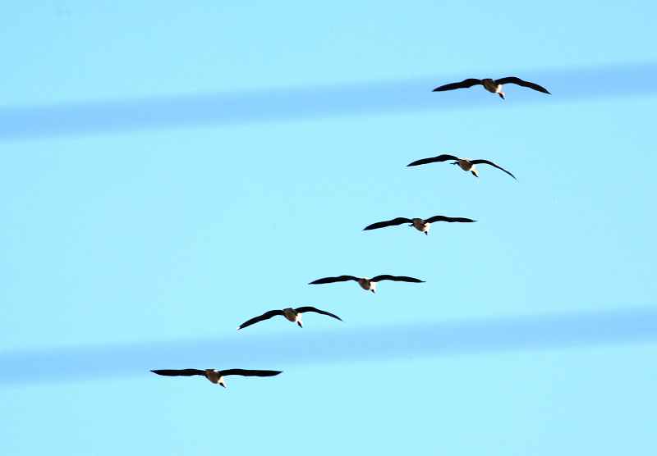

Spring is coming.

Slide 3
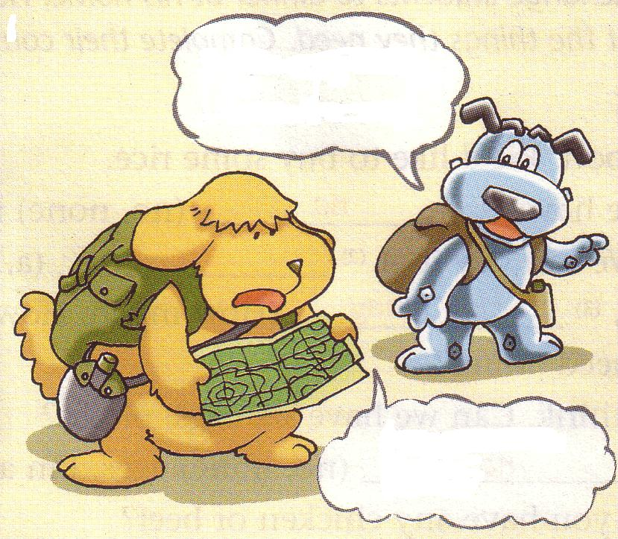
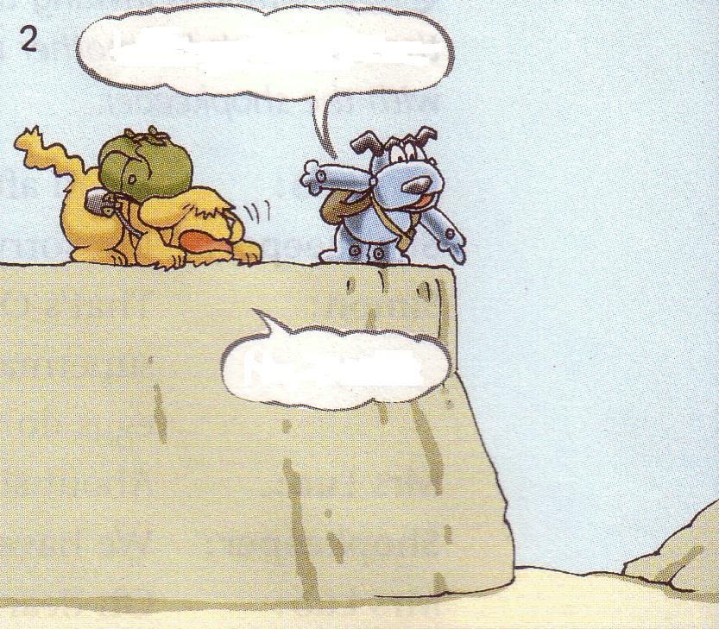
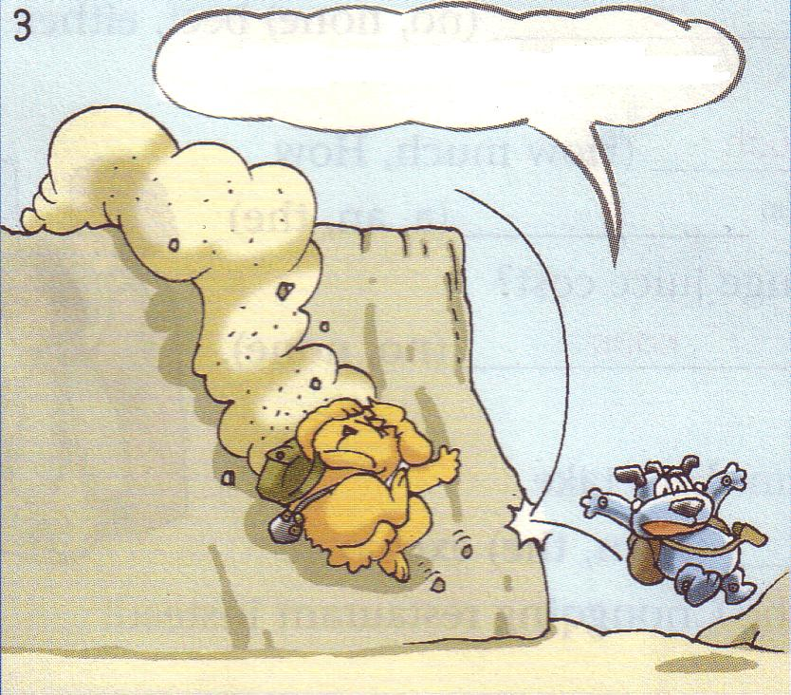
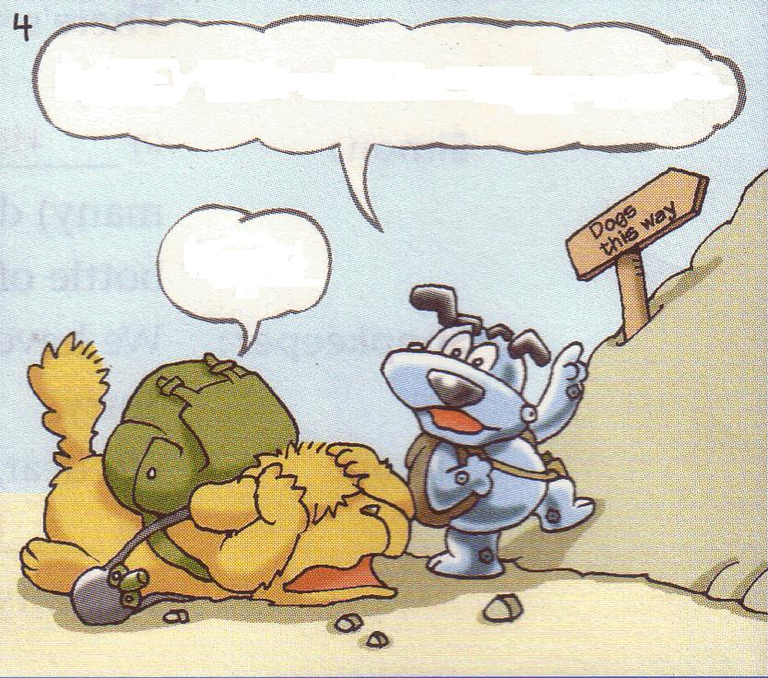
read a map
a path
be afraid
a sign

Slide 4
What happened to(发生) Eddie and Hobo?
They lost their way.

Slide 5

Watch and answer:
1. What does Hobo ask Eddie to do in the beginning?
2. How does Eddie feel when he has to go up
the hill again?
3. Does Hobo really know the way?

Slide 7
Watch and answer:
1. What does Hobo ask Eddie to do in the beginning?
He asks him to go down the hill.
2. How does Eddie feel when he has to go up
the hill again?
He feels afraid.
3. Does Hobo really know the way?
No, he doesn’t.

Slide 8



Read and fill in the blanks:
Eddie and Hobo are going on their t______. Eddie doesn’t know the w______. Hobo thinks he k______ it because there’s a p____between the hills. He tells Eddie not to be a_______. Eddie goes d_________ the hills with Hobo. But they have to go u_____ again. When Eddie hears this, he’s almost mad.(疯的)
rip
ay
nows
ath
fraid
own
p

Slide 9
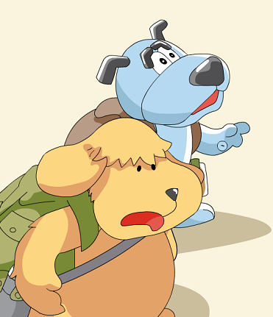
Act it out
Tips：
1.Try to use your body language as much as possible!
2.Add your own words!

Slide 10
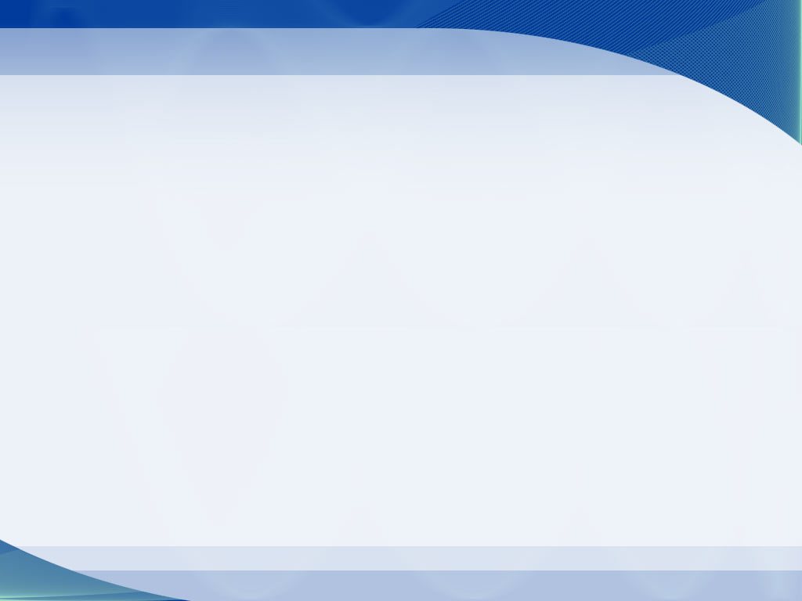
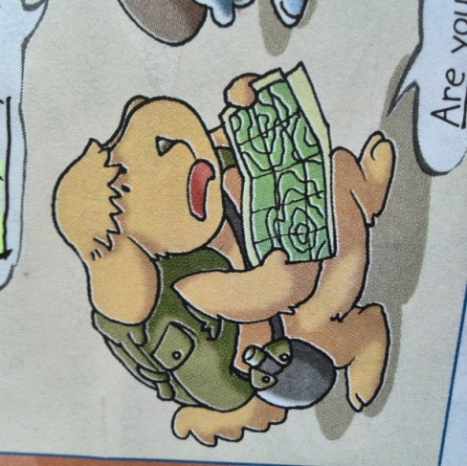
Free talk
If you do not know the way, what will you do?
We can use our mobile phones.
We can ask the way.
We can read a map.
…

Slide 11
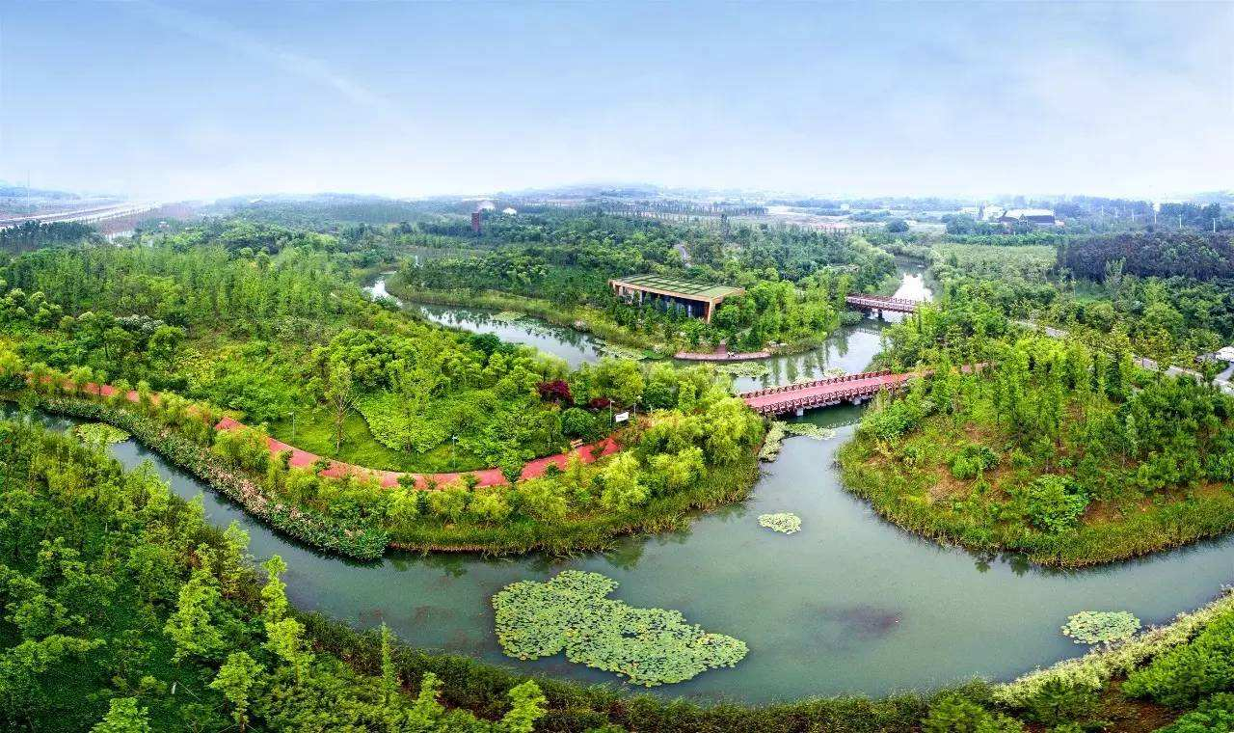
We are going on a trip to Xinlong Park!

Slide 12
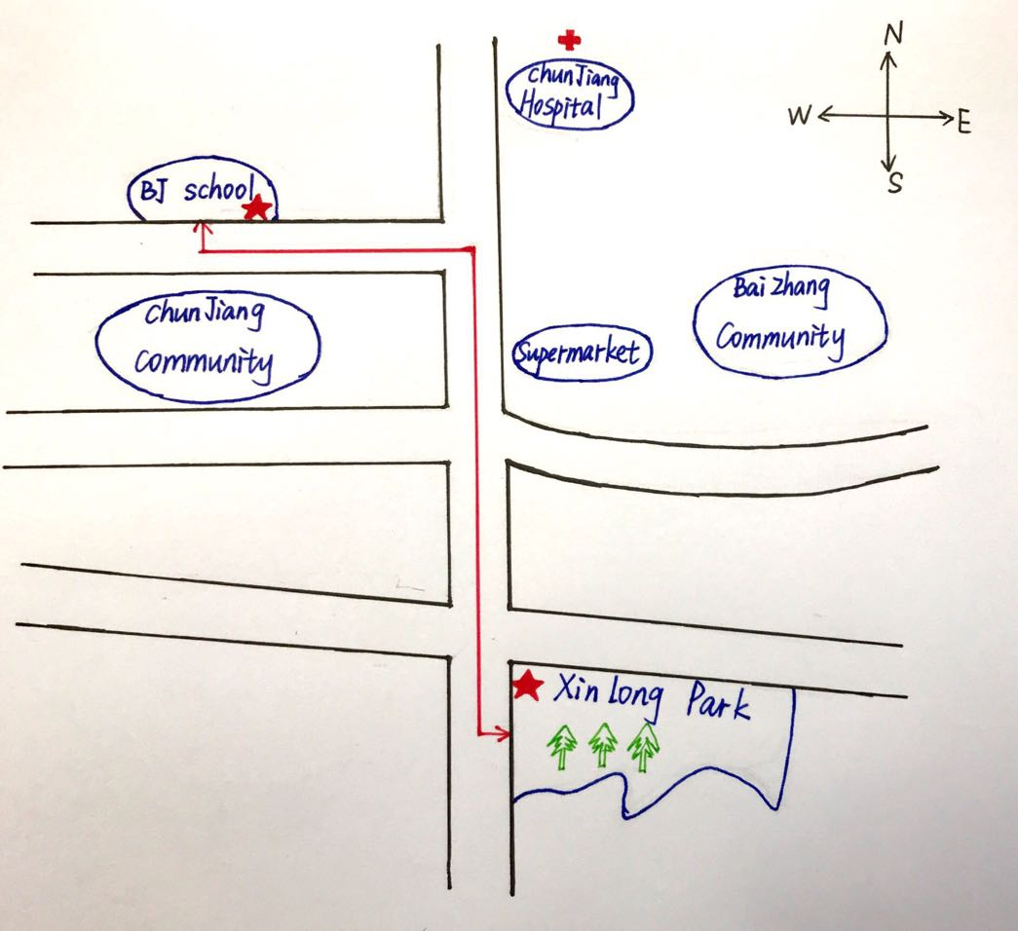

Directions 方向
Chunjiang Hospital
Binjiang Middle School
Baizhang Community
Chunjiang Community
Supermarket
How about Binjiang Middle school and the Supermarket?
A is______of B
A在B的……
Xinlong Park

Slide 13



Let’s learn more directions!
north-east
north-west
north
west
east
south-west
south
south-east

Slide 14
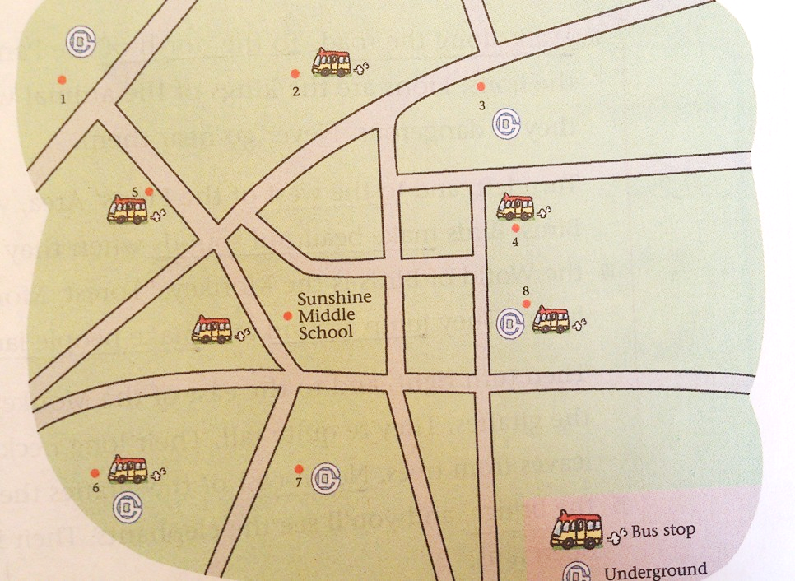
Sunshine Zoo
Sunny Garden
Lake Park
Sunshine Park

Slide 15

Sunny Garden
Sunshine Zoo
Sunshine Zoo is to the north of Sunshine Middle school.
A is to the______of B A在B的外部且不接壤
Lake Park
Sunshine Park
Sunshine Zoo is north of Sunshine Middle school.
Sunny Garden is west of the zoo.
Lake Park is south of Sunny Garden.
Sunshine Park is east of Lake Park.

Slide 16
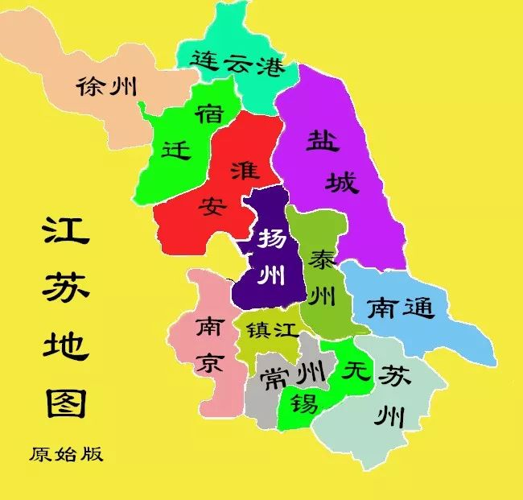
Changzhou is in the___________ of Jiangsu.
south
in the north-west
Xuzhou is ________________ of Jiangsu.
Lianyungang is ___________ of Jiangsu.
in the north
A is in the … of B A 在B内部

Slide 17
east
Wuxi is on the ______ of Changzhou.
on the west
Nanjing is ______________ of Changzhou.
A is on the … of B A 与B接壤

Slide 18
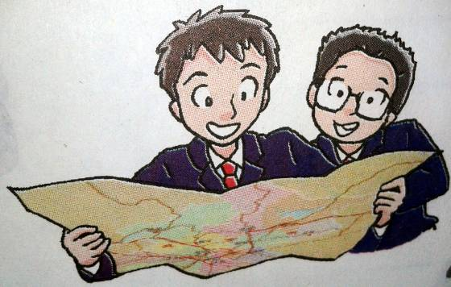
Daniel and Simon are talking about the trip.

Slide 19


Listen and answer:
1. Where are they going for the trip？
They are going to Sunshine Zoo.
2. Where is the zoo？
It's north of the school,about three kilometres away.
3. How will they get there？
They will get there by bus.

Slide 20


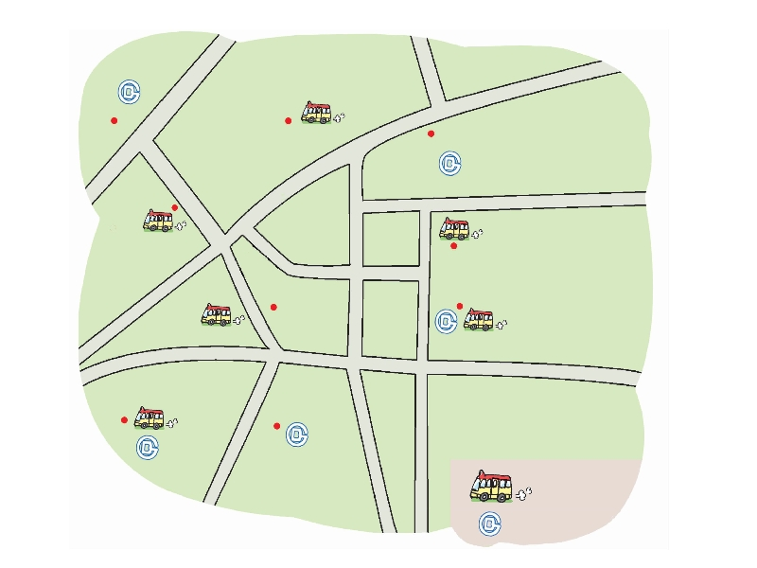
Pair work: Talk about a trip you like.
Where |  |  |  |  | 。。。
How far | 3km | 4km | 2km | 1km | 。。。
How |  |  |  |  | 。。。
Sunshine Zoo
Sunny Garden
Lake Park
Sunshine Park
A: Where are we going for our class
trip?
B: We are going to…
A: Where’s it?
B: It’s north / south / east /
west of ….
A: How far is it?
B: It’s about …away from our school.
A: How will we get there?
B: We will get there .…
2
Sunshine Zoo
1
Sunny Garden
3
Sunny Theatre
5
Sunshine Museum
Sunny Food Centre
4
Sunshine
Middle
School
8
Sunny Shopping Centre
6
Lake Park
7
Sunshine Park
Bus stop
Underground

Slide 21
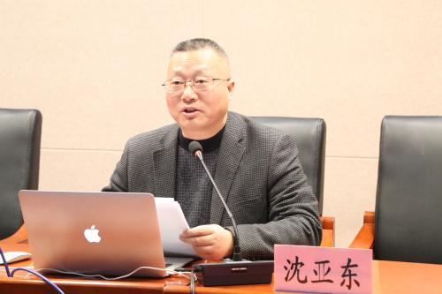

Write a letter to the headmaster
Plan a day out

Slide 22
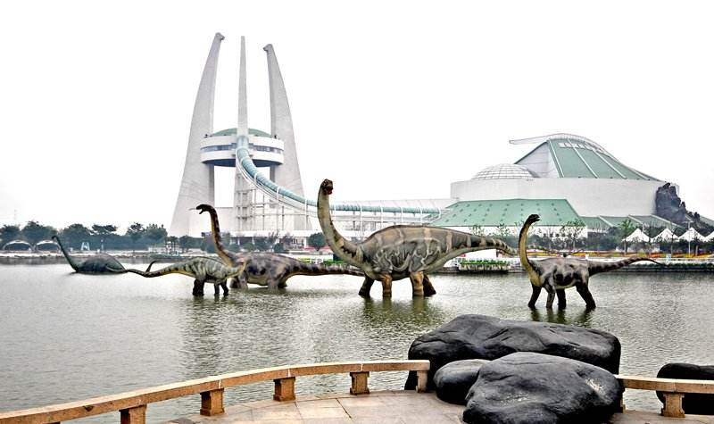
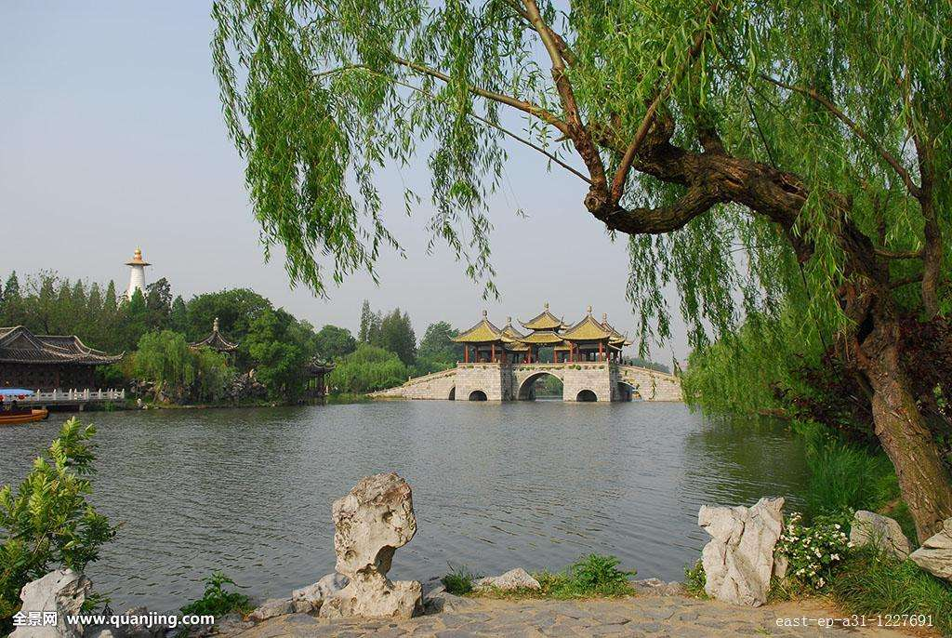
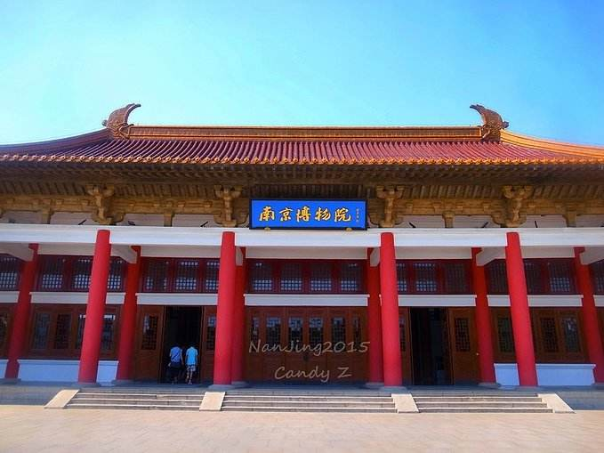
China Dinosaurs Park
Slender West Lake
(瘦西湖)
Nanjing Museum

Slide 23

Homework:
1.Finish the exercises.
2. Preview reading.

