Slide 1
Unit 7
Seasons
Reading

Slide 2
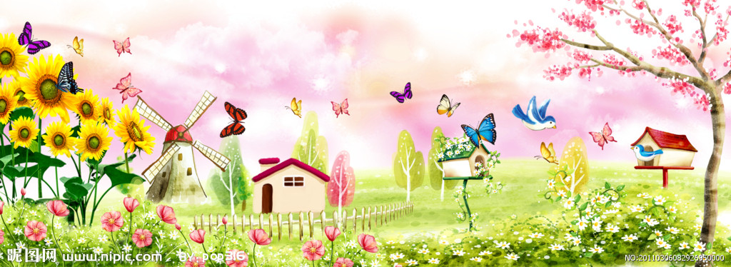
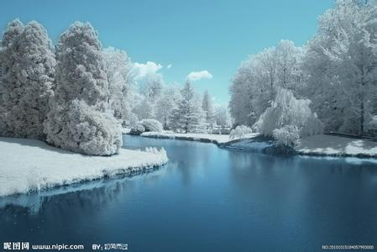
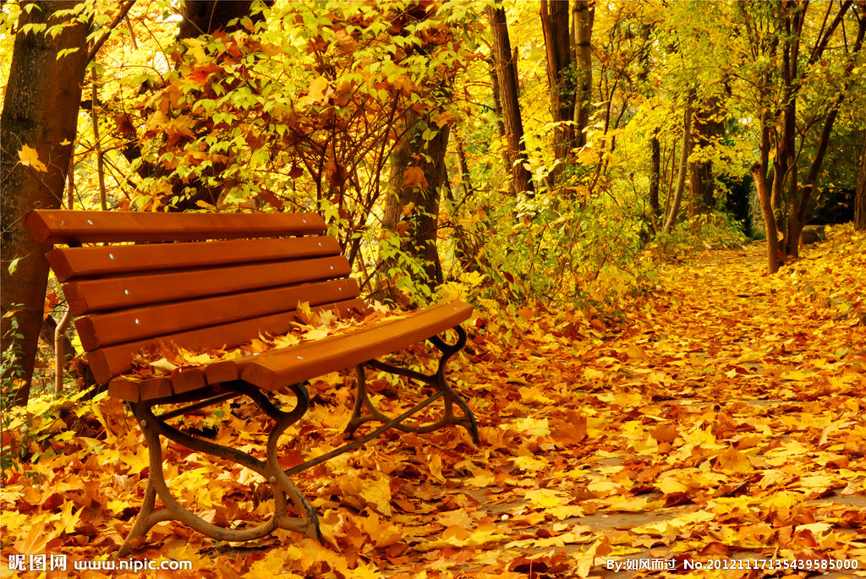
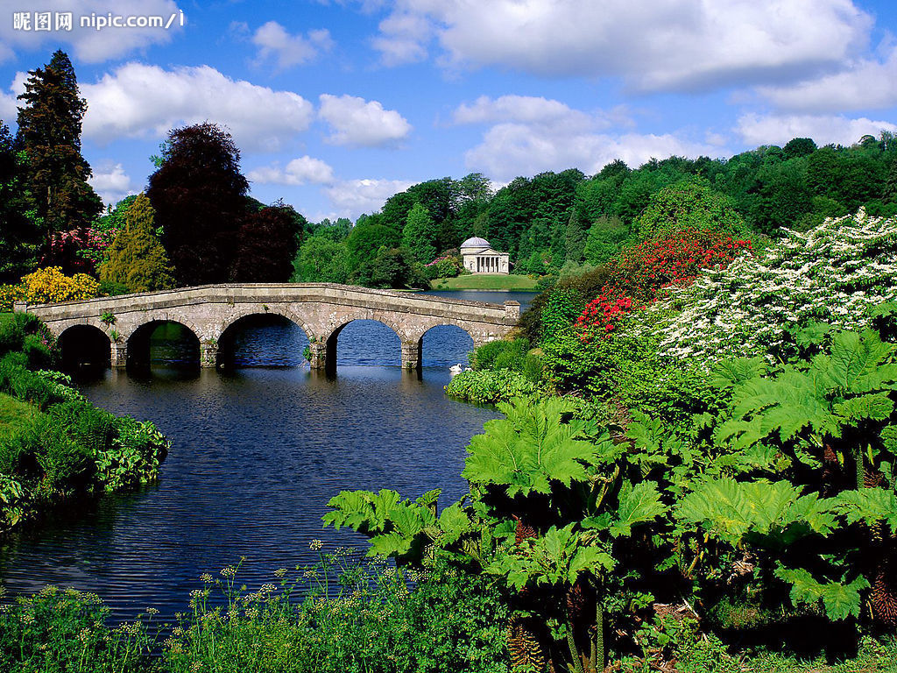
What’s your favorite season?
And why?

Slide 3
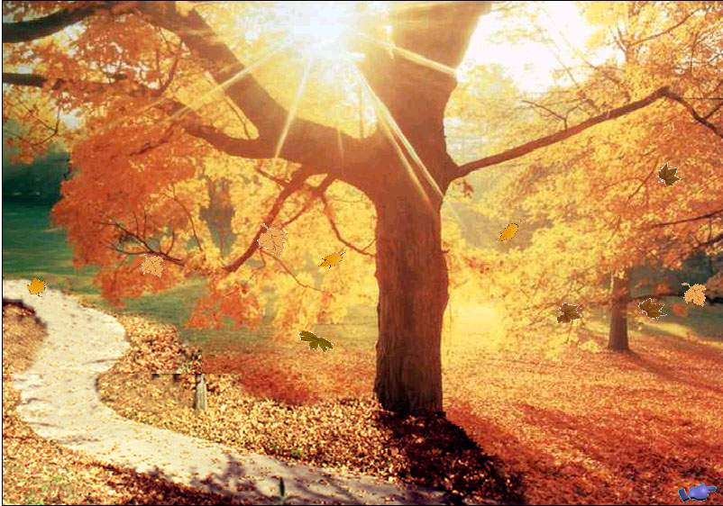
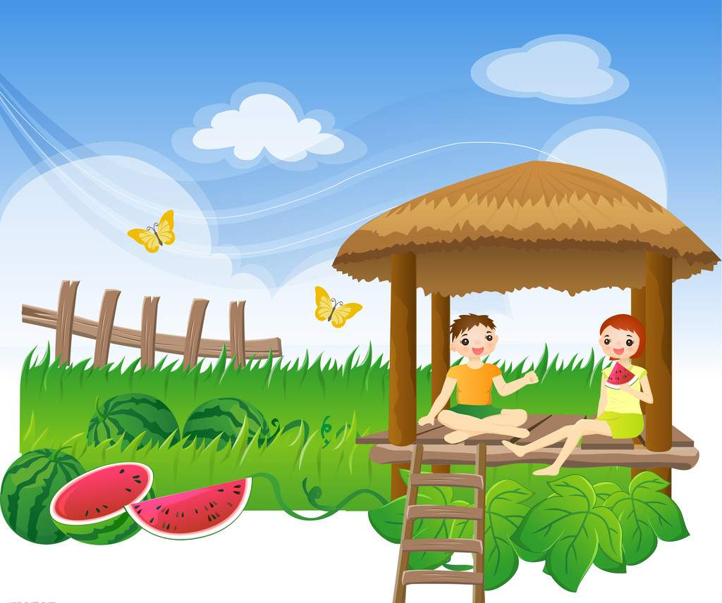
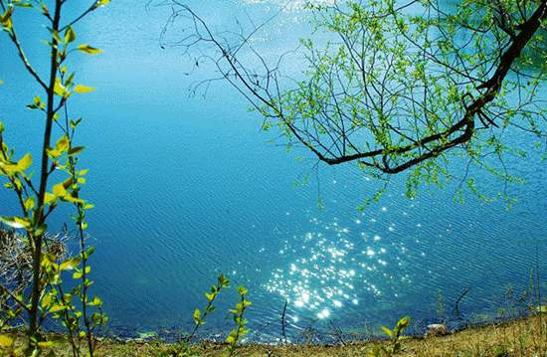
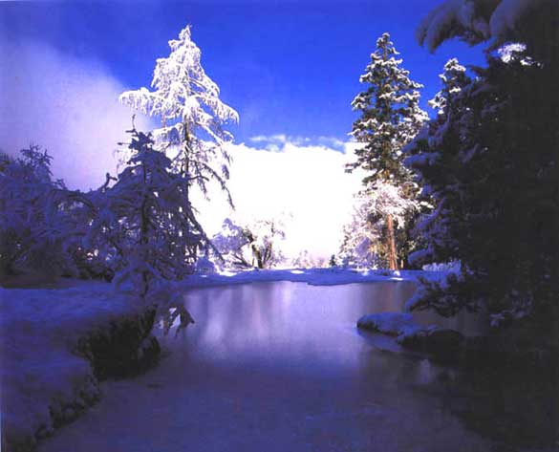
Let’s enjoy a poem about seasons together!

Slide 4

Tips for reading poems:
1. Read the poem slowly.
2. Feel the beauty of the poem
with heart.
3. Pay attention to the rhymes.

Slide 5
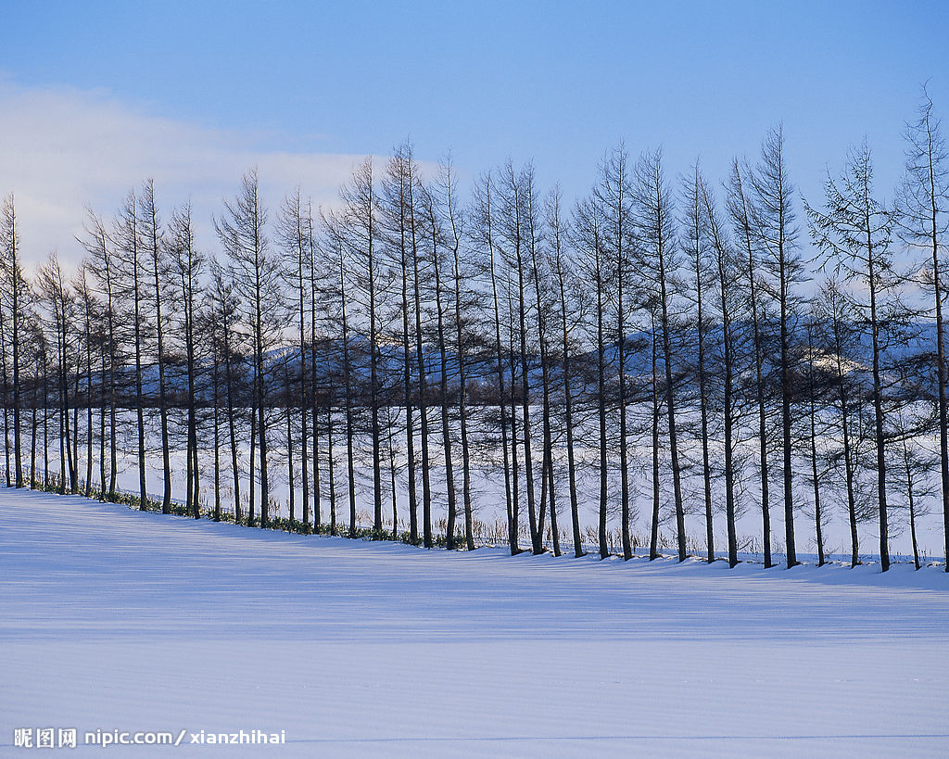
winter

Slide 6
Winter
Winter days are full of snow,
When trees and flowers forget to grow,
And the birds fly far away
To find a warm and sunny day.

Slide 7
1.Why do birds fly far away in winter?
To find a warm and sunny day
If winter comes, will spring be far away?

Slide 8
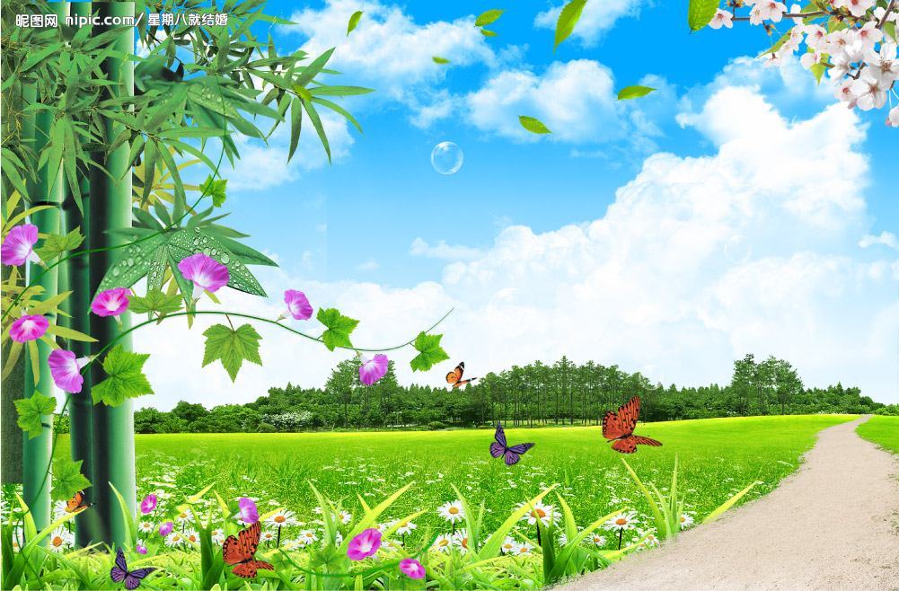
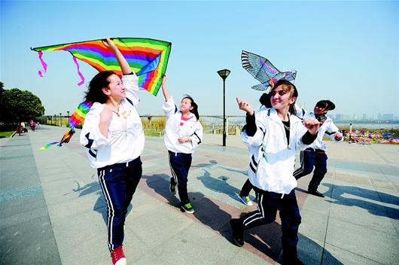
The days of spring are windy and bright,
What a perfect time to fly a kite!
Bees and butterflies play among flowers,
Then hide from the April showers.

Slide 9
animals
bees,butterflies
people
spring
weather
windy bright
showers
fly a kite

Slide 10
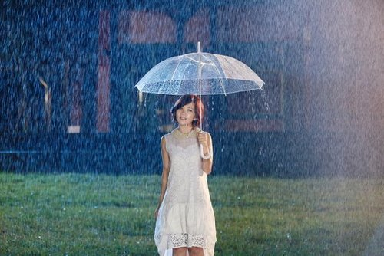
showers
阵雨

Slide 11
Summer
Those sweet memories of summer days
Are about quiet streams and trees and shade,
And lazy afternoons by a pool,
Eating ice cream to feel cool.
How does the writer feel about summer?

Slide 12
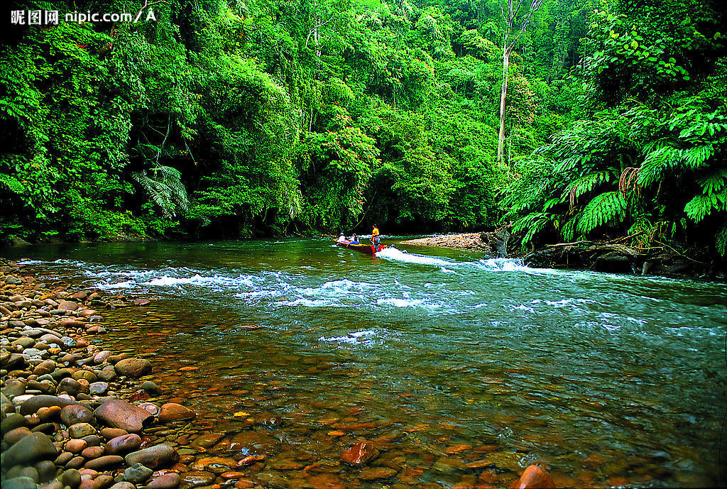
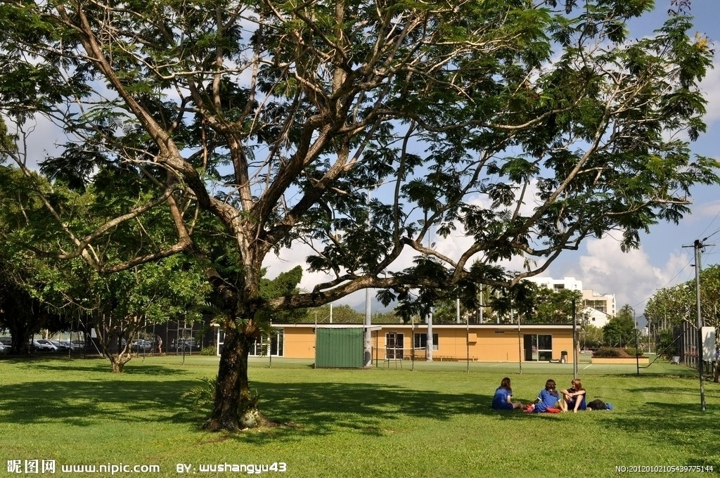
stream
shade

Slide 13

Autumn
Then autumn leaves turn brown,
Fall into piles upon the ground.
Farmers work to harvest crops,
As the days are shorter and the temperature drops.
Soon the snowy seasons will begin,
And it will be a new year once again.

Slide 14
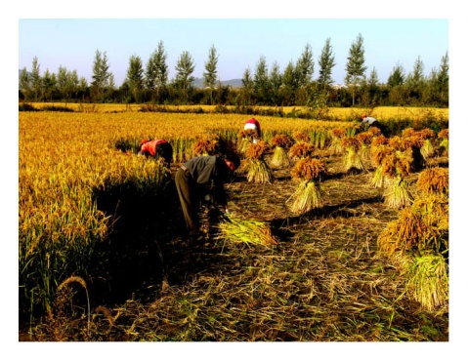
harvest crops
fall into piles
collect crops

Slide 15
What happens in autumn?
a. Full of snow
Birds fly far away
b. A perfect time to fly a kites.
Bees and butterflies play among flowers
c. Brown leaves fall on the
ground.
Farmers harvest crops
autumn
c

Slide 16
 | autumn
turn brown , fall into piles upon the ground
leaves
farmers
harvest crops
days
(get) shorter
temperature
drops

Slide 17
grow
Snow rhymes with
Away rhymes with
Bright rhymes with
Flowers rhymes with
Days rhymes with
Pool rhymes with
Brown rhymes with
Crops rhymes with
Begin rhymes with
day
kite
showers
shade
cool
ground
drops
again

Slide 18
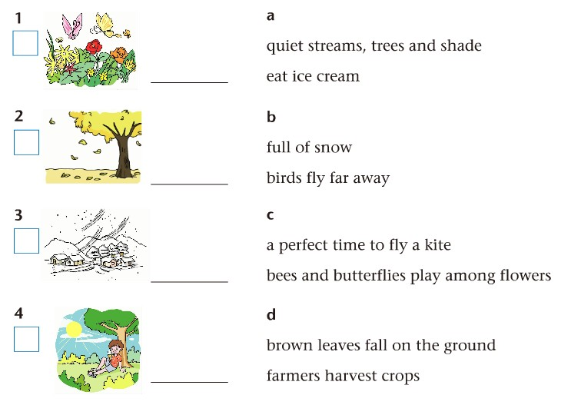
Match each season with the descriptions.
c
spring
d
autumn
b
winter
a
summer

Slide 19

Show Time
Group work: choose one season to read

Slide 20
Let’s correct mistakes
Shirley: Why do we seldom see birds in winter, Amy?
Amy: Because most of them fly away to a warm
aaaaaaand windy place.
Shirley: Can you describe the weather in spring?
Amy: Yes. It’s and bright, and in April, the
may come suddenly.
Shirley: How do people feel on a hot summer
afternoon?
Amy: They feel and like to eat ice cream.
Shirley: How does the weather change when autumn
comes?
Amy: The leaves turn and the
temperature quickly.
sunny
windy
cloudy
showers
wind
lazy
busy
green
brown
rises
drops

Slide 21
B4 Seasons of the year
In winter,white covers the whole earth.It is often very cold and the can drop below zero.
The weather is nice in spring. A windy day is for flying a kite. and butterflies play among flowers.
Then they away when the April showers come.
People often have sweet of summer days.They go swimming and eat . They like to play by quiet or under the of trees.
When autumn comes, the turn brown and into piles upon the ground.Farmers are busy harvesting .
Soon it will be a new year once again.
snow
temperature
perfect
Bees
hide
memories
ice cream
streams
shade
leaves
fall
crops

Slide 22

Tips for you
Try to feel the beauty of the poems,
Practise writing down the English poems,
and you will be another Shakespeare
one day!

