Slide 1
1.有明亮眼睛&深色条纹
2.喜欢独居
3.做某事一小会儿
4.为了它们的皮毛，骨头
或身体其它部分而捕捉它们
5.厚厚的皮毛
6.能跑几个小时不停歇
7.以团队精神合作
8.从不为乐趣而捕杀它们
9.失去生存地区
10.看,听,闻到远处物品
11.对人类有危险
12.失去他们的生命
13.不再买皮毛大衣
have bright eyes & dark stripes
like to live alone
do sth. for a short while
catch them for their fur, bones or
other parts of the body
thick fur
can run for hours without stopping
work as a team
never kill them for fun
lose living areas
see, hear and smell things far away
be dangerous to humans
lose their lives
not buy fur coats any more

Slide 2
8A Unit 5 Wild animals Study skills
Fun with English

Slide 3
Learning aims
1.To learn some more about wild animals and know the importance of protecting wild animals.
2.To know about the suffixes ( adding -ing, -ness and -ion to some verbs and adjectives to form nouns).

Slide 4
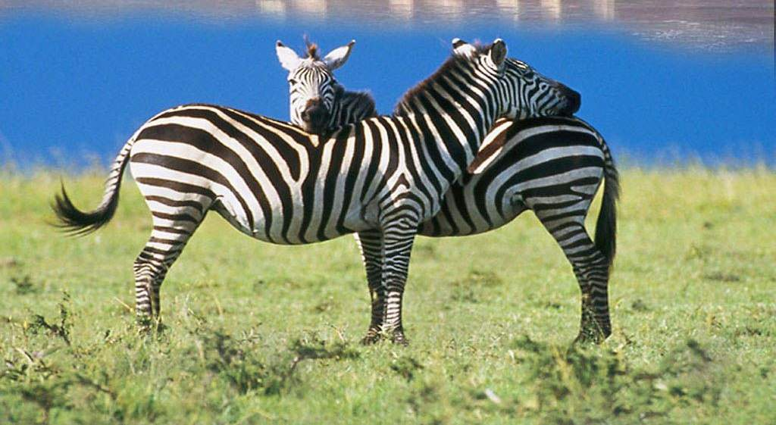

Slide 5
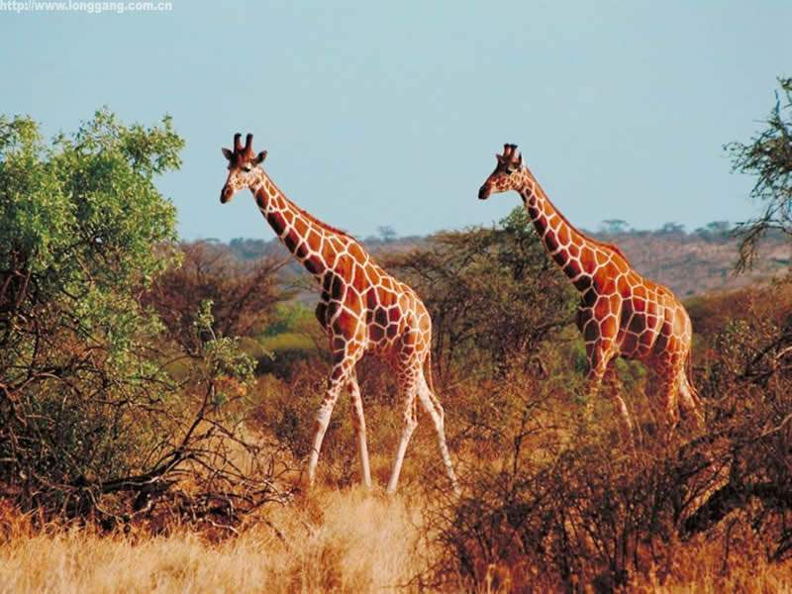

Slide 6
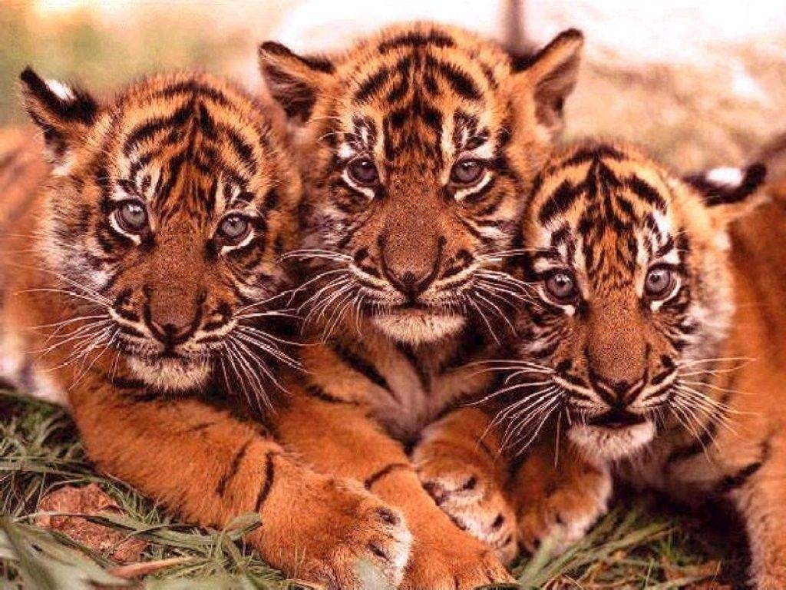

Slide 7
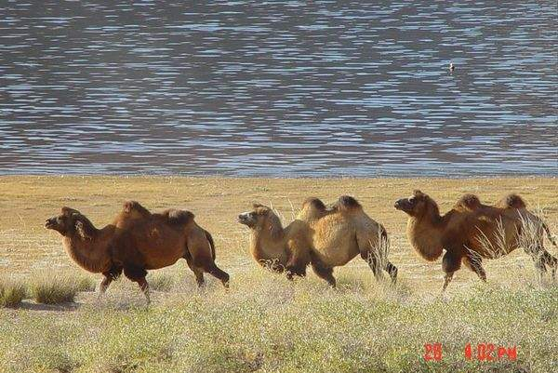

Slide 8
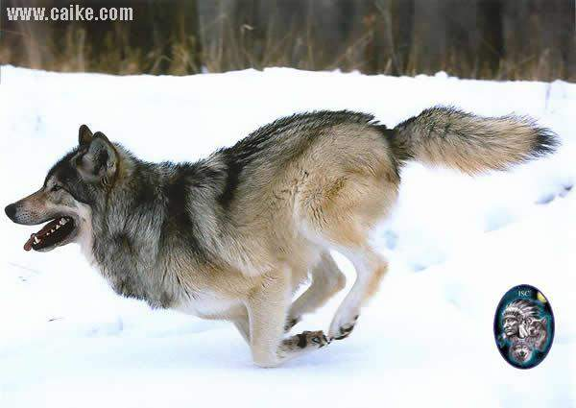

Slide 9
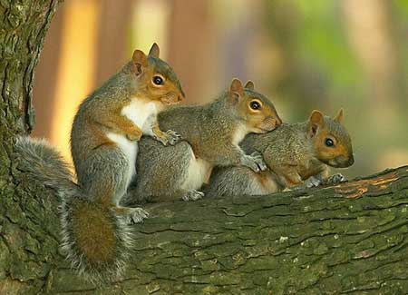

Slide 10
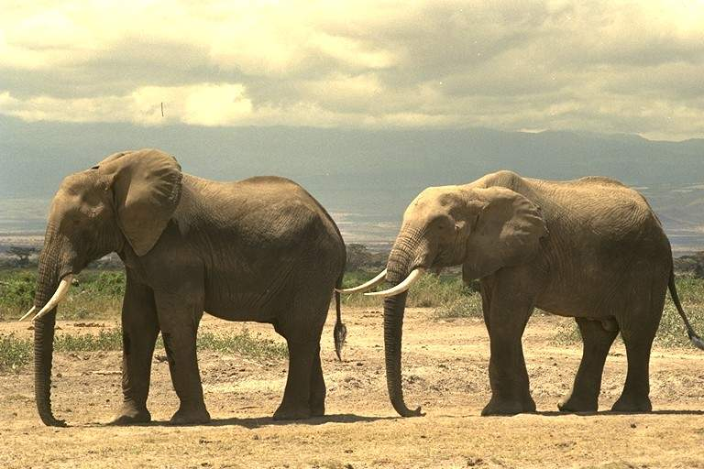

Slide 11
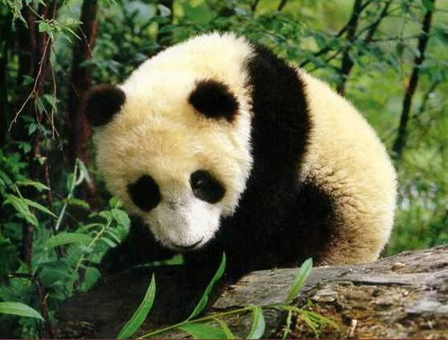

Slide 12
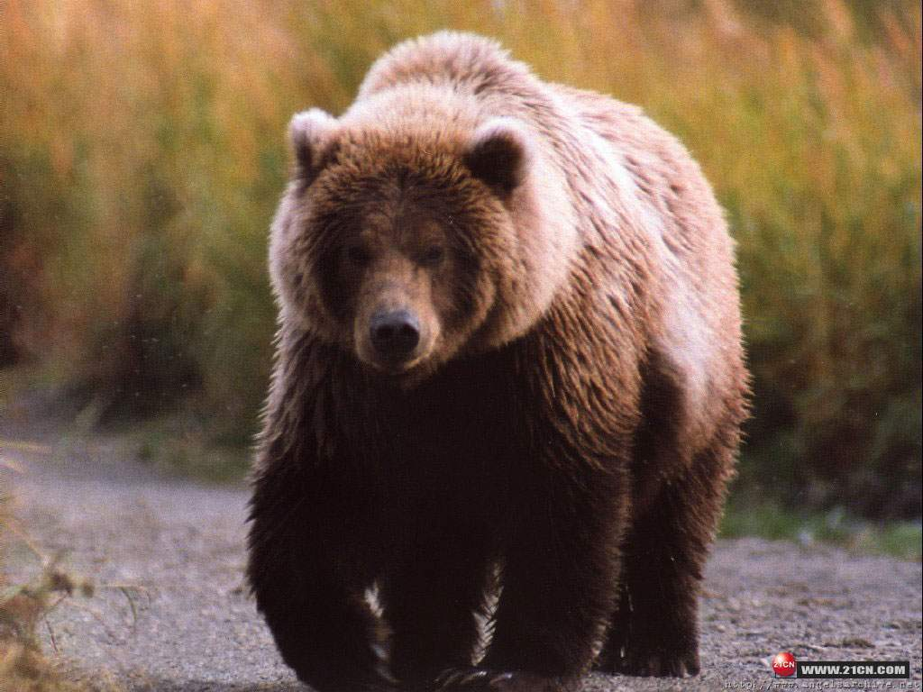

Slide 13
World Wildlife Fund
世界野生生物基金会

Slide 14
The meaning of WWF is to help more wild animals in danger.
WWF asks more people to take action and do something for the wild animals: do not pollute the environment, do not cut down more trees and forests, help them cure (治疗) the illness and make their living areas bigger and bigger.
If we can do the things above, I think that there will be more wild animals in the world. Remember: to protect wild animals is to protect ourselves!

Slide 15
mean + ing = meaning
live + ing =living
act + ion = action
ill + ness = illness
verb / adjective+ noun
suffix
动词 / 形容词 + 后缀 => 名词

Slide 16
Work out the rule:
动词v.
形容词adj.
suffix
Noun
adjective
+ ness
Noun
+ ing
Noun
verb
+ ion
Noun

Slide 17
Suffixes “- ing”, “-ness”, and “-ion”
but sometimes we need to change the ending of the verb/adjective when we add the suffix. For example:
shop--
decide--
invite—
happy--
shopping
decision
invitation
happiness

Slide 18
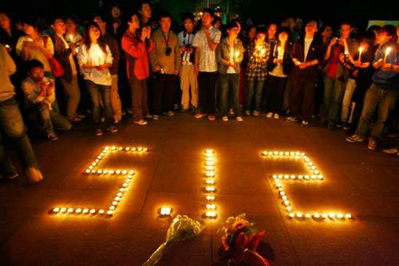
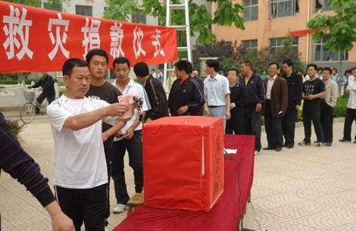
The people are very kind.
Thanks for their ___________ .
kindness

Slide 19
kind kindness
adj. + ness = n.
busy
ugly
happy
iness
illness
richness
kindness
sickness
sadness
darkness
greatness
iness
iness
- y + iness

Slide 20
verb+ing
Noun
feeling swimming hunting
fishing meaning shopping
beginning meeting
painting spelling
cycling drawing

Slide 21
decide--
v.+ ion = n.
decision
+ ion
-e + ion
-e + ation
celebrat
e
instruct
collect
discuss
protect
ion
ion
ion
ion
ion
organiz
invit
prepar
e
e
e
ation
ation
ation

Slide 22
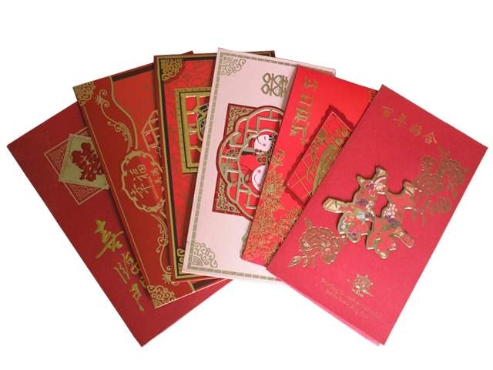
Many friends invite me to their weddings.
I often get many _______ from my friends.
invitations

Slide 23
Let’s do some exercises !

Slide 24
discuss
collect
kind
sick
feel
discussion
collection
kindness
sickness
feeling
6. celebrate
7. begin
8. dark
9. meet
10. invite
celebration
beginning
darkness
meeting
invitation

Slide 25
Fill in the blanks with the words in brackets. Change each word into a noun by adding a suffix. Use the plural form if necessary.

Slide 26
Dear all,
We are members of the Wild Animals Club. Many wild animals are now in danger because of ________(hunt). They need our _________ (protect).
hunting
protection

Slide 27
Wild animals are our friends. Some famous artists have wonderful ________ (paint) of them. Wild animals also have their own families. They have ______ (feel) of _________ (happy) and _______ (sad). We should not kill them for any reason.
We hope you can accept our ________ (invite) and join us. Thank you for your _________ (kind).
paintings
feelings
happiness
sadness
invitation
kindness

Slide 28
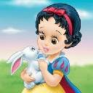
camping
It is wonderful to go _________ outside.
(camp)

Slide 29
用所给单词的适当形式填空
1 All of the students like her because of her __________(kind).
2 We made ______________(advertise) on TV.
kindness
advertisements

Slide 30
1. Mrs. Brown is worrying about her son's serious ___________ (sick) these days.
2. You'd better be more hard-working next time. There are too many __________ (spell) mistakes in your homework.
3. The film was so boring that Mr. Brown slept from _____________ (begin) to end.
4. Wolves have good __________ (hear). As a result, they can hear the things far away.
5. On Sundays, Mum likes to do some ___________ (wash) and __________ (clean).
6. My grandfather has a large __________ (collect) of the __________ (paint) of Xu Beihong.
7. Millie's ___________ (draw) are so beautiful that everyone likes them.
8. Many wild animals need our __________ (protect).
sickness
spelling
beginning
hearing
washing
cleaning
collection
paintings
drawings
protection

Slide 31
climbing
9. Why not go ________ (climb) this Sunday?
10. There are more _____________ (advertise) on TV than in the newspaper.
11. We thanked the host (主人) for his _____________ (kind).
12. I'm always willing to share my ________ (happy) and ___________ (sad) with my best friend.
13. They didn't make any __________ (decide) about the problems during the meeting.
14. Our Physics teacher often asks us to have a __________ (discuss) in our groups.
15. My grandfather's 80th birthday is coming. There will be a ___________ (celebrate) in our house.
16. Thank you for your ___________ (invite) and we'll be at the party on time.
advertisements
kindness
happiness
sadness
decisions
discussion
celebration
invitation

Slide 32
1. After a w____, the hunter hunted a rabbit.
2. Most people think wolves are dangerous to ______________（人类）.
3. Tigers are good at _____________ (捕捉) small animals.
4. After a long ____________(讨论), we all agreed to go on a trip to the zoo.
5. Children need parents’ __________ (保护).
6. What a s___________! You shouldn’t buy the weak.
7. When I hear the good news, my heart is full of h________.
hile
humans
hunting
discussion
protection
hame
appiness

Slide 33
8. He gave me a special present yesterday, but I didn’t a__________.
9. Wolves are friendly towards each other. They often work as a t__________.
10.---What’s the m____________ of the word “killer” in Chinese? ---It means “杀手”.
10._________ (没有一个) of us likes the boring film.
ccept
eam
eaning
None

Slide 34
1. The__________ (live) areas of the wild animals are becoming smaller and smaller.
2.__________ (hunt) make a living by hunting wild animals.
3. Our class has a class __________ (meet) on Monday afternoon.
4. Tomorrow is my birthday. Please accept my _________ (invite) and come to my party.
5. Because of ____________(dark), the baby kept crying.
6. When Tom was born, he _____ (weigh) 3 kilograms.
7. The whole class cared about the r_______of the final basketball competition.
living
Hunters
meeting
invitation
darkness
weighed
esult

Slide 35
1. Squirrels always begin to s________ some food before winter comes.
2. Bees always remember to come back the s_______ way as they went.
3. B________ can’t see with their eyes but they can see with ears.
4. Travellers can easily get l________ in the forest.
5. B______are very hard-working insects.
6. It took her three hours ___________(prepare) the dinner.
ave
ame
ats
ost
ees
to prepare

Slide 36
1. They plan ________ (stay) at home and watch TV tomorrow.
2. Would you please let the old man _______(sit) on your seat?
3. Why did he choose _________(take) a bus to the hill?
4. We should learn __________(look) after the flowers in our gardens well.
5. He agreed ________(help) his grandma with the housework every day.
6. She hopes _________(join) the School Camping Club.
7. My dad taught me ___________(drive) and bought me a car as my birthday present.
to stay
sit
to take
to look
to help
to join
to drive

Slide 37
safety
The policemen carried them to _______.
(safe)

Slide 38
Homework:
Copy the new words five times.
Try to remember the suffixes.

