Slide 1
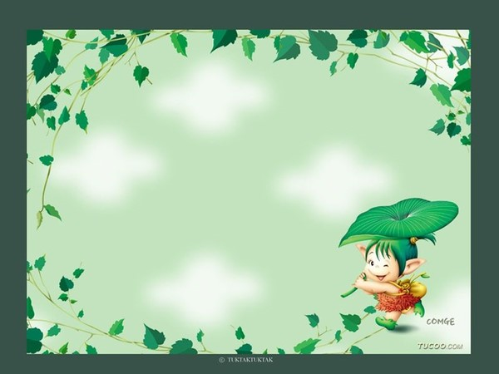
Unit 4 Do It Yourself
study skills

Slide 2
Check your homework
1. 请用剪刀剪出一个老虎。(cut out)
Please cut out a tiger with a pair of scissors.
2. 我建议我爸爸戒烟。(give up doing)
I advised my father to give up smoking.
3. 看着图然后尽量说出另一面有什么。
Look at the picture and try to say what is on the other side.
4. 剪刀是危险的。你最好不要玩弄他们。
(can, had better not)
Scissors can be dangerous. You’d better not play with them.

Slide 3
5. 你最好不要不看题目就做作业。
(had better not)
You’d better not do your homework without reading the questions.
6. 你不应该看那么多电视。(shouldn’t)
You shouldn’t watch so much TV.
7. 不要在课堂上大声喧哗，好吗？
Don’t make much noise in class, will you?
8. 让我们去北京旅游吧，好吗？(let)
Let’s go on a trip to Beijing, shall we?

Slide 4
retell the passage one by one
Paragraph 1: be crazy about, repair, decorate, look terrible
Paragraph 2: a brighter light, make a mistake, power cut, put up a picture, hit a pipe, fill…with…
Paragraph 3: living room, boring, paint…blue, ceiling, floor, cat
Paragraph 4: a shelf, above, spend five hours, not stay, much higher
Paragraph 5: buy, advise, make him angry, attend lessons, know much more

Slide 5
the prefixes
un-, in- and im-

Slide 6
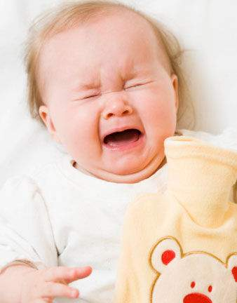
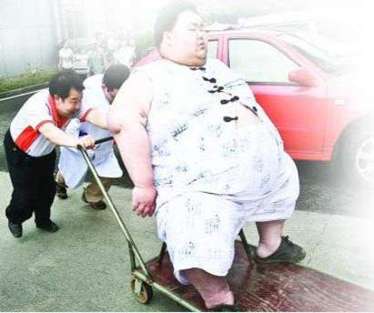
The baby is not happy.
He is unhappy.
The boy is not healthy.
He is unhealthy. zxxk

Slide 7
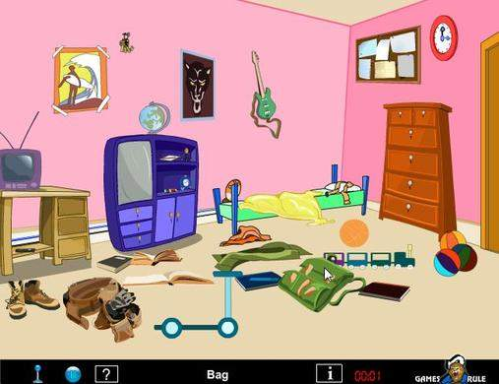
The room is not tidy
It’s untidy.
The book is not interesting.
It’s uninteresting.

Slide 8
Practise
选词填空：
1. Some people are ___________ ( friendly, unfriendly) to birds. They throw stones to them.
2. Some people feel _________ (happy, unhappy) that government give poor people such small and _____________(comfortable, uncomfortable) flats.
3. It is _______ (safe, unsafe) to walk alone on the street at night.
4. We should keep students staying away from the ________ (healthy, unhealthy) books.
unfriendly
unhappy
uncomfortable
unsafe
unhealthy

Slide 9
Opposites(反义词)
unfriendly
friendly →
happy →
comfortable →
safe →
healthy →
unhappy
uncomfortable
unsafe
un-
unhealthy
uncertain
certain →
common →
important →
interesting →
uncommon
unimportant
uninteresting

Slide 10
Prefix im-
Tom often says hello to his teachers.
He is very polite.
Alice never says hello to her teachers.
She is very _________.
impolite
polite →
possible →
patient →
impolite
im-
impossible
impatient

Slide 11
Prefix in-
1. This coat is very expensive. It costs 1000 yuan.
That coat is not expensive. That is ___________
inexpensive.
expensive →
correct →
active →
inexpensive
incorrect
in-
inactive

Slide 12
用所给词的适当形式填空：
You will be _________ to pass the exam if you don’t study hard. (able)
Something ___________ last in the forest. (usual)
It is ___________ to give our students an exam once a week. (necessary)
It is wrong for many youny people to think learing Chinese is ___________. (important)
He feels _________ because he lost his wallet. (happy)
There are some mistakes in his homework, it`s ___________. (correct)
It is __________ to finish so much work in such short time. (possible)
unable
unusual
unnecessary
unimportant
unhappy
incorrect
impossible

Slide 13
Do you know the negative prefixes?
1. un----
2. im----
3. in-----
最常用的前缀
常用在以‘m/ p’ 开头的词前
常用在以‘c’开头的词前

Slide 14
opposites
certain
important
comfortable
interesting
welcome
common
friendly
uncertain
unimportant
uncomfortable
uninteresting
unwelcome
uncommon
unfriendly
able
necessary
active
correct
possible
polite
patient
unable
unnecessary
inactive
incorrect
impossible
impolite
impatient

Slide 15
头脑风暴 ：Let's try together!
1.___possible 9. ___able 17. ___tidy
2. ___polite 10. ___safe 18. ___usual
3. ___patient 11. ___friendly 19. ___ certain
4. ___proper 12. ___happy 20. ___comfortable
5. ___correct 13. ___healthy 21. ___important
6. ___active 14. ___kind 22. ___interesting
7. ___direct 15. ___ lucky 23. ___necessary
8. ___complete 16. ___pleasant 24. ___common

Slide 16
头脑风暴 ：Let's try together!
1.__im_possible 9. __un_able 17. un___tidy
2. _im__polite 10. __un_safe 18. _un__usual
3. _im__patient 11. _un__friendly 19. _un__ certain
4. _im__proper 12. _un__happy 20. _uncomfortable
5. _in_correct 13. __un_healthy 21. _un__important
6. _in__active 14. _un__kind 22. _un__interesting
7. _in_direct 15. _un__ lucky 23. __un_necessary
8. __in_complete 16. _un__pleasant 24. __un_common

Slide 17
Exercises
1 Annie：Do you spend a lot of time doing outdoor sports?
Simon: Sure. It`s usual for me to stay at home all day.
2 Sandy: Our neighbour next door is putting something on the wall.
Mum: It`s possible to sleep with all that noise.
unusual
Impossible zx，xk

Slide 18
Exercises
3 Millie: Are you able to fix your bicycle, Andy?
Andy: No. I`m certain that I can fix it myself.
4 Mum: Suzy, your room is really untidy—things are all over the floor.
Suzy: Sorry, Mum. I`ll tidy up (整理)right now.
uncertain
untidy

Slide 19
Adding:
I don’t believe what he says, because he is not honest.
I don’t believe what he says, because he is _________.
dishonest
dishonest
“dis-”

Slide 20
Adding:
These desks are not regular. Please put these irregular desks in order.
regular →
“ir-”
irregular

Slide 21
Homework:
1.Finish off the exercises.
2.Copy the new words three times.

