Slide 1
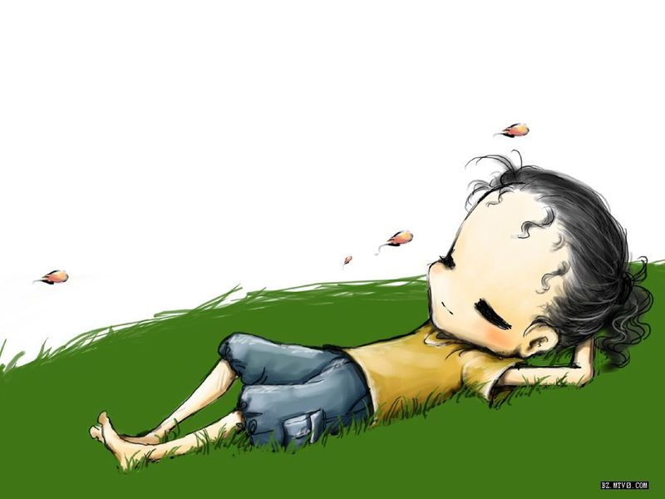
Study skills
Suffixes ‘-ful’ and ‘-less’

Slide 2
Suffixes ‘-ful’ and ‘-less’
名词 | 形容词 | 反义形容词
care
help
use
cheer
meaning
hope
taste
careful careless
helpful helpless
useful useless
cheerful cheerless
meaningful meaningless
hopeful hopeless
tasteful tasteless

Slide 3
Suffixes ‘-ful’ and ‘-less’
名词 | 形容词 | 反义形容词
end
sleep
wonder
success
beauty
noise
colour
/ endless
/ sleepless
wonderful /
successful /
beautiful /
noisy noiseless
colourful colourless

Slide 4
beautiful
colourful
cheerful
useless
wonderful
We went to World Park the day before yesterday. The models in the park were also________. The song and dance shows were also amazing. Their _______
clothes were from different countries and looked very________. All of us felt excited and_______. It was really a great day/ my ticket is ________now, but I’ll keep it!

Slide 5
Write the correct form of these words:
Lee is a student. He always ____
others in his class. (help)
2. All the people cried, ‘ ’ when they
saw one of the seven in the world
in Egypt. (wonder)
3. They waited for a long time because
they to visit inside. But it seemed
to be now. (hope) zxxk
helpful
helps
wonderful
wonders
hoped
hopeless

Slide 6
4. Nobody will be on such a
____ rainy day. ( cheer )
5. Our biography teacher told us that the
( colour ) snakes are
always not dangerous.
cheerful
cheerless
colourful

Slide 7
6. The road is for us to reach the
____ of it. (end)
7. Miss Zhou gave him a look in
class and he understood her
quickly. ( meaning) zx，xk
endless
end
meaningful
meaning

Slide 8
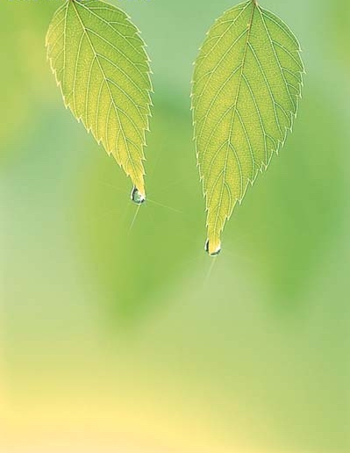
Thank you!

