Slide 1
unit 1 Reading 1
Best friends

Slide 2
Talk show
A: Who’s your good friend?
B: …
A: What’s he/she like?
B: …
A: What do you think of your friend?
B: …
A: What makes him/her so special to you?
B: …

Slide 3
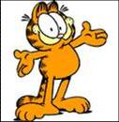
Qualities of my friends
She’d like to share everything with her friends.
generous
I can tell her anything
and she keeps my secrets.
a true friend

Slide 4
She can always help me with my problems. I can go to her when I am in trouble.
helpful
She is willing/ready to help me any time
She is good at telling funny jokes.
She often makes us laugh.
funny
She has a good sense of humour.
humourous

Slide 5
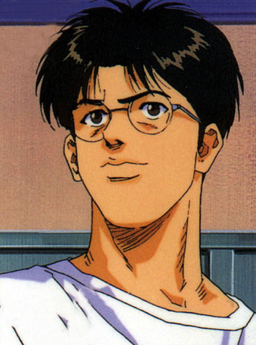
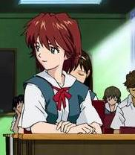
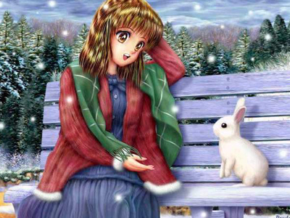
Appearance of friends:
wear round glasses
short hair
straight hair
P9 B1

Slide 6
How many friends does the writer have? Who are they?
_____ is a ____ friend --- she can keep a ________.
_____ looks ______ and has a good sense of _______.
_____ is ________ and _______ --- she is always willing to share things and help others.
true
secret
smart
humour
generous
helpful

Slide 7
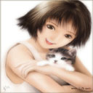
Who can be Betty?

Slide 8
Read and try to catch
as much information as you can!
Name | Sex | Appearance | Personality | Future plans
Betty | female
to be a singer
slim
generous
helpful
short hair

Slide 9
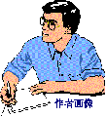
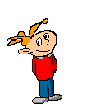
Who can be Max?

Slide 10
Read and try to catch
as much information as you can!
Name | Sex | Appearance | Personality | Behavior
Max | male
tall – 1.75m
have a good sense of humor
knock things onto the floor
wear glasses
tell funny jokes
look smart
never feel bored
long legs

Slide 11
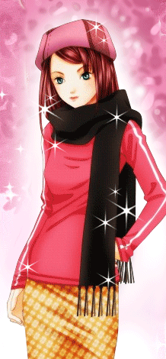
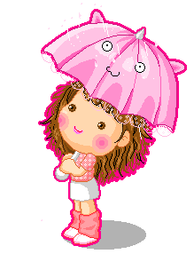
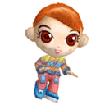
Who can be May?

Slide 12
Read and try to catch
as much information as you can!
Name | Sex | Appearance | Personality | Behavior
May | female
big bright eyes
a true friend
keep a secret
long straight hair
sweet
kind
pretty
never say a bad word about anyone

Slide 13
Best friend | Appearance
Betty
Max
May
slim, short hair
tall , wear small round glasses look smart long legs
big bright eyes, long straight hair, pretty，sweet

Slide 14
Best friend | Personality
Betty
Max
May
generous, be willing to share things with friends，helpful
have a good sense of humour
funny
a true friend, kind

Slide 15
Best friend | Future plan / behavior
Betty
Max
May
a singer
long legs don’t fit under the school desks; knock books and pens onto the floor
keep secrets, never say a bad word about anyone， sweet
details

Slide 16
Betty ‘T’ or ‘F’
F
The writer is very fat.
Betty is willing to help others at any time.
She likes to share things with her
classmates.
4. She only gives seats to old men in need
on the bus.
5. She wants to be a dancer and travels
around the world.
T
T
F
F

Slide 17
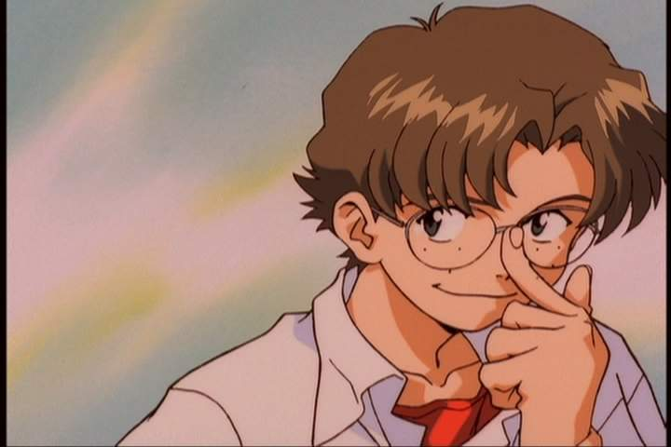
Max Answer some questions:
How tall is Max?
Does Max wear glasses? How does he look ?
3. When we are with Max, How do we feel? Why?
4. Do his legs fit under the school desks?
What happens to him when he walks past the desk?
Almost 1.75 metres tall.
Yes. He looks smart.
We never feel bored or unhappy. He tells funny jokes.
No. He often knocks our books and pens onto the floor.

Slide 18
May Fill in the blanks
May is shorter than me. She has _________ hair. Everyone thinks she is very ______.
May is a ____ friend. When something
_______ me, I can always go to her. I can tell her ________ because she can ____ a ______.
She is ____ and never ______________
about anyone.
straight
pretty
true
worries
anything
keep
secret
kind
says a bad word
P9 B2

Slide 19
Part B2 True or false:
Betty is kind to old people only.
Betty wants to be a singer in the future .
Max looks smart in his small round glasses.
Max is not good at telling jokes.
May is sweet and pretty.
May likes to say bad things about her friends.
everyone
F
T
T
very
F
T
never says
F

Slide 20
Who do you want to be your best friend?
Why?

Slide 21
Best friends
Who would you choose as your best friend?---I’ll choose Betty.
Why?---Because she is generous and helpful.
What does he/she look like?
----She is slim and she has short hair.

Slide 22
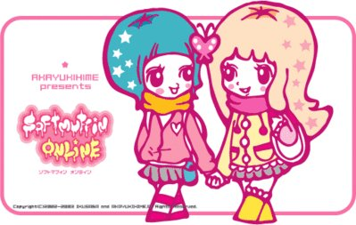
A life without a friend is a life without a sun. 人生在世无朋友，犹如生活无太阳。 A friend in need is a friend indeed. 患难见真交。
A friend is a second self. 朋友是另一个我。

Slide 23
Every man has
his weak side.
人人都有弱点
To be true to everyone,
you can find
your friends.

Slide 24
1.Betty is one of my best friends.
我最好的朋友之一
one of +最高级+n(s)
Changzhou is one of the most beautiful cities.
Jack is one of the tallest boys.

Slide 25
1.be willing to do sth愿意做某事
He is willing to help others if they are in trouble.
He is willing to collect things for the Project Hope.

Slide 26
3.be ready to do sth
准备好做某事；乐于做某事
He is ready for the journey.
He is ready to help people.

Slide 27
4.someone in need 需要帮助的人
这里need做名词
Water is in bad need.(急需要水)
你现在还不必生气。
There is no need for you to be angry.

Slide 28
5.because of与because
Because后跟原因状语从句
Because of sth/doing sth
We didn’t do morning exercises because it rained heavily this morning.
We didn’t do morning exercises because of the heavy rain.

Slide 29
6.have a good sense of humo(u)r
Humo(u)r名词 humorous形容词
Sense 不可数名词时，表示理解和领悟。可数名词时，表示感官。
The five senses：smell,taste,hearing,touch,sight
A person with no sense of direction
一个没有方向感的人

Slide 30
7.knock over sth 撞倒某人某物
He was angry because I knocked over his coffee.

Slide 31
8.think of 想起
These photos made me think of my childhood.
9.say a bad word about sb讲某人坏话

