Slide 1
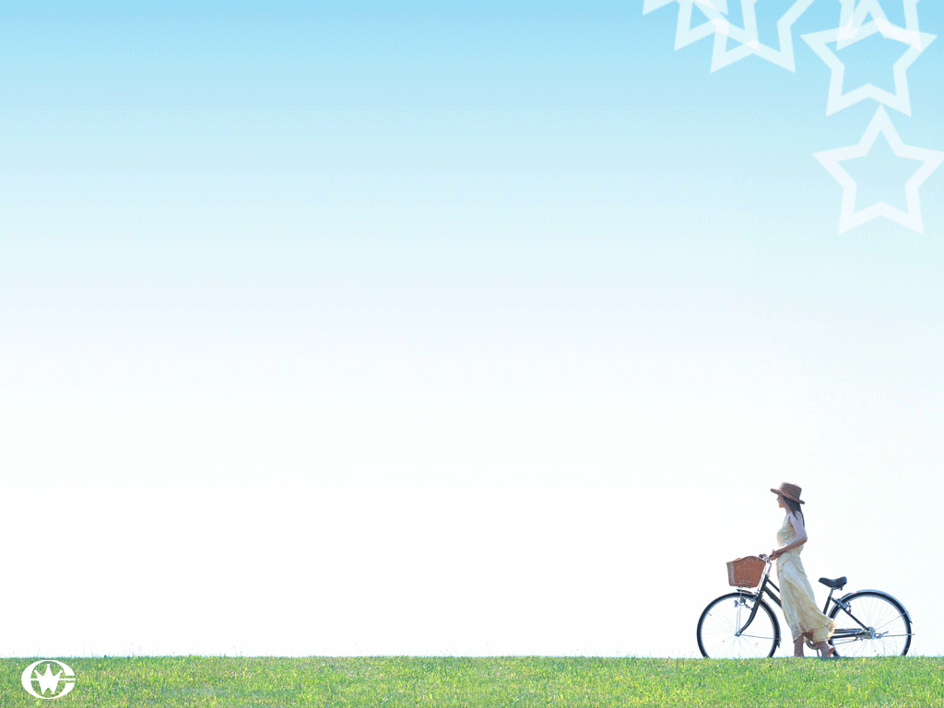
八年级 英语 上
Unit 3 A day out
Integrated skills

Slide 2
Talking about sports
▲Do you like sport?
▲ Do you often watch basketball matches?
▲ Are you in the school basketball team?
▲ When and where do you usually do sports?
▲ Who do you do sports with?

Slide 3
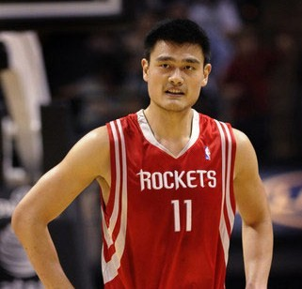
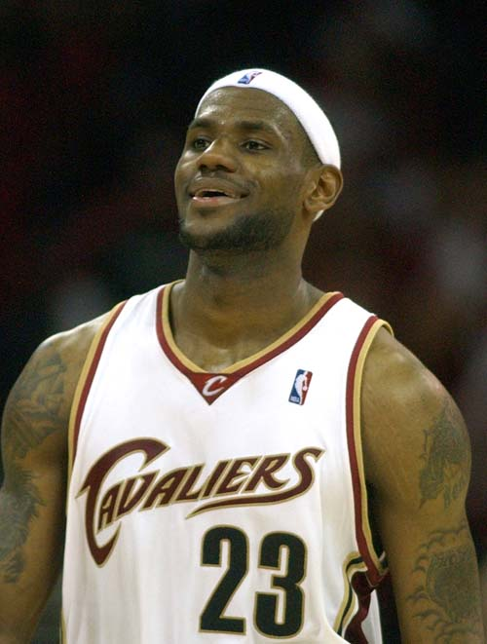
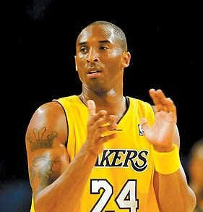
excellent players

Slide 4
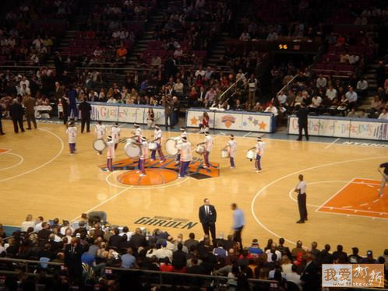
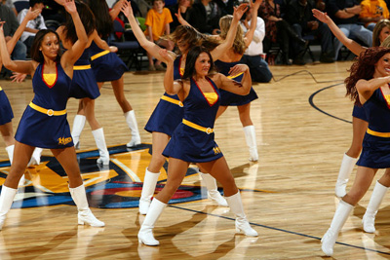
in the first half
half-time
at half-time
in the second half

Slide 5
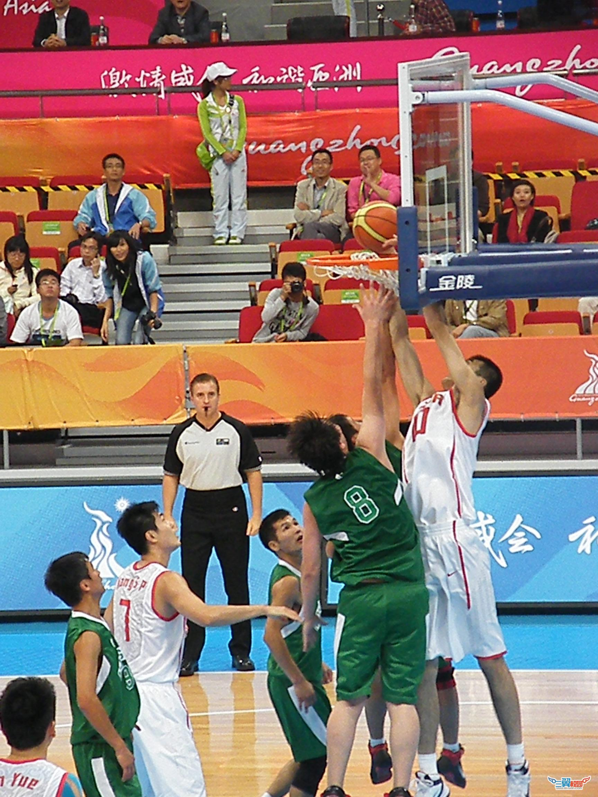
go to the final
be in the final

Slide 6
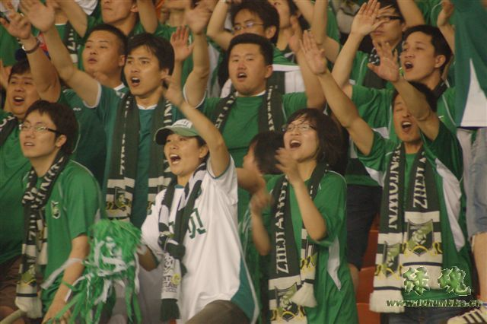
They are cheering for their team.
Their team needs their support.
They are supporters of their team.

Slide 7
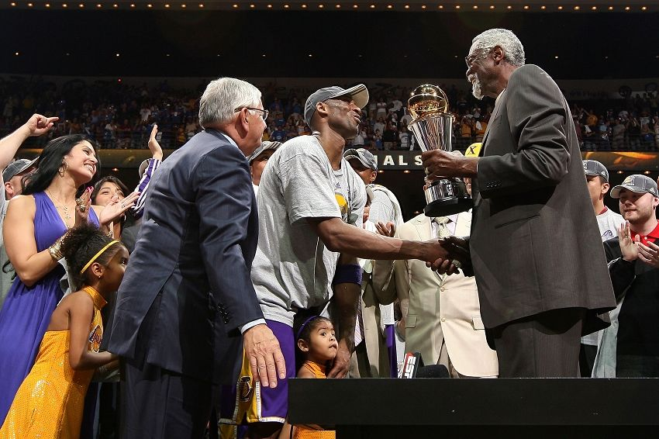
the presentation of cup and medals

Slide 8
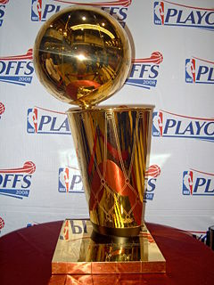
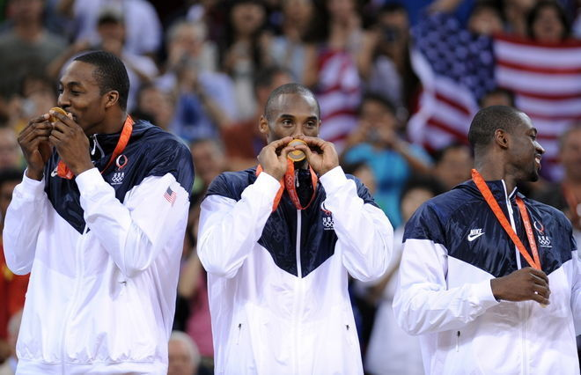
They have medals.
cup
They are the winners.

Slide 9
Self-learning 1
（1）自学内容: Page 37 Part A1
（2）自学方法:
a. 听录音，完成海报。
b.小组汇报，校对答案。
c.小组讨论语言点并讲解。

Slide 10
The basketball final
Beijing Sunshine Secondary School gets to the final!
Our school basketball team needs your support! It is in the final of the basketball competition! The match takes place on (1) , 17 October, at the
(2) ____ in Moonlight Town .
Come and cheer for our team!
Don’t forget to bring your friends!
With your support, we will win!
A1: Listen and help Kitty complete the poster!
Sunday
Sports Centre

Slide 11
Self-learning 2
（1）自学内容: Page 37 Part A2
（2）自学方法:
a. 听录音两遍，完成信息填空。
b.小组讨论、互帮交流。
c.小组汇报，校对答案。
d. 找出重要语言点。

Slide 12
A2: Listen again and complete the notes below
The day of the final
the school gate
9:30 a.m. Meet at (1)___________________.
(2) _________ Bus leaves.
(3) _________ Reach the Sports Centre.
10:30 a.m. (4) ____________.
(5) _________ Half –time.
11:30 a.m. (6) ____________.
(7) _________ Bus leaves from the centre.
Have lunch at Moonlight Restaurant.
1:00 p.m. Get on the bus (8)___________the
restaurant.
1:30 p.m. Back to our school.
Cost of the trip ￥(9) _______ per student
9:45 a.m.
10:15 a.m.
Match starts
10:55 a.m.
Match finishes
11:50 a.m.
in front of
20

Slide 13
Ask and answer
If Linda wants to watch the final,
1.Where and when does she meet Kitty?
How long is the first half of the match?
Where will she have lunch?
How much does the trip cost?
At the school gate at 9:30 a.m.
Twenty-five minutes.
At Moonlight Restaurant.
￥20 per student.

Slide 14
Self-learning 3
（1）自学内容: Page 38 Part A3
（2）自学方法:
a. 读Kitty’s 笔记，判断正误并改正。
b.小组讨论互帮。
c. 小组汇报，校对答案。

Slide 15
A3: True or False
basketball
Our school basketball team is in the final.
The match will take place at Moonlight Middle School in Moonlight Town.
We will go there by underground.
It will take us about half an hour to reach the Sport Centre.
F
the sports centre
F
bus
F
T

Slide 16
A3:True or False
5-minute
5. Half-time is a 20-minute period for the players to rest.
6. We can buy food and drinks during half-time.
7. The match will finish before noon.
8. We will go back to our school after lunch.
F
T
T
T

Slide 17
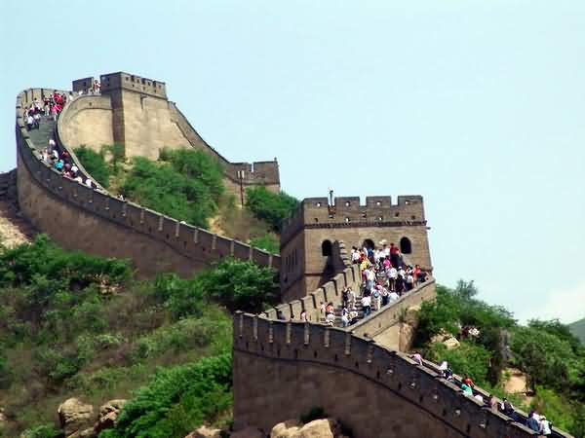
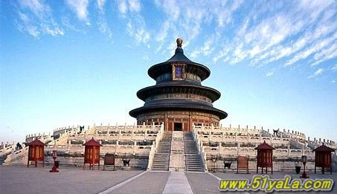
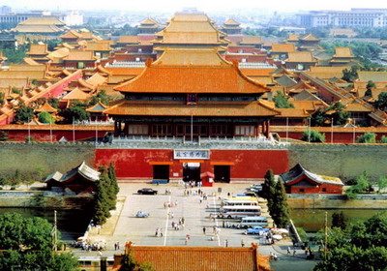
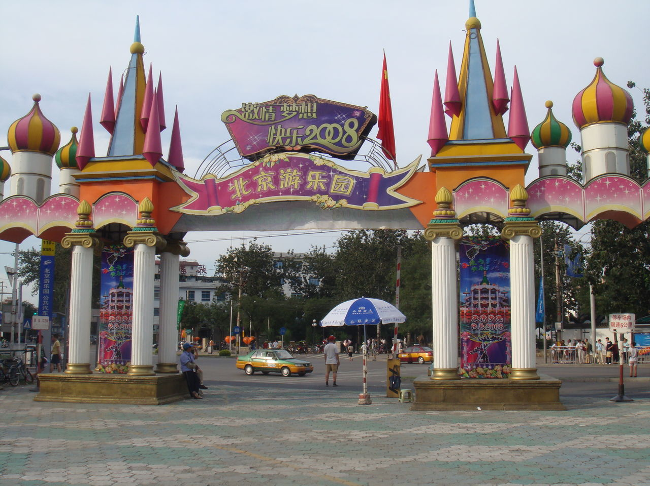
The places of interest in Beijing
the Temple of Heaven
Beijing Amusement Park
the Palace Museum
the Great Wall

Slide 18
How to make suggestions
Good idea!
What a great idea!
That sounds great!
Shall we …?
Let’s …
Would you like to …?
Why don’t you/we …?
Why not …?
What/How about…?
I’d love to, but......
I’m afraid it is not a good idea.

Slide 19
Self-learning 4
（1）自学内容: Page 38 Part B
（2）自学方法:
a. 听对话回答问题。
b. 跟读对话，讨论语言点并讲解。
c. 编写对话并表演。

Slide 20
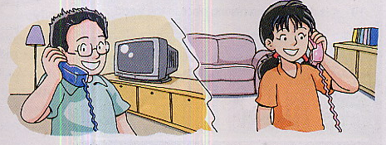
B: Speak up
Listen and answer
Where are we going tomorrow?
The China Science and Technology Museum.

Slide 21
Make up your dialogues
Show Linda around your hometown
A: Where shall we go with…? Shall we…?
B: I’m afraid that’s not a good idea. …
A: Well, we could…
B: Yes, that’s a good idea, but it’s… I’d like to…
A: Sure. Why don’t we … too?
B: What a great idea! Let’s go to… and …

Slide 22
Exercises:
They _______ (到达) the airport late last night.
During ________ (中场休息) , the players can
have a short break.
3. The ______(费用) of the building is over
two million yuan.
4. Our school basketball team got to the f______
of this year’s competition.
5. The final football match ______ ______ (举行) in
______ _______ ________(体育中心) last Sunday.
reached
half-time
cost
inal
took place
the sports centre

Slide 23
没有您的支持，我将不能做出这道题。
______ _______ _______ , I won’t ______ ______
the problem.
2. 我希望你们能来为我们的篮球队喝彩。
I hope you can ______ ______ _______ _______
our basketball team.
3. 昨天我花了半小时才到达体育中心。
It _______ me half an hour ______ _______ ______
the sports centre.
Without your support
work out
come to /and cheer for
took
to get to / arrive at

Slide 24
Homework
大课堂P19.
读背单词、词组、句子. 背诵对话。

