Slide 1
Unit5 Wild animals
Comic strip &
Welcome to the unit

Slide 2
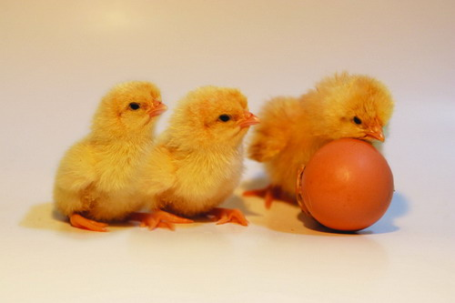
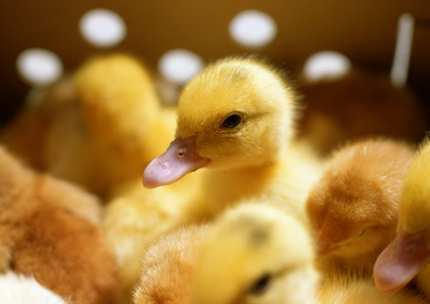
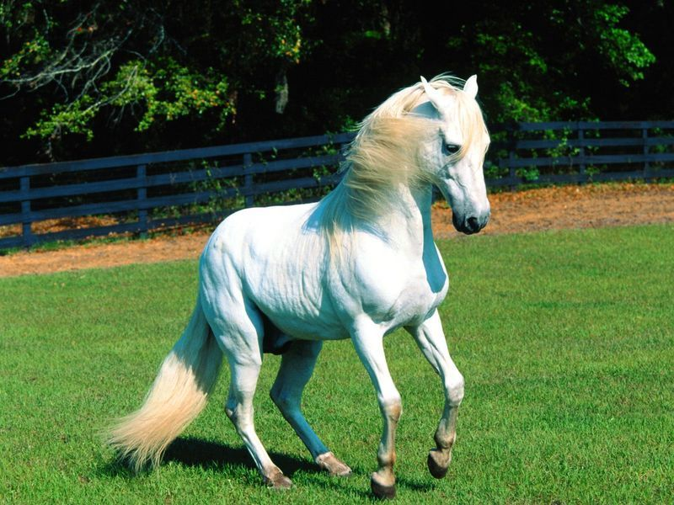
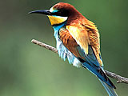
Brain-storming:
dog
chicken
duck
cat
horse
bird

Slide 3
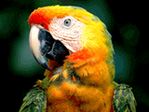
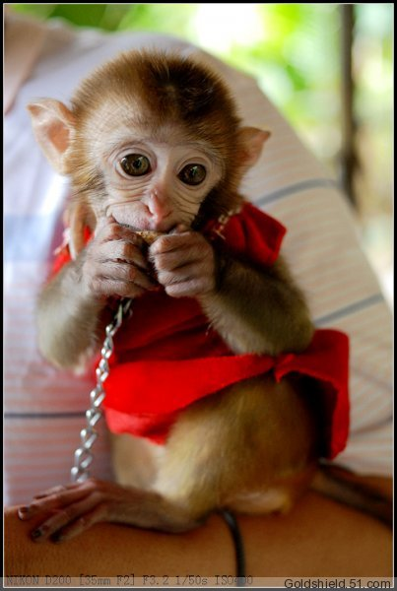
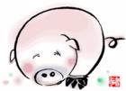
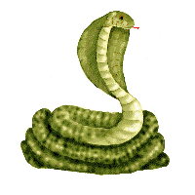
parrot
monkey
pig
snake
goldfish

Slide 4
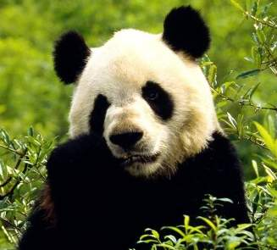
Pre-lesson:
Learning about wild animals.
How much do you know about wild animals?

Slide 5
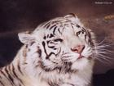
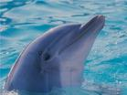
Quiz
1. Which animal is the king in the forest?
Tiger.
2. Which animal is the cleverest animal in the sea?
Dolphin.

Slide 6
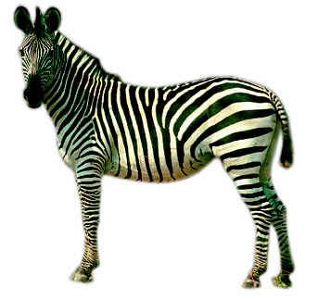
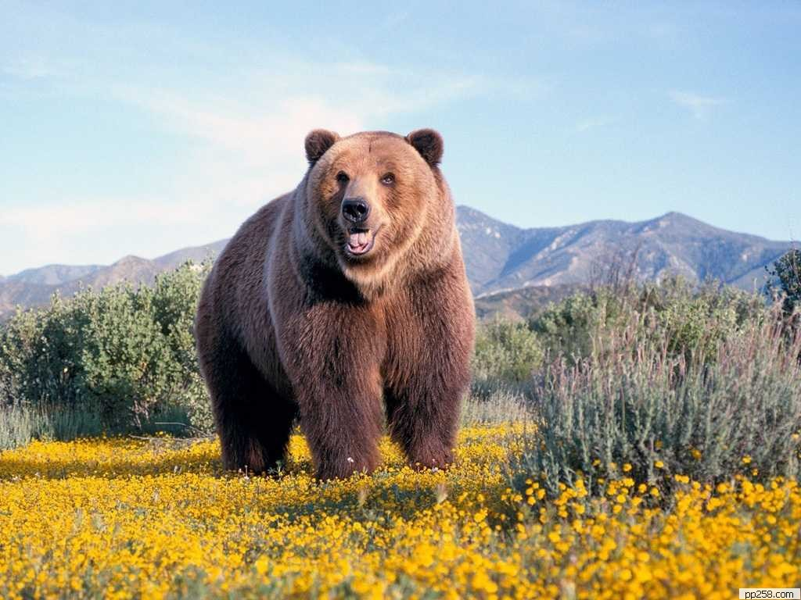
3. They are a kind of horses with black and white stripes on their bodies.
Zebra.
4. Which animal is large, strong and heavy with thick fur(皮毛) ?
Bear.

Slide 7
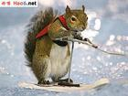
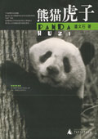
5. Which animal is small and lovely, but has a very big tail?
Squirrel.
6. Which animal looks very cute and lives only in China?
Giant Panda.

Slide 8
tiger
dolphin
zebra
bear
squirrel
giant panda

Slide 9
Words & phrases:
wild
free
dish
no way
pity
have/take pity on
die
in fact
adj. 野生的
n. 自然环境，野生状态
adj. 自由的，不受束缚的
n. 一道菜；盘，碟
<口>不可能
n. 同情
同情，怜悯
vi. 死
实际上，事实上

Slide 10
While-lesson:
The Wild Animals Club is doing a quiz on wild animals. How much do you know about them? Write the correct names under the pictures.
bear dolphin giant panda squirrel tiger zebra

Slide 11
Listen and fill in the form：
Name | Like best wild animals
Kitty
Simon
Peter
Millie
monkeys
lions
pandas
pandas

Slide 12
Do a survey
Work in pairs, talk about the animals you like best /least and tell the reason(s).
 | bear | dolphin | giant panda | zebra | squirrel | tiger
Me
Partner
→

Slide 13
Model dialogue:
A: What wild animal do you like best/least?
B: I like… best/least.
A: Why?
B: Because they are…
A: What do they eat?
B: … What animal do you like best/least?
A: I like…best/least because…
←

Slide 14
Listen and answer
1. Does Eddie want to live in the wild? Why or why not?
No. He thinks the wild animals may become dishes on the table any time.
2. Will Eddie eat the wild animals? Why or why not?
Yes. He may die without them, and these are not wild animals.

Slide 15
Role-play
Please act the dialogue out
with your partner.

Slide 16
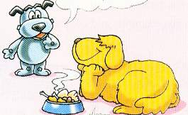
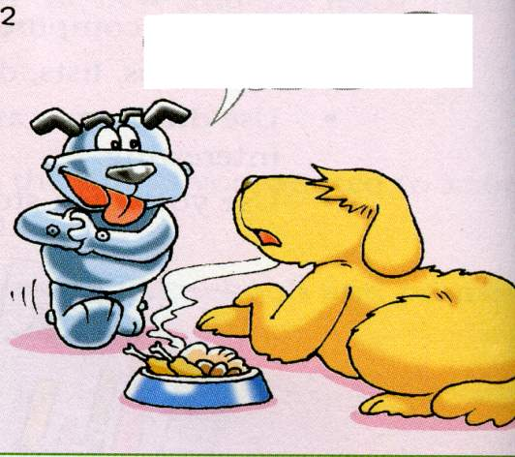
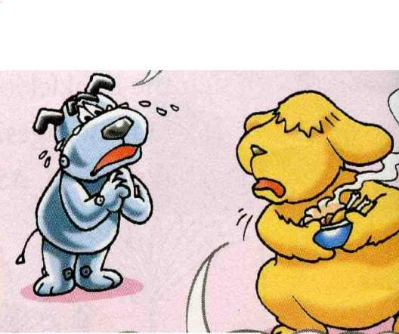
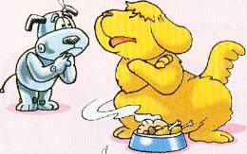

Slide 17
Translate :
Post-lesson:
1.事实上，许多野生动物没有足够的食物。
In fact, many wild animals don’t have enough food.
2. 你想住在野外吗？
Would you like to live in the wild?
3.我们应该同情贫困的人。
We should have pity on poor people.

Slide 18
1.他们随时可能变成桌子上的菜。
2.请你不要捉它们，好吗？--不可能。
3.事实上，没有他们我可能会死。
They may become dishes on the table any time.
----Could you please not catch them?
----No way.
In fact, I may die without them.

Slide 19
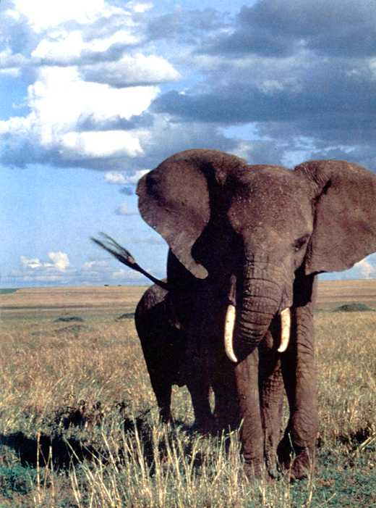
They are the largest animals on the land.
some more wild animals
elephant

Slide 20
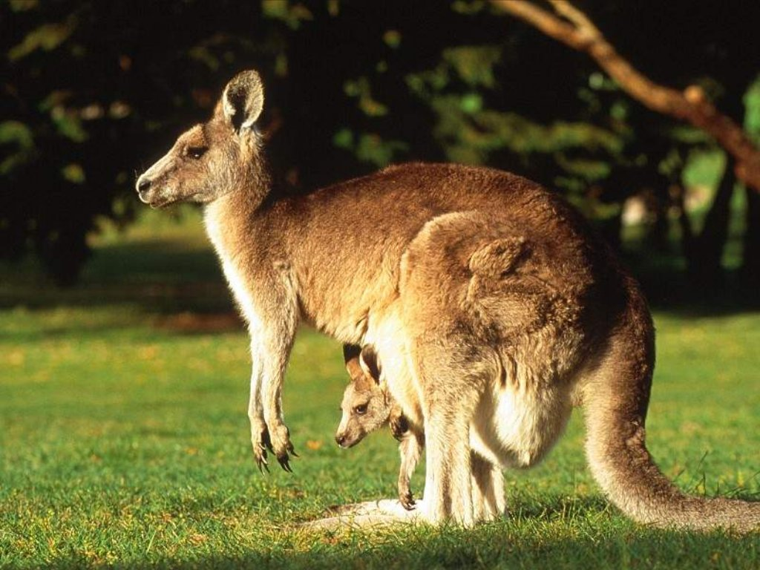
They live in Australia and carry a pocket in the front, what are they?
kangaroos

Slide 21
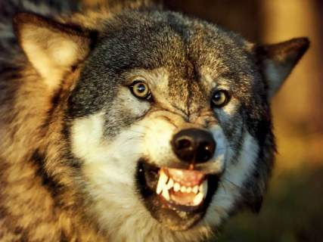
They hunt in groups
and look like dogs.
wolf / wolves

Slide 22
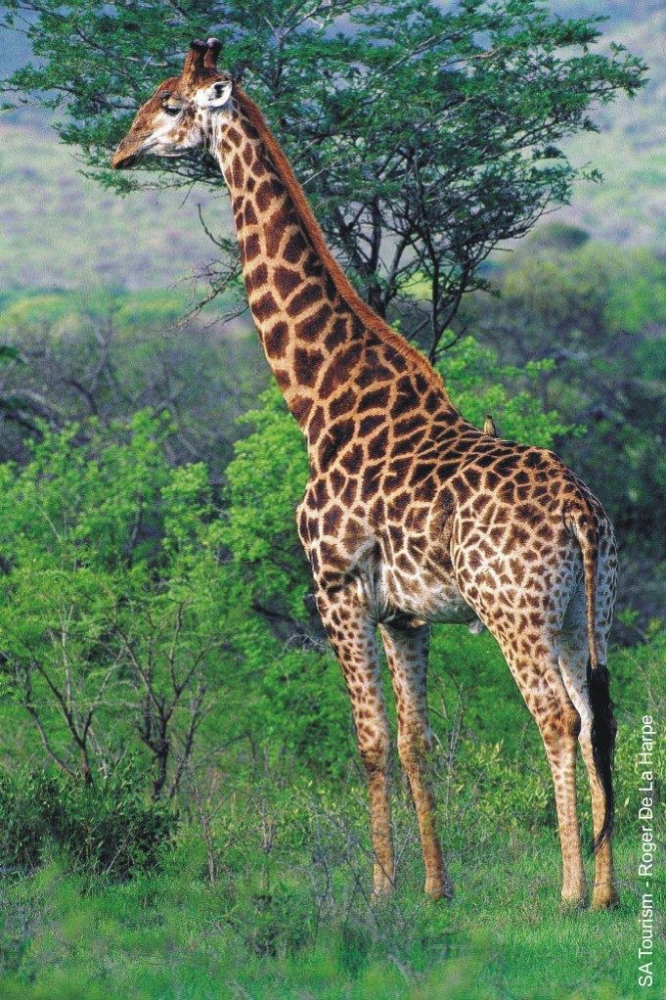
They have very long necks and they eat leaves.
giraffe

Slide 23
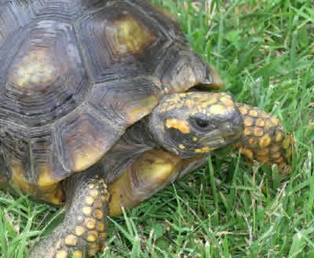
It has a big shell on its back and moves slowly.
tortoise

Slide 24
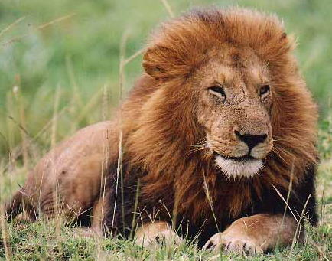
It lives mainly in Africa. A male one has thick hair over its head and shoulders.It is called king of the animals.
lion

Slide 25
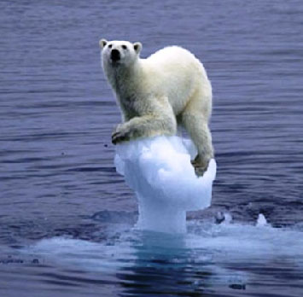
It lives in North Pole.
It is huge in size. It is good at swimming and catching fish.
polar bear

Slide 26
Fill in the blanks:
The students in our class like different kinds of a______ . Kitty likes monkeys best, because she thinks they are c_____ and funny. Simon likes lions best, because he thinks they are s______ and they can run f____. Peter and Millie b____ like pandas best, because they think that pandas l____ very cute. I myself like dolphins best, and I often go to watch dolphin s_____.
nimals
lever
trong
ast
oth
ook
hows

Slide 27
Wild animals are our friends. We should protect(保护) them.

Slide 28
Homework:
1.Finish the exercise in the workbook .
2.Preview Reading and find some information about giant pandas.

Slide 29
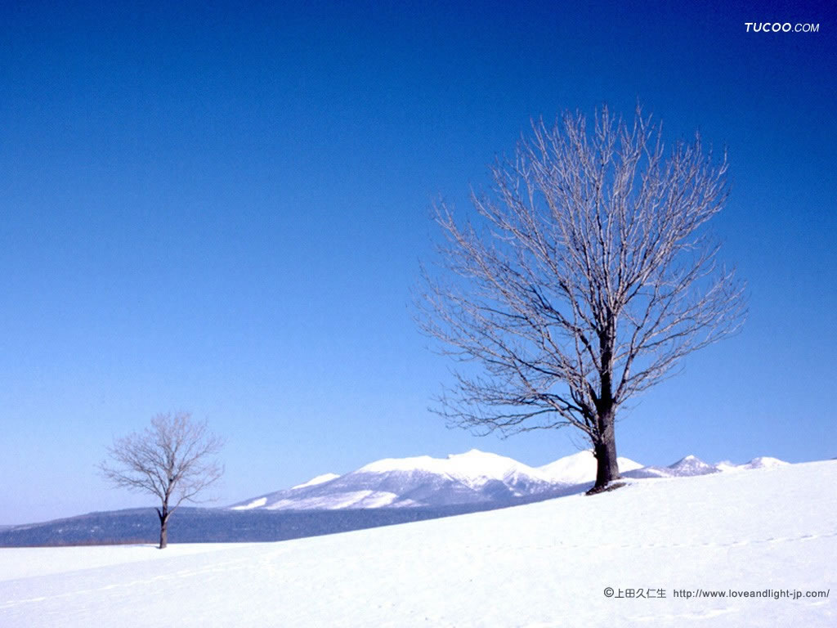
Thank you!

